Slide 1
Data Analytics in Python (ECO 6763)
David Guo, PhD
Department of Economics, CoB, UTSA
Notes:
Financial (Risk) Modeling in Python

Slide 2
Agenda
Introduction
Class Format
Warm up: let us know each other (SIS)
Brief Intro to Data Science
Why Python
Talk about class:
Syllabus
Homework
Exam
Projects
Set up Python IDE
Lecture 1

Slide 3
Class Format
In-person w/ Zoom option
Zoom cloud recording link will be posted in Canvas session folder for review
In-person class in BB 3.03.04, full attendance worth of 5% credit core
Slack channel is favored for instant Q&A
1:1 zoom meeting can be requested
Office hours – 12-1 every Friday on Zoom

Slide 4
Let us do kick-off survey – Student Information Sheet (SIS)
Your name, major, department
Part-time or Full-time Student
Any programming language experience, if yes, where you are at a scale of 1-10?
What is your plan after your program?
What do you expect from this course?
Notes:
that you want the class to remember you

Slide 5
About me
Working Experience
Principal Data Scientist @ General Motors
Senior Data Scientist @ USAA
Biomedical Research Professor @ UT Health at San Antonio
Education Background
IT PhD @ Dept. ISCS at UTSA (on-going)
MS in Applied Statistics (UTSA Class 2012)
PhD in Biochemistry @ HKUST
MS in Microbiology @ XMU
David Guo - LinkedIn
Notes:
Still want to have a brief introduction of myself so it would not be half of the semester, you are still wondering who is this guy?
Audit is like state inspection of a car, it is mandatory and to ensure the car would not cause anyone a trouble including the driver as well as the customer or shareholder…

Slide 6
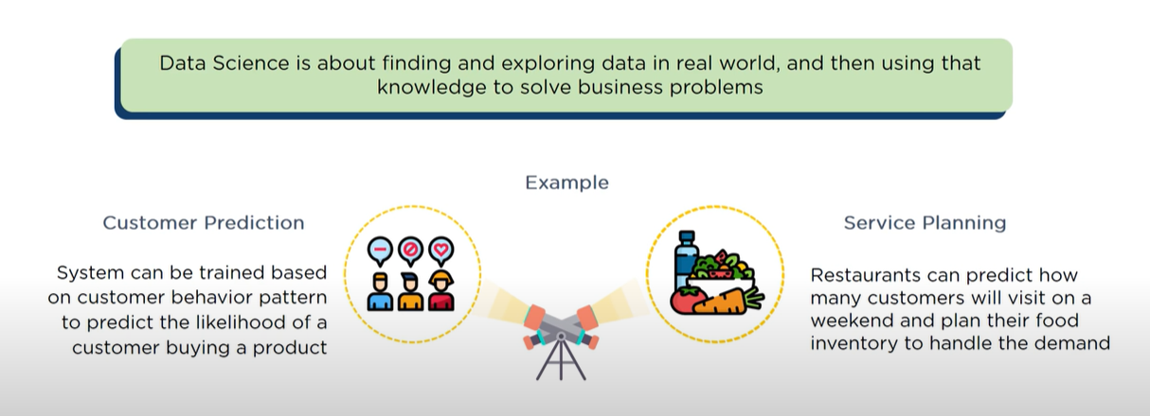

What is Data Science?
The way it happens - code
“Talk is cheap. Show me the code”
– Linus Torvalds
(the Creator of Linux and Git)
Notes:
Karen Heath, 1992

Slide 7
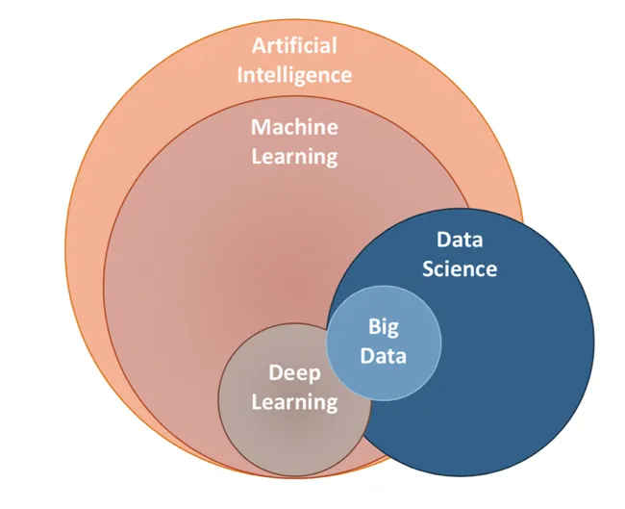
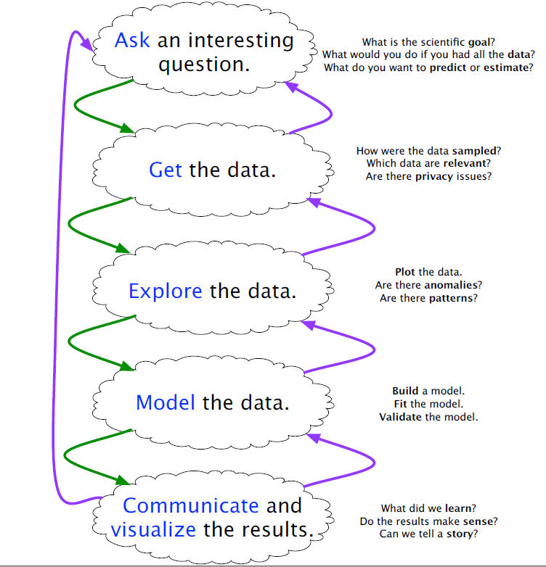
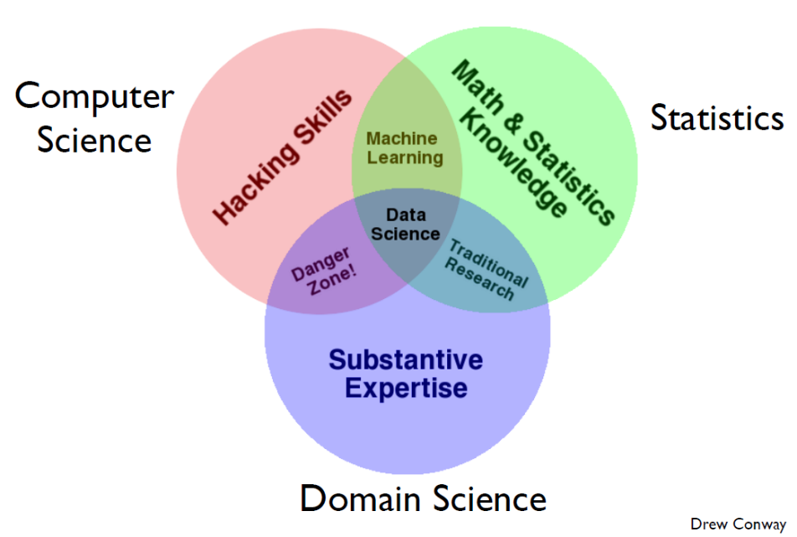
What does Data Science do?
Notes:
IN this class: I will use Data scientist modeling interchangbly
interdisciplinary

Slide 8
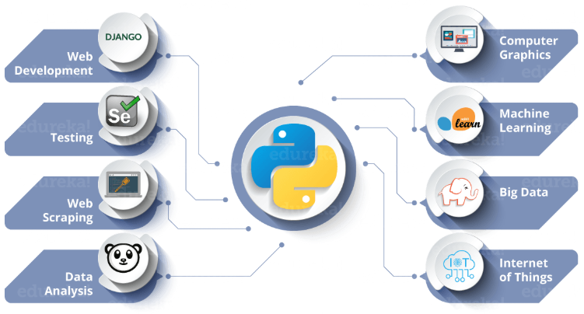
Tool for data science – Python
Python is a general purpose programming language.
Shallow learning curve (easy to start).
Well-supported scientific functionality and it is free.
The only option for deep learning.
Trends
Programming Language Trends (Youtube)
Github Language Trend
Google Trends
Applications:
Application of Python in Agriculture (Youtube)
Data Science at The New York Times
Notes:
library ecosystem, entry barrier, Platform independence, Readability, visualization options, Community support, Growing popularity

Slide 9
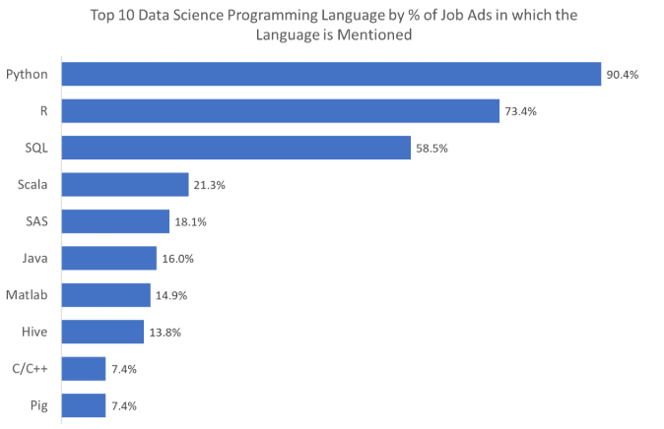
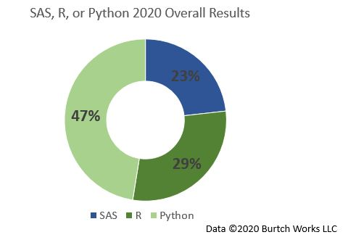
Popularity and Job Perspective
Source: Towards Data Science
Notes:
100 data science job advertisements, across four English-speaking countries (Australia, Canada, UK and USA), found on LinkedIn between 22 April 2019 and 5 May 2019. These job ads were selected to represent a broad cross-section of employer types, sizes, industries and job levels, and purely managerial roles were not considered

Slide 10
Let us review the Syllabus

Slide 11
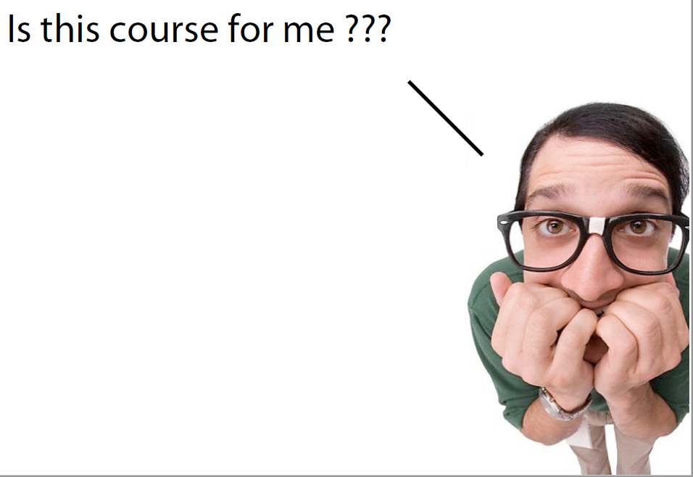
Completed courses - Linear Algebra and calculus
Recommend to have fundamental econometrics / statistics knowledge
Open-minded to coding and new technologies
You will be prepared for an entry level data analyst role in industry.
I will guide you thru the journey as a firefighter and cheerleader.
Notes:
Basic Econometric/stats knowledge—(Linear/logistic) regression; if not , I don’t see both of us suffer because of that, and talk to me after class

Slide 12
Extra Resources:
Reference Book:
See links in Syllabus and will be updated in Slack
GitHub and Kaggle:
Get an account, respectively. It is FREE.
Use other people’s code with critical thinking
Online course:
UCB Introduction to Data Science
Harvard CS109 Data Science
Coursera/Udemy/edX…

Slide 13
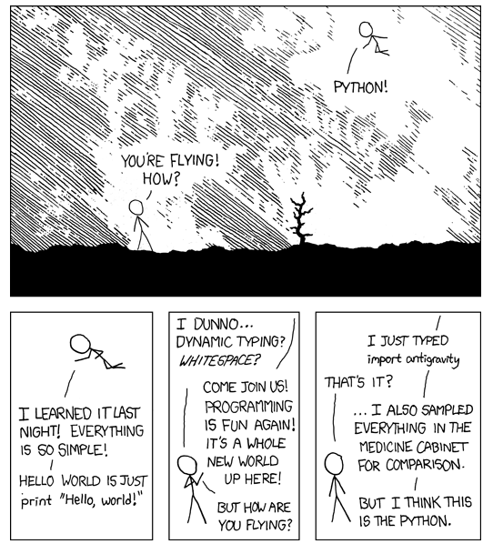
Let us do it!

