Slide 1
Strategic Insights (ECON 5360 Fall 2024)
Instructor: David Guo
Aug. 21, 2024

Slide 2
Agenda
Introduction
Class Format
Warm up: Student Information Sheet – extra credits
Application of Data Science for Strategic Insights
Why Python is important - the dominant data science tool
Discussion on Class: Syllabus
Course set up: Python IDE, Jupyter Notebook

Slide 3
Class Format
Online classes Wed 7 PM – 9:30 PM
Zoom link can be found in Syllabus
Zoom recording will be available in Canvas for after class review
Instant Message Channel: Slack
Email: dgqv3@mst.edu

Slide 4
Let us know each other – Student Information Sheet
Your name and major, year of your program
Are you a Part-time or Full-time student?
Have you used any other programming language before, if yes, name it with experience level at a scale of 1-10?
What is your plan after the program?
What do you expect the most from this course?

Slide 5
About me – David Guo, PhD
MST part-time lecture since Fall 2023
USAA full-time Data Scientist, CFO Office of USAA
UTSA part-time IT PhD, research interests:
1) large language model for unstructured adverse drug reactions prediction
2) forecasting algorithms
Previous working experience:
Principal Data Scientist support CPO sales and customer engagement in GM (2021-2023)
Senior Data Scientist support P&C underwriting business in USAA (2017-2021)
MS in Applied Statistics (UTSA Class 2012)
Assistant Research Professor in UT Health at San Antonio (2003-2012)
More available @ David Guo LinkedIn Profile

Slide 6
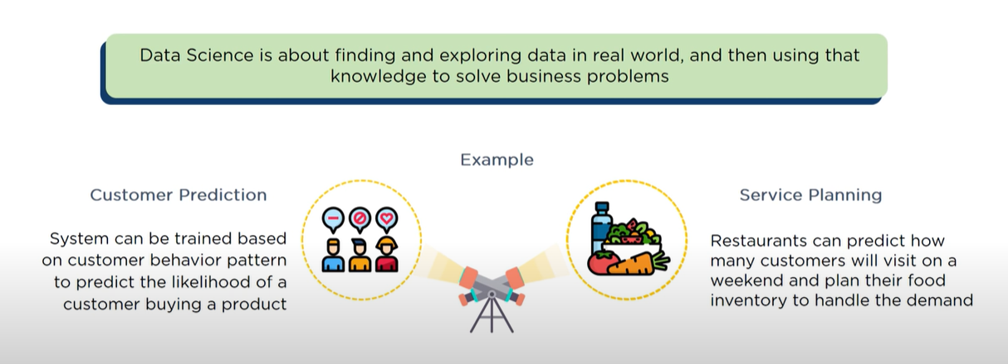
Application of Data Science for Strategic Insights

Slide 7
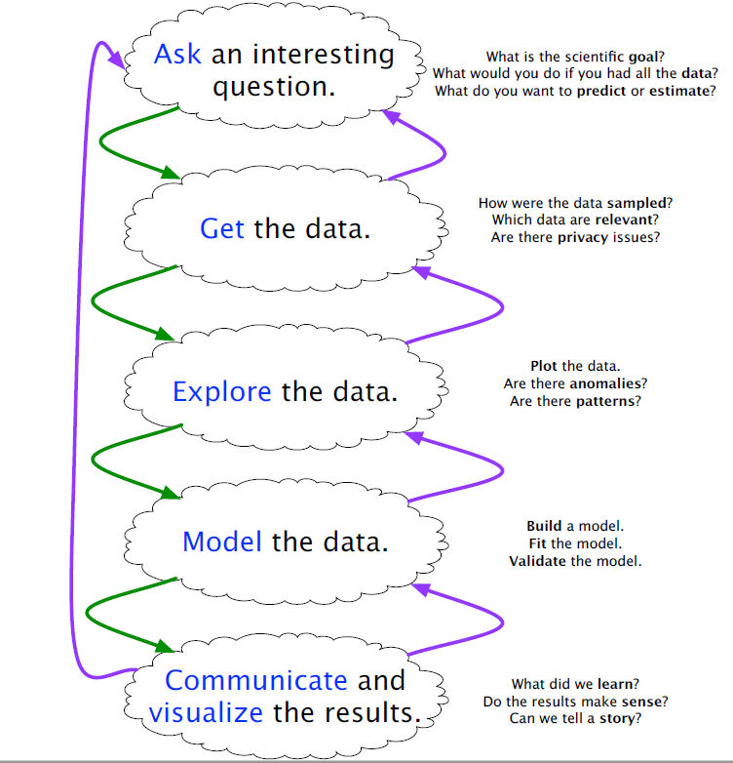
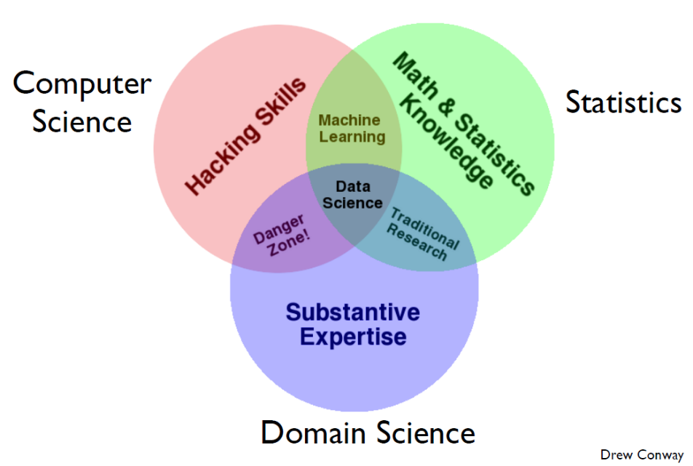
What does Data Science do?

Slide 8
Tool for Data Science – Python
Python is an opensource programming language
Shallow learning curve (easy to start)
Well-supported scientific functionality
Only option for major deep learning frameworks, e.g. Pytorch, Tensorflow, JAX,
Reasons to Learn Python 8 Reasons
Trends of Programming Language
Popularity of Programming Language Trends (Youtube)
Github Language Trend
Google Trends

Slide 9
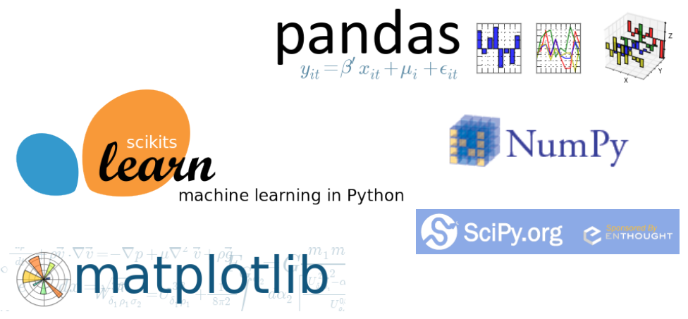
What to be covered in this course?
Numpy – fundamental scientific computing packages.
Pandas – data frame manipulation and analysis package.
Matplotlib – plotting and visualization.
Scipy/StatsModels – statistical tests and modeling
Scikits-learn – machine learning and data mining.

Slide 10
Syllabus
https://umsystem.instructure.com/courses/272772/files?preview=28430911
Categories | Score/Weight | Due Date or Exam Date (all time in CDT)
Homework Assignments | 25% ( 5% for each HW assignment) | Due by next session date (11:59pm, CDT)
Open book exam | 20% | Take-home exam @ week 8, due by next session date (11:59pm, CDT)
Group Project (Part I) presentation | 25% | Code and slides are due 1 day before the presentation date (11:59pm CDT). The revised code due by the Saturday of the presentation week.
Group Project (Part II) presentation | 25% | Same as above
Attendance and class participation | 5% | Throughout the semester
Total | 100%

Slide 11
Is this course right for you?
Completed courses in calculus/statistics for non-Econ, ECON 1100 & 1200 for Econ
Open to learn a new programming tool - Python
I will be your firefighter and cheerleader along the way!
No assigned textbook: Free online reference book
Others learning channels: Kaggle /Coursera/Udemy/edX…

Slide 12
Set up Course Environment
Python Integrated Development Environment (IDE)
1) Local Environment: Anaconda, VS code, PyCharm
2) Online Environment: Google Colab

