Slide 1
Retrieval-Augmented Adverse Drug Reaction Prediction: From System Organ Class to Life-Threatening Outcomes
David Guo
Invitation: Yale School of Public Health
Notes:
Good morning, everyone. Thank you for the opportunity to present my research.
My work focuses on retrieval-augmented AI for pharmacovigilance, specifically improving adverse drug reaction prediction using historical FDA FAERS reports.
Today I'll briefly present three related projects covering severity prediction, organ-level outcome prediction, and our ongoing GraphRAG framework.

Slide 2


Introduction
David Guo
IT PhD in AI/ML (expected in August’26)
Data Scientist in diverse industries for 12 years
Adjunct professor at Missouri University of Science and Technology
Biochemistry PhD @ HKUST
Former biomedical researcher at UT Health at San Antonio
Dissertation: Prediction of Adverse Drug Reaction
Notes:
I will complete my PhD in Information Technology with a specialization in AI and Machine Learning this August.
I worked as a data scientist in healthcare, automotive, insurance, and finance, while also teaching graduate data science courses.
My interdisciplinary background combines biomedical research with AI, allowing me to develop explainable machine learning methods for clinical decision support.

Slide 3
Agenda
Topic 1
Topic 2
Topic 3
ADR Multi-label Prediction in System Organ Class (SOC)
ADR Severity Prediction – Death/Lethal vs Non-Death/Lethal
Knowledge GraphRAG for ADR Prediction
Map ADR outcome in 29K PT to 27 SOC as Multi-label target
Develop a hybrid retrieval framework using normalized drug ingredients and ATC Level 4 therapeutic classes
and characterize temporal data drift across quarterly FAERS releases
Hybrid information retrieval -BM25 and Dense vector
Attention-aware data engineering and multi-source information aggregation
Evaluate ensemble machine learning, deep learning, and fine-tuned LLMs for ADR prediction
Construct Neo4j Knowledge GraphDB w/ 3.7M ADR cases
Re-rank meta-path retrievals based on local PageRank
Evaluate the complementary impact of semantic similarity and graph-based ranking on ADR prediction performance
Notes:
Today's talk has three parts.
First, predicting System Organ Classes from ADR narratives.
Second, predicting life-threatening adverse drug reactions.
Third, extending retrieval using knowledge graphs through GraphRAG.
Together these projects progressively increase the amount of structured knowledge incorporated into prediction.

Slide 4
TOPIC 1
ADR Multi-label Prediction in System Organ Class (SOC)
Research Question:
How can retrieval-augmented representations enhance the accuracy, robustness, and interpretability of multi-label SOC prediction from unstructured ADR narratives?
Challenges:
Existing ADR prediction methods rely on fragmented data sources—typically isolated clinical notes or social media posts—and lack a unified, large-scale data integration framework.
Notes:
The first project asks:
Can retrieval-augmented learning leverage millions of historical FAERS reports to improve prediction of life-threatening ADRs?
Traditional models only learn from individual reports, but pharmacovigilance naturally benefits from retrieving similar historical cases.

Slide 5
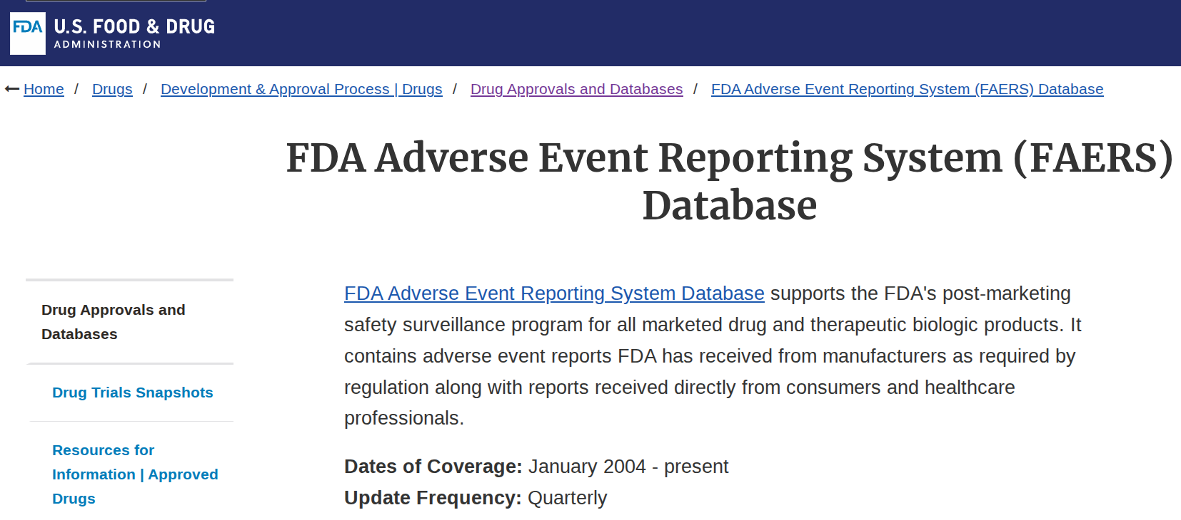
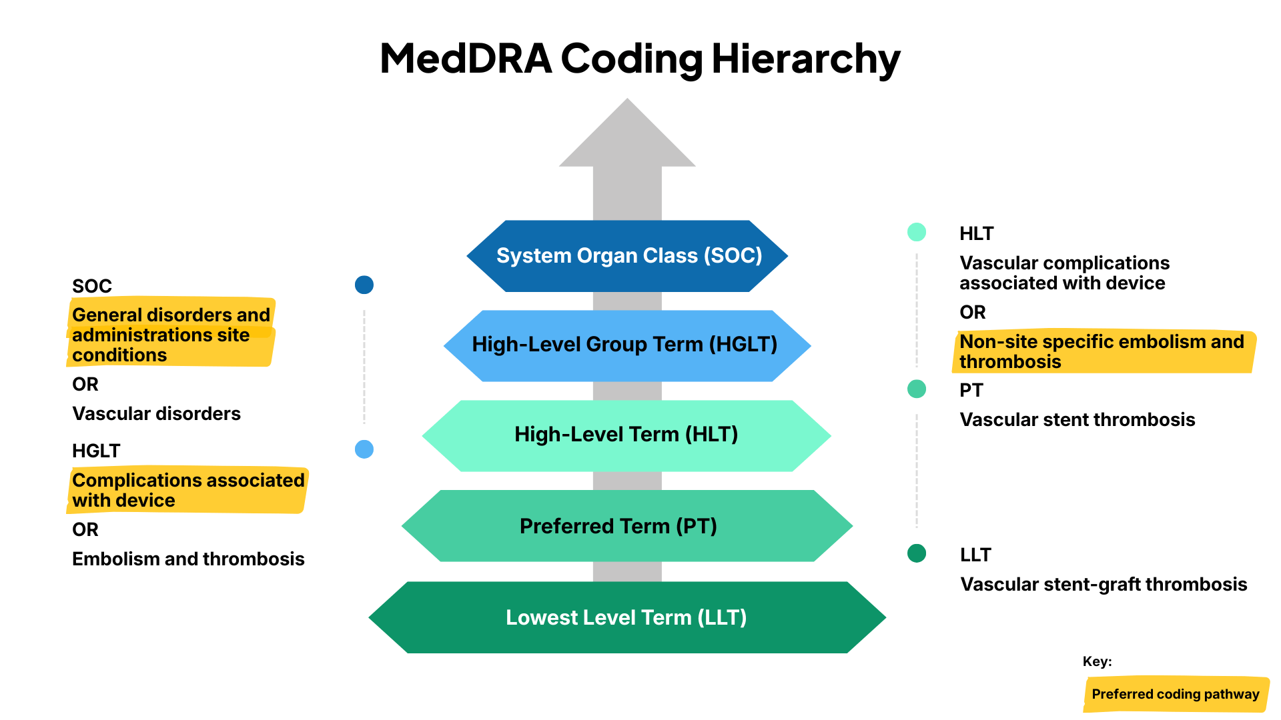
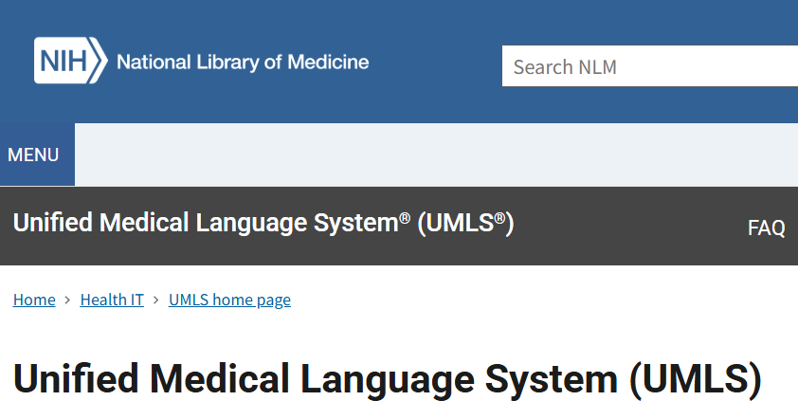
1.1 Solution: Data Sourcing
Fetch FAERS Data
Up to Q1 2026
→
→
→
→
→
→
Notes:
Fetched FAERS data up to Q1 2026, show history of FAERS raw data, medical dictionary for regulatory activities (MedDRA), a standardized medical terminology dictionary for sharing of regulatory information.
Our primary data source is FDA FAERS.
We collected reports from 2004 through the first quarter of 2026.
FAERS contains millions of spontaneous adverse event reports with patient demographics, medications, outcomes, and reported adverse reactions.

Slide 6
1.2 Solution: Data Engineering
Fetch FAERS Data
Up to Q1 2026
→
Normalize Drug Name and ATC L4
→
→
→
→
→
Caseid Query: {"patient": "{"age": "64.0", "age_cod": "yr", "gndr_cod": "m", "wt": "75.0", "wt_cod": "kg"}", "treatment": ... {"drugname": "lenvima", "ingredient": "lenvatinib", "atc4": "other protein kinase inhibitors", "route": "oral use", "dose": "20.0 mg capsule qd"}; ... {"drugname": "keytruda", "ingredient": "pembrolizumab", "atc4": "pd-1/pd-l1 (programmed cell death protein 1/death ligand 1) inhibitors", "route": "intravenous drip", "dose": "200.0 mg injection q3w"}; ...", "indi_pt": "renal cell carcinoma stage iv; metastatic renal cell carcinoma; renal cell carcinoma stage iv", "yr_qtr": "2026q1"}
Type | Period | Count
Retrieval DB | 2004Q1-2024Q4 | 3,593,932
Training Set | 2025Q1-2025Q3 | 166,120
OOT Set | 2025Q4-2026Q1 | 106,428
Construct Query in JSONL
Notes:
Case-query JSON structure with patient demographics, treatment info (drug, ingredient, anatomical therapeutic chemical (ATC) level 4, route, dose, indication PTs. Dataset split: 3.6M reports (2004Q1–2024Q4) for retrieval DB construction, 3 quarterly releases of 166K cases (2025Q1–Q3) for training, and 2 latest quartrly releases 2025Q4 and 2026Q1 106K cased ) for tempor
Raw FAERS reports are highly heterogeneous.
We normalized drug names to ingredients using RxNorm and mapped medications into ATC Level 4 therapeutic classes.
Each case is converted into a standardized JSON representation containing demographics, medications, indications, and temporal information.
This standardized representation greatly improves retrieval consistency.

Slide 7
1.3 Solution: PT to SOC Mapping to Define Target
Fetch FAERS Data
Up to Q1 2026
→
Normalize Drug Name and ATC L4
→
Map PT to SOC
→
→
→
→
ADR in 11 Preferred Terms (PT): ileus; dehydration; faecaloma; dizziness; cancer pain; decreased appetite; bacterial translocation; headache; diarrhoea; circulatory collapse; sepsis
ileus -> ['gastrointestinal disorders']
dehydration -> ['metabolism and nutrition disorders']
faecaloma -> ['gastrointestinal disorders']
dizziness -> ['cardiac disorders', 'nervous system disorders', 'vascular disorders']
cancer pain -> ['neoplasms benign, malignant and unspecified (incl cysts and polyps)']
decreased appetite -> ['general disorders and administration site conditions', 'metabolism and nutrition disorders']
bacterial translocation -> ['infections and infestations']
headache -> ['nervous system disorders']
diarrhoea -> ['gastrointestinal disorders']
circulatory collapse -> ['vascular disorders']
sepsis -> ['infections and infestations']
1 PT to multiple SOC mapping
Mapped SOC: 'neoplasms benign, malignant and unspecified (incl cysts and polyps)', 'infections and infestations', 'gastrointestinal disorders', 'nervous system disorders', 'vascular disorders', 'cardiac disorders', 'metabolism and nutrition disorders', 'general disorders and administration site conditions'
Multi-label SOC (8 positives out of 27 dimensions): [0 1 0 0 0 0 1 1 0 0 1 0 0 1 0 1 1 0 0 0 0 0 0 0 0 0 1]
Notes:
PT to SOC Mapping: Mapped 11 preferred terms to System Organ Classes (27 total multi-label dimensions). Example: "dizziness" → 3 SOCs (cardiac, nervous system, vascular). Shows one-to-many mapping with multi-hot encoding.
Individual adverse reactions are reported as MedDRA Preferred Terms.
However, one preferred term may belong to multiple organ systems.
Therefore, we map approximately 29,000 preferred terms into 27 System Organ Classes, producing a multilabel prediction problem.

Slide 8
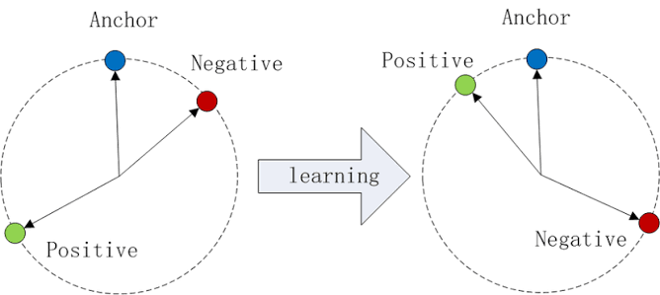

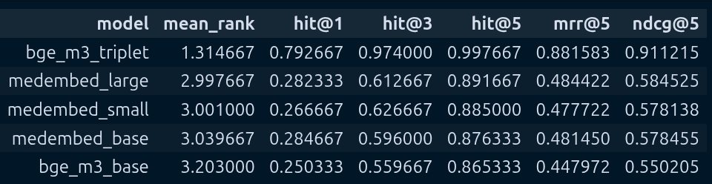
1.4 Solution: Fine-tune Embedding Model – Convert Text to Vector
Fetch FAERS Data
Up to Q1 2026
→
Normalize Drug Name and ATC L4
→
Map PT to SOC
→
Embedding Model
→
→
→
Caseid Query: {"patient": "{"age": "64.0", "age_cod": "yr", "gndr_cod": "m", "wt": "75.0", "wt_cod": "kg"}", "treatment": ... {"drugname": "lenvima", "ingredient": "lenvatinib", "atc4": "other protein kinase inhibitors", "route": "oral use", "dose": "20.0 mg capsule qd"}; ... {"drugname": "keytruda", "ingredient": "pembrolizumab", "atc4": "pd-1/pd-l1 (programmed cell death protein 1/death ligand 1) inhibitors", "route": "intravenous drip", "dose": "200.0 mg injection q3w"}; ...", "indi_pt": "renal cell carcinoma stage iv; metastatic renal cell carcinoma; metastatic renal cell carcinoma; renal cell carcinoma stage iv", "yr_qtr": "2026q1"}
Triple Loss:
Encode
Query Embedding (1024 dimension):
array([ 0.01515 , -0.006317, 0.03087 , ..., 0.02869 , 0.006718, -0.00535 ], shape=(1024,), dtype=float16)
Notes:
We fine-tuned the BGE-M3 embedding model using one million instruction pairs.
Triplet loss pulls similar ADR cases together while separating unrelated cases.
The resulting embeddings capture both semantic similarity and pharmacological context.
Using open source embedding model BGE_m4 as base model, fine-tuned on 1M Query-PT pairs.
Using trip loss function to minimize the angle between anchor and positive, and maximize the angle between anchor and negatives.
Let us check the embedding performance compare to the base model and 3 difference size medical embedding models. 5 metrics are computed as top 1, 3, 5 hit, mean reciprcalr rank (MRR) and noarmlzied dcisounted gain accumualtion (NDCG). Encode text queries to 1024-dim vectors.

Slide 9


1.5 Solution: Construction Search DB and Information Retrieval
Fetch FAERS Data
Up to Q1 2026
→
Normalize Drug Name and ATC L4
→
Map PT to SOC
→
Embedding Model
→
Hybrid Retrieve BM25 + Dense
→
→
Top5 Sematic Matches
IDs: [3238518, 3287456, 3423125, 3350654, 3245516]
Scores: [ 1.44758348, 0.90507292, -0.3958535 , -0.89441837, -1.06238452]
Patient: 76 yr, F, 59.8 kg
Drug: mianserin hydrochloride, venlafaxine
Indication: depression
Yr_qtr: 2025q1
Top5 Lexical Matches
IDs: [3227685, 2201309, 3274897, 3287041, 2859269]
Scores: [100.612854 , 100.36943817, 98.56613159, 95.6333847 , 95.56513977]
Notes:
Demo of hybrid retrieval for a depression case (mianserin + venlafaxine). Top-5 lexical matches via BM25 (scores ~95–100) and top-5 semantic matches via dense vectors (cosine scores ~-1 to 1.4). Combines BM25 + dense embedding for retrieval.
Retrieval combines two complementary methods.
BM25 captures exact lexical matches.
Dense vector search captures semantic similarity.
Together they retrieve ten historical cases that provide contextual evidence for prediction.

Slide 10
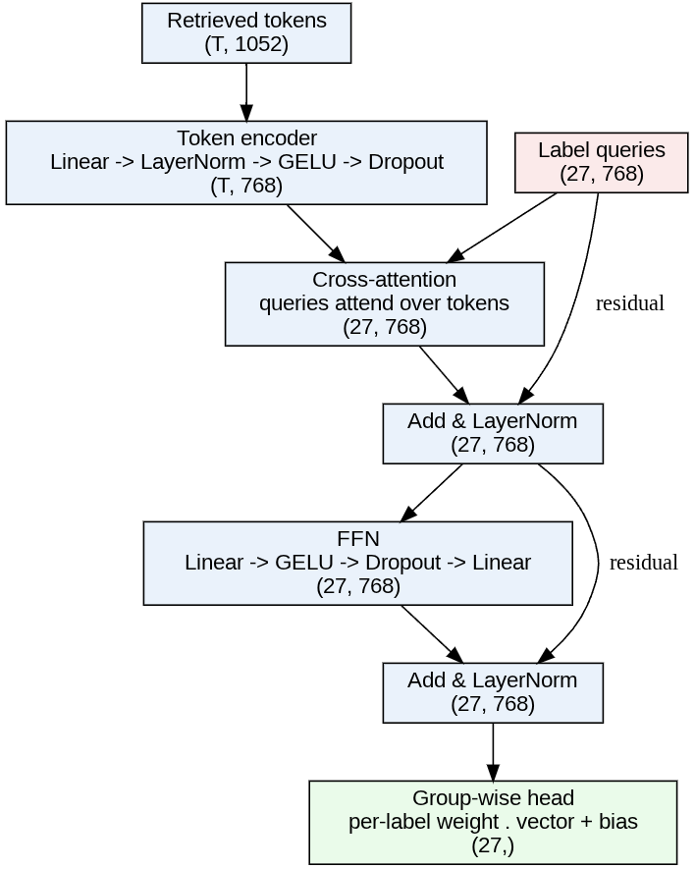
1.6 Solution: Fit Predictive Models
Fetch FAERS Data
Up to Q1 2026
Normalize Drug Name and ATC L4
Map PT to SOC
Embedding Model
→
Hybrid Retrieve BM25 + Dense
→
Define Models
(IV/DV)
→
→
→
→
→
Input dimension: (10, 1052)
Normalized Score (1)
Multi-label (27)
Retrieval Embedding (1024)
Output dimension: (27, )
[0 1 0 0 0 0 1 1 0 0 1 0 0 1 0 1 1 0 0 0 0 0 0 0 0 0 1]
Architecture of Deep Learning Model
Notes:
Instead of treating all retrieved cases equally, our model learns attention weights over retrieved evidence. Each System Organ Class (SOC) has its own learned query vector that selectively attends to the most relevant historical reports. This allows the model to explain which retrieved cases contribute most to each prediction.
Each input consists of the query case and 10 retrieved cases. Every retrieved case includes a normalized retrieval score, 27 multi-labels, and a 1024-dimensional embedding.
We use a cross-attention label-query classifier for the 27-class multilabel SOC task:
Token encoder: Projects the query and retrieved tokens into a shared 768-dimensional feature space.
Cross-attention: Uses one learned query vector per SOC class to attend to the query case and retrieved cases, enabling label-specific evidence weighting.
Layer normalization and feedforward network: Refines the attended representations for stable learning.
Classification: Each SOC representation is passed through its own classifier to produce 27 independent sigmoid outputs.
Overall, the model acts like a mini one-layer Transformer decoder, where the decoder tokens are learned SOC queries that selectively gather evidence from the query case and its 10 retrieved neighbors.

Slide 11
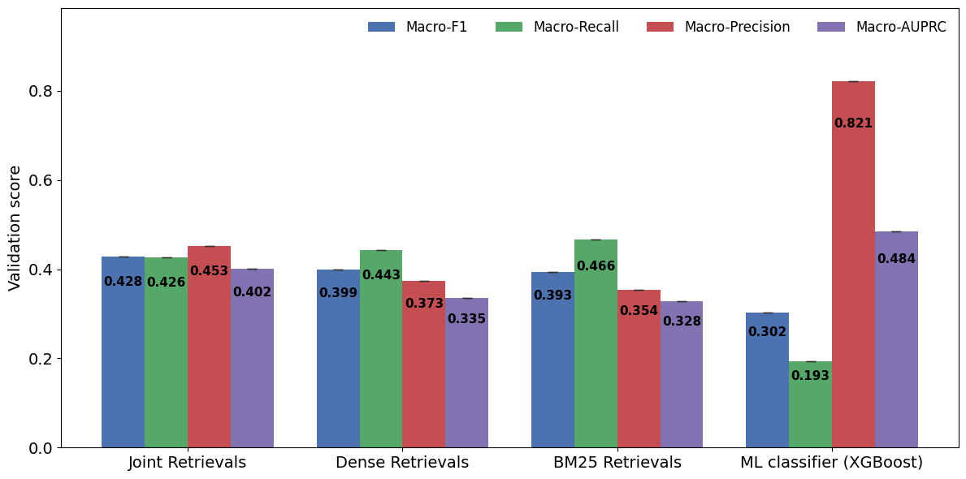
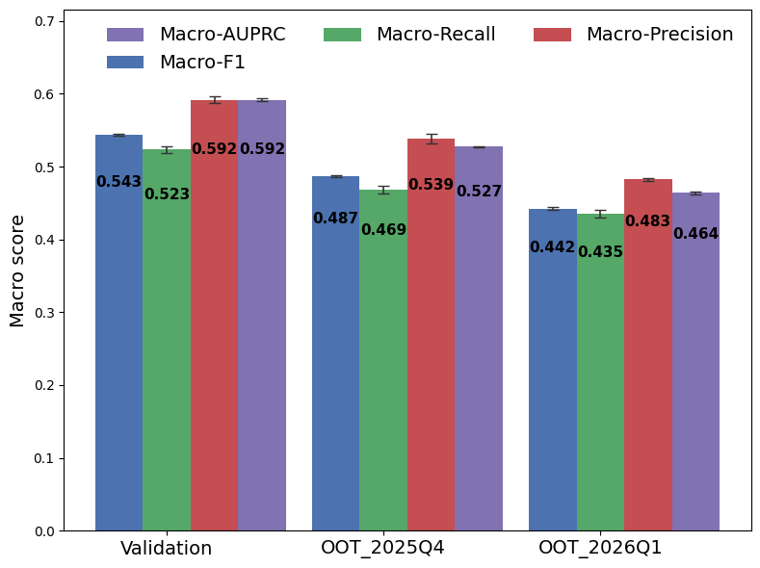
1.7 Evaluation: Benchmarking Model Performance Against the Baseline
Fetch FAERS Data
Up to Q1 2026
Normalize Drug Name and ATC L4
Map PT to SOC
Embedding Model
→
Hybrid Retrieve BM25 + Dense
→
Define Model
(IV/DV)
→
Model Performance
→
→
→
→
KNN Vote Prior and ML Baselines
Evaluation on Val and OOT Sets
Notes:
Benchmarking ML models, deep learning baselines, and LLMs against hybrid retrieval results on validation and OOT sets.
We compared traditional machine learning, deep learning, and retrieval baselines.
Retrieval-augmented learning consistently improved prediction performance over KNN and standard neural models.
Importantly, the improvements generalized to out-of-time test sets.

Slide 12
1.8 Conclusion - SOC Multi-label Prediction
Two findings stand out.
Hybrid retrieval substantially improves prediction accuracy
Hybrid retrieval achieves an average macro-F1 of 0.465 on the out-of-time (OOT) test sets, compared with 0.428 for the KNN voting baseline. This substantially outperforms the random prediction baseline (positive density ≈ 0.15).
Temporal performance drift remains a challenge as reporting patterns evolve over time.
Evaluation on temporal out-of-time (OOT) test sets reveals evidence of data drift, with declining on ADR cases in Q1’26 (macro-F1 of 0.442) from cases Q4’25 (macro-F1 of 0.487), suggesting that evolving pharmacovigilance data distributions pose an ongoing challenge for model generalization.
Notes:
Two findings stand out.
Hybrid retrieval substantially improves prediction accuracy.
However, temporal drift remains an important challenge as reporting patterns evolve over time.

Slide 13
TOPIC 2
Binary ADR Prediction:
Death/Lethal vs Non-Death/Lethal
Research Question:
How can retrieval-augmented learning leverage historical FAERS reports to predict life-threatening ADR outcomes - Death/Life-Threatening vs Non-Death/Life-Threatening?
Challenges:
Sparse, noisy, and heterogeneous ADR narratives with limited contextual information make it difficult to learn robust and discriminative representations for accurate ADR severity prediction.
Notes:
The second project focuses on predicting whether an adverse event is life-threatening.
Instead of predicting multiple organ systems, we simplify the task into a binary classification problem while exploring more efficient representations.

Slide 14
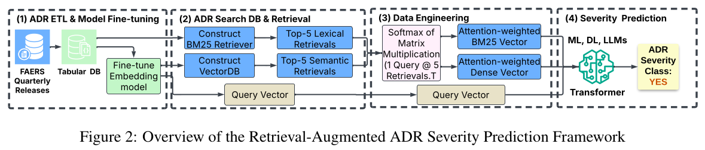
2.1 Overview
Notes:
Highlight the data engineering in part 3 that aggregate 10 retrieval representations into 2 dense vectors, plus the query vector, the input size is reduced from 10X 1024 to 3X 1024.

Slide 15
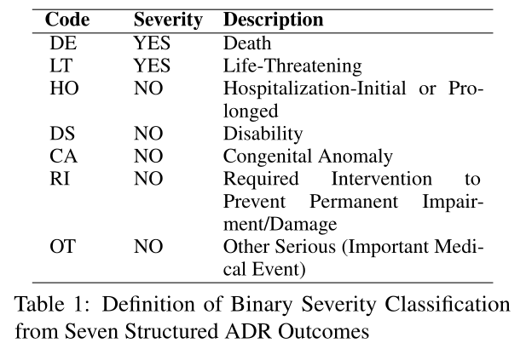
2.2 Solution: Data Engineering
Fetch FAERS Data
→
Define Unique Outcome Code
→
Define Binary Target - Severity
→
→
Uni_code | Count
HO | 1,230,469
OT | 1,066,388
DE | 304,088
LT | 224,943
DS | 98,806
RI | 22,429
CA | 7,832
Notes:
We consolidated the seven FAERS outcome categories into a binary severity label.
This produces a large, balanced dataset suitable for supervised learning.

Slide 16
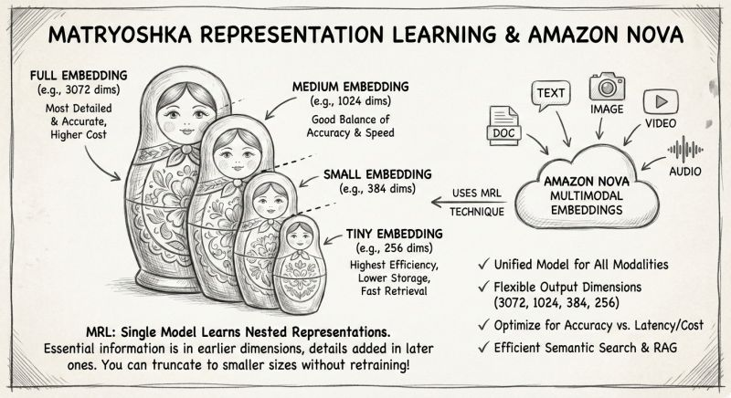
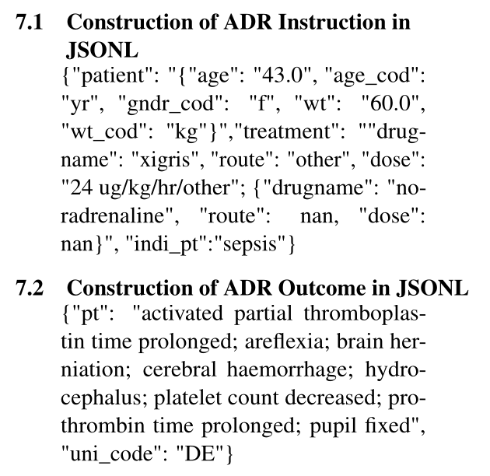
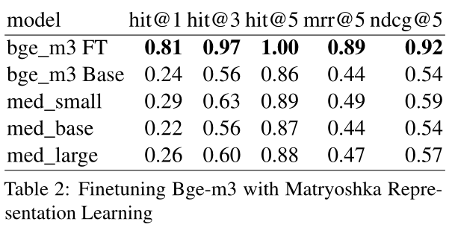
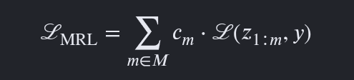
2.3 Solution: Matryoshka Representation Learning for Embedding
Fetch FAERS Data
→
Define Binary Target Severity
→
Define Binary Target Severity
→
Fine-tune
Embedding Model
→
The Matryoshka loss is the sum of the individual losses computed at each dimension
Base Model: https://huggingface.co/BAAI/bge-m3
Notes:
Matryoshka Representation Learning (MRL) trains embeddings that remain informative even when truncated to lower dimensions, enabling efficient retrieval with minimal loss in accuracy.
Amazon Nova leverages MRL to generate scalable embeddings that support fast semantic search across different latency and reduced embedding sizes without retraining separate models. It serves multiple retrieval scenarios by dynamically trading off embedding dimensionality, storage cost, retrieval latency, and prediction accuracy.
Fine-tuned BAAI/bge-m3 base embedding model using Matryoshka loss (the sum of individual dimension-wise losses), enabling flexible-dimension representations for binary severity target definition on FAERS data through Q3 2025.
We adopted Matryoshka Representation Learning. The key idea is that embeddings remain useful even when compressed into lower dimensions. Amazon Nova recently adopted this strategy because it reduces storage and retrieval costs while maintaining retrieval quality.

Slide 17
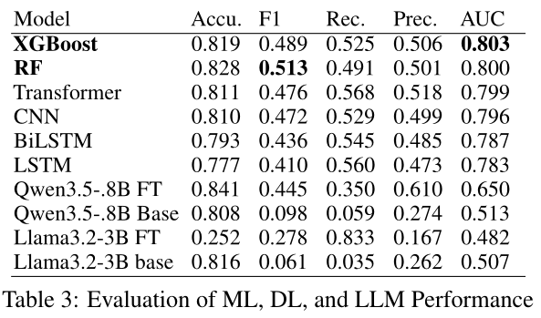
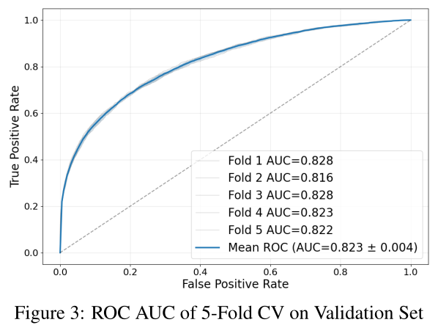
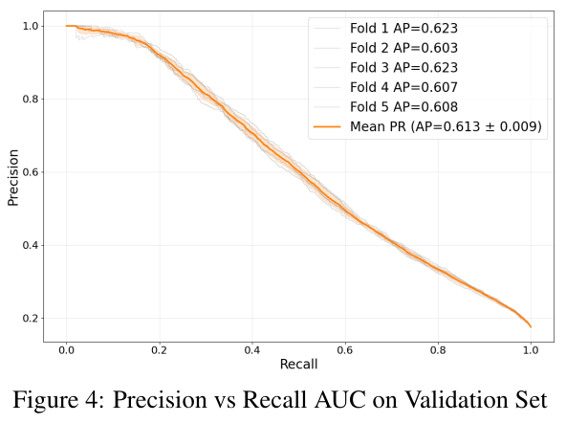
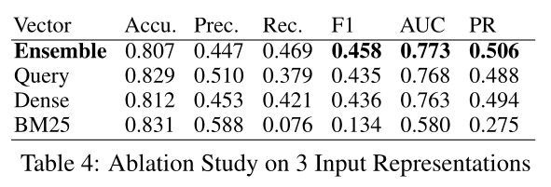
2.4 Evaluation: Model Performance – ML vs DL vs LLM
Fetch FAERS Data
Up to Q3 2025
→
Define Binary Target Severity
→
Define Binary Target Severity
→
Fine-tune
Embedding Model
→
Model Performance
Notes:
Rather than feeding all ten retrieved embeddings into the classifier, we aggregated them into compact evidence vectors. Surprisingly, this smaller representation allowed tree-based ensemble models like XGBoost to outperform both deep learning models and fine-tuned LLMs. This highlights that better feature engineering can sometimes outperform larger models.
With aggregated representations of 10 retrievals fo hybrid pipelines into 2 vectors plus 1 query vector, traditional ensemble machine learning classifier like XGBoost and Random forest outperform 4 DL models, and 2 finetuned LLMs, in terms of F1 and AUC.
W also run ablation study on 3 information source BM25, Dense vector and query, the ensemble prediction from 3 pipelines outperform each individual predictions alone.

Slide 18
2.5 Conclusion
Attention-weighted evidence aggregation reduces the required training input from a dimension of 10X1024 to 3X1024 while preserving informative representations, enabling a tree-based ensemble classifier to outperform deep learning baselines and fine-tuned LLMs in both F1 score and AUC metrics.
Notes:
Attention-based evidence aggregation preserves informative signals while dramatically reducing model complexity.
This leads to higher accuracy and improved computational efficiency.

Slide 19
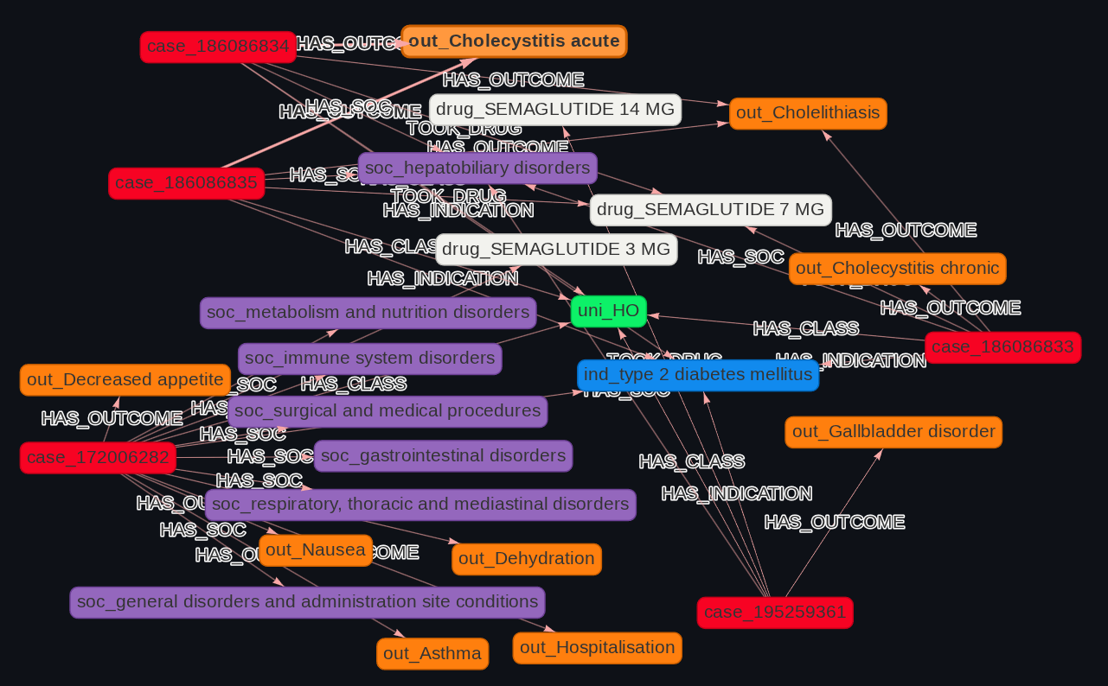
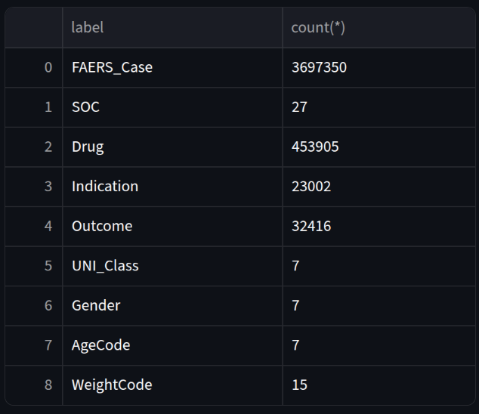
3 FAERS GraphRAG for ADR Exploration and Prediction
Demo
Nexusmed.ai
Notes:
This prototype demonstrates how clinicians can explore related drugs, adverse events, and patient histories interactively.
Rather than returning isolated reports, the system explains predictions using connected evidence from the knowledge graph.

Slide 20

Acknowledgment
Dr. Raymond Choo (PhD Advisor)
Texas Advanced Computing Center (TACC)
Exploratory and Predictive Analytics on Adverse Drug Reactions (MDE260011), NSF Advanced Cyberinfrastructure Awards, Amount: $4000
Pittsburgh Supercomputing Center (PSC)
UTSA High Performance Computing (ARC)
Next: Claude Training for Public Health Research @ https://github.com/bcqguo/claude_4_public_health
Notes:
Finally, I'd like to acknowledge support from my advisor Dr. Choo, and TACC, PSC, UTSA Advanced Research Computing, my committee members, and my collaborators.
Thank you for your attention. I'd be happy to take any questions.

Slide 21
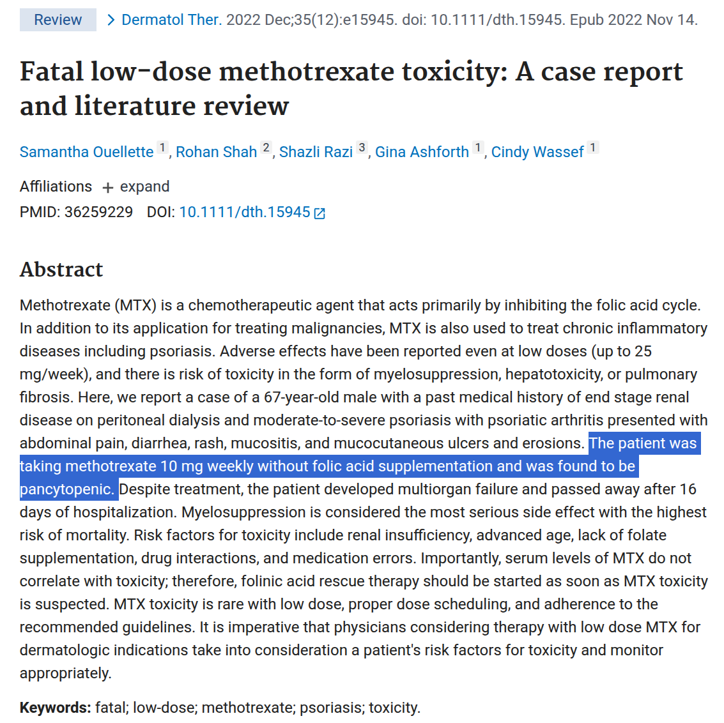
Appendix

