Slide 1

Multitask Classification – Is that a Snoring Sound?
Team 5 – Luis B. Reyes and David Guo

Slide 2
Problem statement - Snoring prevents restful, healthy sleep. Over time, this condition can cause serious complications such as sleep apnea which pauses breathing hundreds of times during the sleep.
Proposal – Deep learning (DL) has been widely used to deal with the unstructured data such as image, sound, text, etc. In this proposal, we will apply a DL algorithm to develop an multi-task model that take the sound recording as input and classify the sound to determine if the sound is a Snoring. We will showcase the application of the model by implementing it in a Raspberry Pi with recording device that will continue to take the sound input and output the binary classification of 0 (no snoring) /1 (snoring). Together with other medication devices, patient can be treated with necessary administration.
Ethical Concern – no ethical concern on this application given the implementation of model is on an edge device with no data exchange proposed.
Stakeholder – patient who has medium or severe snoring issue, healthcare providers such as hospital, clinic, nursing house.
One UTSA Circle • San Antonio, Texas 78249

Slide 3
Primary Design – Tensorflow will be used as the end-to-end platform to test, fine-tune, and deploy the DL model.
Development Stage -
Data collection and pre-processing
Test model building considering the trade-off of model complicity and performance
Fine-tune model to boost prediction accuracy on binary outcome of snoring or not.
Test model implementation on edge device (Raspberry Pi) that takes streaming recording.
Achieve best model performance with optimized length of recording.

Slide 4
Data collection:
1) UrbanSound8K with 10 classese from Kaggle @ https://www.kaggle.com/datasets/chrisfilo/urbansound8k
2) Snoring sound data:
Shared by Author of "A real‐time snore detector using neural networks and selected sound features", by S.A. Mitilineos et al., Presented at 2nd International Electronic Conference on Applied Sciences, 15–31 October 2021, Eng. Proc. 2021, 11(1), 8; https://doi.org/10.3390/ASEC2021-11176
Wav files characteristics: 48 kHz, 24 kbps, raw (unfiltered) recordings
2500 Wav files for snoring and non-snoring, respectively.

Slide 5
Data Pre-processing:
1) Feature exrtaction
signal in the time-frequency domain by computing discrete Fourier transforms
Mel-frequency cepstral coefficients
chromagram from a waveform
Melspectrogram
Energy contrast
Tonal centroid feature
2) Model Input
Stack sound features to form a 2-D model input
Map 2D input with labels

Slide 6
Modeling Approaches to be explored:
1) Multi-Layer Perceptron (MLP)
2) Multi Layer DL
3) Convolution 1D/2D DL
4) RNN model – LSTM / GRU
Optimization Efforts:
Optuna will be used for fine-tuning hyperparameters, including learning rate, optimizer, loss functions, epoch/step, etc.
Explainable AI Efforts:
Captum will be used to explain the model

Slide 7
Appendix
Notes:
Add icons for each department.

Slide 8
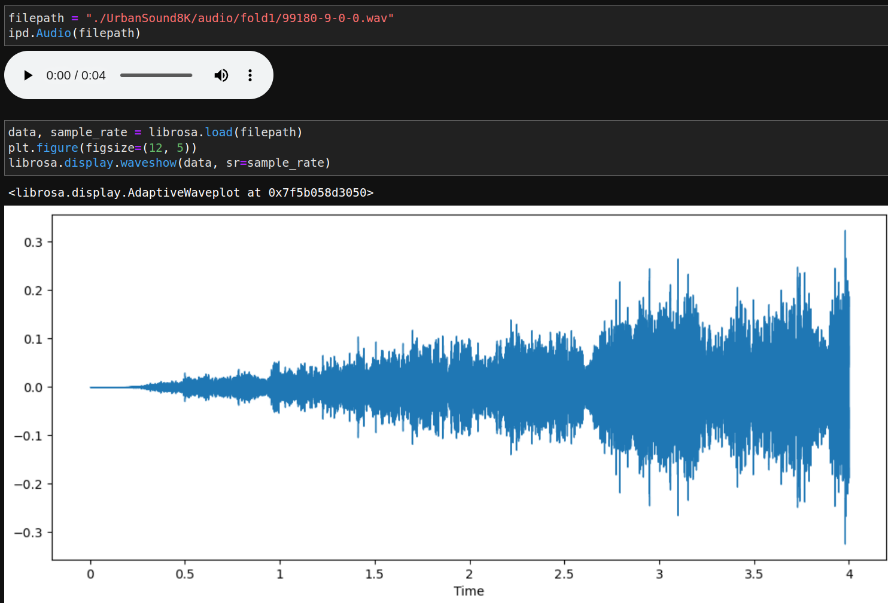
Explore Input Data

Slide 9
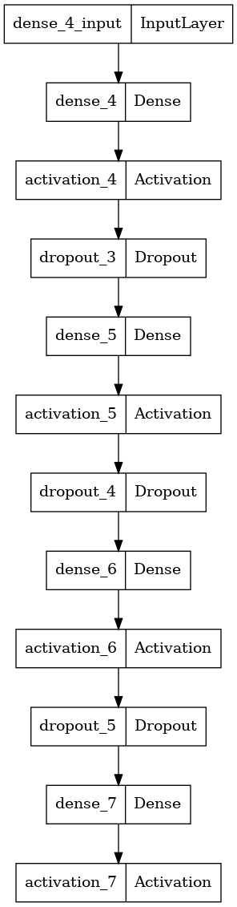
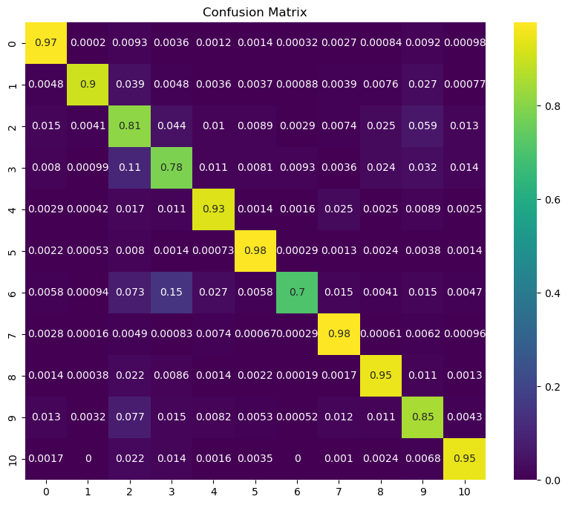
Model Architecture and Performance (Class 10 is Snoring)

Slide 10
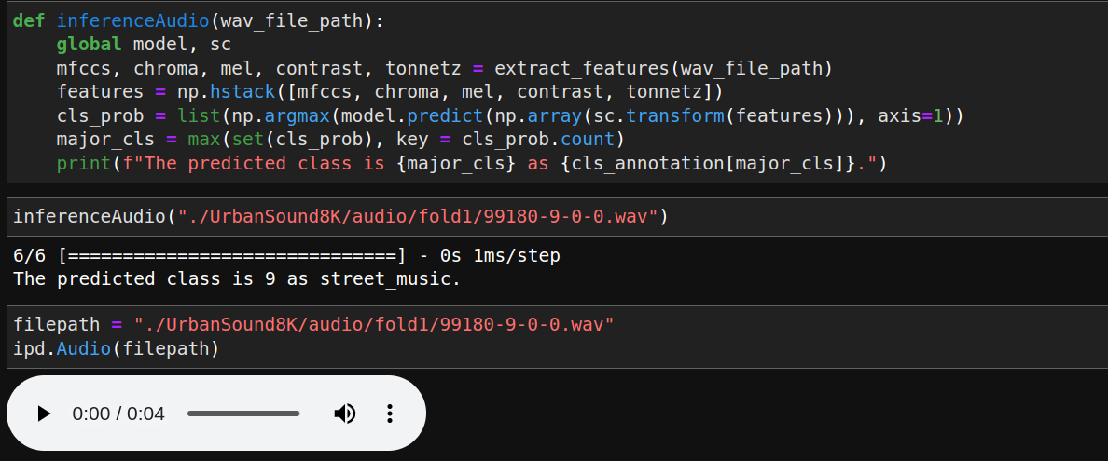
Model Inference

