Slide 1
European Soccer Match analysis
IST 565 – Data Mining
Brandon croarkin

Slide 2
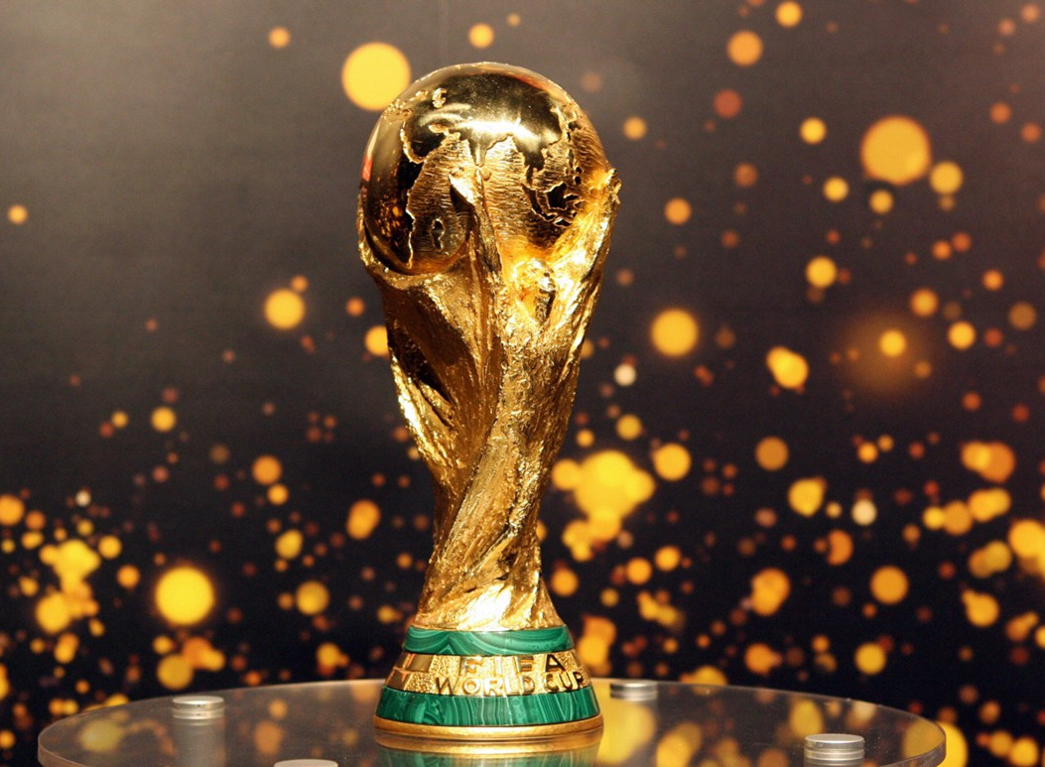
World soccer popularity
According to FIFA, there are 4 billion soccer fans in the world.
265 million players are actively involved in soccer around the world.
The 2014 World Cup set several social media records. Eighty-eight million people worldwide engaged with the 2014 final match on Facebook, racking up 280 million Facebook interactions. (For comparison, this year's Super Bowl drew 62 million people and 270 million interactions on Facebook.)

Slide 3
Project Goals
What interesting findings can be found in the data?
Do playing styles differ between leagues?
What has the biggest impact on a soccer player rating?
How accurately can a soccer match be predicted? Can it beat the betting odds?

Slide 4
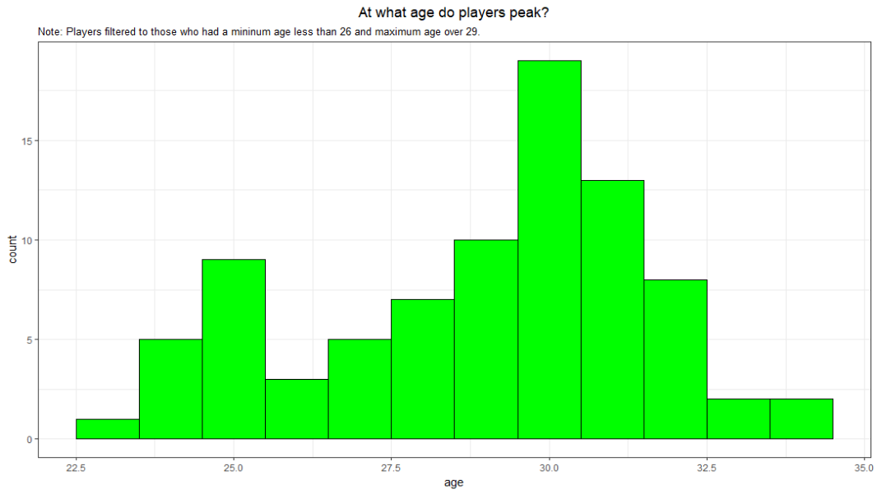
Interesting Findings: At What age do players Peak?
Soccer players reach their peak rating at the age of 30.

Slide 5
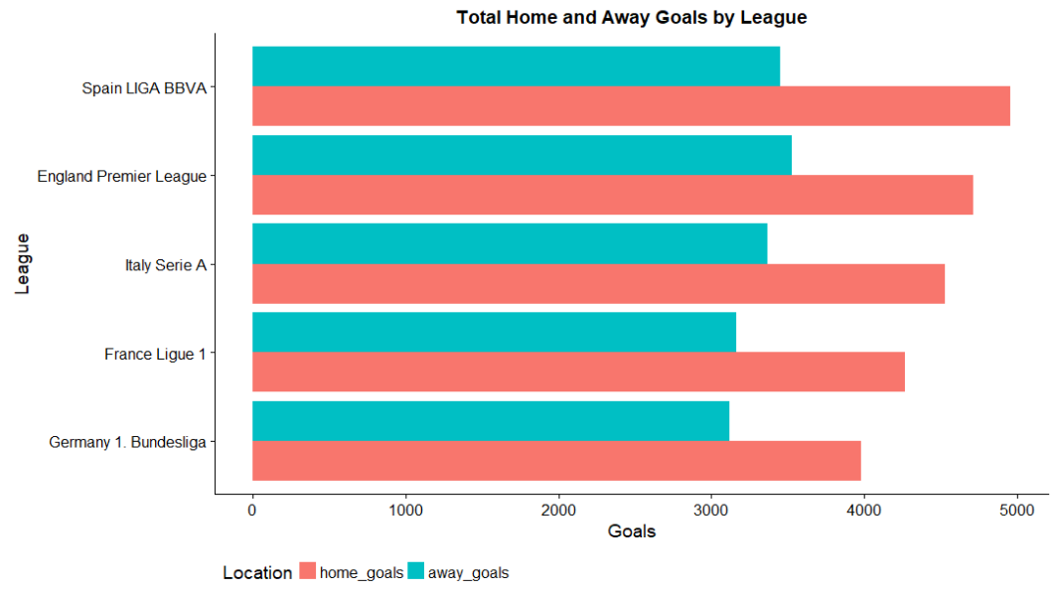
Interesting findings: Home and away goals by League
Spain has the most goals scored.
Germany has the least goals scored.
The home team scores ~35% more goals than the away team on average.

Slide 6
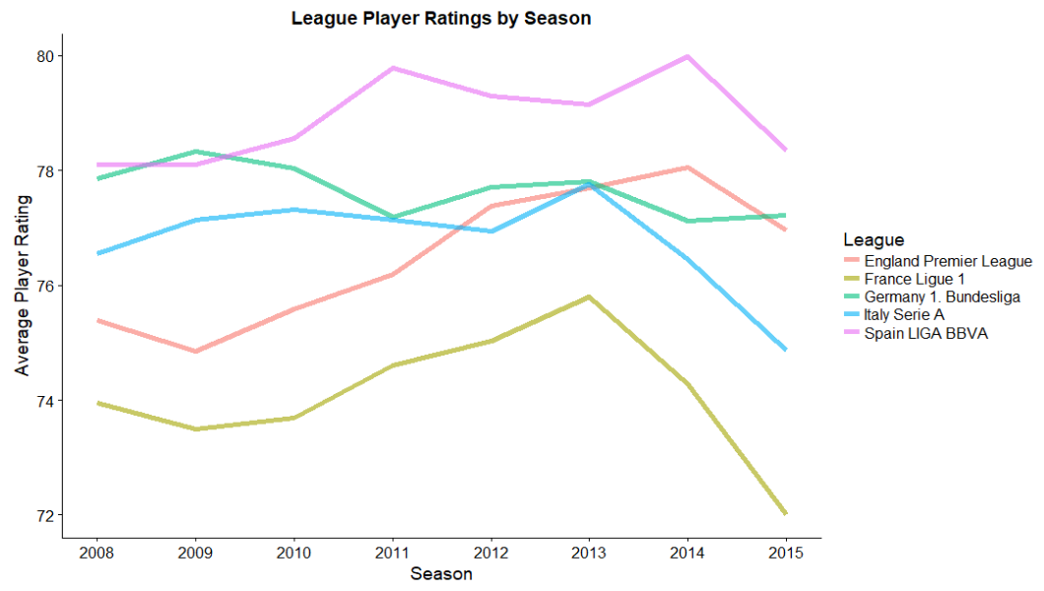
Interesting findings: Average player ratings by league
Spain has the highest average player rating at 79.
France has the lowest average player rating at 74.

Slide 7
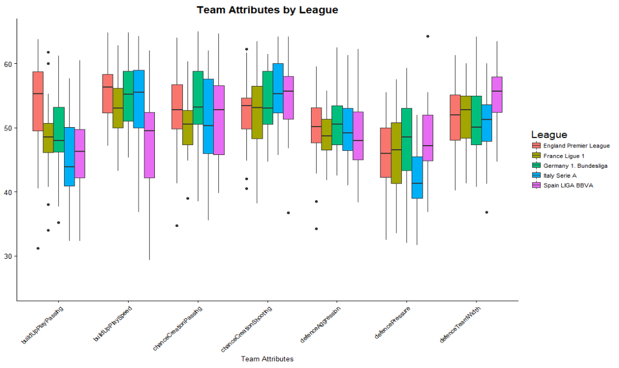
playing styles by league (Clustering)
England has the highest average build up play passing and speed
Spain is high in chance creation shooting and defensive team width, but low in build up play speed and passing
Italy has the lowest defensive pressure
Germany has the highest defensive pressure

Slide 8
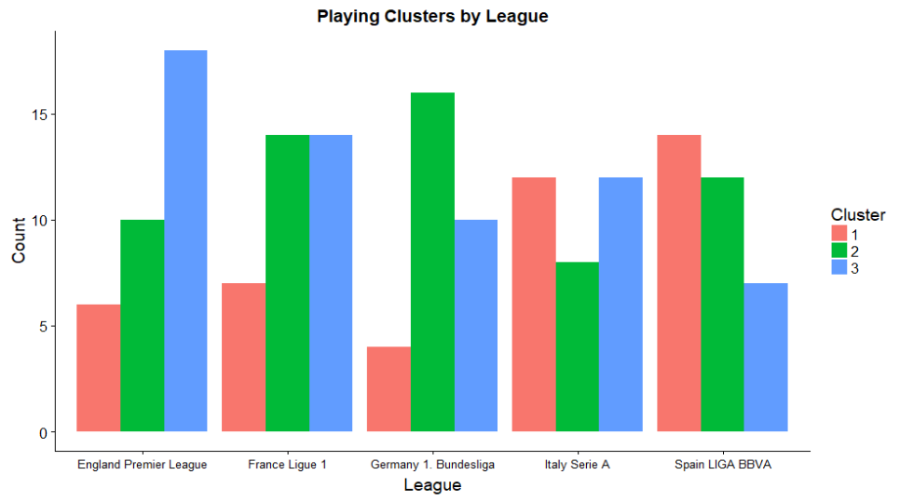
playing styles by league (Clustering)
Cluster 1 (compact and defensive) – narrow defensive team width, low defensive pressure and aggression, low chance creation passing
Cluster II (direct, counter-attack) – low build up play and passing, high chance creation shooting, high defensive team width, and high defensive pressure
Cluster III (possession) – high build up play and passing, high chance creation passing, high defensive aggression
Notes:
This matches with the previous visual.
England has the most Cluster III, which is fast and aggressive style of build up play
Germany has the most Cluster II, which is high defensive pressure

Slide 9
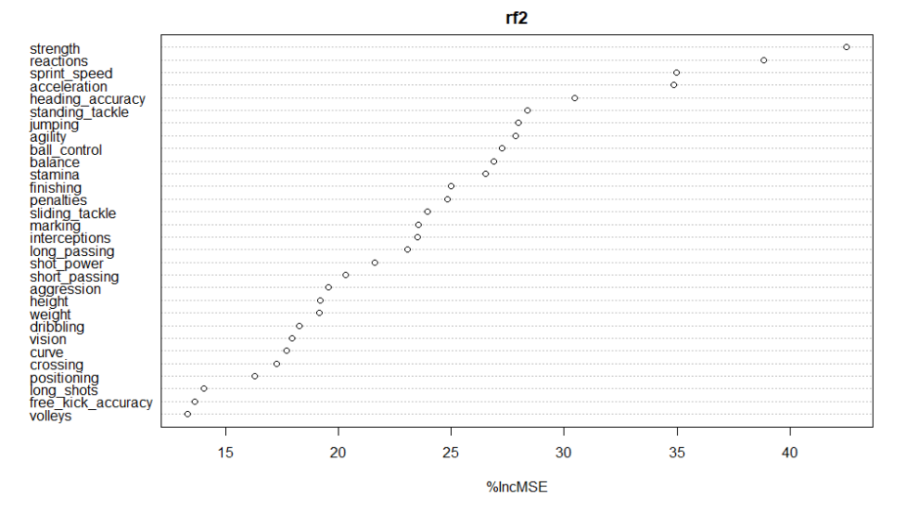
What Attributes have the largest affect on player Rating? (Random Forest)
Strength was listed as the most important factor in a player rating with sprint speed in 3rd!
Ball control came in at #9
Long passing at #17
Short passing at #19
Athletic factors are very high on list
Technical skills are lower on the list ☹
Note: age was removed as a factor in the Random Forest model

Slide 10


Predicting match Results (Random Forest, SVM, and Naïve Bayes)
46% of matches are won by the home team
28% of matches are won by the away team
26% of matches result in a tie
Bookies get the match result right about 53% of the time. This is only 7% better than guessing a Home Win for every game!
Notes:
A bookie sets odds, accepts and places bets, and pays out winnings on behalf of other people.

Slide 11
Predicting match Results (Random Forest, SVM, and Naïve Bayes)
Algorithm | Accuracy | Parameters
Random Forest | 48.4% | Default
Naïve Bayes | 51.5% | Default
SVM | 52.4% | Radial kernel, C = 1
Attributes Used
Home win percentage
Away win percentage
Home team’s average player rating
Away team’s average player rating
NOT READY FOR LAS VEGAS SPORTS GAMBLING YET ☹
Notes:
Potential Model Improvements
Team win streaks
Historical results vs. team

