Slide 1
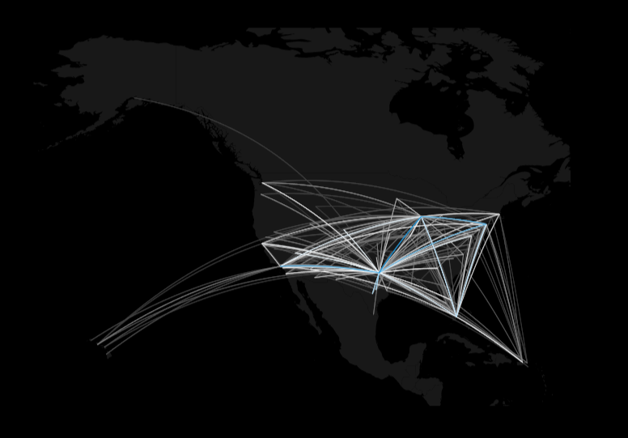
2008 Arrival Delay Analysis
American Airlines vs. Everyone Else
Brandon Croarkin, Michelle Mak, TS Yeap IST 687 - Applied Data Science June 27, 2018

Slide 2
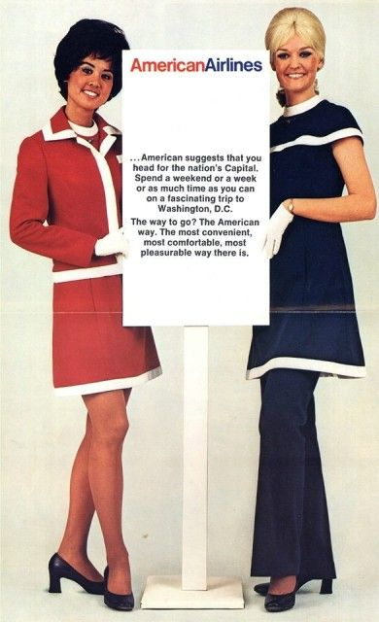
[introduction/problem statement]
In 2008, American Airlines experienced a total of 172,197 arrival delays, which was the second highest number of delays among its competing class of 20 airlines.
We used data analysis techniques to:
Find where the biggest pain points were for American Airlines
Compare findings to the industry average.
We ultimately wanted to minimize future arrival delays by using the data to predict the probability of experiencing future delays.
Notes:
Speaker: TS

Slide 3
[essential research questions]
Type 1 Questions: Initial Discoveries
Which airline experiences the most delays?
What is the average length of a delay?
Which airline experiences the longest delays?
When do delays occur most frequently?
Which airport has the most delays?
Type 2 Questions: Exploratory Analysis
What causes airline delays?
Can we predict the length of a delay?
Notes:
Speaker: TS

Slide 4
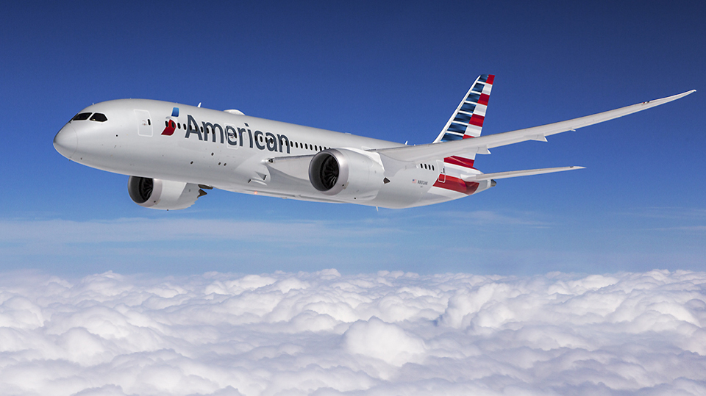
[initial findings]

Slide 5
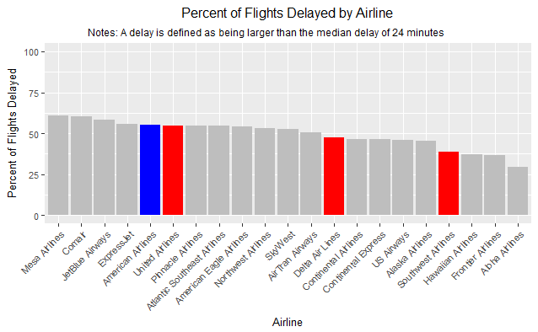
[ which airline experiences the most delays? ]
Notes:
Speaker: Michelle
Since American Airlines is a large airline with a lot of flights, we decided to compare ourselves to three like companies: United Airlines, Delta Airlines, and Southwest Airlines. By framing ourselves to like companies, we hope to understand how we relate to our main competition so we can more accurately understand where we stand. From the analysis below, we sadly see that the American Airlines is one of the worst offenders for the percent of flights delayed and is the worst of the competitors as well.

Slide 6
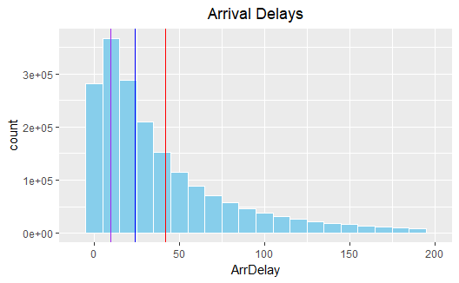
[ average length of a delay ]
AMERICAN AIRLINES Mean: 42.2 minutes
Median: 29 minutes
Mode: 10 minutes
INDUSTRY AVERAGE Mean: 42.8 minutes
Median: 24 minutes
Mode: 10 minutes
Notes:
Speaker: Michelle
All in all, the average length of a delay is about 42 minutes long (red line). However, airline delays are most commonly only 10 minutes long (purple line). The median of this data set is 24 minutes (blue line). The above chart also cuts the xlim at 200 to not show some of the large outlier values. You can see the large effect of this by how spread out the mode, median, and mean lines are.

Slide 7
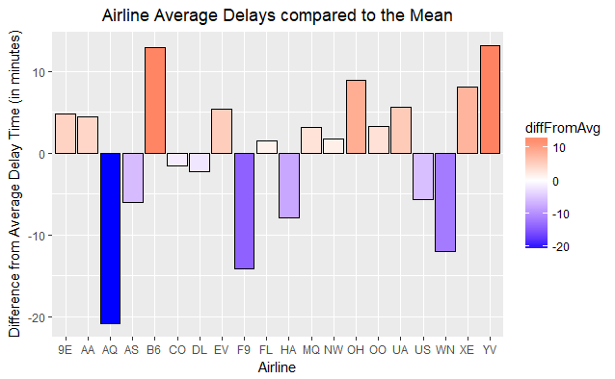
[ which airline experience the longest delays? ]
American Airlines (AA) has above average delays
Airlines that experience the LONGEST delays
Mesa Airlines (YV)
JetBlue (B6)
Notes:
Speaker: Michelle

Slide 8
[ when do delays occur most frequently? ]
By day of week:
American Airlines: Friday
Industry Average: Friday
By month of year:
American Airlines: June
Industry Average: December
Notes:
Speaker: TS

Slide 9
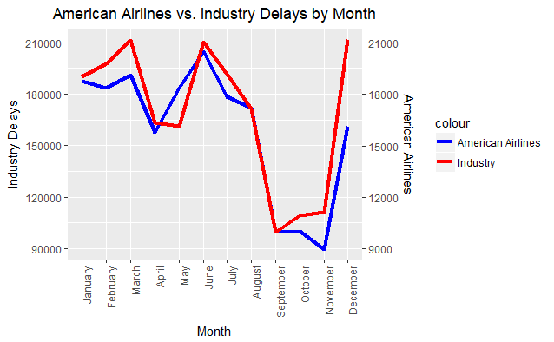
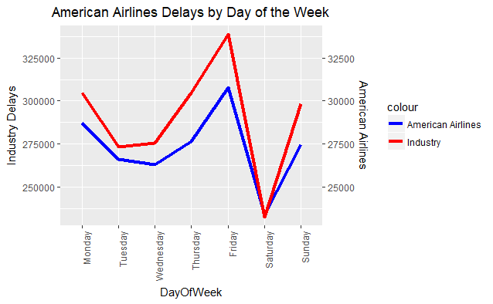
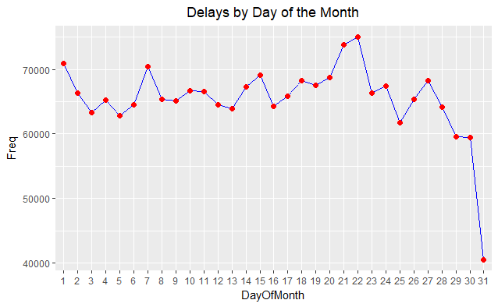
[ when do delays occur most frequently?]
Notes:
Speaker: TS
BY DAY OF THE WEEK:
Predictable pattern of delays occurring on Friday, Monday, and Sunday, which are three days that make sense for getting a lot of air traffic.
BY MONTH:
December is the month with the most delays, which was anticipated due to weather and holidays.
March and June were the next highest.
Trend shows that most of the delays occur during periods that are likely correlated with more overall flights
Each of these months is a month with a lot of holiday/vacation travel.
BY DAY OF THE MONTH:
Drop in the 31st because not all months have a 31st
21st and 22nd have the most delays --
But there is not an obvious trend or pattern based on this breakdown of data

Slide 10
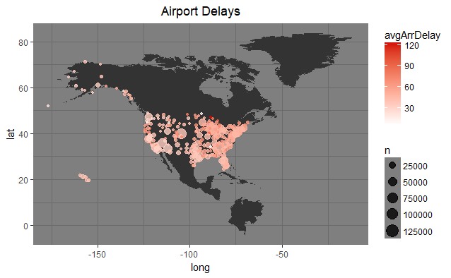
[ which airport experiences the most delays? ]
Arrival delays map by origin airport
Notes:
Speaker: Brandon

Slide 11
Industry Average
Worst Airports:
CMX (Hancock, MI)
PLN (Pellston, MI)
SPI (Springfield, Il)
MQT (Marquette, MI)
ALO (Waterloo, IO)
Best Airports:
TUP (Tupelo, MS)
INL (International Falls, MN)
SLE (Salem, OR)
WYS (West Yellowstone, MT)
ADK (Adak Island, AK)
Top 5 Worst & Best Airports
Notes:
Speaker: Brandon

Slide 12
American Airlines
Worst Airports:
GUC (Gunnison, CO)
HDN (Hayden, CO)
EGE (Vail, CO)
KOA (Kailua, HI)
JAC (Jackson, WY)
Best Airports:
OAK (Oakland, CA)
FAT (Fresno, CA)
BWI (Baltimore, MD)
CMH (Columbus, OH)
BUR (Burbank, CA)
Top 5 Worst & Best Airports
Notes:
Speaker: Brandon
Based on this analysis, there wasn’t too much overlap between the best and worst airports of American Airlines vs. Industry. However, this is still valuable information because we can dive into what the AA hubs at the BEST airports are doing differently than the WORST ones to find potential improvements.

Slide 13
[exploratory analysis]

Slide 14
[ what causes delays?]
Cause | Avg. Delay (min)
Carrier (Industry) | 19.18
Carrier (AA) | 21.34
Weather (Industry) | 3.70
Weather (AA) | 3.17
NAS (Industry) | 15.02
NAS (AA) | 16
Security (Industry) | 0.09
Security (AA) | 0.05
Late Arr (Industry) | 25.3
Late Arr (AA) | 25.21
The data set came with five predetermined causes:
Carrier delay
Weather delay
National Air Security delay
Security issue delay
Late arrivals delay
Notes:
Speaker: Michelle
Based on these averages, late arrivals is definitely the biggest contributor to other arrival delays -- it’s an endless circle.
So clearly, by alleviating late arrivals to begin with, we can nip our biggest issue in the bud.

Slide 15
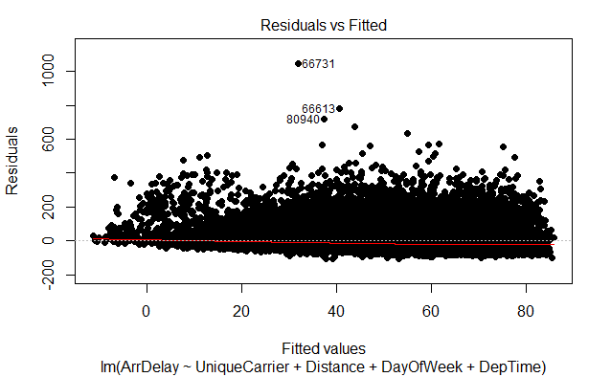
[ can we predict delays? ]
Based on our initial findings, we used these five variables in our multiple linear regression model to try to predict delays:
Unique Carrier
Departure Hour
Month
Distance
Weekend
We were unable to achieve a great R-squared in this model. An analysis of the residuals gives us some insight on why this is. We have such a large spread in residuals. It appears that there is a lot of inherent error in the model that makes predicting airline delays hard.
Notes:
Speaker: Brandon
American Airlines: Industry Average 1. UniqueCarrier - 42%
DepHour - 67% 2. DepHour - 39%
Month - 32% 3. Month - 16%
Distance - 0.5% 4. Distance - 2%
Weekend - 0.006% 5. Weekend - 0.02%

Slide 16
[takeaways]
IN CONCLUSION
We ultimately cannot predict delays or length of delays -- too many outlying factors
BUT WE DID LEARN
Southwest Airlines is the bee’s knees
Most flights and (one of the) least delays
Delays happen a lot on Friday
So plan your long weekends accordingly!
Factor in extra time when traveling in December
Notes:
Speaker: Brandon

Slide 17
Q & A
Easy questions only please

Slide 18
THE END
Thanks for flying with American Airlines!

