Slide 1
S&P GLOBAL & CRISIL CAMPUS HACKATHON 2026
SIGNAL TAPE · REPLAY WEEK
Foreshock
8.7
Central-bank surprise hike
-4.89%
9.1
Gulf shipping standoff
-0.67%
Unstructured news and social text in. Structured risk signals out, driving a tactical index rebalancer and an event-driven stress tester.
9.5
Regional bank failure
-1.62%
8.6
Category-4 hurricane
-0.53%
8.1
Payments ransomware
-0.27%
6.2
Unconfirmed rumour
held back
Chip = impact score (1-10). Right = stress P&L on an 85-position wholesale book. All data synthetic.
Nael Saade· ABV
AI/NLP Risk Engine · Module A: tactical rebalancer · Module B: strategic stress testing
Notes:
Hook: 'Headlines move markets faster than any desk can read them. Foreshock turns raw news and tweets into three numbers per item - sentiment, event class, impact - and then acts on them.' The panel on the right is the end result of the replay week: five scripted shocks, each auto-triggering a stress test, and one rumour the system deliberately did NOT act on. All data are synthetic and flagged as such.

Slide 2



Risk signals hide in unstructured text
The business problem
Approach: sense, score, act
Desks and risk teams cannot read thousands of headlines and posts an hour. They need a structured, trustworthy signal: how positive or negative it is, what kind of event it describes, and how big it could be.
Sense
Ingest news and social posts, drop reposts, link each item to an S&P-100 name or the broad market.
1
Volume and velocity
Score
News wires, GDELT-style feeds and social posts never stop.
Sentiment from −1 to +1, one of 12 event classes, impact 1–10, damped by source reliability and corroboration.
2
Noise and trust
Reposts and rumours must not move money; wire-confirmed facts should.
Act
3
Two time horizons
Module A rebalances a 20-stock index. Module B stress-tests an 85-position wholesale book.
Intraday tilts for an index; scenario stress for a wholesale book.
Foreshock · S&P Global & Crisil Campus Hackathon 2026
2
Notes:
Problem in my own words: the signal is in the text, but text is unstructured, voluminous and unreliable. Two requirements from the case: an AI/NLP engine producing sentiment, event class and impact; and at least one downstream module. I built both modules because they share the same engine and show two time horizons: tactical (intraday weights) and strategic (event-driven stress). The key design question was trust: a single tweet should not move money, a wire-confirmed story should.

Slide 3
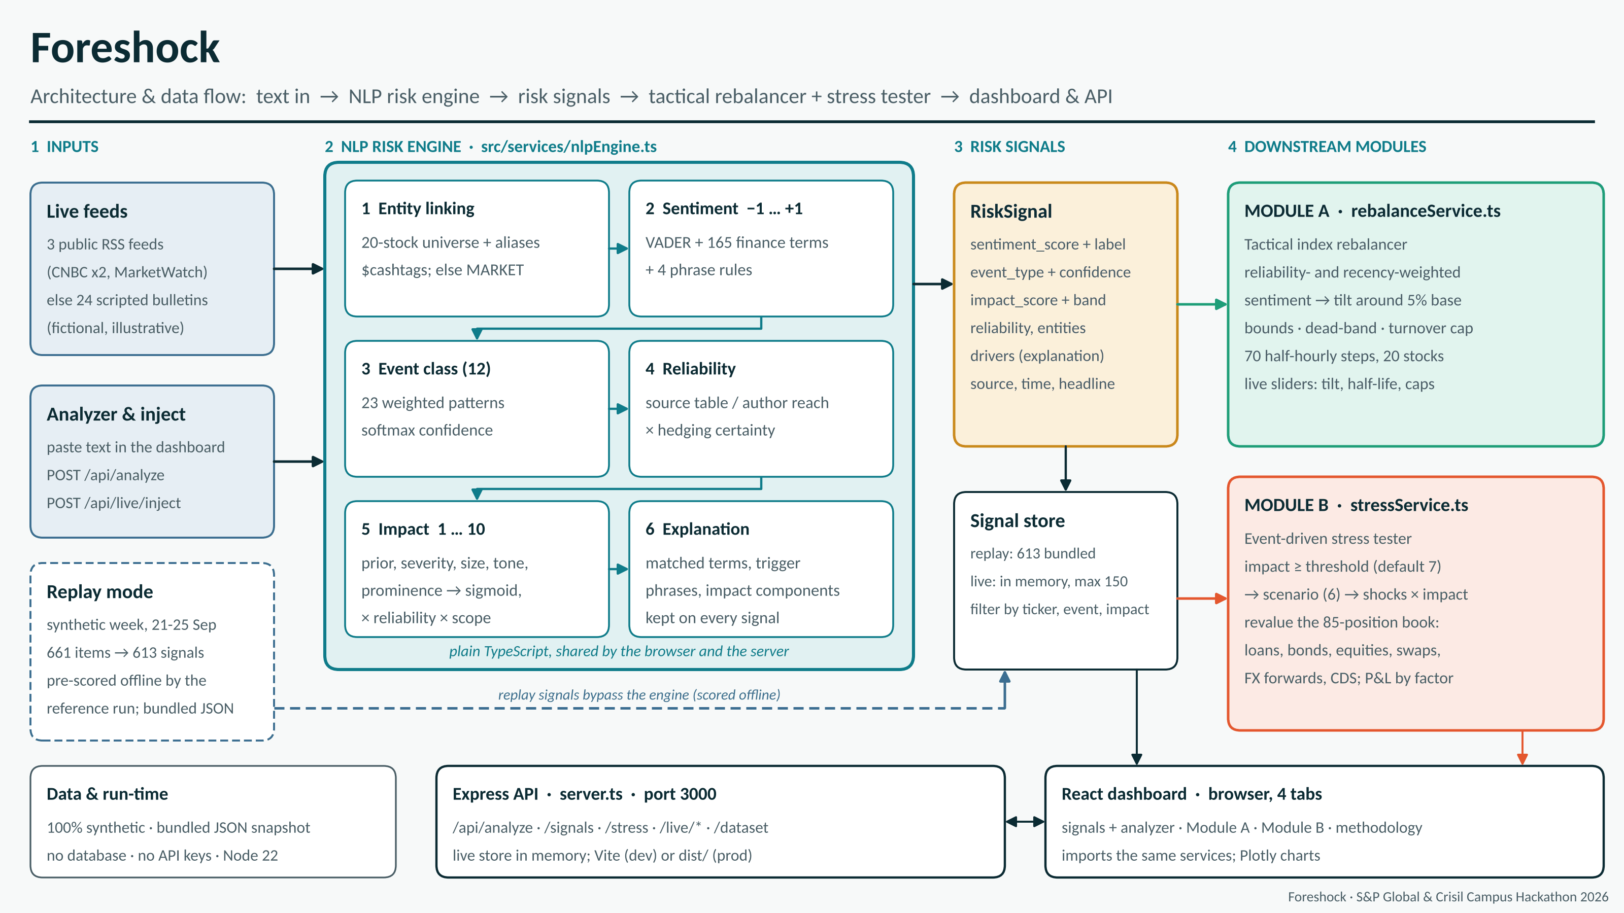
System design: one engine, two consumers
Foreshock · S&P Global & Crisil Campus Hackathon 2026
3
Notes:
Walk left to right. Sources feed connectors that normalise everything to one Document schema. The engine runs six stages: clean and de-duplicate, link entities, score sentiment, classify the event, estimate reliability, and finally impact. Its output is a typed RiskSignal published as JSONL/CSV and via a FastAPI service. Module A and Module B are independent consumers of that one contract. Everything is streaming-safe: a signal only uses information available at its timestamp, which is what makes the back-test honest. The detailed diagram is in docs/architecture.png.

Slide 4



Implementation highlights
CORE
MODULE A
MODULE B
AI/NLP Risk Engine
Tactical rebalancer
Strategic stress tester
VADER plus a finance lexicon, phrase and direction rules
12 event classes from weighted evidence, with confidence
Impact 1-10 from event prior, severity cues, size and prominence
Damped by source credibility, hedging and corroboration
Per-stock sentiment: decayed, shrunk, credibility-weighted
Tilt base weights, then bounds, dead-band and turnover cap
Market-wide bad news de-risks high-beta names
No look-ahead; every move traces to its headlines
Fires on impact above 7, adverse tone, mapped event class
Shocks scaled by impact: equity, rates, spreads, PD, FX
Revalues loans, bonds, equities, swaps, FX forwards, CDS
P&L attribution by risk factor reconciles exactly
≈1,400 items per second on one CPU core
83% less trading than a naive version
6 scenarios · 85 positions · 3 derivative types
Foreshock · S&P Global & Crisil Campus Hackathon 2026
4
Notes:
Three technical choices worth defending. 1) Lexicon-plus-rules NLP: transparent, millisecond-fast, auditable; FinBERT is a one-flag upgrade (--backend finbert) and the same interface. 2) Reliability weighting: impact is damped for single, hedged, low-reach sources and rises as independent outlets corroborate - that is how a rumour stays below the trigger. 3) Trade control in Module A: decay, shrinkage, dead-band and a turnover cap are what cut trading by about 83 percent versus naive sentiment weights. Module B uses simple, explainable sensitivities (duration, convexity, CS01, DV01, PD x LGD) so every number can be checked by hand - and there are tests that do exactly that.

Slide 5
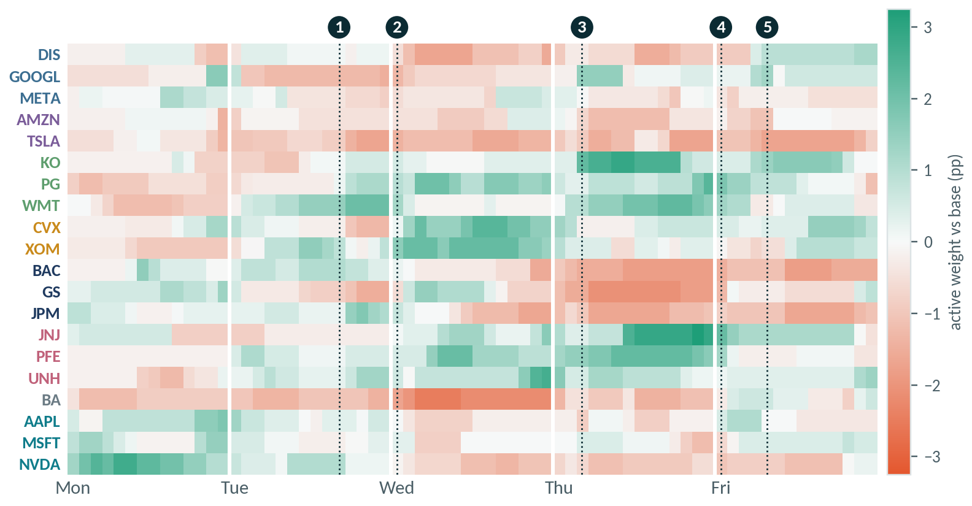
Key results: the engine and Module A
613
0.94
83%
signals from 661 news and social items in under 0.5 s; 48 reposts removed
event-class accuracy on a held-out set (n = 48). Sentiment 0.75 vs 0.65 for plain VADER; impact rank correlation 0.76
less trading than naive sentiment weights; cost drag 6.7 vs 38.1 bp over the week
Cumulative one-way turnover (%)
Foreshock
Naïve sentiment weights
Foreshock
Dotted lines = stress-test triggers: 1 rate hike · 2 Gulf standoff · 3 bank failure · 4 hurricane · 5 ransomware
Foreshock · S&P Global & Crisil Campus Hackathon 2026
5
Notes:
Left to right. 613 structured signals from 661 inputs at roughly 1,400 items per second on one CPU thread; the 48 dropped items are reposts and retweets. Held-out numbers come from a small hand-labelled set I split into dev and test; I tuned only on dev. Sentiment 0.75 beats plain VADER at 0.65; event classification is 0.94; the impact score ranks events well (rho 0.76) but is a heuristic - high-impact precision and recall are only about 0.5 on the held-out set, which is why Module B also requires adverse tone, a mapped event class and a cool-down. The heatmap is Module A over the week: NVDA overweight Monday, Boeing and Tesla underweight midweek, Exxon and Chevron overweight on the Gulf standoff, banks underweight after the bank failure. Turnover chart: the naive approach trades 763 percent of the book over the week, ours 133 percent.

Slide 6



Domain impact: from headline to P&L in minutes
Thursday, replayed
Stress loss per triggered event (% of book)
6.2
10:05 ET · one tweet
Unconfirmed claim of frozen withdrawals from a 412-follower account. Scored, but held below the trigger.
9.5
10:40 ET · wire confirms
Bankruptcy filing and deposit run reported; two more outlets follow within the hour. A Credit Event stress test fires.
−1.62%
Result on the wholesale book
Front office
Risk management
Model risk
−$44.6M: rates +32.4, spreads −30.1, credit losses −27.8, equity −19.0. Loan expected loss $21.8M → $49.6M.
Sentiment-aware index weights with 83% less turnover.
Event-triggered stress tests with factor attribution.
Every score ships with evidence, a version and tests.
Foreshock · S&P Global & Crisil Campus Hackathon 2026
6
Notes:
This is the story I would tell in the live demo. Thursday 10:05: one low-reach tweet claims a bank froze withdrawals. The engine scores it 6.2 - content is alarming, but reliability is low (follower count, hedged wording, no corroboration) - so no stress test fires. At 10:40 a wire reports the bankruptcy; impact is 9.5, a Credit Event stress test fires automatically and the book is revalued: about minus 45 million dollars, 1.6 percent. Note the attribution: falling rates cushion the book by 32 million, but spreads, credit losses and equity overwhelm it, and loan expected loss more than doubles. Why it matters: front office gets calmer, explainable weights; risk gets automatic, attributable stress tests; model-risk and compliance get evidence, versions and tests behind every number.

Slide 7

Limitations and next steps
What I would tell a sceptical risk manager
Next steps
Demo data are synthetic and scripted; prices are random, so no alpha is claimed.
Rule and lexicon NLP misses subtle language. Held-out set is small (n = 48) and self-labelled.
Impact is a calibrated heuristic: held-out high-impact precision and recall are about 0.5.
Stress shocks are illustrative sensitivities, linear in impact, not regulatory scenarios.
1
Calibrate impact with event studies on real returns instead of a hand-tuned scale.
2
Move from linear scaling to factor or historical-simulation shocks; add capital and liquidity metrics.
3
Stream with Kafka and add model governance: versioning, drift monitors, audit log.
Foreshock · S&P Global & Crisil Campus Hackathon 2026
7
Notes:
Be upfront about the limits - it builds credibility with a risk jury. The data are synthetic by design (free X API reads are gone and NewsAPI's free tier is delayed), so the numbers demonstrate mechanics, not market performance. The NLP is deliberately transparent; the evaluation set is small and I report only the held-out half. Impact is a heuristic; stress shocks are illustrative. Next steps are the standard path to production: learned models behind the same interfaces, calibration against real event studies, richer scenario design, and governance.

