Slide 1
Restaurant Review Analysis: Service Quality
Bernie Chen, Kai Snyder, Nahum Yared, Shreya Gundam, Skye Southall, Sunny Xiaohan Wang
Comp 488-003 Team 2
Notes:
sunny

Slide 2


Construct of Interest
Goal
Stakeholders
Create a synthetic expert to classify restaurant reviews based on the 5 service quality dimensions.
Restaurant owners
Customer service managers
Individuals looking to enter the restaurant or service industry
Identify most important service dimension a restaurant should focus on based on customer feedback.
Notes:
shreya

Slide 3





Assurance
Reliability
Trust in restaurant's ability to deliver a safe and enjoyable dining experience.
Consistency in delivering quality food and service.
5 Dimensions of
Service Quality
Tangibility
Responsiveness
Physical elements that represent the quality of service.
The promptness with which staff attend to customers.
Empathy
Personalized service and attentive interactions with customers.
Notes:
shreya

Slide 4
Overview Of Approach
Step 01
Step 02
Step 03
Data
Training
Model Validation
Google Maps Scraper on Apify to gather ~8000 restaurant reviews across several cities in the United States. Ex:
Cary, NC
Chicago, IL
New York, NY
Develop script for GPT- 3.5-Turbo classification of restaurant reviews into 5 different service dimensions
Hand-label >500 reviews for amateur labeling referencing
Compare results of GPT-3.5-Turbo labeling with amateur labels
Train synthetic expert on GPT labels
Compare synthetic expert label results with validation set labeled by GPT
Notes:
sunny

Slide 5



Key Assumptions
Closed Stores
Validation Labelling
Review Authenticity
Customer sentiment at closed stores are unmeaningful in the context of the post-COVID hospitality space
Manual labelling of samples is unbiased and reviews are perceived similarly among group members
Each review accurately reflects the opinion of a real customer (i.e., no spam or paid reviews)
Notes:
kai

Slide 6
Example Reviews
Reliability
Empathy
Tangibility
“It’s always consistent. Great food and drinks. Been going here since they first opened! Still a great time!”
- John, Atlanta
“Our server was awesome and provided thoughtful recommendations. We requested a change of table twice, and the staff was very accommodating.”
- Betty, New Orleans
“The menu quotes are funny, good way to pass the time it took to get our food. Cool name and plenty of seating.”
- Audrey, Chicago
Notes:
kai

Slide 7


Training Data Preparation
Data Removal
Emojis
Non-English reviews
Line breaks
Leading periods and colons
Leading, trailing, and duplicate spaces
URLs replaced with “URL”
Empty Reviews
GPT Labelling
Used GPT 3.5-Turbo instead of 4.0
Time and Usage Model Cost
GPT 4.0 had marginally better accuracy for labeling
GPT 3.5 labeling accuracy (compared to manual):
Reliability: 90.87%
Assurance: 89.48%
Responsiveness: 89.29%
Tangibility: 69.44%
Empathy: 82.54%
Notes:
bernie

Slide 8
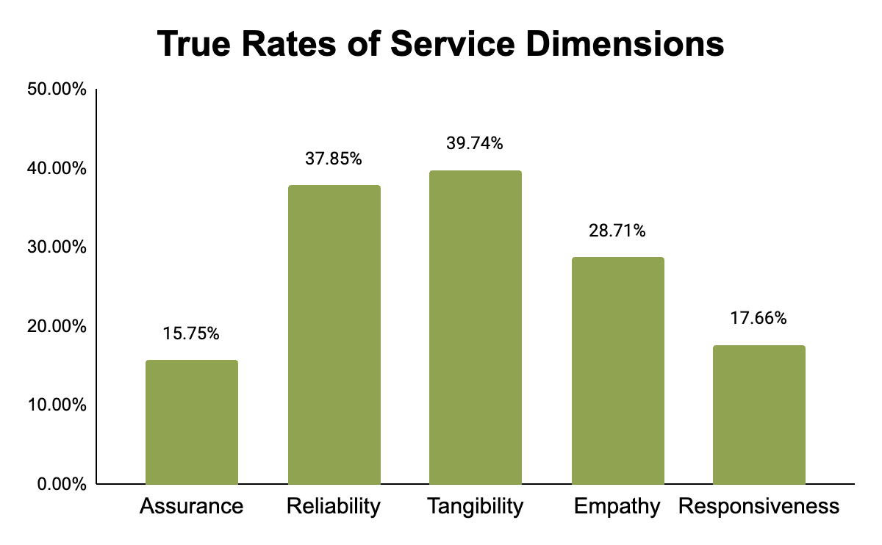
Training Dataset Findings
Total Reviews: 6586
Assurance:
False: 5549
True: 1037
Reliability:
False: 4093
True: 2493
Tangibility:
False: 3969
True: 2617
Empathy:
False: 4695
True: 1891
Responsiveness:
False: 5423
True: 1163
Notes:
nahum

Slide 9
Model Specifics
Type
HyperParams
Train-Test
Testing Accuracy
Validation
DistilRoBERTa
-base
Case Sensitive
Text Classification
Question Answering
num_train_epochs:
3
warmup_steps:
500
threshold:
0.50
Training split:
80%
Testing split:
20%
Precision: 0.706
Recall: 0.544
F1: 0.614
AUC: 0.851
Precision: 0.318
Recall: 0.251
F1: 0.281
AUC: 0.631
Notes:
nahum

Slide 10
Limitations
Accuracy
Consistency
GPT Labeled Training Set
Amateur labeling conducted by our team
Training Data
Overfitting
Relatively Limited Training Dataset (~6000 reviews after cleaning)
Sentiment lost by grouping negative and positive reviews together
Notes:
skye

Slide 11



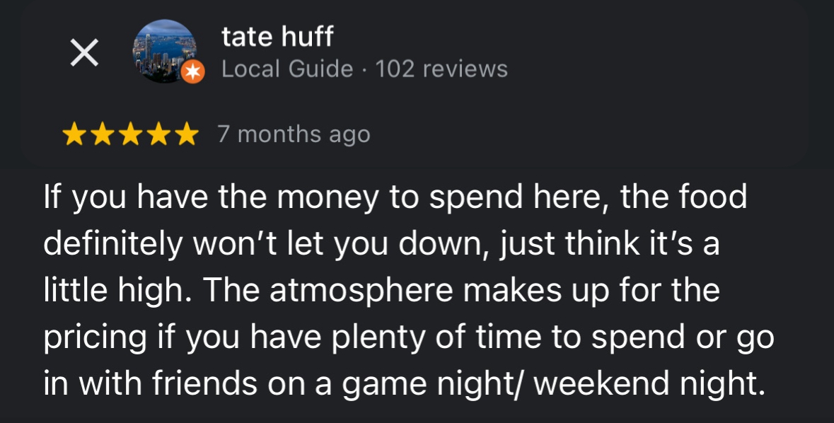
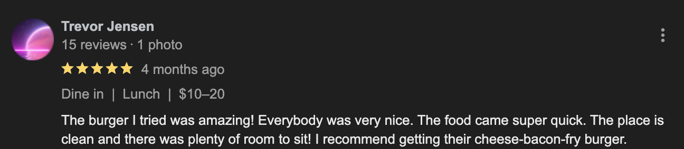
Business Applications
Team Choice: Reliability
Model Prediction: Reliability, Empathy
Team Choice: Reliability, Responsiveness
Model Prediction: Reliability, Responsiveness
Customers of Sup Dogs prioritize Tangibility and Reliability
Team Choice: Tangibility
Model Prediction: Tangibility
Team Choice: Reliability
Model Prediction: Tangibility
Notes:
bernie
Didn’t give me the proper order and said they can’t help me out the next business day, ['Reliability', 'Responsiveness']
“Great service, very tasty food. We tried the boneless wings and a variety of hot dogs. The veggie dog got thumbs up, and the chili was great. Tots were fried to crispy perfection.” ['Reliability', 'Empathy']
Team Choice: Reliability
Model Prediction: [‘Tangibility’]
The atmosphere makes up for the pricing if you have plenty of time to spend or go in with friends on a game night/ weekend night.

Slide 12
References/Sources
Thank you!
Daniel M. Ringel, Creating Synthetic Experts with Generative Artificial Intelligence (December 11, 2023)
Available at SSRN: https://papers.ssrn.com/abstract_id=4542949
Service Performance: Definitions of 5 Service Dimensions
https://www.serviceperformance.com/the-5-service-dimensions-all-customers-care-about/
Apify Scraper
https://apify.com/compass/crawler-google-places

