Slide 1
FEATURE BASED PANORAMIC IMAGE GENERATION

Slide 2
PROJECT
Paper: Brown and Lowe’s Recognizing Panoramas
Goal: Creation of panoramic images from multiple images by using matching features.
Code Environment: OpenCV 3.2 on Python 3

Slide 3
STEPS
Detect interest points.
Compute features.
Match points.
Create a homography matrix.
Do projective transformation.
Stitch images.
Input
Output

Slide 4
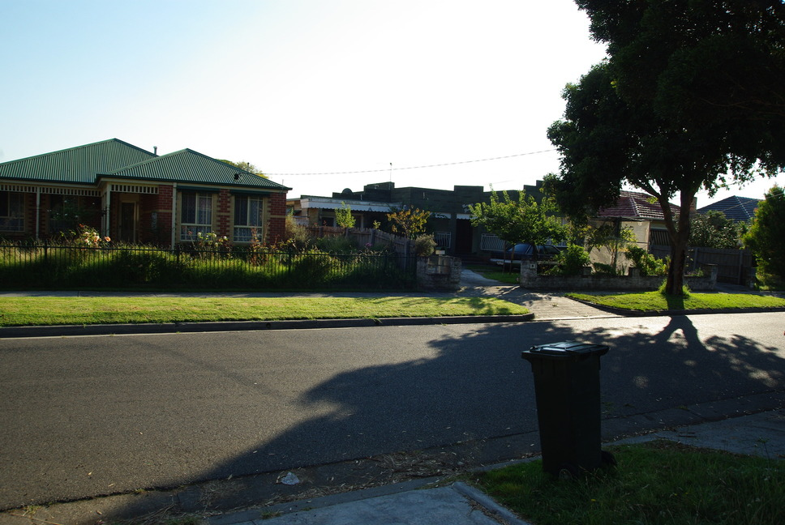
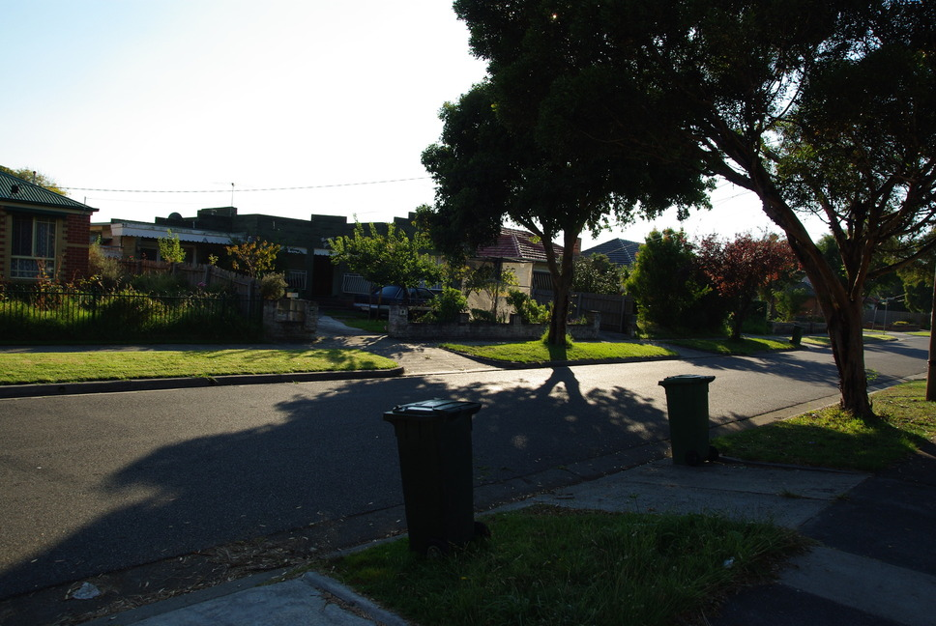
INPUT

Slide 5
INTEREST POINTS & FEATURES
Scale Invariant Feature Transform (SIFT)
Find Scale-Space Extrema
Keypoint Localization & Filtering
Orientation Assignment
Create descriptor
OpenCV: xfeatures2d.SIFT_create() -> .detect() & .compute()
Notes:
Difference of Gradients -> Application of LoG pyramids different pyramids at different levels.
Hassian detector

Slide 6
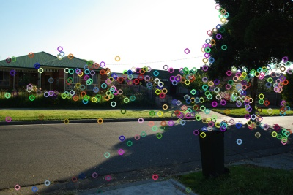
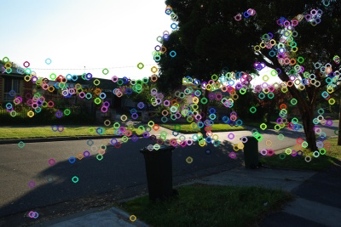
DETECTED INTEREST POINTS

Slide 7
MATCHING
Define distance function that compares two descriptors.
Two alternatives:
Fast Library for Approximate Nearest Neighbors (FLANN) - Faster
Brute Force
Test all the features in the other image, find the one with min distance.
Distance ratio test.
OpenCV: DescriptorMatcher_create() -> .knnMatch()
Notes:
BFMatcher is going to try all the possibilities (which is the meaning of "Brute Force" and hence it will find the best matches.
FLANN, meaning "Fast Library for Approximate Nearest Neighbors", will be much faster but will find an approximate nearest neighbors. It will find a good matching, but not necessarily the best possible one.

Slide 8
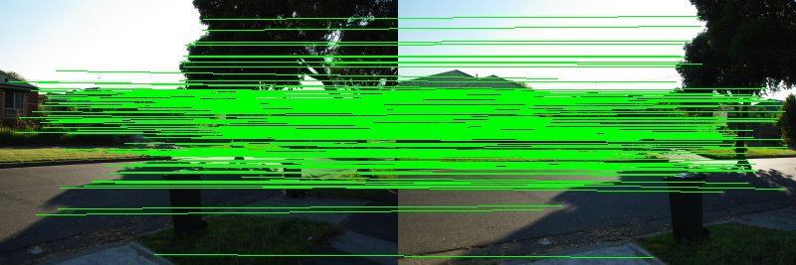
MATCHES

Slide 9
HOMOGRAPHY MATRIX
RANSAC Algorithm
Select randomly the minimum number of points required to determine the model parameters.
Solve for the parameters of the model.
Determine how many points from the set of all points fit with a predefined tolerance.
If the fraction of the number of inliers over the total number points in the set exceeds a predefined threshold τ , re-estimate the model parameters using all the identified inliers and terminate.
Otherwise, repeat steps 1 through 4 (maximum of N times).
OpenCV: findHomography()
Notes:
As you know, with homography matrices we are able transform images into desired forms. Here, we user RANSAC method to calculate homography matrix.

Slide 10
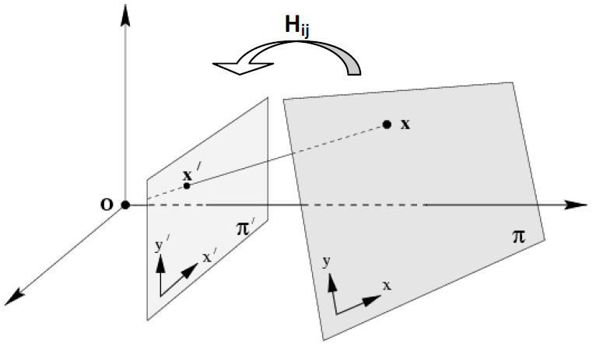
PROJECTIVE TRANSFORMATION
OpenCV: warpPerspective()

Slide 11
STITCH IMAGES
Simple matrix operations.

Slide 12
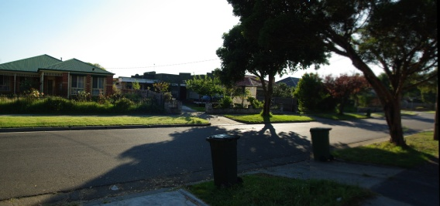
OUTPUT

Slide 13
LIMITATIONS
Input images must be given in certain order.
Best results for same focal lengths.
The longer the execution time, the more images.

