Slide 1
Escaping Big Tech – Cybersecurity and phone services

Slide 2
Door Prize – Don’t Let Us Forget!!!!
Faraday phone sleeve door prize!

Slide 3
First, some things to remember!!!
Principle One: This is a moving target
  What we know today may well be different tomorrow. We can almost count on it.

Slide 4
First, some things to remember!!!
Principle Two: NO ONE knows everything about this
  We must all rely on one another, and check each other. Regularly.

Slide 5
First, some things to remember!!!
Principle Three: No one is doing this perfectly
  It would require too much of a normal, otherwise productive person’s time.
  Therefore, don’t get frustrated in the process! Work on continually improving & managing your frustration.

Slide 6
First, some things to remember!!!
Principle Four: Sometimes we will have to consider paying for services that we’ve previously received for “free”
  We have gotten used to using products without having to pay money. This has proven to be costly—for our privacy and our ability to communicate freely.
  When something is free, you are the product (few exceptions).

Slide 7
First, some things to remember!!!
Principle Five: We may need to learn more about the technical side of communicating online
  Big Tech has designed their services to keep us from having to know more.

Slide 8
First, some things to remember!!!
Principle Six: We may need to work more to make this happen
  Some things that Big Tech have made easy for us we may need to do more hands on to accomplish.

Slide 9
Updates!!!
ProtonMail
"You know you’re over the target when you start catching flak..."

Slide 10
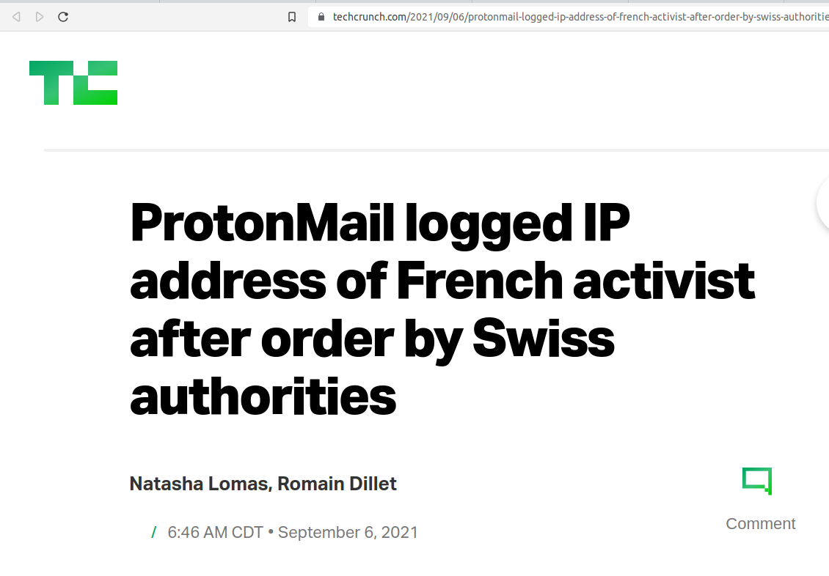
Updates!!!

Slide 11
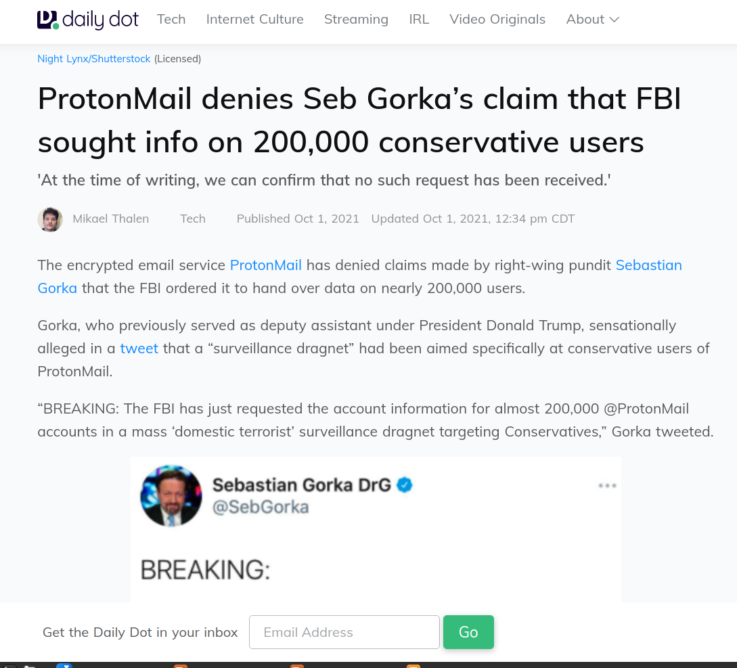
Updates!!!

Slide 12
Updates!!!
Gunbroker app
Removed from Apple App Store, Google Play Store

Slide 13
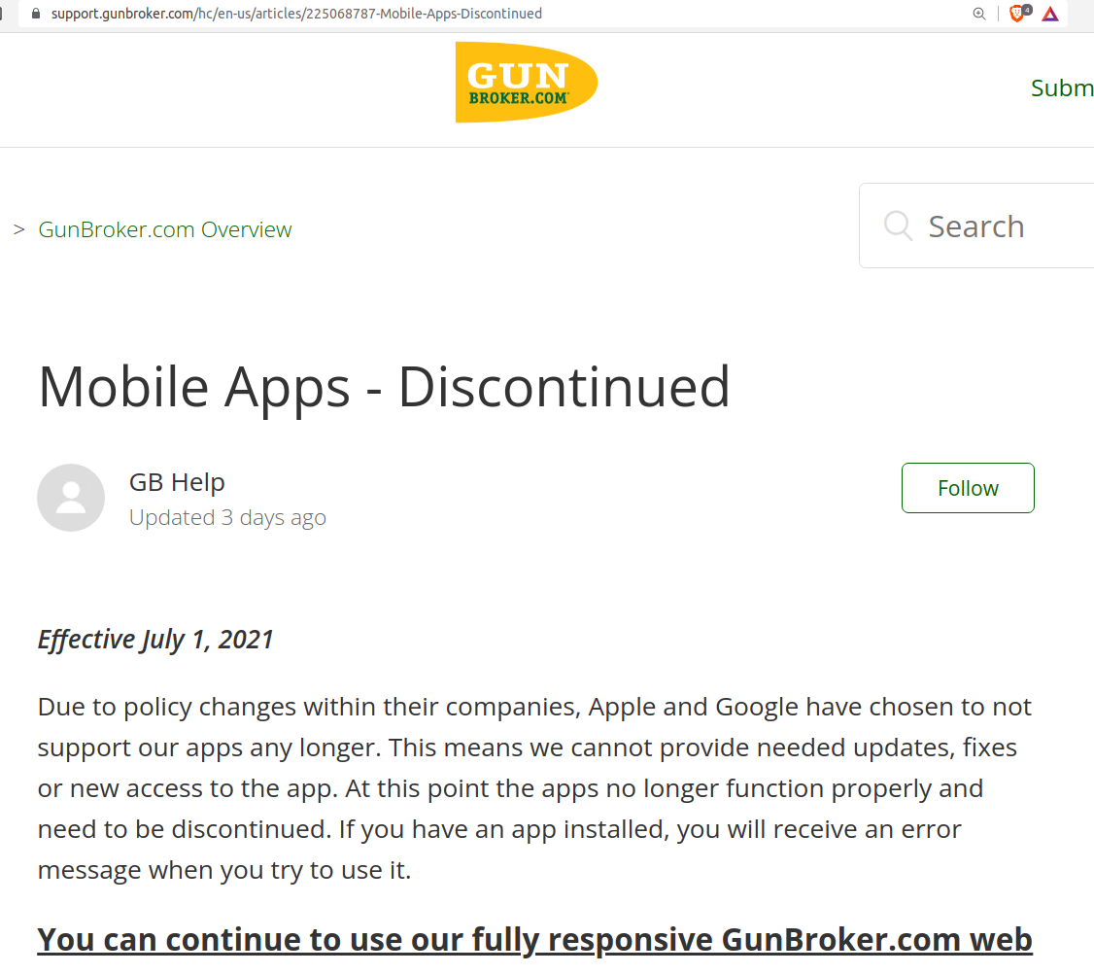
Updates!!!

Slide 14
Updates!!!
DuckDuckGo
Another reason to avoid?

Slide 15
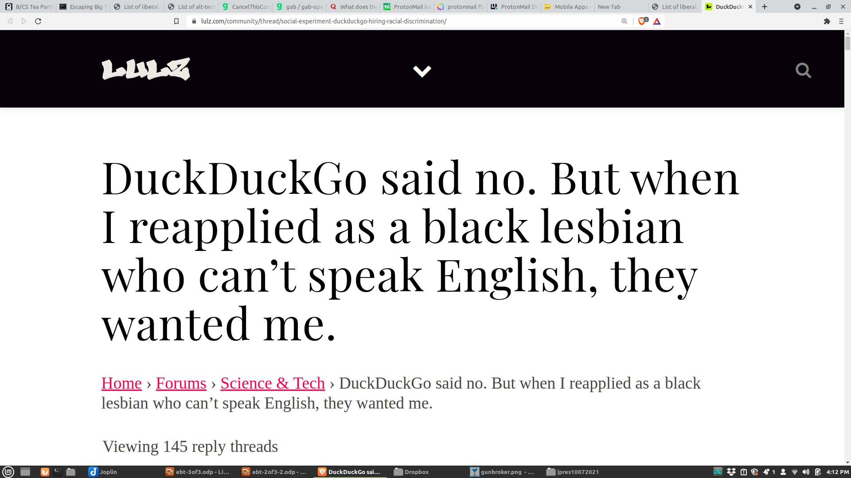
Updates!!!

Slide 16
Cyber Security
We have all heard about Randsomware attacks recently.
  Colonial Pipeline($4.4M), Steamship Authority of Massachusetts, JBS (the world’s largest meatpacker)($11M), and the Washington DC Metropolitan Police Department
  So far, in 2021, over $45M has been paid out to hackers using Randsomware.

Slide 17
Cyber Security
KnowBe4 has been used by the City Of Bryan for many years
The Cybersecurity training program is being used as an example for the State of Texas.
Many cities in Texas have copied the City Of Bryan model for Cybersecurity training.

Slide 18
Virtual Private Network (VPN)
A VPN encrypts your data and routes the traffic through a server in another location.
Your Internet Provider doesn’t see what you are looking at online.
Recommendation:
  PIA VPN

Slide 19
Virtual Private Network (VPN)
PIA VPN
  Cost Effective ($2.99-4.99/month billed annually)
  User Friendly
  Lots of options for where to route traffic and they are all pretty reliable servers.

Slide 20
Password Managers
Stores passwords for an unlimited number of websites. Making it easier to remember 1 password then letting the manager remember the passwords for the sites for you.
Recommendation: 1 Password
  Only PM not hacked (yet)
  Cost effective (between $2-$10/month)
  User Friendly

Slide 21
Password Makers
Dice ware
  Diceware.demuth.org
  Passphrases, not passwords
  Example:
    TheQuickBrownFoxon07Oct21!

Slide 22
Phone Service Providers
AT&T, Verizon, etc. all give to “charities” like Planned Parenthood and La Rasa.
They give the excuse that they are matching employee donations. Seriously?
Recommendations: PuretalkUSA, Patriot Mobile

Slide 23
Phone Service Providers
PureTalk USA
  Reasonable rates ($55/month for unlimited everything) discounts for military/multiple lines/etc.
  Same coverage as AT&T since they use AT&T towers
    This still gets money to AT&T, but cuts the amount.

Slide 24
Phone Service Providers
Patriot Mobile
  Same rates as PureTalk USA
  Uses Sprint CDMA systems, less coverage than PureTalk USA
  They donate to any charity you select, but Planned Parenthood is not an option.

Slide 25
PART 5: Phones
1. Flip phones (“dumb” phones)

Slide 26
PART 5: Phones
1. Flip phones
2. Monthly, disposable phones

Slide 27
PART 5: Phones
1. Flip phones
2. Monthly, disposable phones
3. De-googled Android phones
Notes:
https://source.android.com/
https://lineageos.org/ (only Pixel phones!)
/e/

Slide 28
PART 5: Phones
De-googled Android phones
- Brax.me phone
- Freedom Phone
- /e/OS Phone
- make your own
Notes:
https://source.android.com/
https://lineageos.org/ (only Pixel phones!)
GrapheneOS
/e/OS https://esolutions.shop/shop/e-os-teracube-2e/
PureOS https://puri.sm/products/librem-5-usa/

Slide 29
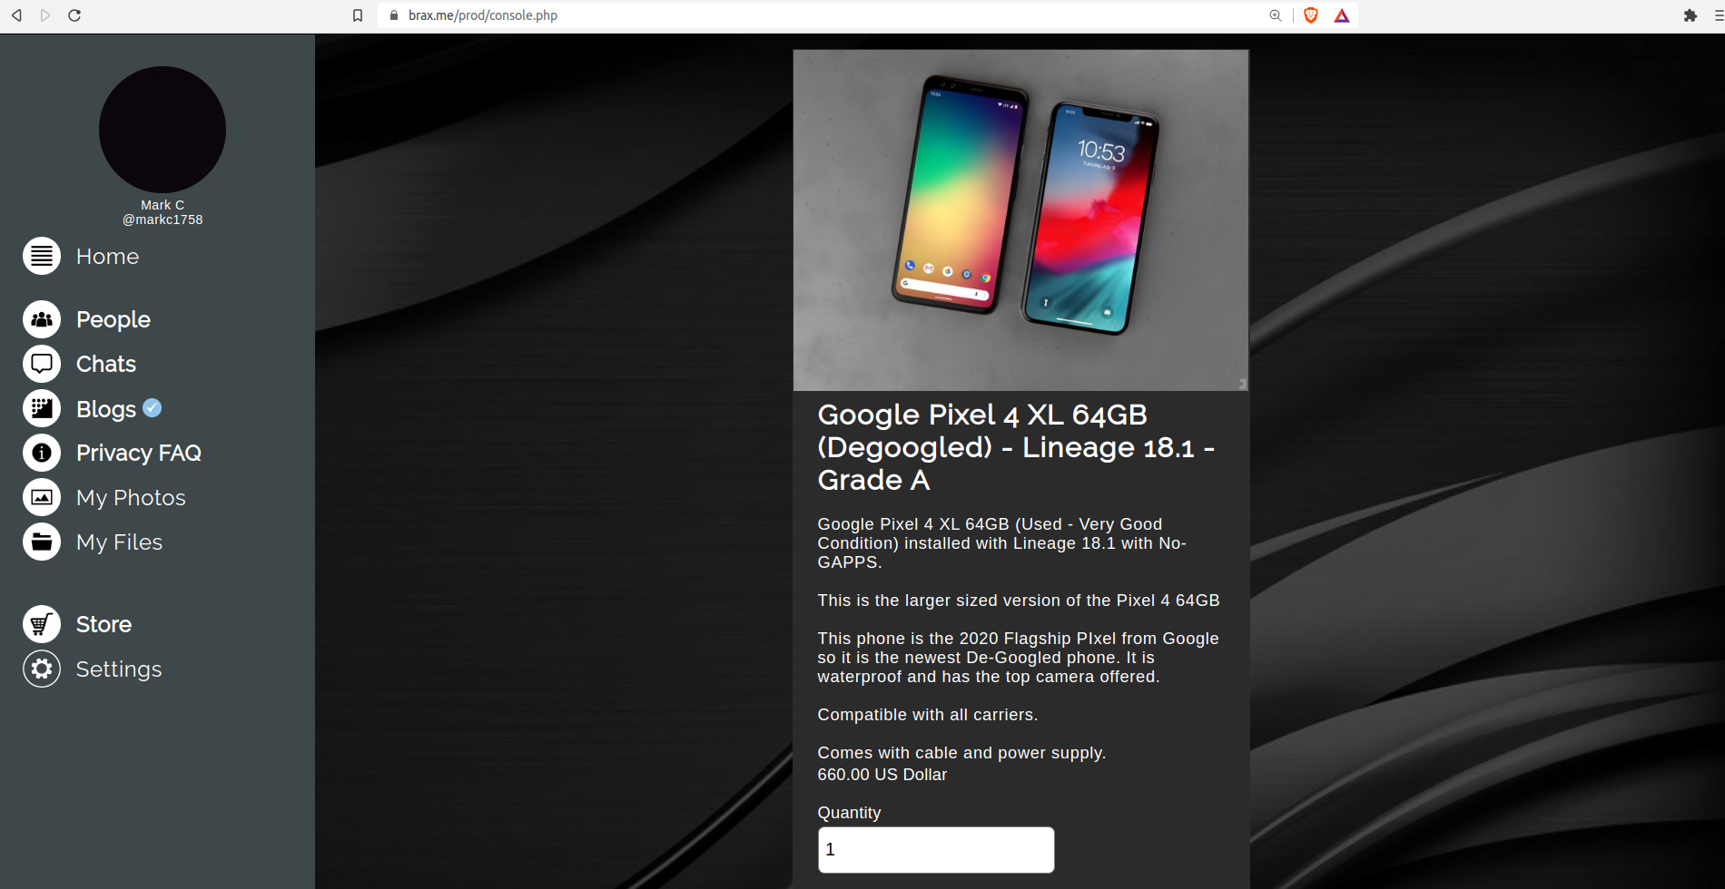
Notes:
https://source.android.com/
https://lineageos.org/ (only Pixel phones!)
GrapheneOS
/e/OS https://esolutions.shop/shop/e-os-teracube-2e/
PureOS https://puri.sm/products/librem-5-usa/

Slide 30
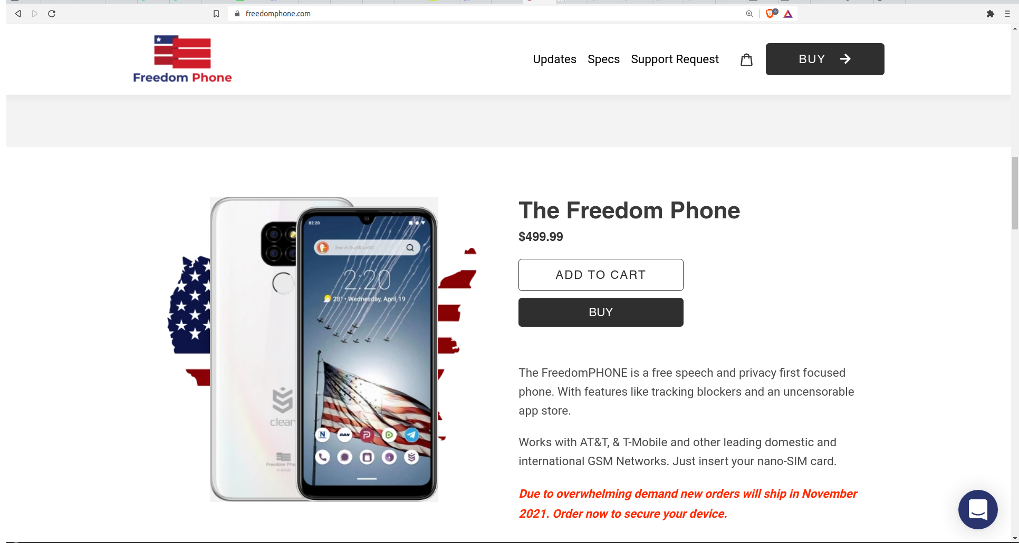
Notes:
https://source.android.com/
https://lineageos.org/ (only Pixel phones!)
GrapheneOS
/e/OS https://esolutions.shop/shop/e-os-teracube-2e/
PureOS https://puri.sm/products/librem-5-usa/

Slide 31
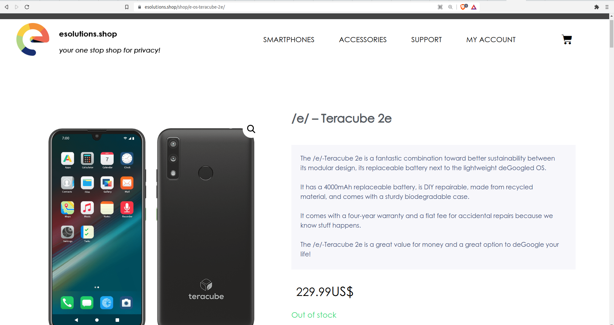
Notes:
https://source.android.com/
https://lineageos.org/ (only Pixel phones!)
GrapheneOS
/e/OS https://esolutions.shop/shop/e-os-teracube-2e/
PureOS https://puri.sm/products/librem-5-usa/

Slide 32
PART 5: Phones
1. Flip phones
2. Monthly, disposable phones
3. De-googled Android phones
4. Linux phones

Slide 33
PART 5: Phones
Linux phones (non-AOSP)
- PinePhone ($200)
- Librem 5 USA (made in U.S., $2000)
- “8 Best Linux Phones for Privacy and Security” - link
Notes:
PinePhone https://www.pine64.org/pinephone/
PureOS https://puri.sm/products/librem-5-usa/

Slide 34
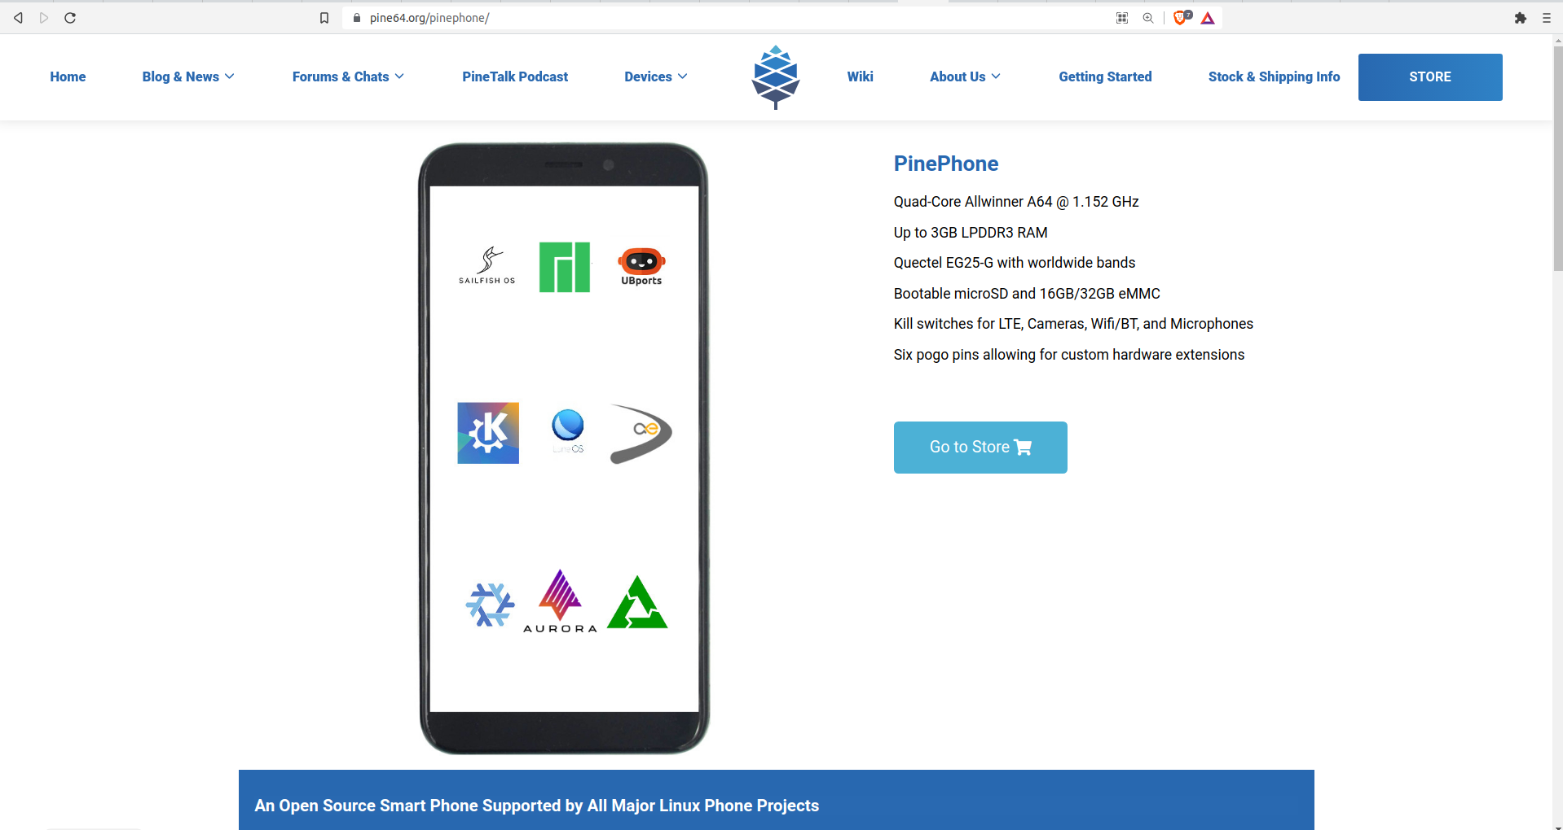
Notes:
PinePhone https://www.pine64.org/pinephone/
PureOS https://puri.sm/products/librem-5-usa/

Slide 35
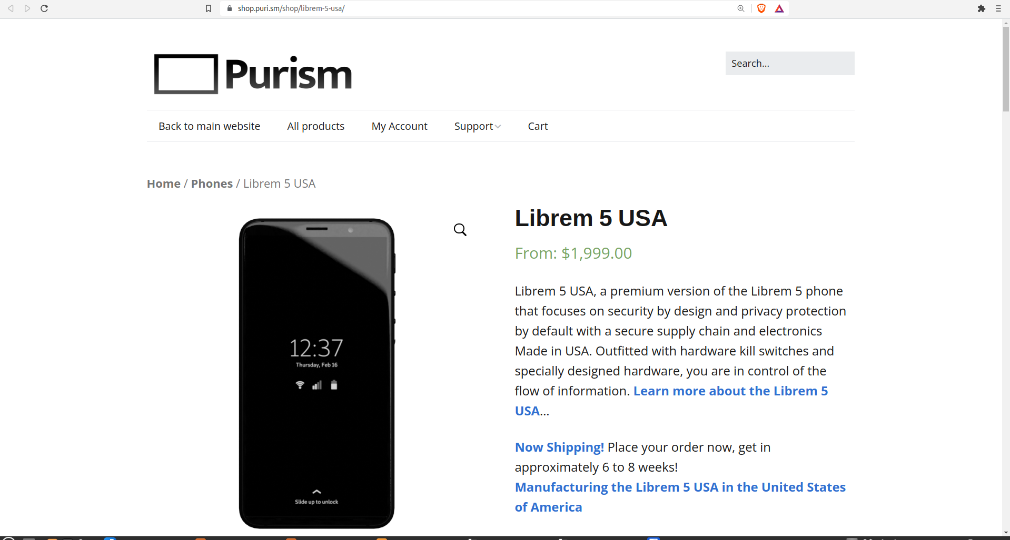
Notes:
PinePhone https://www.pine64.org/pinephone/
PureOS https://puri.sm/products/librem-5-usa/

Slide 36
PART 5: Phones
1. Flip phones
2. Monthly, disposable phones
3. De-googled Android phones
4. Linux phones
5. Punkt phone
Notes:
https://www.pcmag.com/reviews/punkt-mp02
https://www.punkt.ch/en/products/mp02-4g-mobile-phone/

Slide 37
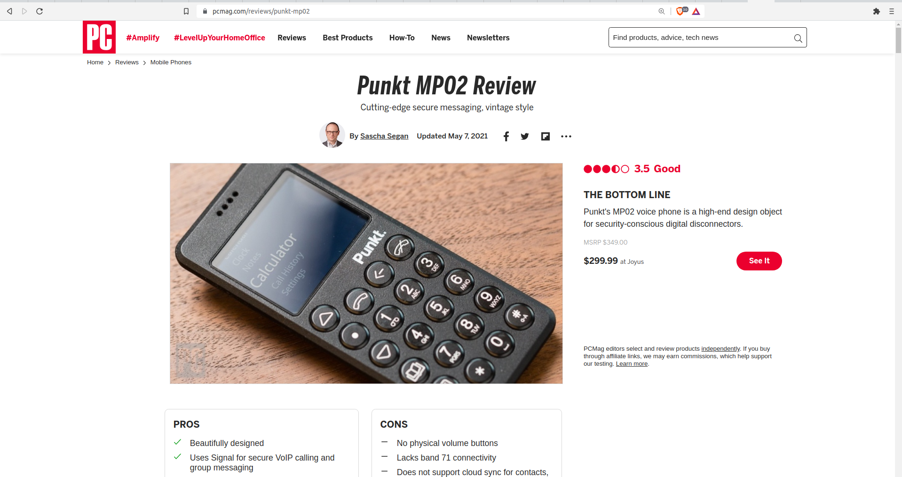

Slide 38
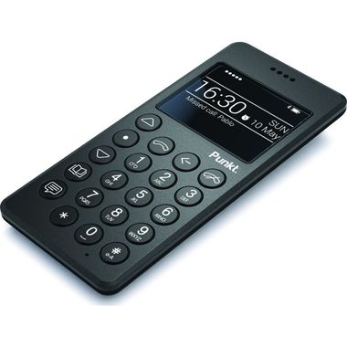

Slide 39
PART 5: Phones
What gets shut down when?
Notes:
https://www.pcmag.com/news/cdma-vs-gsm-whats-the-difference

Slide 40
PART 5: Phones
What gets shut down when?
AT&T has already shut down its 2G GSM network and most recently said it will shut down 3G GSM/UMTS in February 2022.
T-Mobile will shut down 3G GSM/UMTS in April 2022 and will shut down 2G GSM in December 2022.
T-Mobile will shut down the 3G CDMA network used by some Sprint and Boost customers on January 1, 2022.
Verizon will shut down its 3G CDMA network on December 31, 2022.
Notes:
https://www.pcmag.com/news/cdma-vs-gsm-whats-the-difference
In the US, Verizon, US Cellular, and the old Sprint network (now owned by T-Mobile) use CDMA. AT&T and T-Mobile use GSM.

Slide 41
Escaping Big Tech meeting 3 of 3
Faraday phone sleeve door prize!

Slide 42
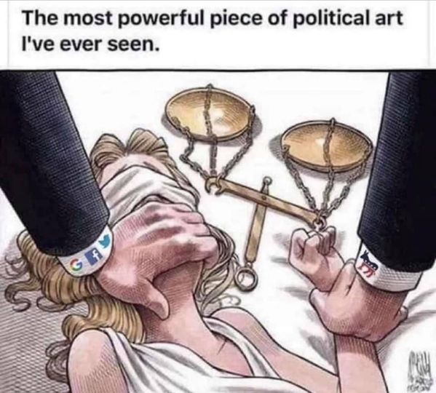
Notes:
https://www.pcmag.com/reviews/punkt-mp02
https://www.punkt.ch/en/products/mp02-4g-mobile-phone/

Slide 43
Questions?
bcsteaparty.com/escaping-big-tech

