Slide 1
Escaping Big Tech meeting 2 of 3

Slide 2
Escaping Big Tech meeting 2 of 3
1. Recap and definitions

Slide 3
Escaping Big Tech meeting 2 of 3
1. Recap and definitions
2. Social Media alternatives

Slide 4
Escaping Big Tech meeting 2 of 3
1. Recap and definitions
2. Social Media alternatives
3. Amazon and other online alternatives

Slide 5
Escaping Big Tech meeting 2 of 3
1. Recap and definitions
2. Social Media alternatives
3. Amazon and other online alternatives
4. How to keep up!

Slide 6
Escaping Big Tech meeting 2 of 3
1. Recap and definitions
2. Social Media alternatives
3. Amazon and other online alternatives
4. How to keep up!
5. Next meeting info

Slide 7
PART 1: Recap
Definitions and Demonstrations:
- “browser”

Slide 8
PART 1: Recap
Definitions and Demonstrations:
- “browser”
- “search engine”

Slide 9
PART 1: Recap
Definitions and Demonstrations:
- “browser”
- “search engine”
- “the cloud”

Slide 10
PART 1: Recap
Definitions and Demonstrations:
- “browser”
- “search engine”
- “the cloud”
- “email client”

Slide 11
PART 1: Recap
Updates from last meeting:

Slide 12
PART 1: Recap
Updates from last meeting:
- Google drive/One Drive alternatives

Slide 13
PART 1: Recap
Updates from last meeting:
- Google drive/One Drive alternatives
- Skiff update

Slide 14
PART 1: Recap
Updates from last meeting:
- Google drive/One Drive alternatives
- Skiff update
- Proton Calendar app for Android (beta)

Slide 15
PART 1: Recap
Updates from last meeting:
- Google drive/One Drive alternatives
- Skiff update
- Proton Calendar app for Android (beta)
- aggienetwork.com Google Drive 10 GB limit

Slide 16
PART 1: Recap
Walk the walk report:

Slide 17
PART 1: Recap
Walk the walk report:
- Garmin GPS, purchased at abt.com

Slide 18
PART 1: Recap
Walk the walk report:
- Garmin GPS, purchased at abt.com
- De-googled Android phone, from Brax.me

Slide 19
PART 1: Recap
Walk the walk report:
- Garmin GPS, purchased at abt.com
- De-googled Android phone, from Brax.me
- B/CS TP Mailchimp replacement still...pending

Slide 20
PART 2: Social Media alternatives
Facebook alternatives

Slide 21
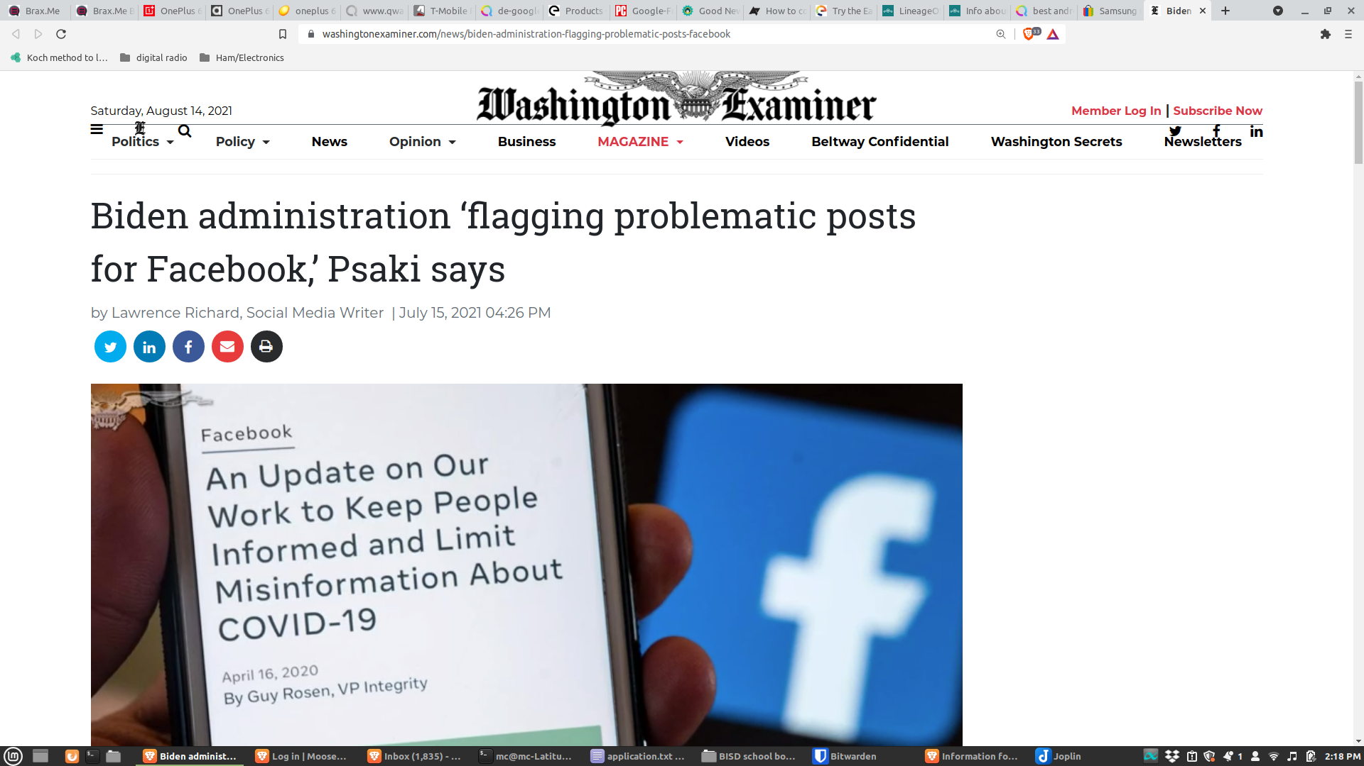

Slide 22


Slide 23
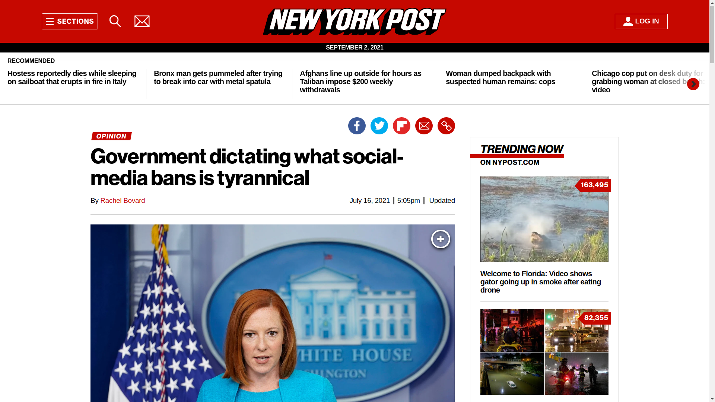
Notes:
https://nypost.com/2021/07/16/government-dictating-what-social-media-bans-is-tyrannical/

Slide 24
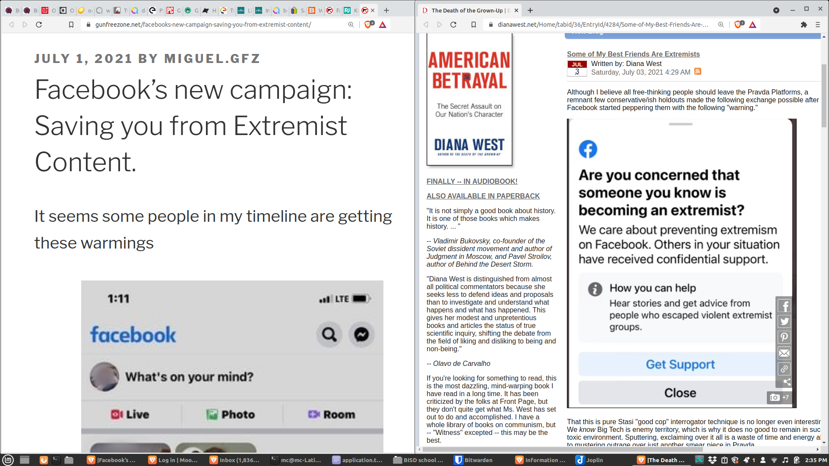

Slide 25
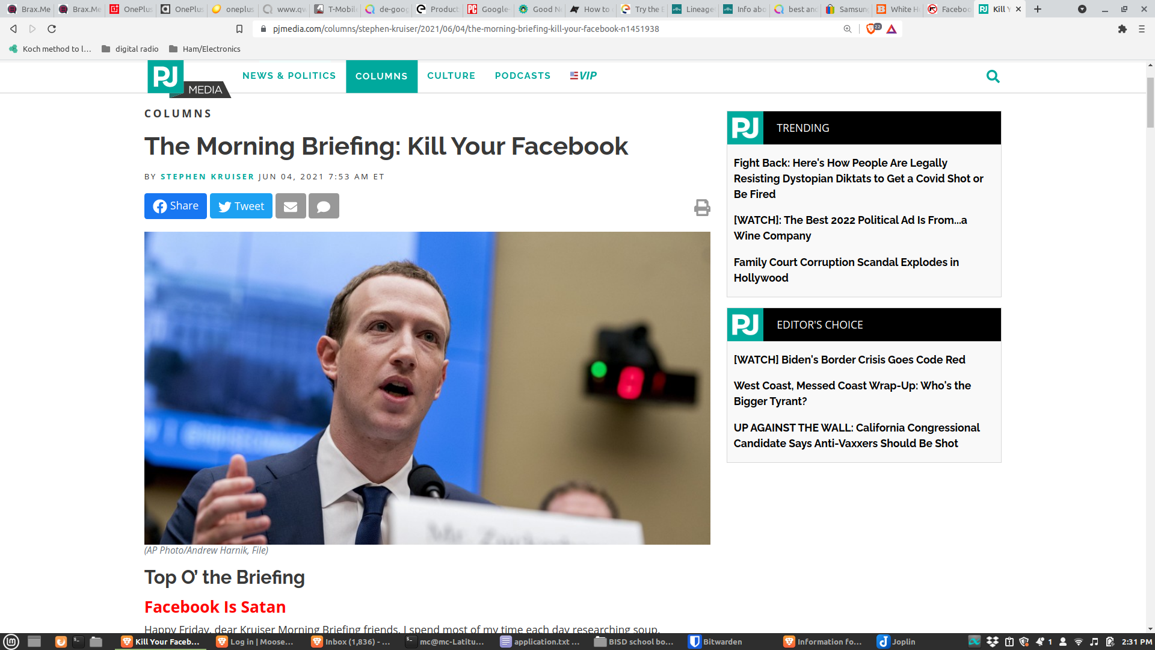

Slide 26
PART 2: Social Media alternatives
Facebook alternatives
The problems with Facebook competitors….

Slide 27
PART 2: Social Media alternatives
Facebook alternatives
- MeWe?

Slide 28
PART 2: Social Media alternatives
Facebook alternatives
- MeWe
- Brax.me?

Slide 29
PART 2: Social Media alternatives
Facebook alternatives
- MeWe
- Brax.me
- Minds?

Slide 30
PART 2: Social Media alternatives
“Minds is the anti-Facebook that pays you for your time.”
— Wired
“Minds is a neutral public platform. Our research-based approach in handling misinformation and other types of controversial lawful content is to facilitate civil discourse through free speech, which is the only way to change someone’s mind. It is your choice to engage with someone, keep scrolling, report or block.”

Slide 31
PART 2: Social Media alternatives
Twitter alternatives

Slide 32
PART 2: Social Media alternatives
Twitter alternatives
- Parler?

Slide 33
PART 2: Social Media alternatives
Twitter alternatives
- Parler
- Gab?

Slide 34
PART 2: Social Media alternatives
Twitter alternatives
- Parler
- Gab
- GETTR?

Slide 35
PART 2: Social Media alternatives
Texting (calling?) alternatives

Slide 36
PART 2: Social Media alternatives
Texting (calling?) alternatives
  Standard SMS texts are not secure

Slide 37
PART 2: Social Media alternatives
Texting (calling?) alternatives

Slide 38
PART 2: Social Media alternatives
Texting (calling?) alternatives
- Session?

Slide 39
PART 2: Social Media alternatives
Texting (calling?) alternatives
- Session
- Signal?

Slide 40
PART 2: Social Media alternatives
Texting (calling?) alternatives
- Session
- Signal
- Telegram?

Slide 41
PART 2: Social Media alternatives
Texting (calling?) alternatives
- Session
- Signal
- Telegram
- Wire?

Slide 42
PART 2: Social Media alternatives
YouTube alternatives

Slide 43
PART 2: Social Media alternatives
YouTube alternatives…
...and an workaround!

Slide 44
PART 2: Social Media alternatives
YouTube alternatives
- Rumble

Slide 45
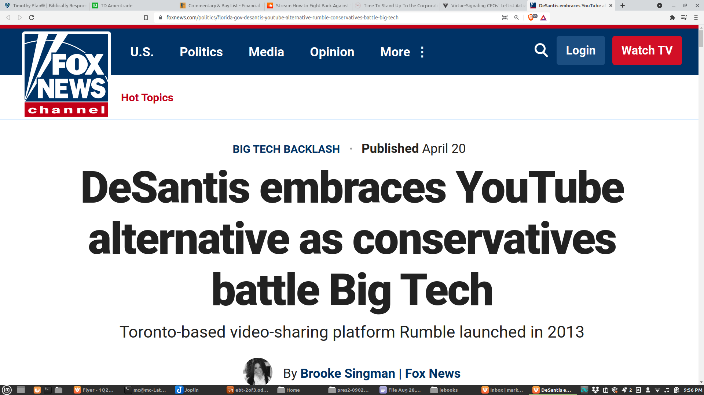

Slide 46
PART 2: Social Media alternatives
YouTube alternatives
- Rumble
- Odysee (LBRY)

Slide 47
PART 2: Social Media alternatives
YouTube alternatives
- Rumble
- Odysee (LBRY)
- Bitchute

Slide 48
PART 2: Social Media alternatives
YouTube alternatives
- Rumble
- Odysee (LBRY)
- Bitchute
- Guntube

Slide 49
PART 2: Social Media alternatives
YouTube alternatives
- Rumble
- Odysee (LBRY)
- Bitchute
- Guntube
- newpipe.net (Android app only, through the F-Droid open-source app catalog)

Slide 50


Slide 51
PART 2: Social Media alternatives
Instagram?

Slide 52
PART 2: Social Media alternatives
Netflix? Amazon Prime?

Slide 53
PART 2: Social Media alternatives
Frankspeech

Slide 54
PART 3: Amazon alternatives
Amazon is Cancel This Company’s Public Enemy #1

Slide 55
PART 3: Amazon alternatives
E-books
- Project Gutenberg
“...Amazon sells for money many titles in print and digital format that you can get free from Project Gutenberg...For older (pre-1926) content, there is a good chance that Project Gutenberg has it free of charge, but Amazon will charge money for it.”

Slide 56
PART 3: Amazon alternatives
E-books
- Open Library
  openlibrary.org
  Part of Internet Archive
  Millions of books

Slide 57
PART 3: Amazon alternatives
E-books
- Municipal libraries
B/CS Public Library System (links to a list of free book sites)
E-Book Central (NYPL)

Slide 58
PART 3: Amazon alternatives
Physical books
- ThriftBooks.com (thanks RT!)
- BookStores.com
- ChristianBook.com
- author websites?
Notes:
Diana West: Amazon
Kurt Schlichter: Amazon
Frank Turek: Amazon
Greg Koukel: Self
I had thriftbooks on this list, and a Berean (c.f. Acts 17:11) attendee checked CancelThisCompany.com and rightly corrected me!

Slide 59
PART 4: Other, and misc.

Slide 60
PART 4: Other, and misc.
Buying:

Slide 61
PART 4: Other, and misc.
Buying:
Goods/services from countries who hate us

Slide 62
PART 4: Other, and misc.
Buying:
Goods/services from countries who hate us
Goods/services from neutral countries

Slide 63
PART 4: Other, and misc.
Buying:
Goods/services from countries who hate us
Goods/services from neutral countries
Goods/services from U.S. blue states

Slide 64
PART 4: Other, and misc.
Buying:
Goods/services from countries who hate us
Goods/services from neutral countries
Goods/services from U.S. blue states
Goods/services from U.S. red states

Slide 65
PART 4: Other, and misc.
Buying:
Goods/services from countries who hate us
Goods/services from neutral countries
Goods/services from U.S. blue states
Goods/services from U.S. red states
Goods/services from Texas

Slide 66
PART 4: Other, and misc.
Buying local goods and services from a local, friendly or at least neutral vendor

Slide 67
PART 4: Other, and misc.
Payment services

Slide 68
PART 4: Other, and misc.
Payment services
- GoFundMe -> GiveSendGo or Subscribestar

Slide 69
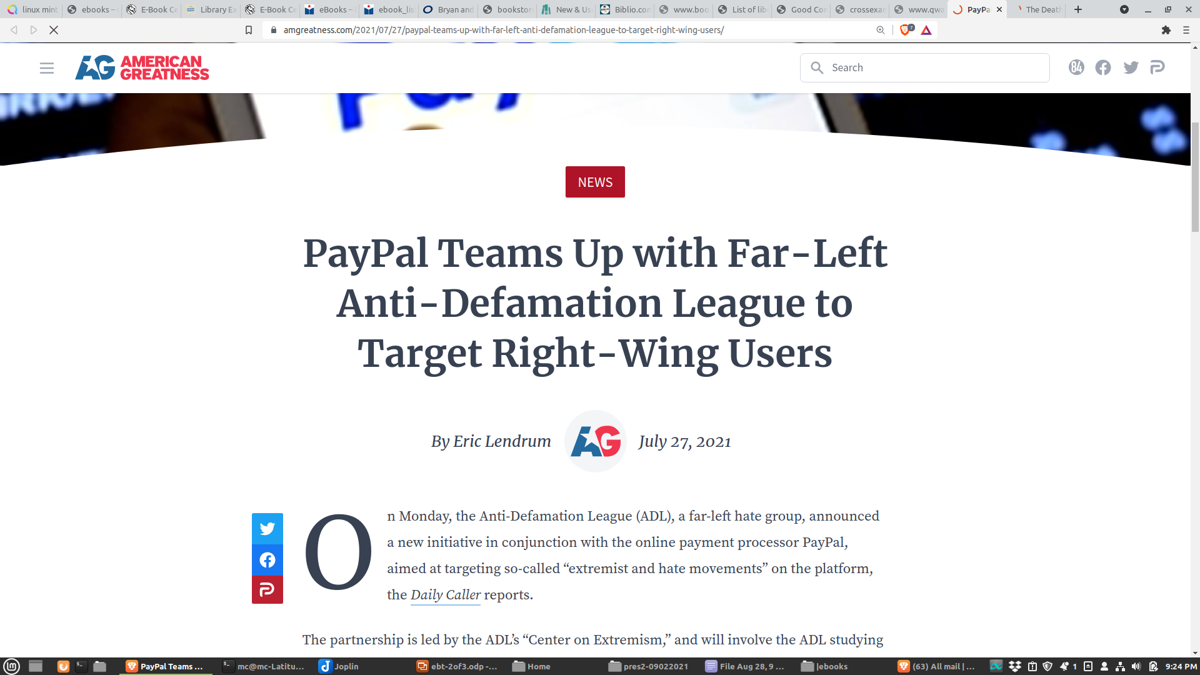

Slide 70
PART 4: Other, and misc.
Payment services
- GoFundMe -> GiveSendGo or Subscribestar
- Paypal/Venmo -> Zelle(?) CashApp(?) > GabPay
Notes:
https://news.gab.com/2021/08/01/an-alternative-to-paypal-is-coming/

Slide 71
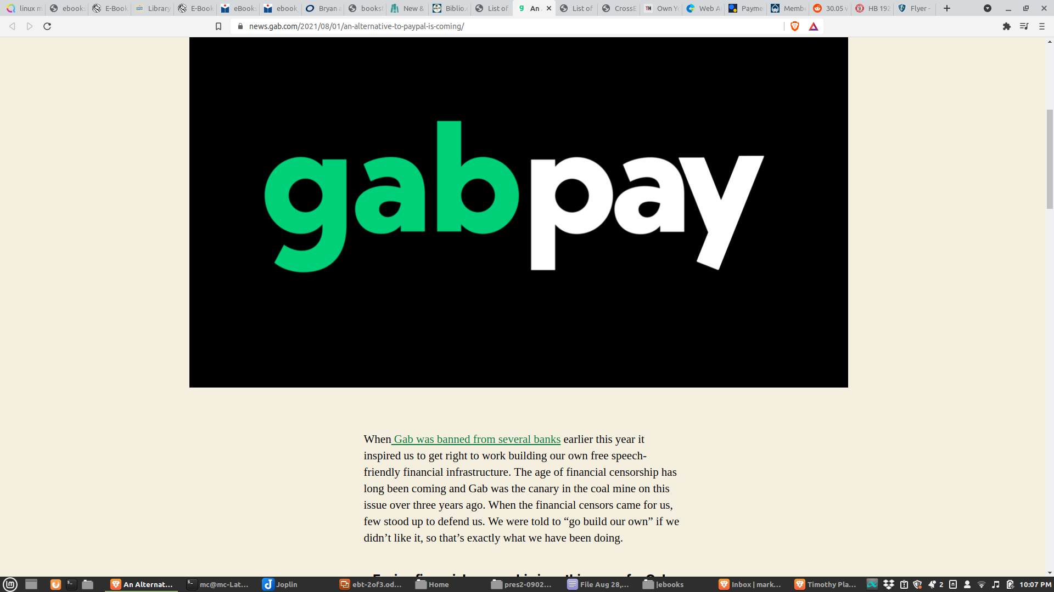

Slide 72
PART 4: Other, and misc.
Payment services
- GoFundMe -> GiveSendGo or Subscribestar
- Paypal/Venmo -> Zelle(?) CashApp(?) > GabPay
- Piryx Giving Stream Link: giving.piryx.com (used by True Texas Elections)

Slide 73
PART 4: Other, and misc.
Payment services
- GoFundMe -> GiveSendGo or Subscribestar
- Paypal/Venmo -> Zelle(?) CashApp(?) > GabPay
- Piryx Giving Stream Link: giving.piryx.com (used by True Texas Elections)
- Authorize.net

Slide 74
PART 4: Other, and misc.
Recognizing 2A-phobic businesses
Notes:
https://texas.gunowners.org/hb-1927-final-version-what-does-it-say/

Slide 75
PART 4: Other, and misc.
Recognizing 2A-phobic businesses
- 30.06, 30.07 compliant signage
Notes:
https://texas.gunowners.org/hb-1927-final-version-what-does-it-say/

Slide 76
PART 4: Other, and misc.
Recognizing 2A-phobic businesses
- 30.06, 30.07 compliant signage
- 30.05 for unlicensed carriers (as of yesterday)
Notes:
https://texas.gunowners.org/hb-1927-final-version-what-does-it-say/

Slide 77
PART 4: Other, and misc.
Recognizing 2A-phobic businesses
- 30.06, 30.07 compliant signage
- 30.05 for unlicensed carriers (as of yesterday)
- non-binding "no guns" signs could be a nod to carriers
Notes:
https://texas.gunowners.org/hb-1927-final-version-what-does-it-say/

Slide 78
PART 4: Other, and misc.
Recognizing 2A-phobic businesses
- 30.06, 30.07 compliant signage
- 30.05 for unlicensed carriers (as of yesterday)
- non-binding "no guns" signs could be a nod to carriers
- Texas3006.com
Notes:
https://texas.gunowners.org/hb-1927-final-version-what-does-it-say/

Slide 79
PART 5: Financial
Escaping Big Banks

Slide 80
PART 5: Financial
Escaping Big Banks
- use neutral local/regional banks

Slide 81
PART 5: Financial
Escaping Big Banks
- use neutral local/regional banks
- use neutral local/regional credit unions

Slide 82
PART 5: Financial
Escaping Big Banks
- use neutral local/regional banks
- use neutral local/regional credit unions
- Christian Community Credit Union mycccu.com

Slide 83
PART 5: Financial
Investing/Investment Services

Slide 84
PART 5: Financial
Investing/Investment Services
Financial Issues Stewardship Ministries financialissues.org

Slide 85
PART 5: Financial
Investing/Investment Services
Financial Issues Stewardship Ministries financialissues.org
If Christians would stop investing money in companies promoting unbiblical values, there would be no culture war in this country...
We have that much power in our numbers.

Slide 86
PART 5: Financial
Investing/Investment Services
Financial Issues Stewardship Ministries
Timothy Plan funds and ETFs, timothyplan.com

Slide 87
PART 5: Financial
Investing/Investment Services
Financial Issues Stewardship Ministries
Timothy Plan funds and ETFs
American Conservative Values Fund (ACVF)

Slide 88
PART 6: Ways to keep up
Notes:
https://afaaction.net/take-action/
apps: https://www.afa.net/resources/mobile-apps/

Slide 89
PART 6: Ways to keep up
CancelThisCompany.com
Notes:
https://afaaction.net/take-action/
apps: https://www.afa.net/resources/mobile-apps/

Slide 90
PART 6: Ways to keep up
CancelThisCompany.com
AFAAction.net/take-action
AFA Action will notify you once or twice a week about issues confronting the American family. Our alerts have been very successful in influencing legislation and America's Fortune 500 companies
Notes:
https://afaaction.net/take-action/
apps: https://www.afa.net/resources/mobile-apps/

Slide 91
PART 7: Next meeting
Notes:
https://afaaction.net/take-action/
apps: https://www.afa.net/resources/mobile-apps/

Slide 92
PART 7: Next meeting
Online security and privacy module
Notes:
https://afaaction.net/take-action/
apps: https://www.afa.net/resources/mobile-apps/

Slide 93
PART 7: Next meeting
Online security and privacy module
Passwords and password managers
Notes:
https://afaaction.net/take-action/
apps: https://www.afa.net/resources/mobile-apps/

Slide 94
PART 7: Next meeting
Online security and privacy module
Passwords and password managers
VPNs
Notes:
https://afaaction.net/take-action/
apps: https://www.afa.net/resources/mobile-apps/

Slide 95
PART 7: Next meeting
Online security and privacy module
Passwords and password managers
VPNs
Phones, phone services, phone operating systems
Notes:
https://afaaction.net/take-action/
apps: https://www.afa.net/resources/mobile-apps/

Slide 96
PART 7: Next meeting
Online security and privacy module
Passwords and password managers
VPNs
Phones, phone services, phone operating systems
Open source software
Notes:
https://afaaction.net/take-action/
apps: https://www.afa.net/resources/mobile-apps/

Slide 97
PART 7: Next meeting
Online security and privacy module
Passwords and password managers
VPNs
Phones, phone services, phone operating systems
Open source software
Open source computer operating systems
Notes:
https://afaaction.net/take-action/
apps: https://www.afa.net/resources/mobile-apps/

Slide 98
Questions?
bcsteaparty.com/escaping-big-tech

