Slide 1
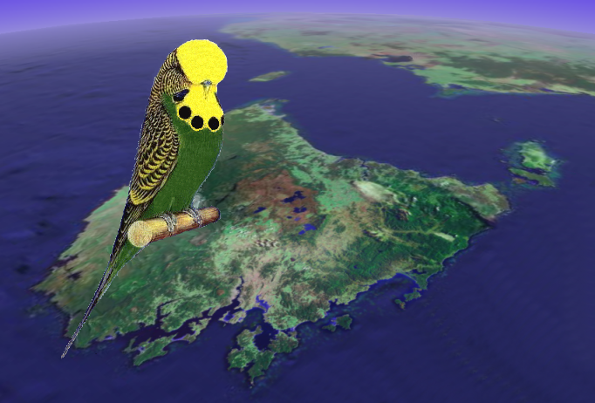
Burnie 2009
Budgerigar Council of Tasmania

Slide 2
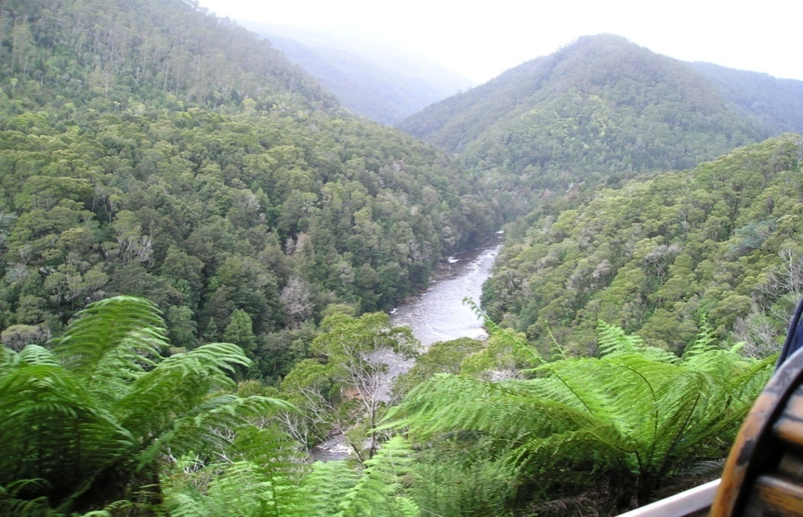

Take your time
Extend your stay, hire a car and experience the best of what Tassie has to offer

Slide 3
What happens now
Information show bags have been distributed
  Sneak preview of intended itinerary
  Information on Burnie and surrounds
Expressions of interest are also in the WA pack
Firm program of the Tasmanian show will be distributed in January 2009
Keep up to date with what is happening at:
  http://www.national2009.com

Slide 4
Bookings
Tasmanian Travel & Information Centre - Burnie
Little Alexander Street
Burnie Tasmania 7320
ABN: 9750 23 22 004
Licence No. Tas 116
Telephone: 03 6434 6111 Fax: 03 6434 6123 Email: travel@burnie.net
Website: www.tasmaniantravelcentre.com.au
Contact point “Charles”

Slide 5
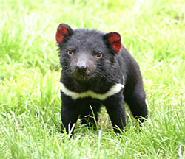
Be a Devil in 2009
See you in Tasmania

