Slide 1

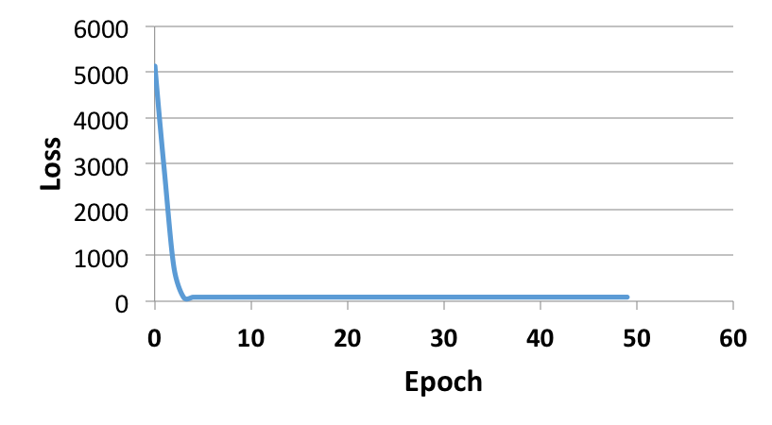
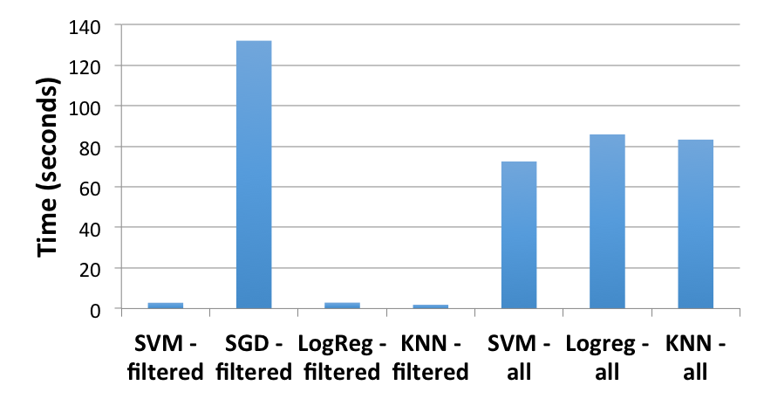
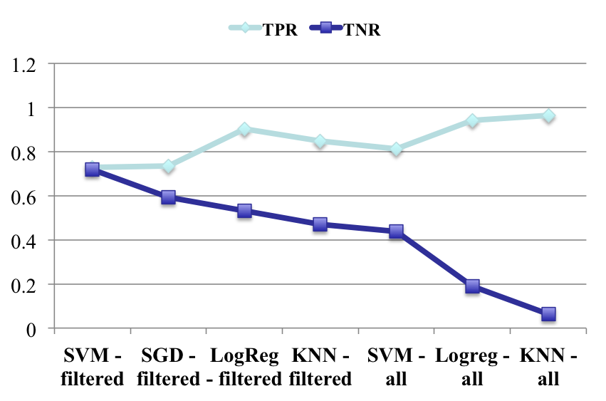
Comparative Analysis of Artificial Intelligence Techniques for
Cancer Diagnostics
Udai Baiswala, Brandon Cui, Natalie Ng
Stanford Computer Science
Motivation
A. Dataset Description
GSE16449: Kidney Cancer Prediction
GSE13576 cont.
Many non-AI projects attempt to find linkages between gene expressions and cancer
Medical papers frequently include datasets that link whole cell gene expressions with cancers.
We will investigate the performance of different AI techniques for gene expression datasets
Ultimately, we hope to develop an understanding of what techniques work well for evaluating gene expression data
C. Results without preprocessing
E. Preliminary LSTM
70 patients with 34,731 genes each
Each sample has metadata detailing if the expressions come from cancerous or benign kidney tissues
 | Prediction | Actual | Percent
Cancer | 16 | 18 | 88.89%
Benign | 46 | 49 | 93.88%
 | Prediction | Actual | Percent
Cancer | 15 | 18 | 83.3%
Benign | 49 | 49 | 100%
LSTMs are a sophisticated technique to classify samples using neural networks.
We currently have a preliminary version of the program running, but we are having issues with an unbalanced loss function.
Runtime: 14.516 s
Runtime: 11.802 s
B. Methodology
Fig 1. Results from logistic regression.
Fig 2. Results from SVM
Purpose of this dataset is to gain intuition for the different AI techniques
Since we have a small dataset, we run 10 cross fold validation
We ran the following techniques
  Data preprocessing
  Logistic Regression
  SVM
D. Results with preprocessing
 | Prediction | Actual | Percent
Cancer | 16 | 18 | 88.89%
Benign | 52 | 52 | 100%
 | Prediction | Actual | Percent
Cancer | 16 | 18 | 88.89%
Benign | 52 | 52 | 100%
Problem Definition
Runtime: 1.677 s
Runtime: 11.802 s
Input: Gene expression data for a person either with or without cancer
Output: Classification of whether the gene expression is cancerous
Baseline: K-nearest neighbors
  ~15% false positive rate
  ~50% true positive rate
Oracle: Leading cancer tests
  ~5% false positive rate
  ~5% true positive rate
Fig 3. Results from logistic regression.
Fig 4. Results from SVM
We notice that filtration improves both the runtime and the accuracy of classification
Fig 7. Loss from each iteration of LSTM
GSE13576: Relapse Prediction
Challenges
Classifying between cancer and benign was too trivial a classification problem
Datasets have a many features and few samples, making many AI techniques suboptimal
Small datasets require thoughtful applications of resampling techniques
A. Dataset Description
C. Runtime Analysis
We chose to predict relapse as a classification problem because classifying between cancer and benign is too trivial
196 patients with 55,670 genes each
Each sample has metadata detailing if the expressions come from tumors that relapsed or remained relapse-free
SGD is computationally expensive
We gain significant runtime benefits from data filtration
Approaches
Analysis
Preprocessing
  Normalization – Total expression of each patient normalized to same sum.
  Filtration – Keep differentially expressed (p > 0.01) genes with a fold change of >5.
K-nearest neighbors with k=3 and k=5
Stochastic Gradient Descent with Perceptron loss and ‘elastic net’ regularization
SVM: A non- probabilistic model that uses features to assign a sample to one of two classes
LSTM (Long Short Term Memory) - A type of recurrent neural net that ‘remembers’ which input/feature, is the most important.
AI methods run using Scikit-learn or Tensor Flow Python packages
More than any artificial intelligence technique, careful data pre-processing and filtration improves accuracy the most dramatically
We see a tradeoff in true positive and true negative rates during classification
SVMs have the best performance in terms of balancing true positive and true negative rates
B. Methodology
Fig 5. Runtimes of all techniques from Scikit-learn
Purpose of this dataset is to gain a deeper understanding of how different AI techniques impact classification accuracy
Since we have a small dataset, we run 10 cross fold validation
We ran the following techniques
  Data preprocessing
  Logistic Regression
  SVM
  SGD
  LSTM
D. Accuracy Analysis
We generally see a tradeoff between true positive and true negative rates
We see a definite improvement with data filtration
SVM with filtered data gives us the best results
Next Steps
Tweak our implementation of LSTM to ensure a balanced loss function
Analyze another dataset to ensure consistency of our observations
Fig 6. Accuracy of techniques from Scikit-learn

