Slide 1
30 Day Photo Challenge
Benjamin Culkin

Slide 2
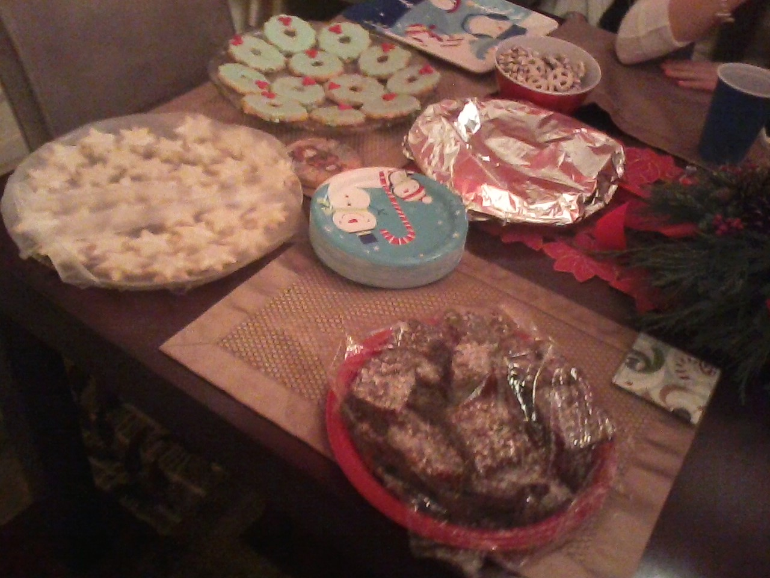
Favorite Food

Slide 3
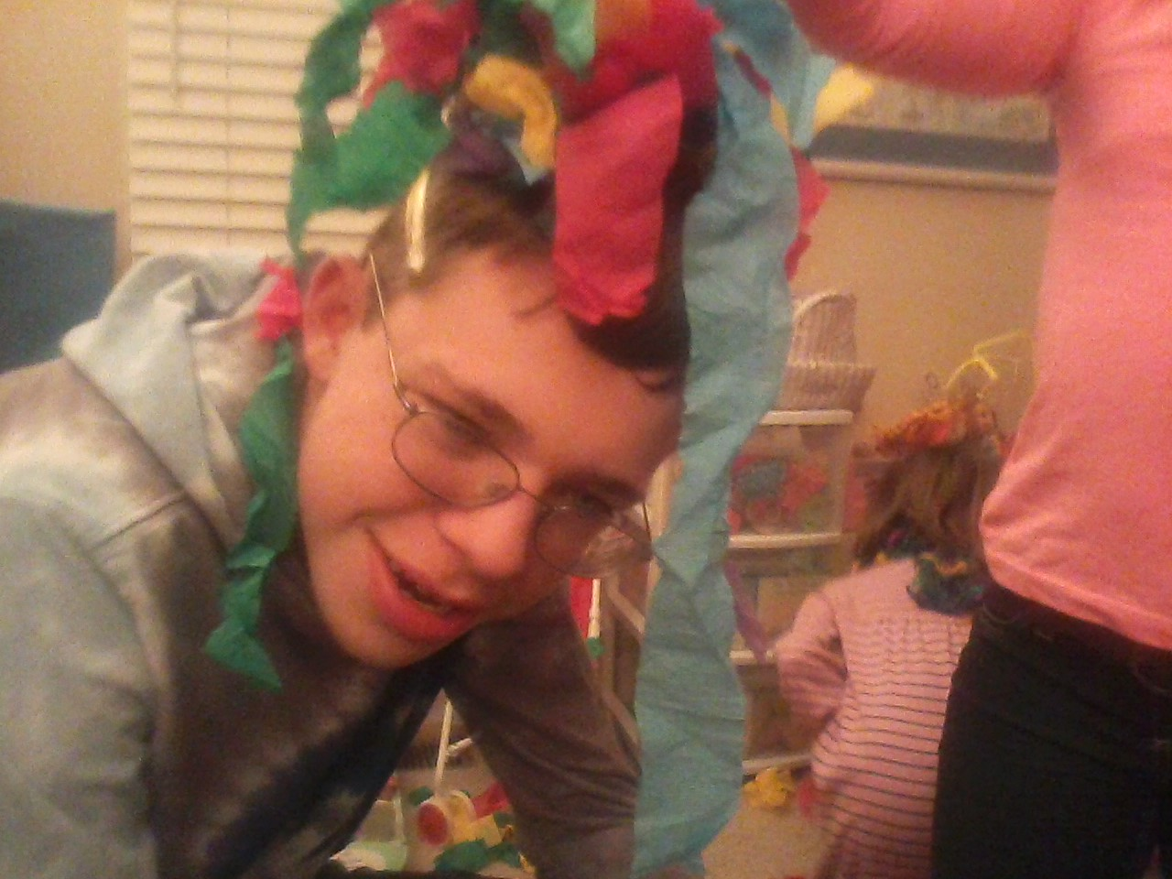
Smile

Slide 4
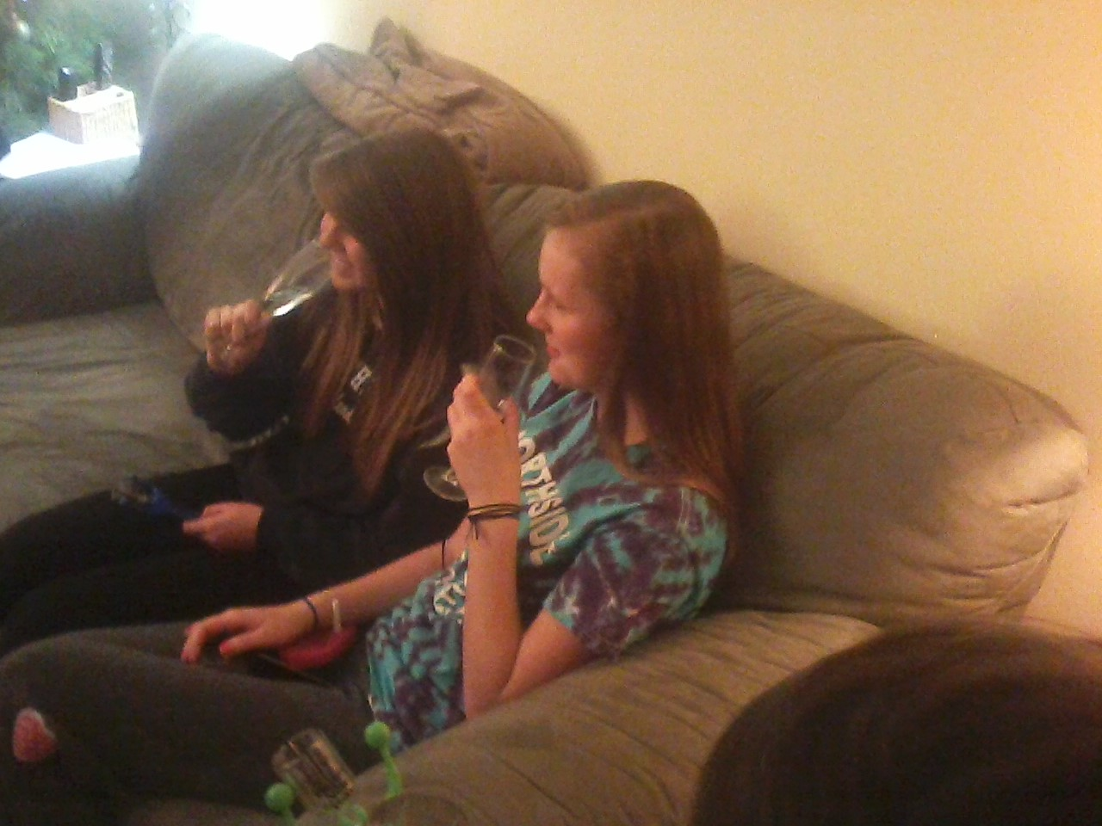
Happiness

Slide 5
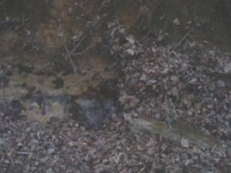
Leaves

Slide 6

Morning Sky

Slide 7
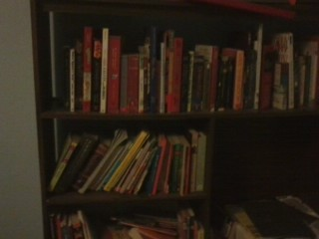
Books

Slide 8
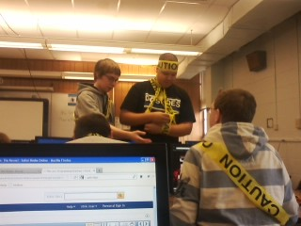
Something Funny

Slide 9

Favorite Color

Slide 10
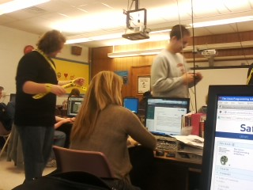
Inspiring Person

Slide 11
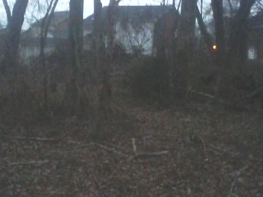
Nature

Slide 12
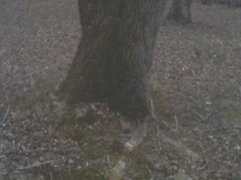
Something Old

Slide 13
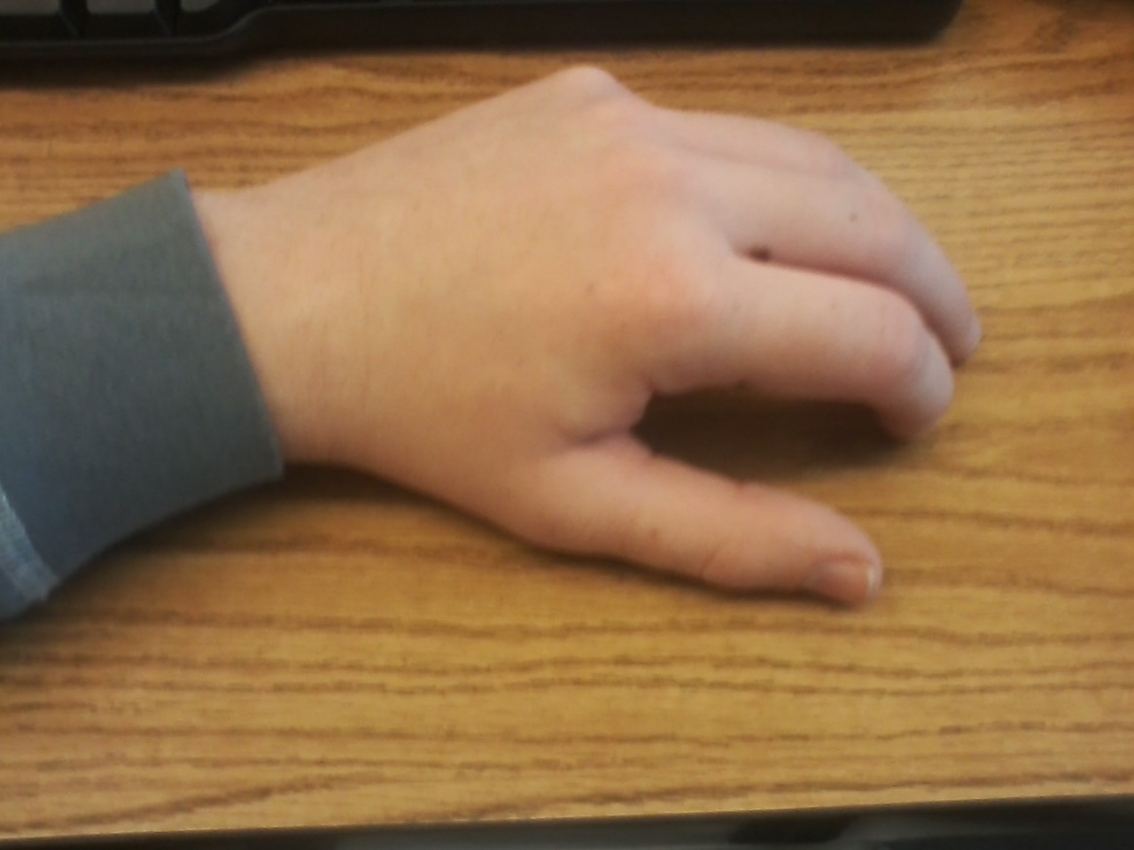
Hands

Slide 14
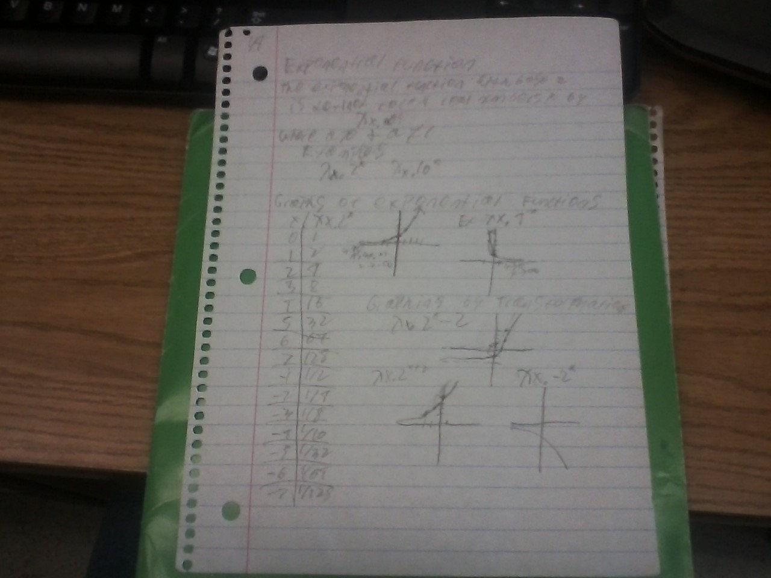
Written Words

Slide 15
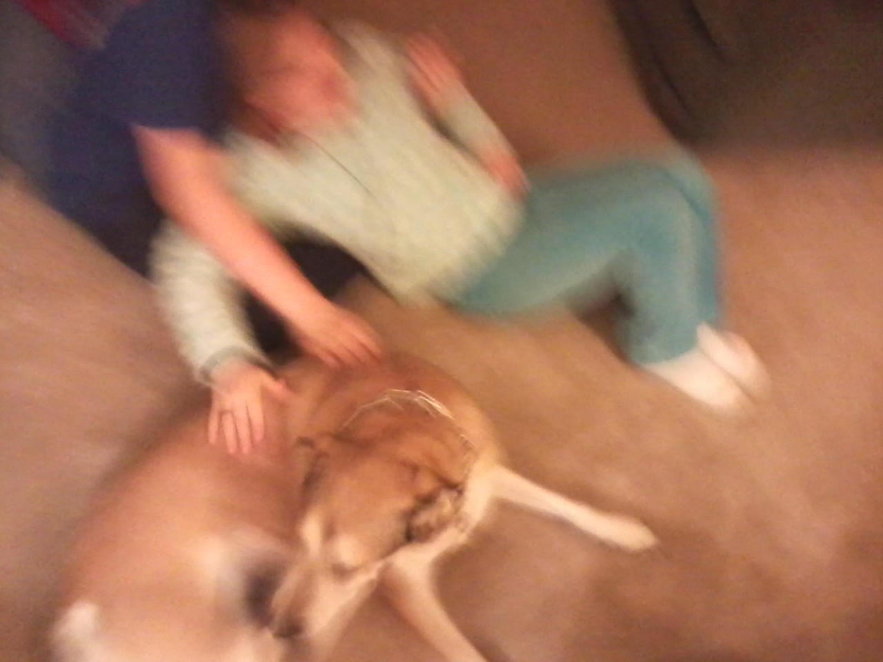
Movement

Slide 16
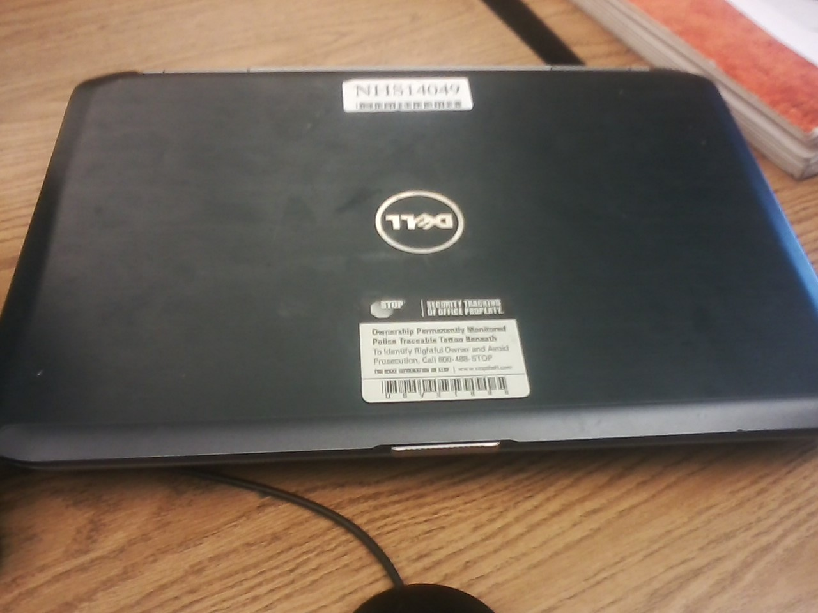
Technology

Slide 17
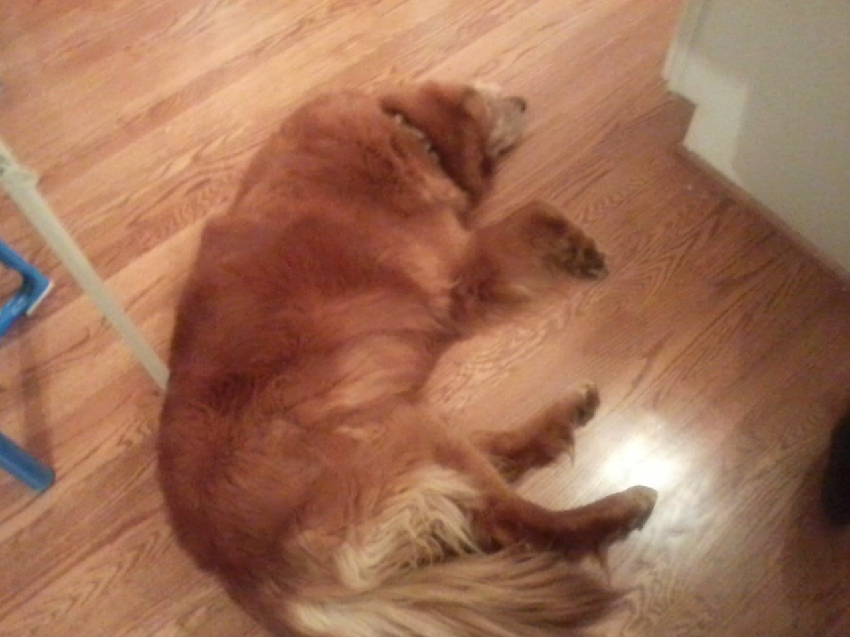
Animals

Slide 18
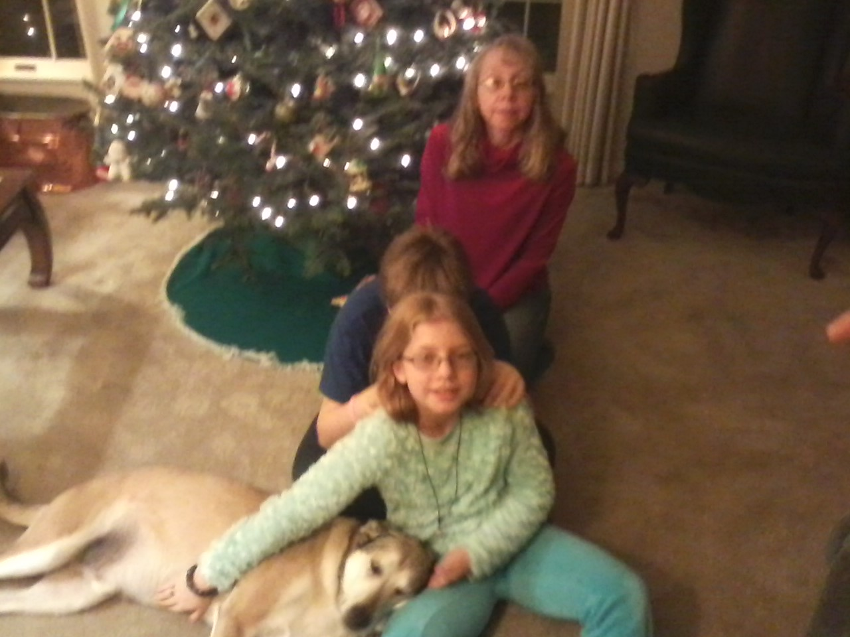
Memories

Slide 19
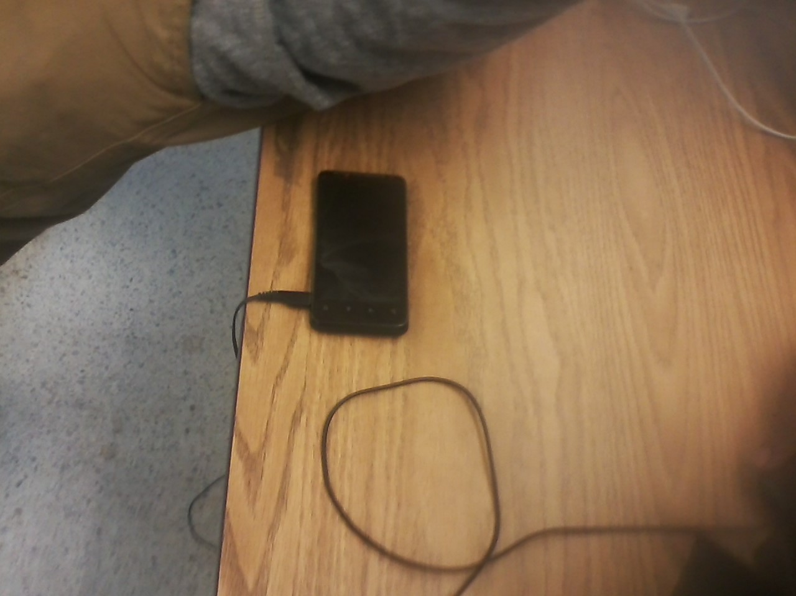
Something New

Slide 20
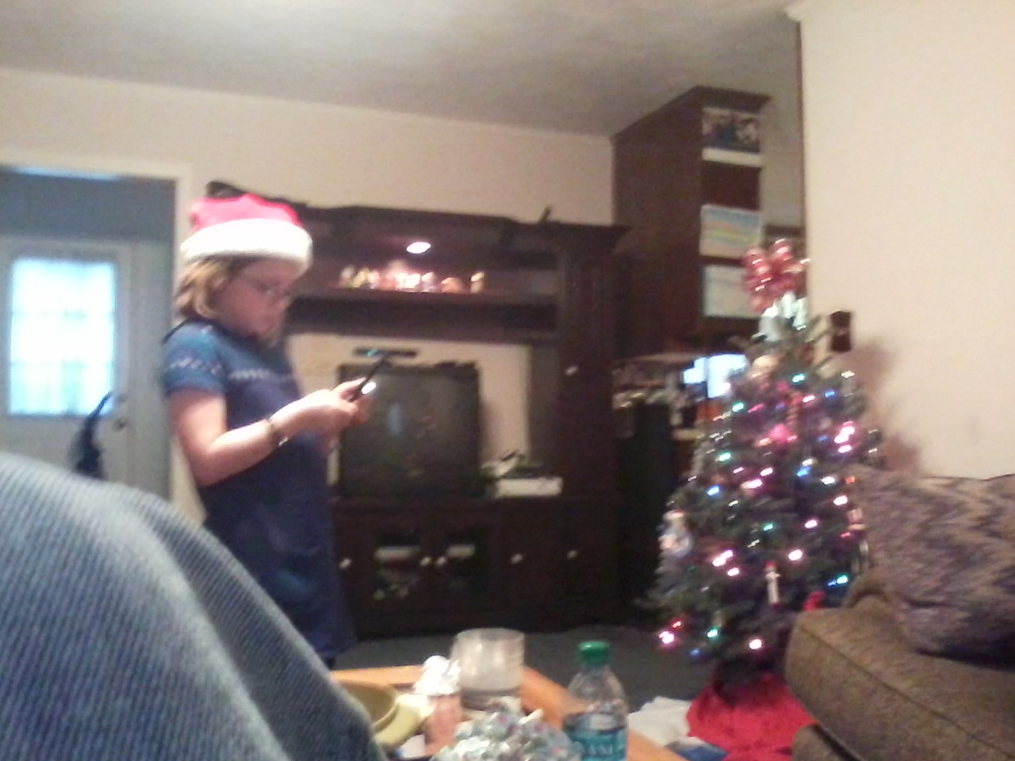
Best Friend

Slide 21

Seasonal

Slide 22
Where You Sleep

Slide 23

Clothing

Slide 24
In Your Closet

Slide 25
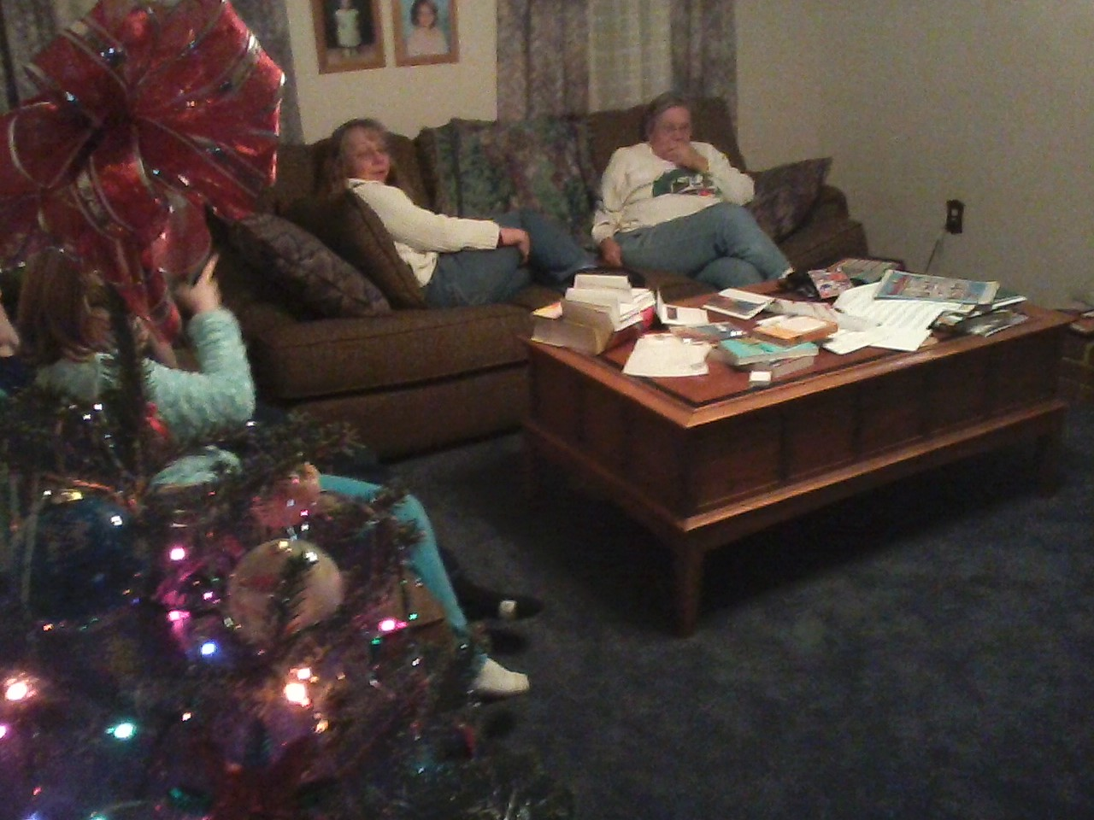
Gratitude

Slide 26
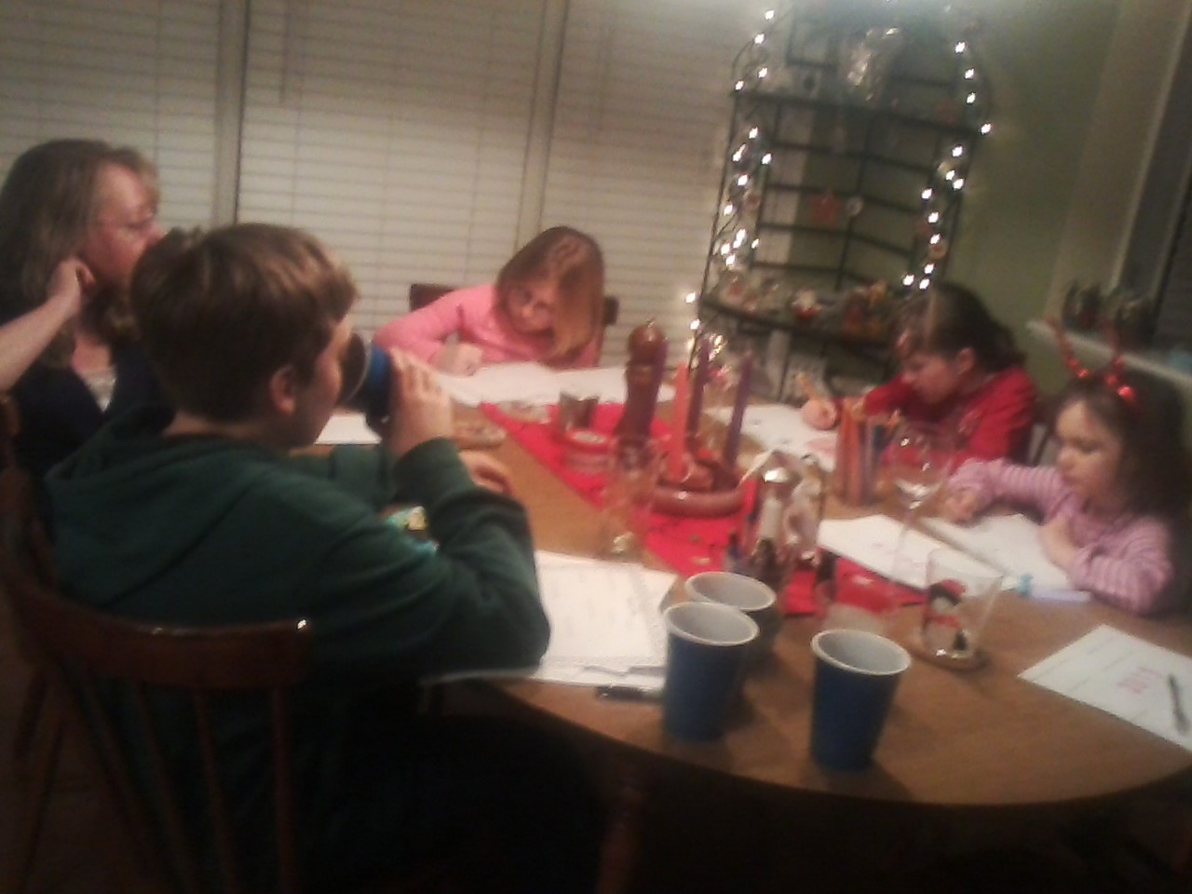
Artwork

Slide 27
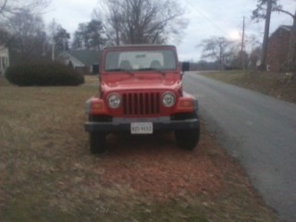

Transportation

Slide 28
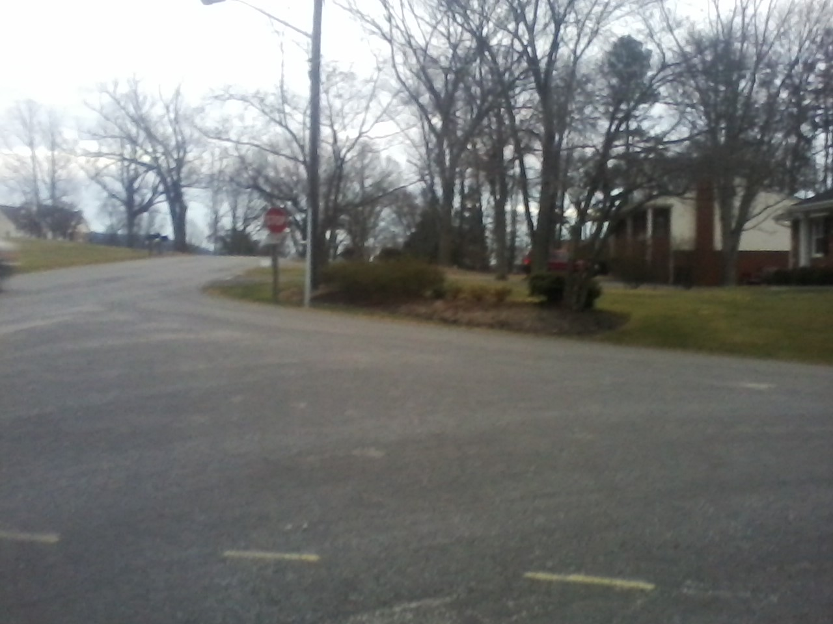
Daily Routine

Slide 29

Nighttime

Slide 30
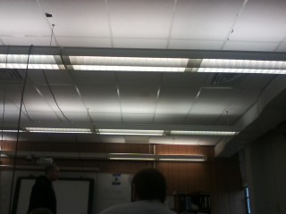
Light

Slide 31

Self Portrait

Slide 32
FIN

