Slide 1


Joe Sumpter
Tech Levitate
@techlev
joe@techlevitate.com

Slide 2
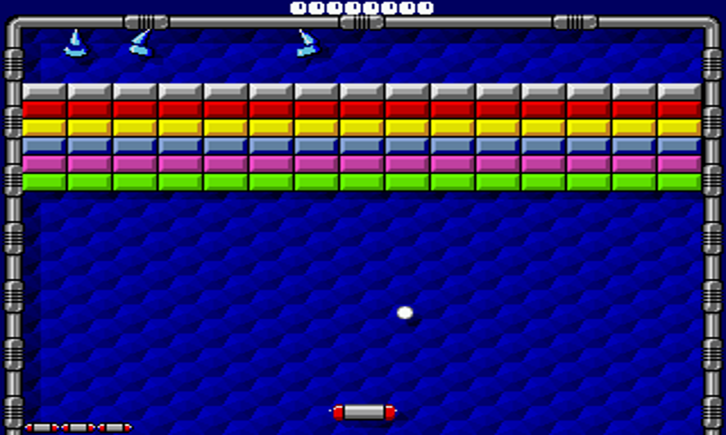
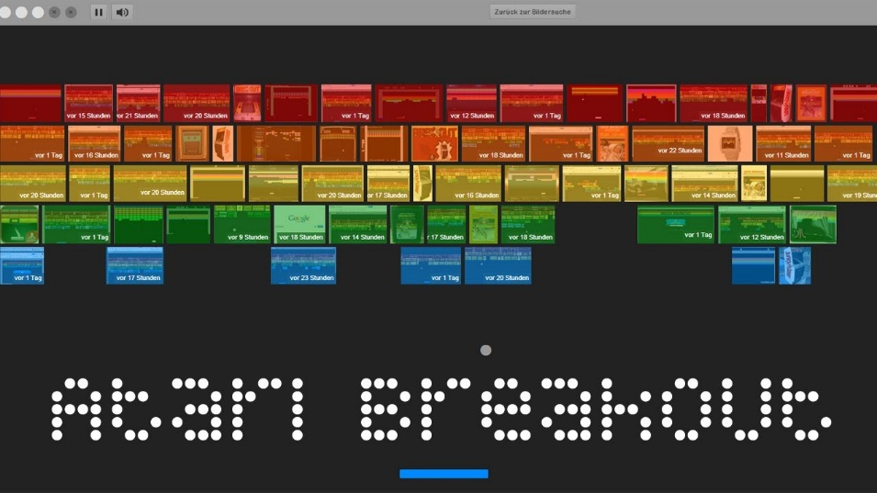
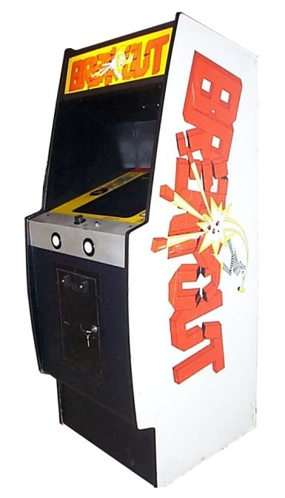
Classic Game Revival
Taito Arkanoid and Atari Super Breakout are among the most popular games of all time
Very simple game play and design
Worked on multiple platforms and in arcades
Universally cloned by game developers but not in a unique way
Still popular on many platforms for classic arcade gamers

Slide 3

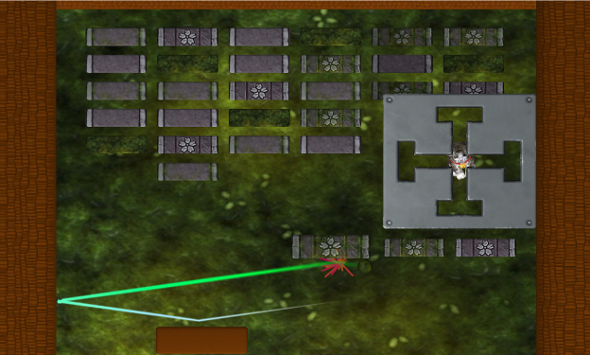
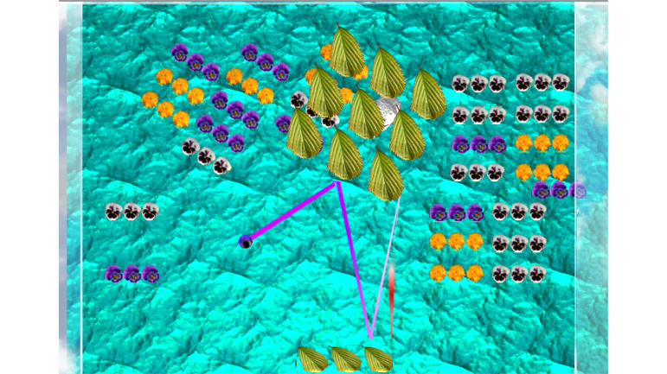
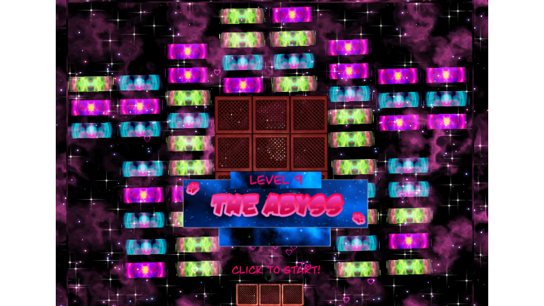
Kitty Cat Breakout
Goal: Similar to the classic bricks game where you use the paddle and ball to eliminate the bricks. However this time you smash the bricks to save the cute little cat!
Features:
Hip Hop Dance beats
Speed power ups and paddle ups
Uniquely designed levels
Samsung VR experience
Cute cats to save!

Slide 4



Team
Jodessiah Sumpter
15+ years software development and tech lead experience at Fortune 500 companies
MBA in Marketing and Information Systems
Role: Panther (a.k.a Programmer)
Jeremiah Sumpter
Supervisor at Eaton Corporation
Experienced D.J. and videographer.
Role: Lion (a.k.a D.J.)
Joynisha Sumpter
Experienced game artist and tester
Game Studio Entrepreneur (Break Limit Designs)
MFA, Design and Technology with focus on Game Design
Role: Tiger (a.k.a Designer)

Slide 5

Opportunity
= High Score (quickest time) tracked using Block Chain
+
Factom Plugin for Unity Game Developers

Slide 6

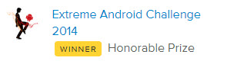

Traction

