Slide 1
Enterprise systems
Needed for examination.

Slide 2
Section a
a) Information systems produce the information that organizations need to make decisions, control operations, analyze problems and create new products or services. Explain the three activities found in information systems.
Ans:
Input of data resources: Involves data entry or the capturing, recording and editing of business transactions and other events for processing. Data can be captured using optical scanners, bar code readers, computer keyboards, microphones, menu displays, etc.
Processing data into information: Involves the manipulation, transformation, analysis, sorting, classification, etc. of input data into information for end users.
Output of information products: Involves the information products that results from data processing such as reports, forms, graphic images, video displays, audio responses, etc.

Slide 3
Section a
b) Evaluate the basic functions performed by an enterprise resource planning system in an organization.
Ans:
Enterprise resource planning (ERP) is a set of integrated programs that manage a company’s vital business operations for an entire organization.
Basic functions performed by an enterprise resource planning system in an organization
Improved access to quality data for operational decision making
Elimination of costly, inflexible legacy systems Improvement of work processes
Opportunity to upgrade and standardize technology infrastructure

Slide 4
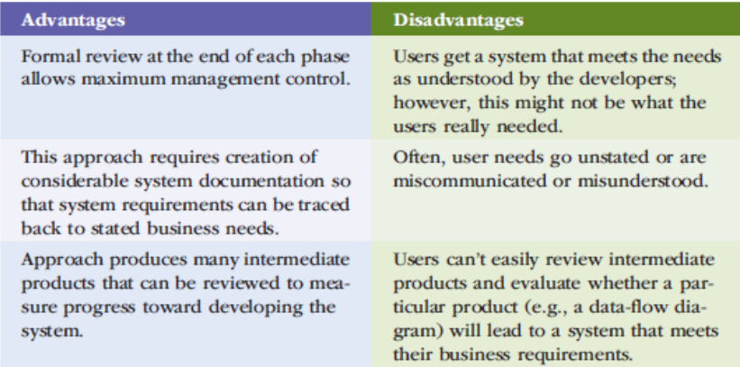
Section a
c)Discuss the advantages and disadvantages of the waterfall approach to system development.
Ans:

Slide 5
Section a
d) Differentiate between a management information system and a decision-support system as they relate to managers.
Ans:
Management Information Systems (MIS): Provide reports and displays to managers example daily sales analysis reports.
Decision Support Systems (DSS): Provide interactive ad hoc support for decision making example a what-if-analysis to determine where to spend advertising money, Decision Trees, Sensitivity Analysis etc.

Slide 6
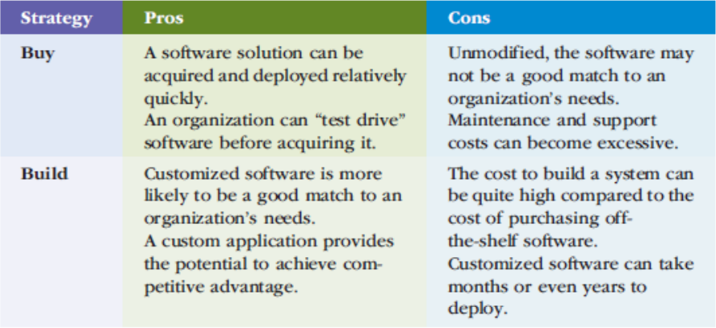
Section a
e) Discuss the advantages and disadvantages of both buying and building software.
Ans:

Slide 7
Section b
a)Discuss the role of information technology in the support of business systems of an organization
Ans:
Role of information technology in the support of business systems of an organization
Communication systems : Part of management is gathering and distributing information, and information systems can make this process more efficient by allowing managers to communicate rapidly.
Operations Management : How you manage your company's operations depends on the information you have. Information systems can offer more complete and more recent information, allowing you to operate your company more efficiently.
Decision-Making : The company information system can help you make better decisions by delivering all the information you need and by modeling the results of your decisions. A decision involves choosing a course of action from several alternatives and carrying out the corresponding tasks.
Record-Keeping : Your company needs records of its activities for financial and regulatory purposes as well as for finding the causes of problems and taking corrective action. The information system stores documents and revision histories, communication records and operational data

Slide 8
Section b
b) Briefly discuss three ethical, social, or political issues that can be raised by developing or using information systems.
Ans:
Cheap hardware promotes expensive systems – people and maintenance are expensive.
Staff skills are inadequate to use a system well – training, motivation needed
Natural disasters such as fire, cyclone and flood also present risk to IT systems, data and infrastructure. Damage to building and computer hardware can result in loss or corruption of customer records/transactions.
c) Explain the hosted software model for enterprise systems and justify why this approach is so appealing to SMEs.
Ans:
Hosted software refers to software that is installed, hosted and accessed entirely from a remote server or location. Hosted software is hosted and managed by the software manufacturer or a third-party vendor. Users can access it globally through the Internet.
Hosted software is most commonly used by SMEs (small and medium sized enterprises) who have a fairly small IT department. This software solution makes it easier for smaller companies to maintain and update applications from a central location, while also offering a cost-effective solution that can be used by entire departments.

Slide 9

Section b
a)Discuss any two types of agile development process.
Ans:
Agile Methods
Scrum : It is an Agile Software development method for project management.
Characteristics
Prioritized work is done.
Completion of backlog items
Progress is explained
Agile Software Development
Extreme programming : Promotes incremental development of a system using short development cycles to improve productivity, accommodate new customer requirements.

Slide 10
Section b
b) Discuss the structure of an organization using the Anthony’s triangle, justifying the information needs and types of information systems at each level.
Ans:
Levels of the structure of organization using Anthony’s triangle
Operational level
Controlling day to day operations (e.g. Stock control, credit control etc.)
High volume, speedy processing, constant monitoring, computerized.
Structured decisions
Inputs: from transaction processing, databases
Output: reports or answers to queries
Tactical level
Implement strategies and monitor operations
Some complexity and uncertainty. Involve both structured and unstructured decisions
Control systems provide feedback on e.g. Budgets, production, inventory etc.
Regular and exception reporting, queries supported by database – the organization’s memory

Slide 11
Section b
b) Discuss the structure of an organization using the Anthony’s triangle, justifying the information needs and types of information systems at each level.
Ans: cont’d
Levels of the structure of organization using Anthony’s triangle
Strategic level
Novel, unstructured problems, creativity and initiative needed, little automation possible.
Strategically useful information is external, with no artificial boundaries, future oriented, qualitative and quantitative, informal information, multidimensional, collaborative.
Information sources: employees, outside contacts, professional bodies, published materials, commissioned reports etc.

Slide 12
Section b
c)Examine the benefits derived from implementing a customer relationship management system in an organization.
Ans:
Helps a company manage all aspects of customer encounters, including marketing, sales, distribution, accounting, and customer service.
Automates and integrates the functions of sales, marketing, and service in an organization.
To capture and view data about customers and to improve communications.

