Slide 1
Computational Fluid Dynamics
College of Aerospace Engineering
NUAA

Slide 2
Project
Write a 2-d Finite Volume Method CFD code for Euler equations.
  Unstructured or structured grid;
  Programming language: any
Submission
  working source code and examples;
  report
Due date: 2021.5.8

Slide 3
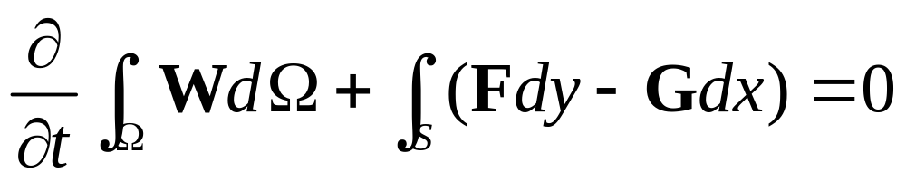
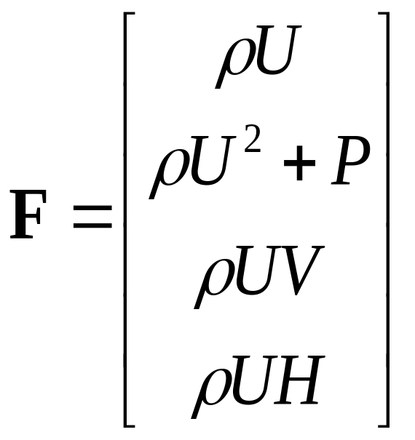
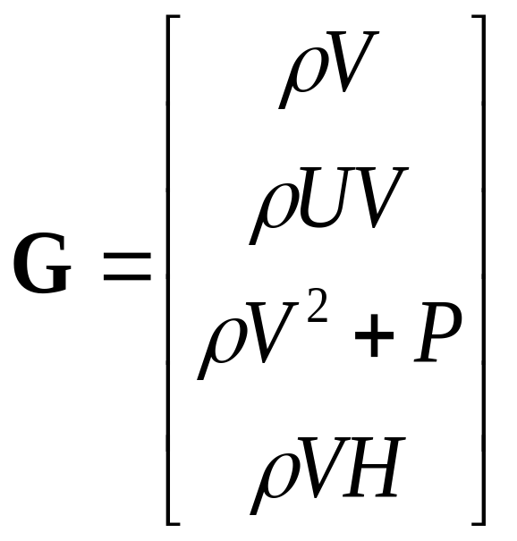
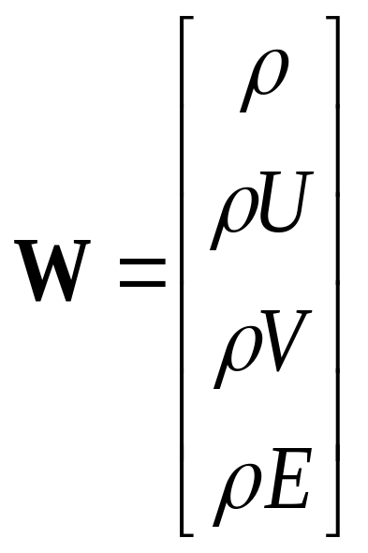
Euler equations in integral form
（*）

Slide 4
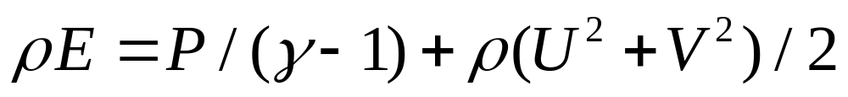
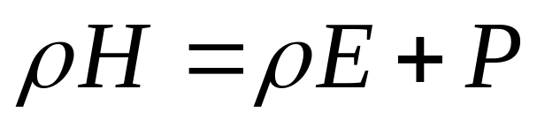
Euler equations in integral form
Where

Slide 5
Nomenclature
b
p
k
i
a
Cell centroids, edges and grid vertices

Slide 6
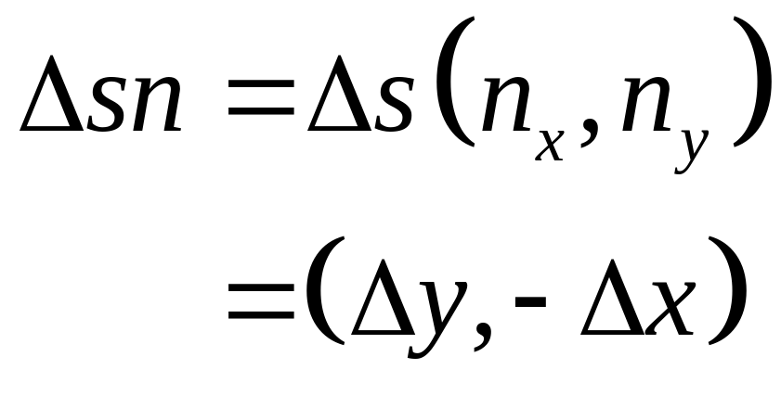

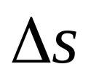
Nomenclature
b
i
a

Slide 7
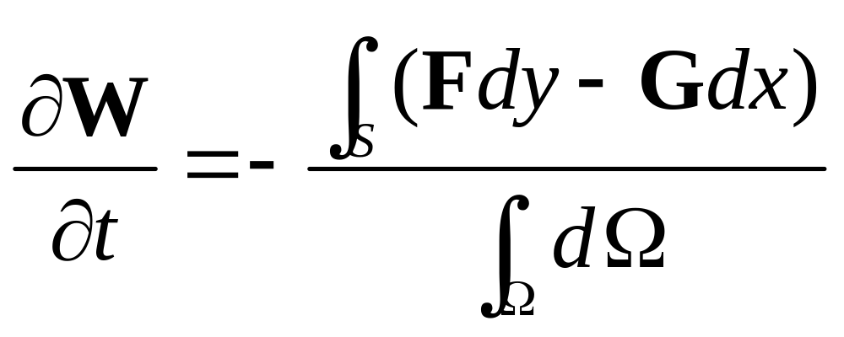
Finite volume discretisation
(**)

Slide 8

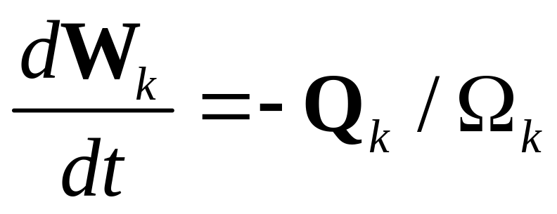
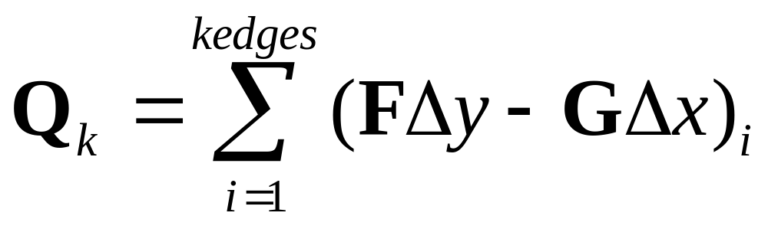
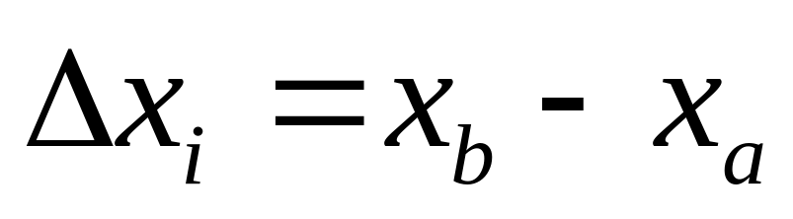
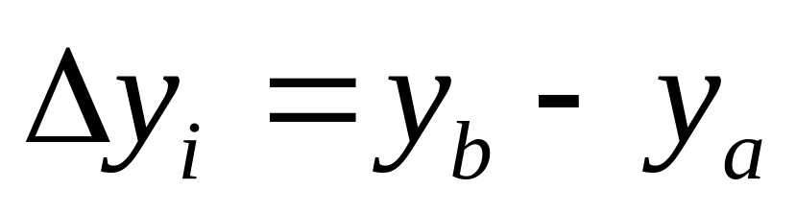
Finite volume discretisation
Choosing cell as control volume，using(**)

Slide 9
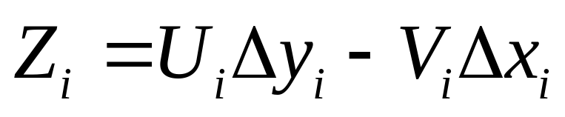
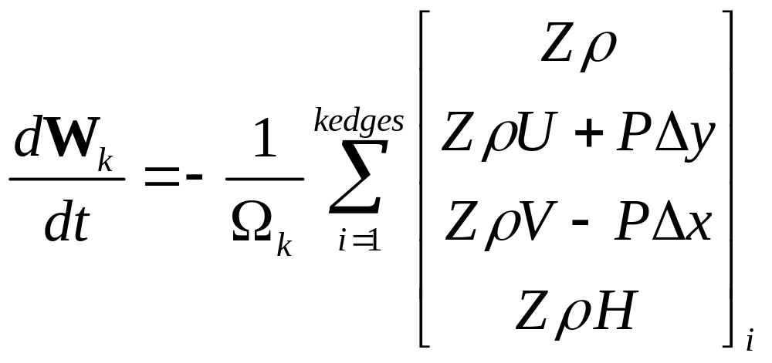
Finite volume discretisation
Let ，then

Slide 10

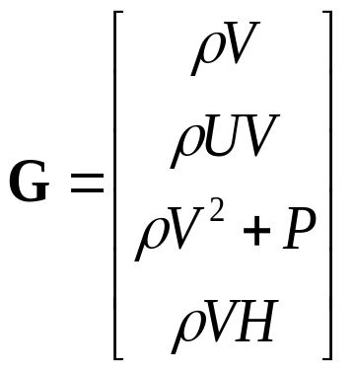
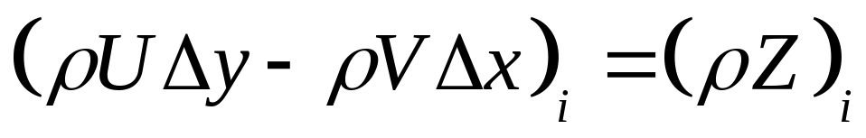
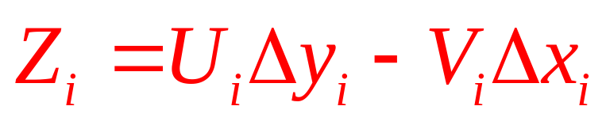
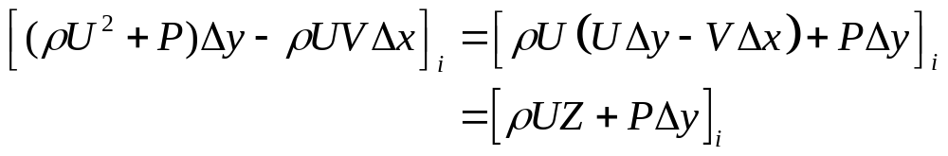
Finite volume discretisation

Slide 11
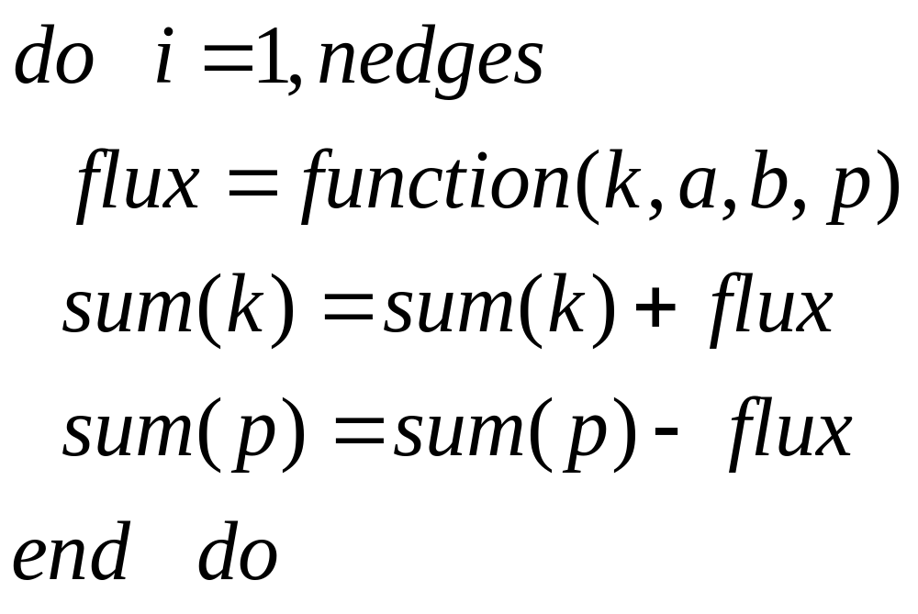
Finite volume discretisation
Edge based data structure

Slide 12
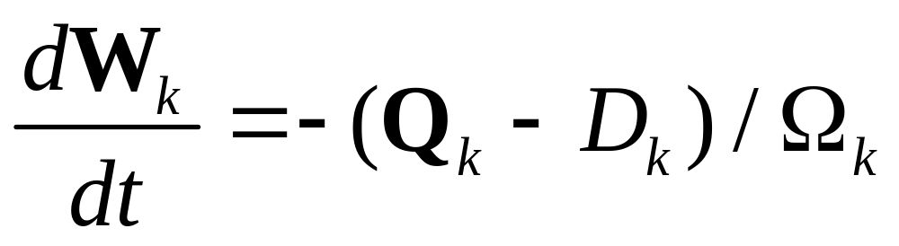
Artificial dissipation
Cell-centred schemes such as the one described above are non-dissipative, so that any errors (discretisation errors, round-off error etc.) are not damped and oscillations may be present in the steady-state solution. In order to eliminate these oscillations, artificial dissipative terms are needed.

Slide 13
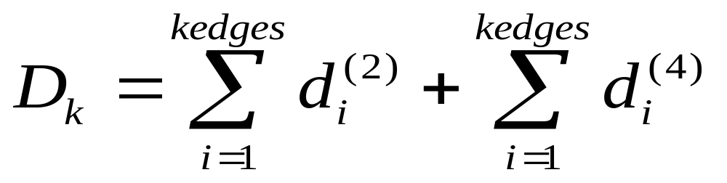
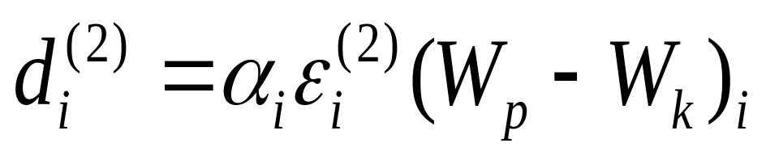
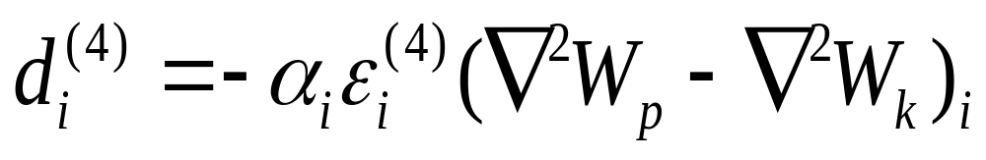
Artificial dissipation
Second and fourth order hybrid artificial dissipation proposed by Jameson
Where

Slide 14
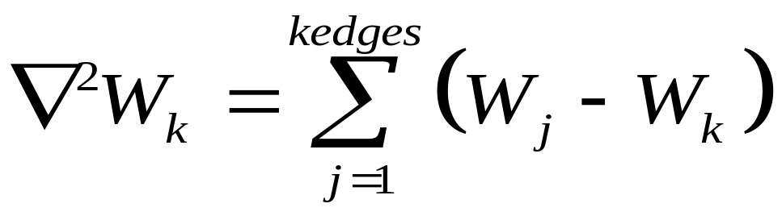
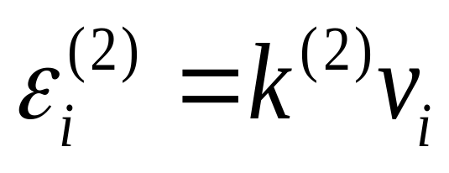
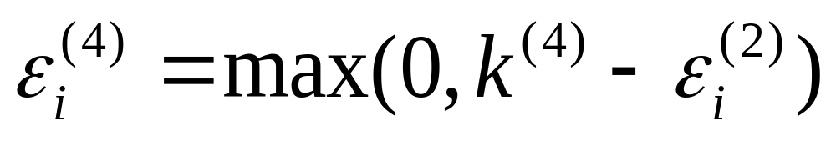
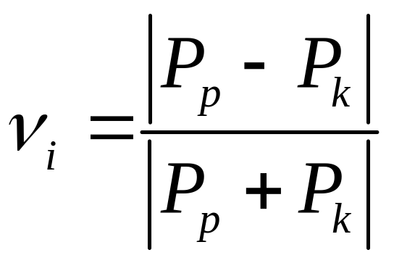
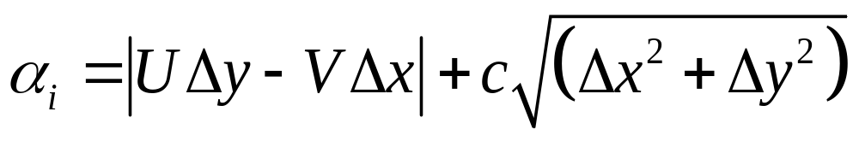
Artificial dissipation
Scaling factor of shock sensor

Slide 15
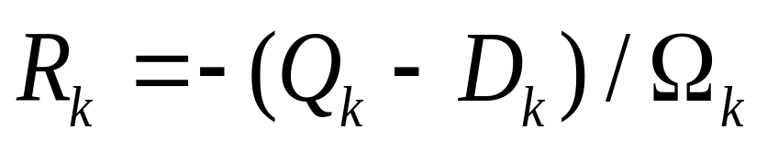
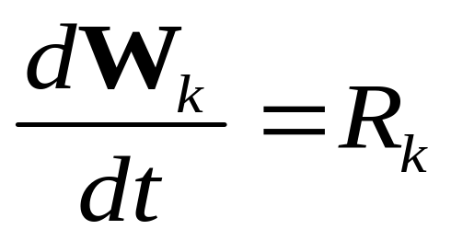
Time discretisation
Let
Then（**）can be written as

Slide 16
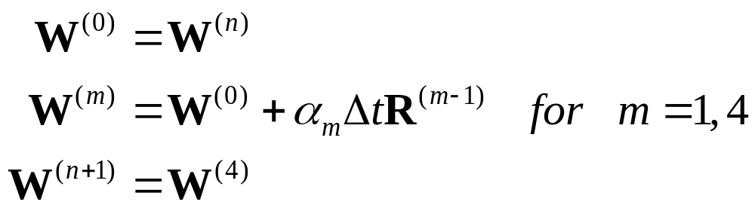
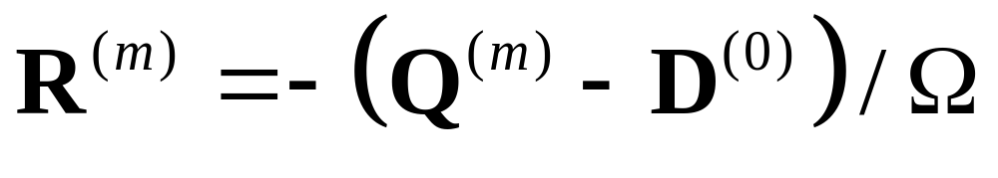
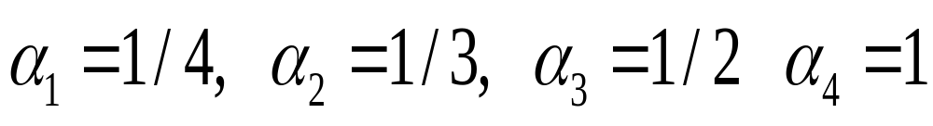
4-stage Runge-Kutta scheme
where

Slide 17
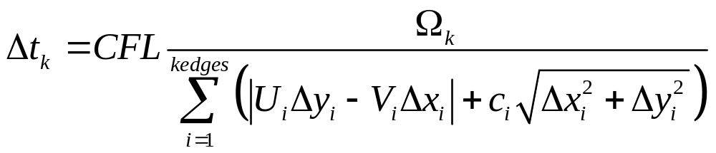
Local time step

Slide 18
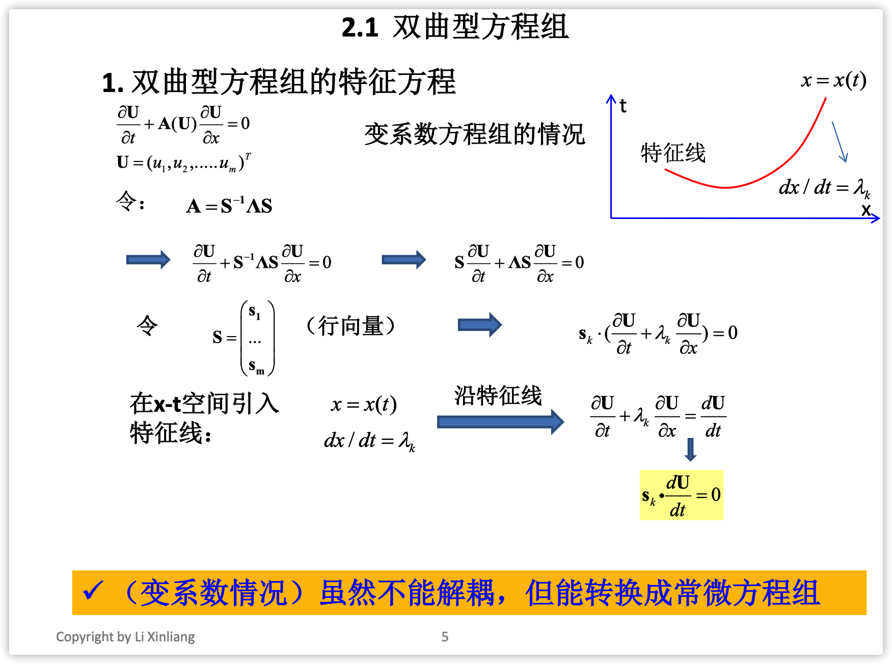
Riemann invariants

Slide 19
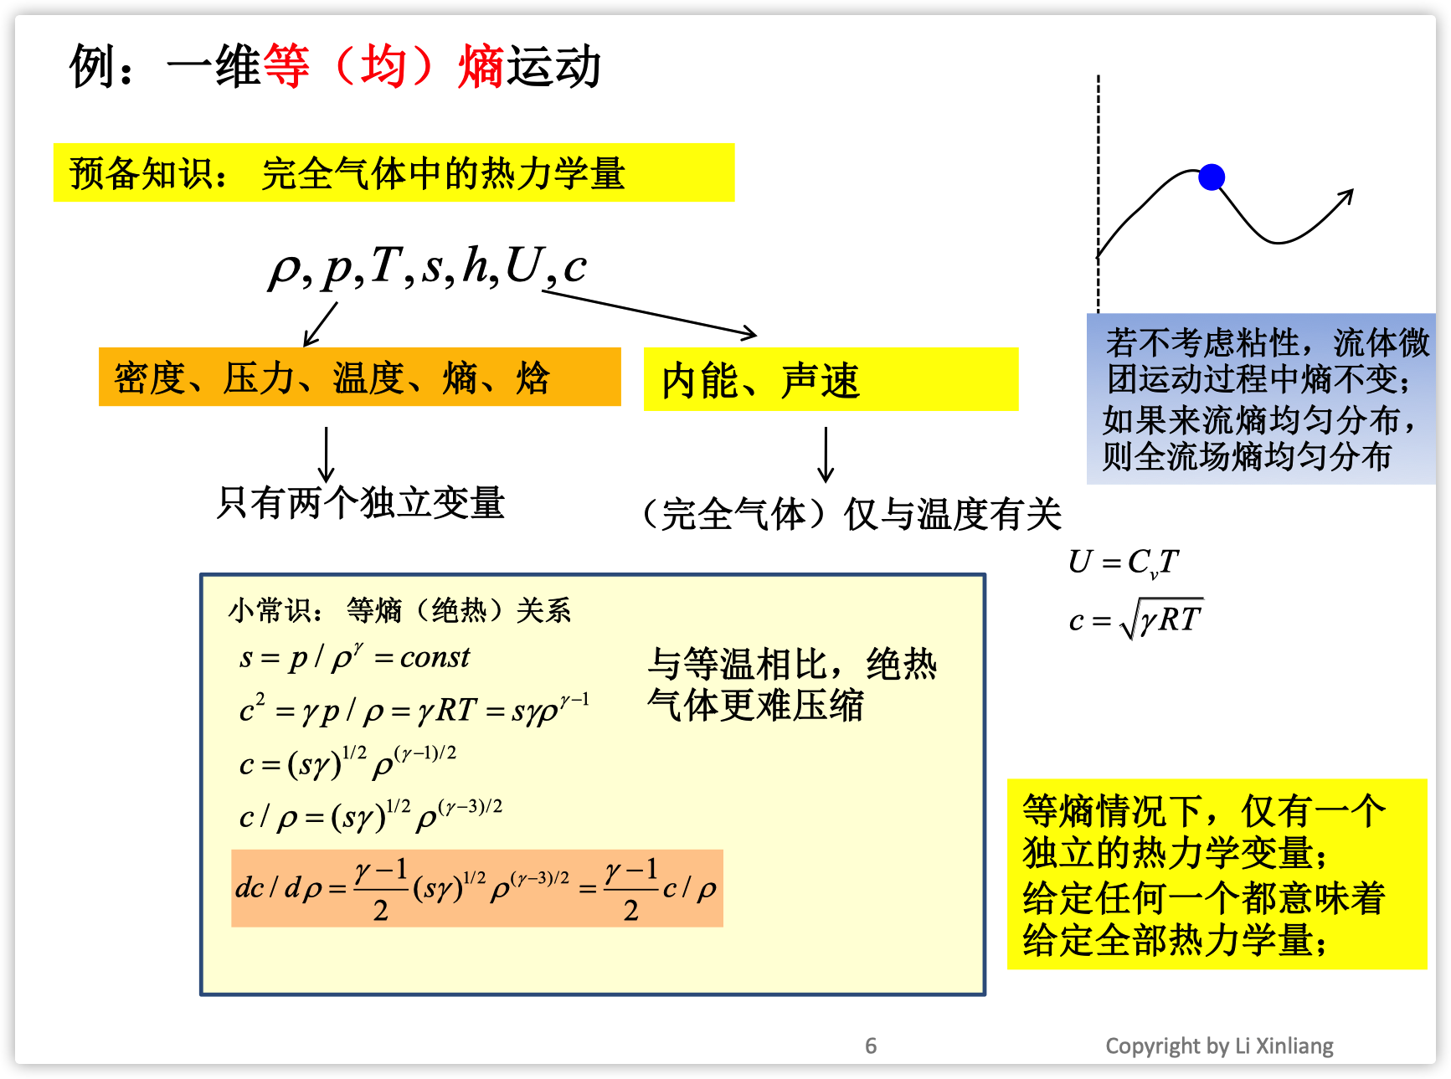
Riemann invariants

Slide 20
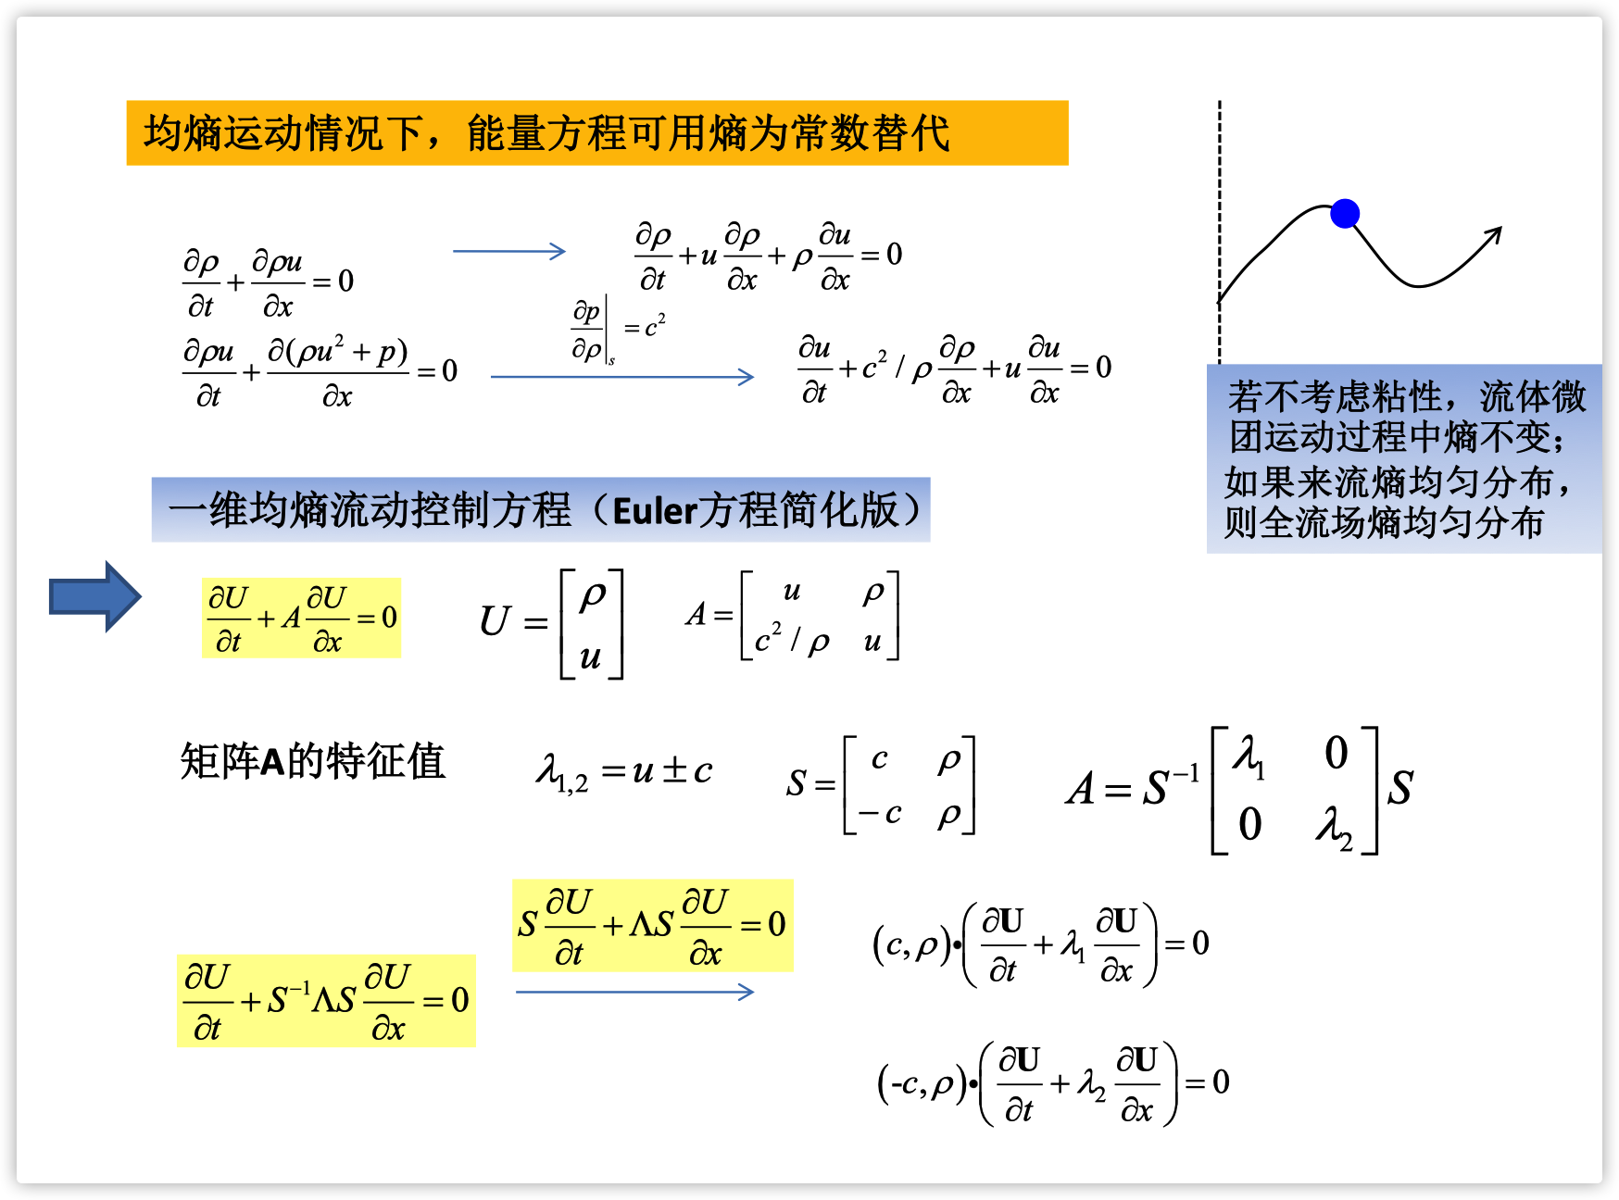
Riemann invariants

Slide 21
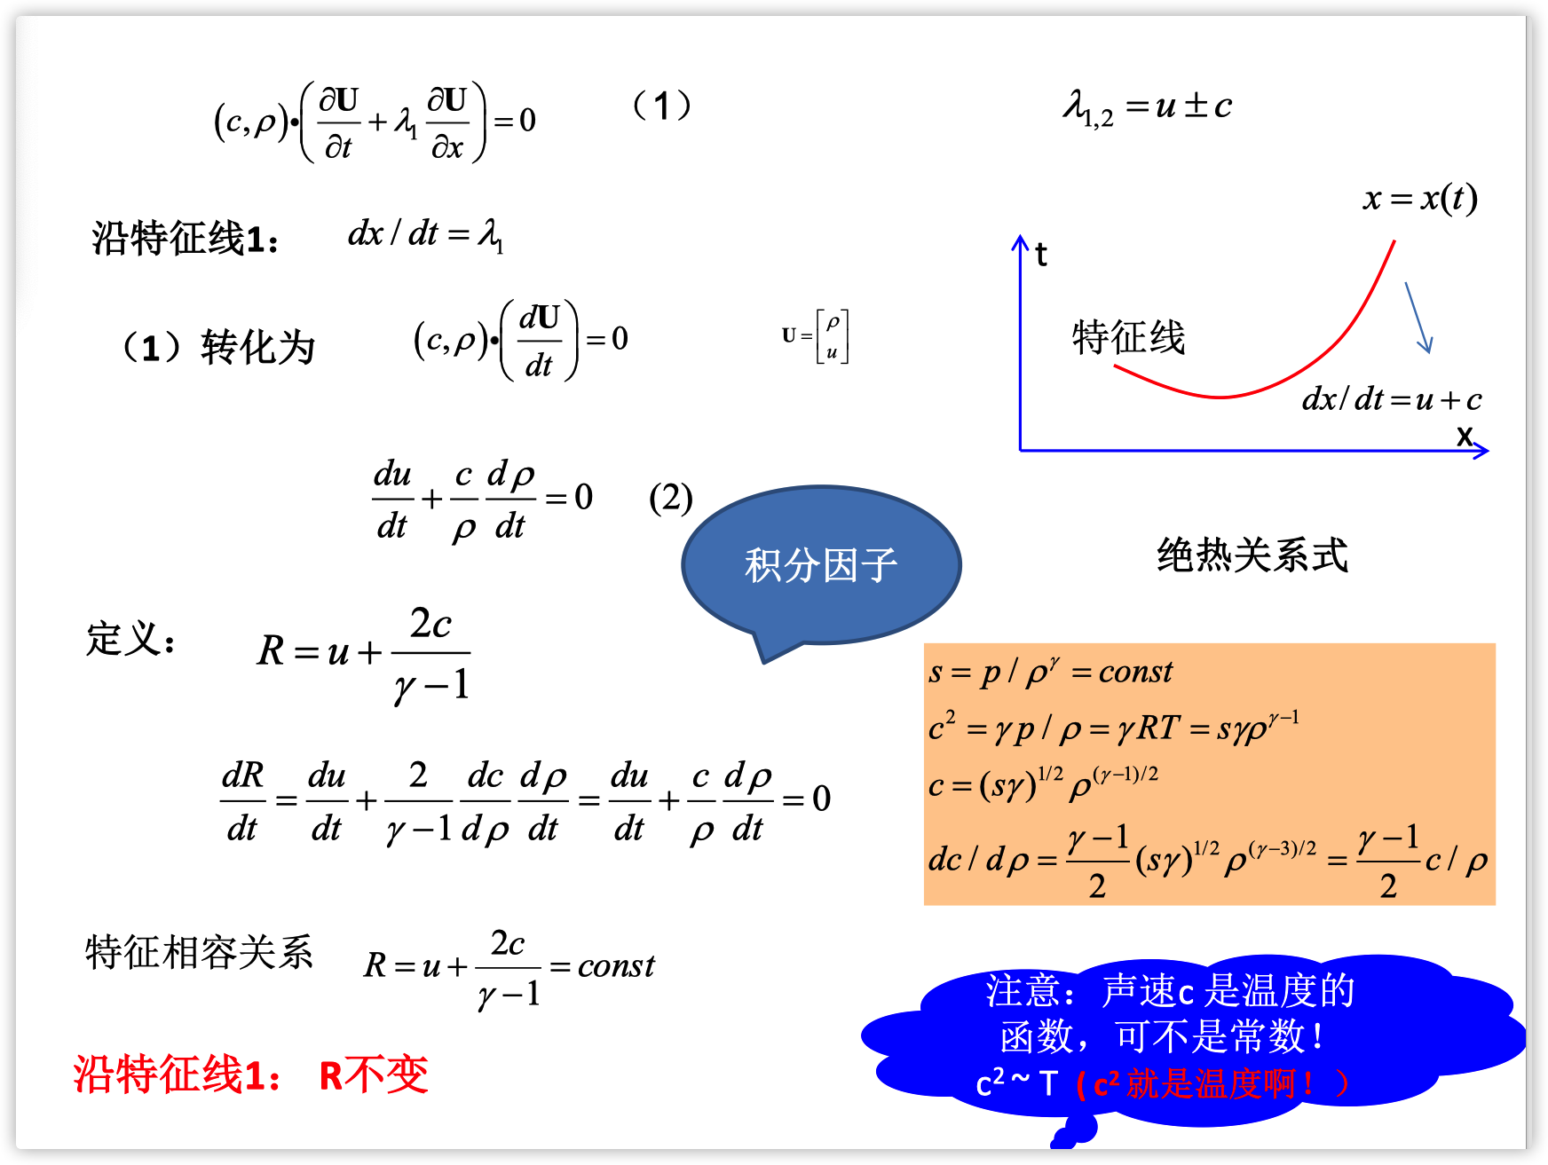
Riemann invariants

Slide 22
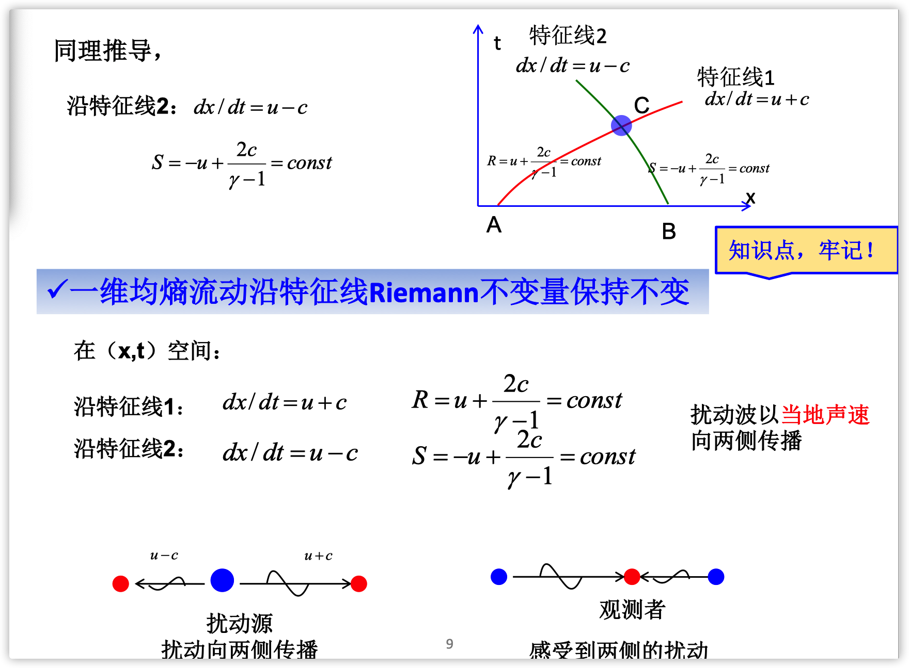
Riemann invariants

Slide 23
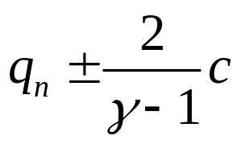
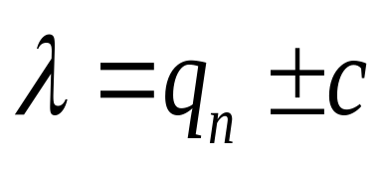
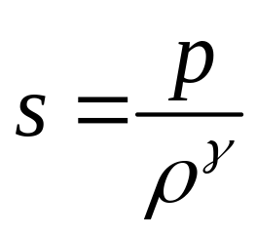
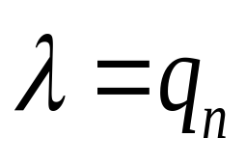

Riemann invariants
along characteristic line
is constant
along characteristic line
is constant
is constant
along characteristic line

Slide 24

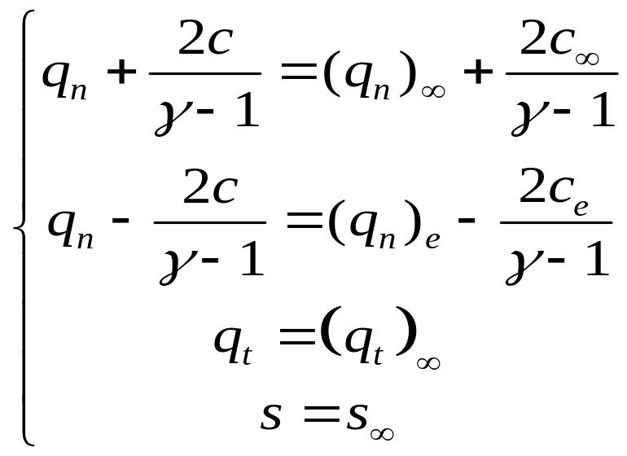

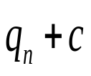
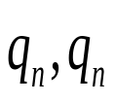
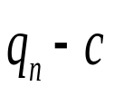

Subsonic in-flow

Slide 25
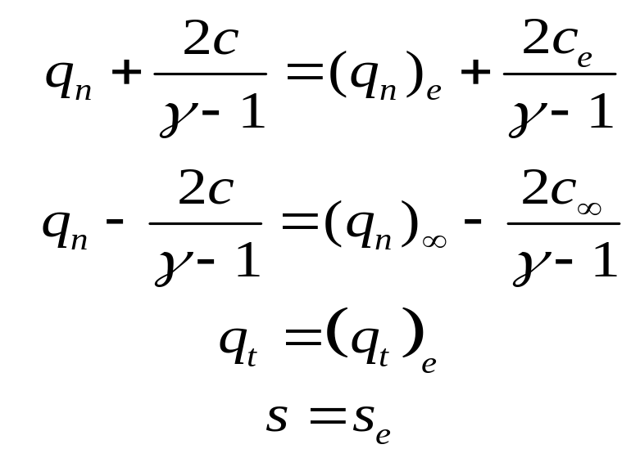

Subsonic out-flow

Slide 26
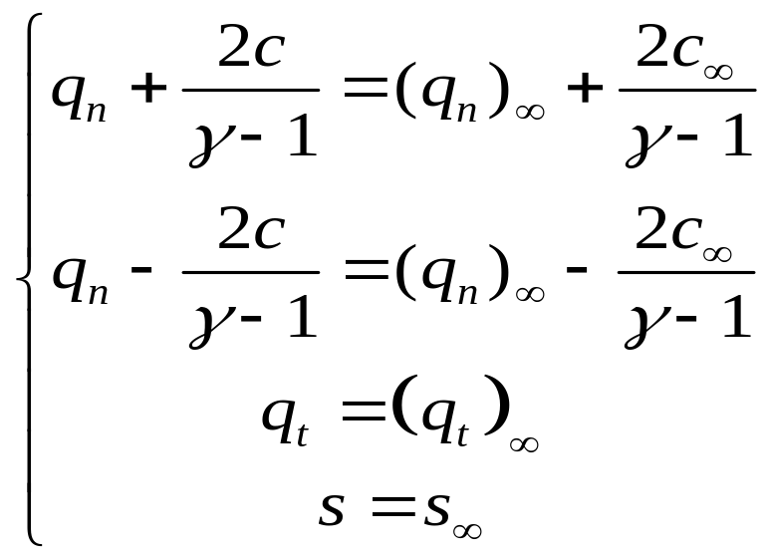


Supersonic in-flow

Slide 27


Supersonic out-flow

Slide 28



Slide 29

Grid

Slide 30

Grid(partial)

Slide 31

Result

Slide 32

Result

Slide 33

Convergent history

