Slide 1
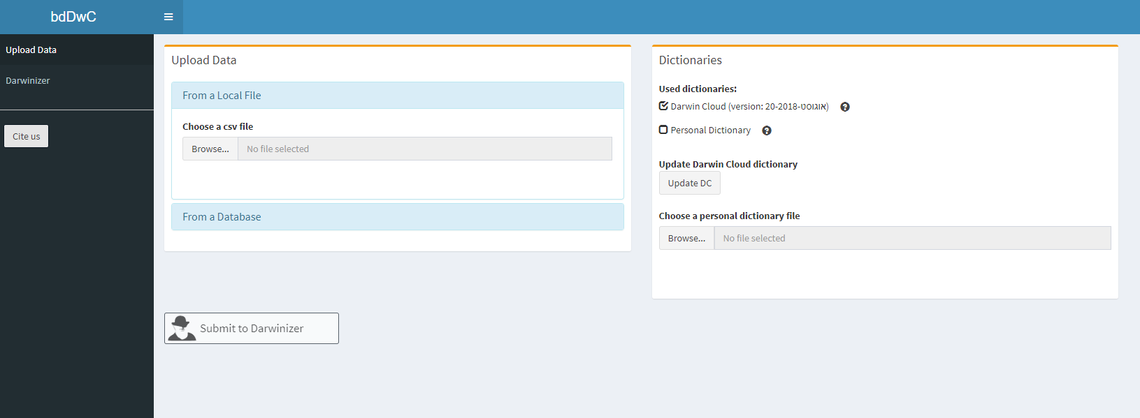
Upload or download data
Add dictionary
Tabs
Execute Darwinizer

Slide 2
Upload or download data
Add dictionary
Tabs
Execute Darwinizer

Slide 3
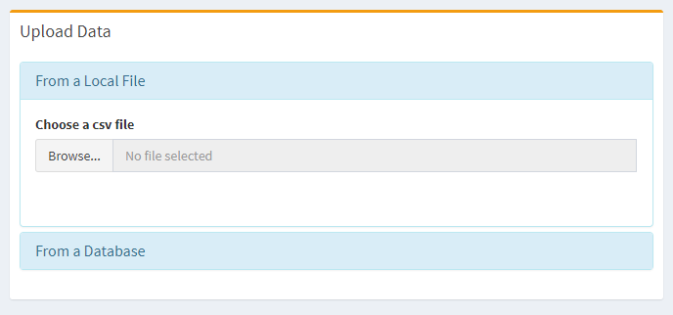

Slide 4
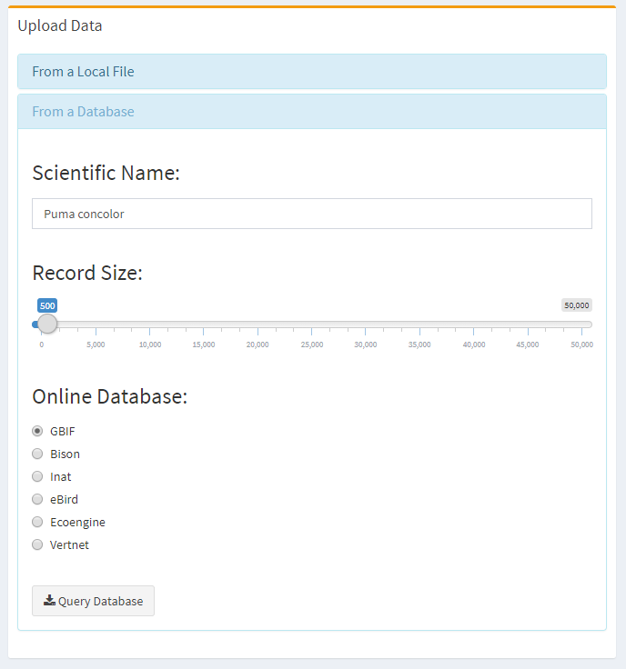

Slide 5

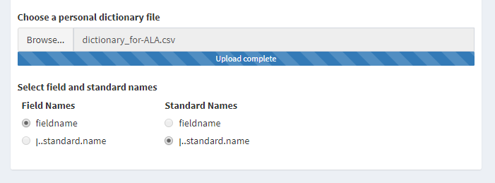


Slide 6
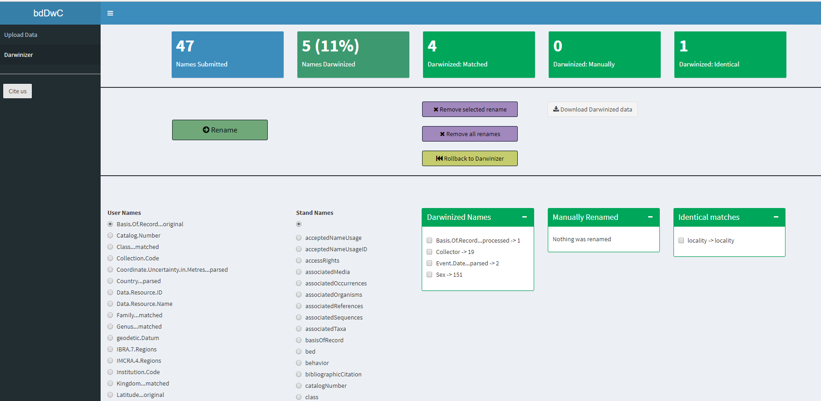
Statistics
Action buttons
Name conversion results
Manual renaming
Darwinized
Manual
Identical

Slide 7
Upload or download data
Add dictionary
Tabs
Execute Darwinizer

Slide 8
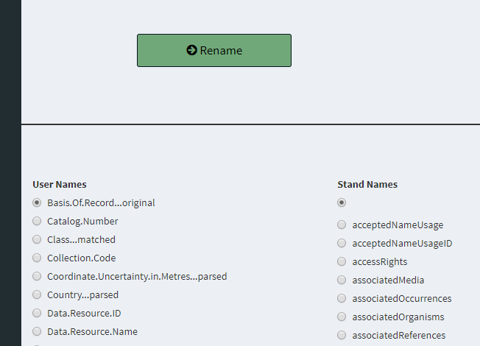
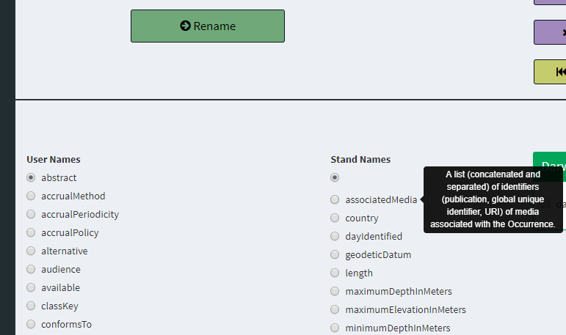

Slide 9
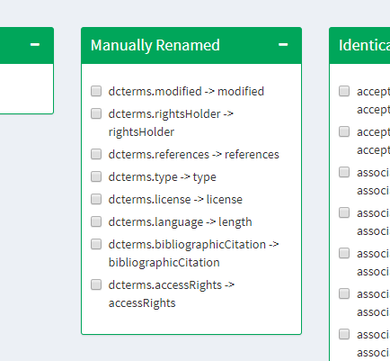

Slide 10






This work is supported by the
Israel Science Foundation (ISF)
Grant No. 127/16
This work is supported by the
Israel Science Foundation (ISF)

Slide 11

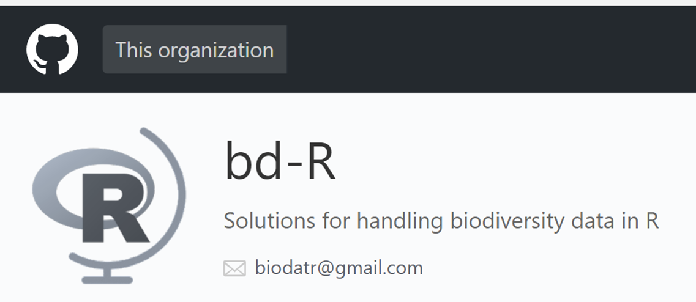








The bdverse
bdclean
User-friendly data cleaning pipeline for the inexperienced R user
bdtools
Tools and reports addressing different data quality issues
bdDwC
bdchecks
bdvis
bdutilities
Darwinazing datasets
Managing & executing Data checks
Unique biodiversity data visualizations & dashboards
Reusable functions & modules across the bdverse
Notes:
list of components: a set of clear data checks, tax workflow, summary tables
Implementing flexibility
Hopefully in the future: customized workflow for : museum data, citizen science, marine organisms, invasive species

Slide 12

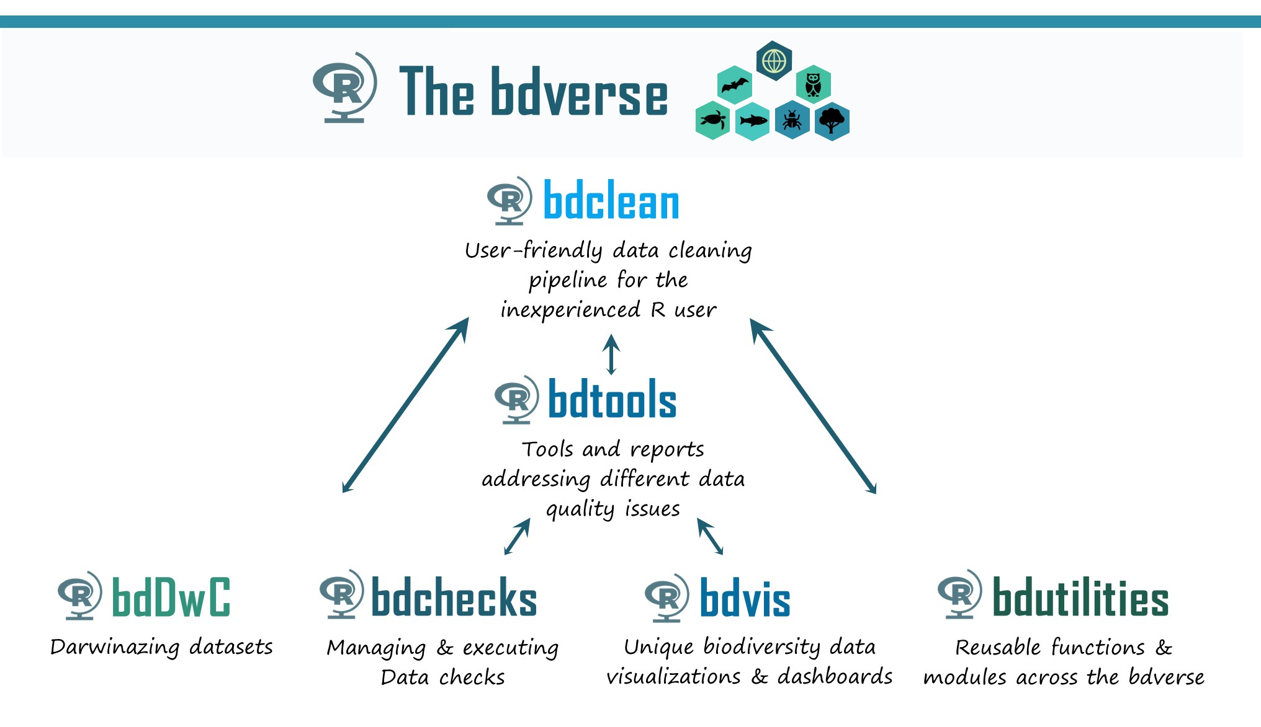
bdDwC

Slide 13
bdDwC

Slide 14
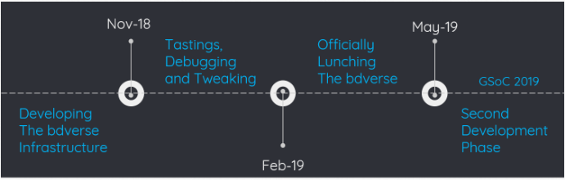

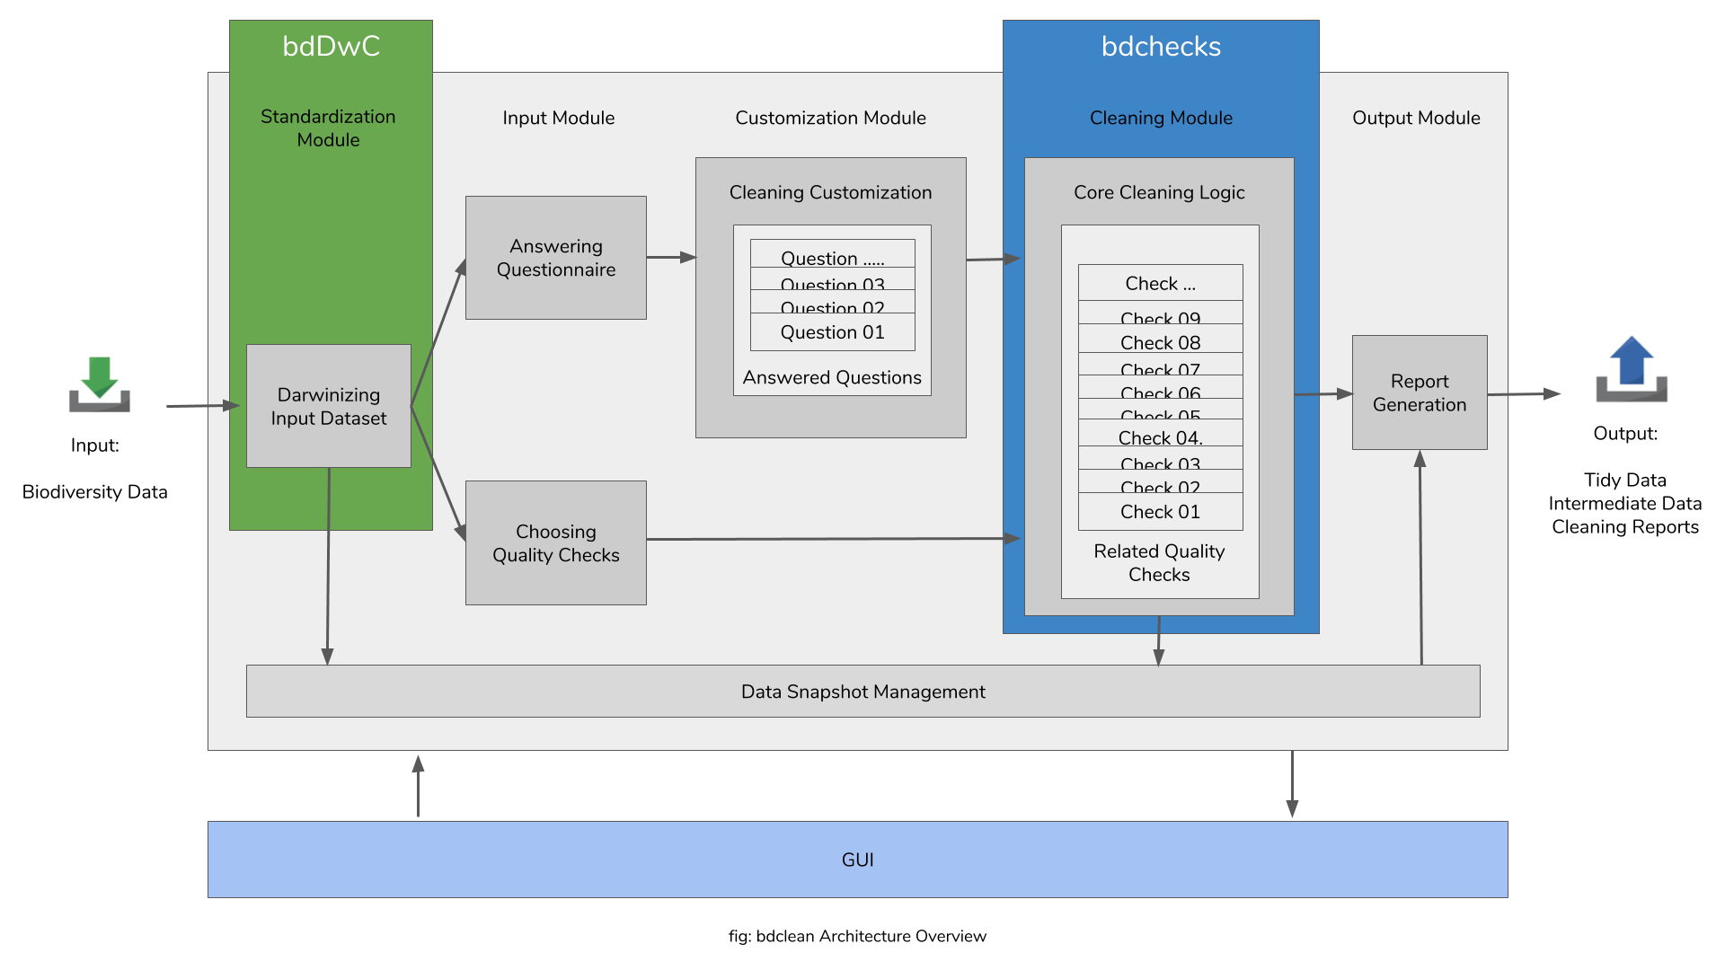
Input:
Biodiversity Data

