Slide 1
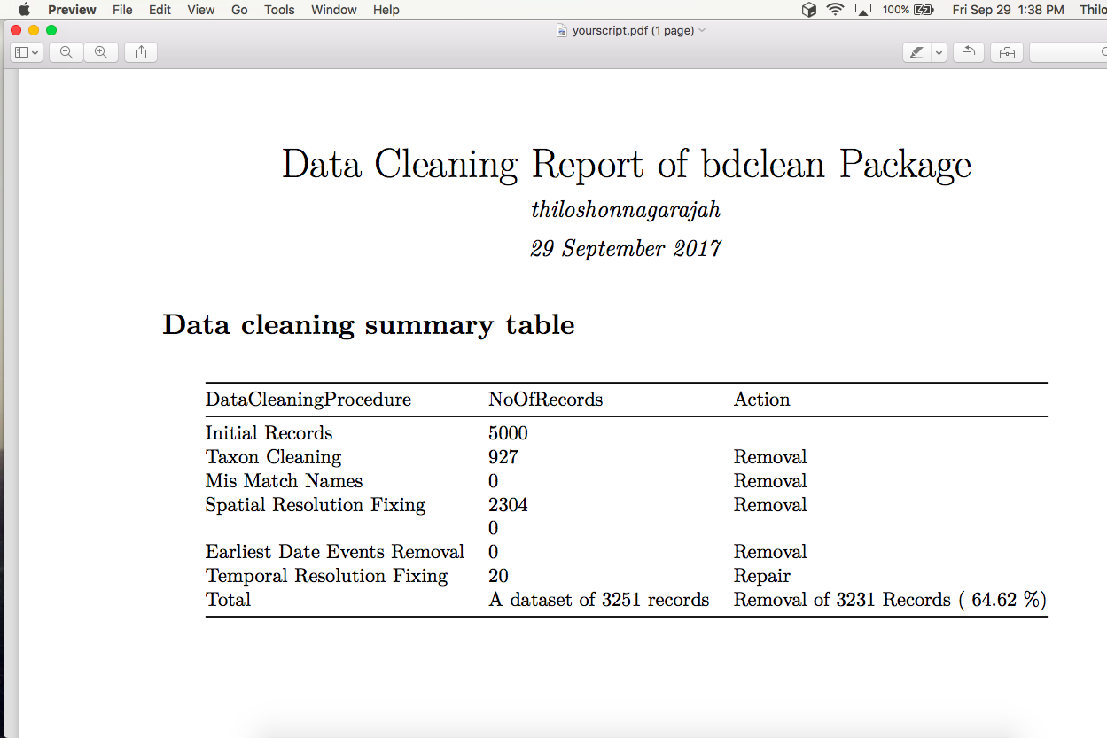



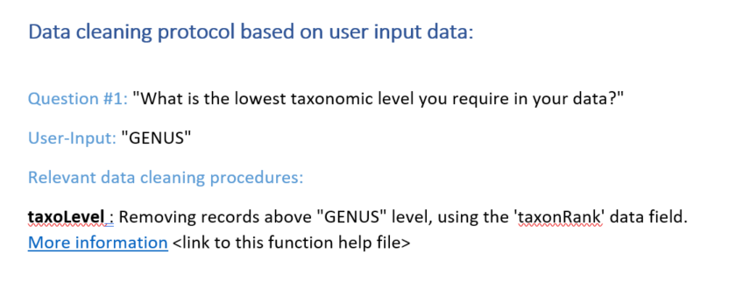


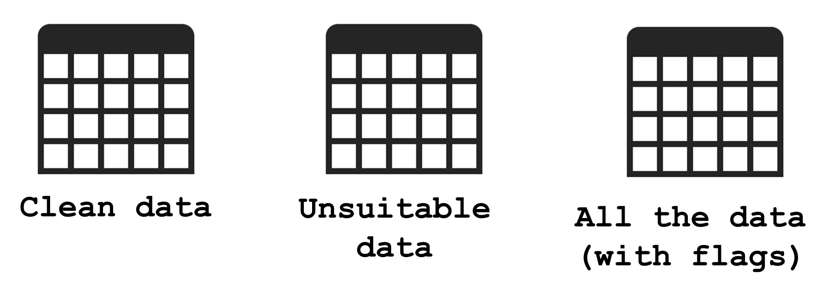
User input
Data cleaning
Outputs
A questionnaire for inquiring user needs
Data checks are performed based on user input

Slide 2
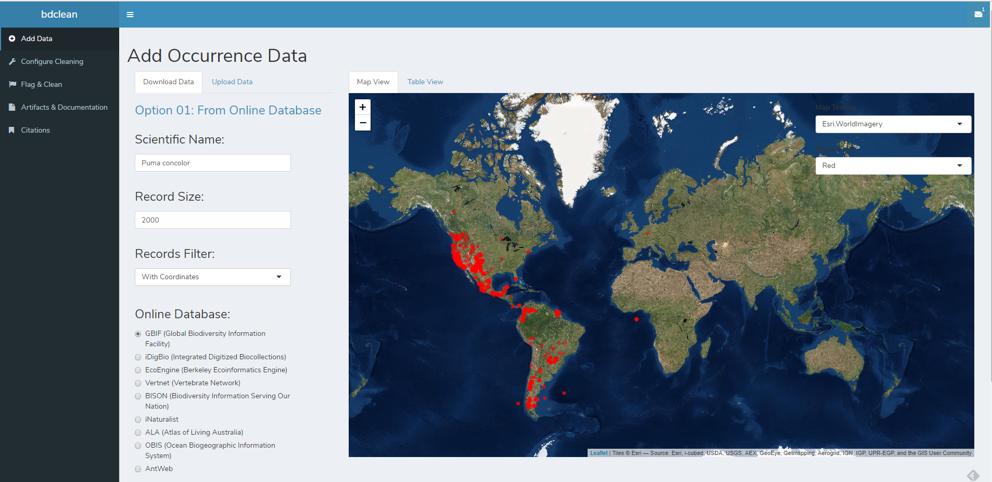

Slide 3
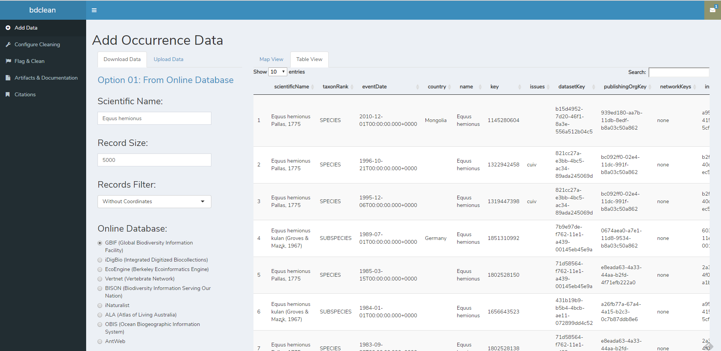

Slide 4
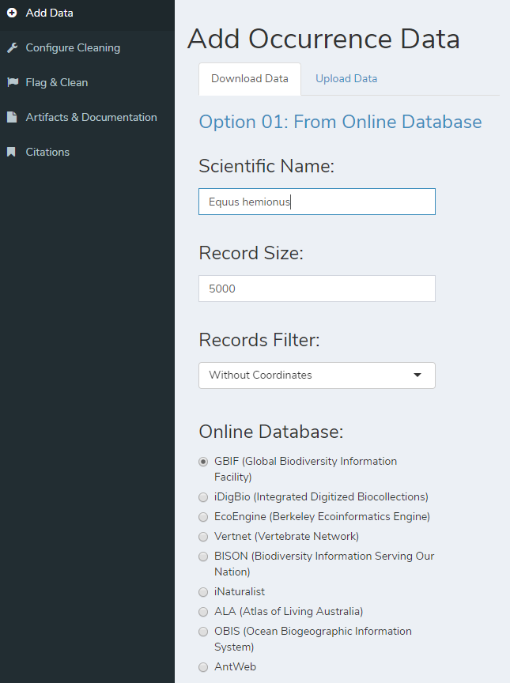
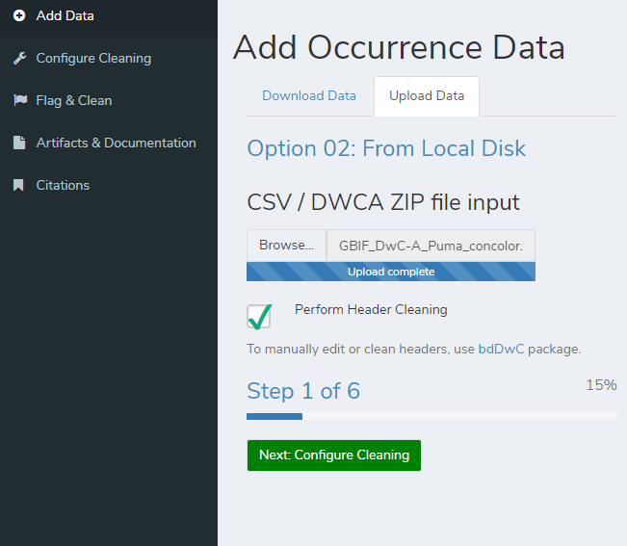

Slide 5
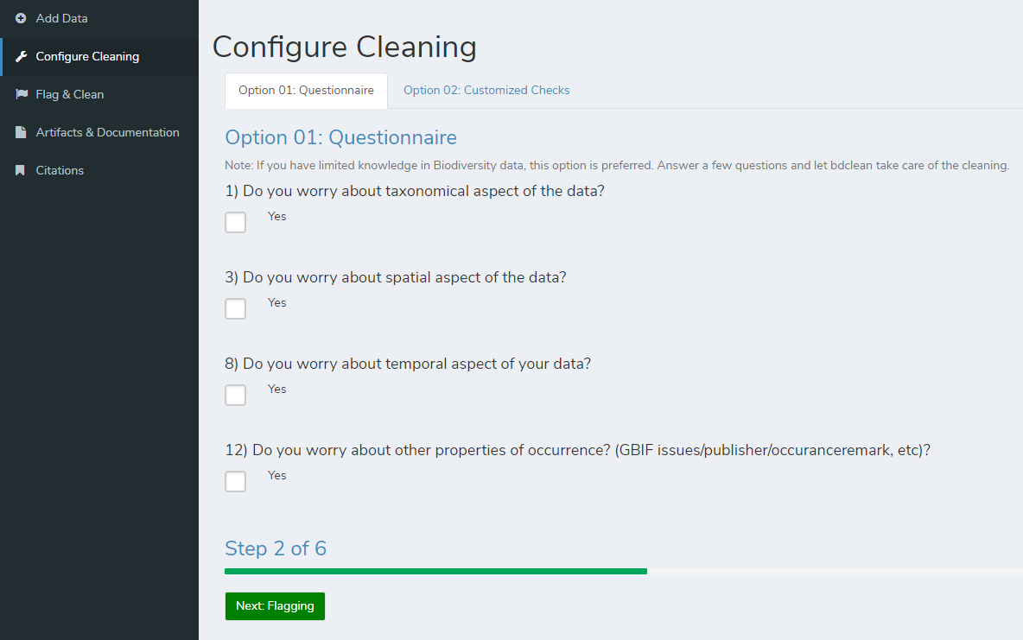

Slide 6
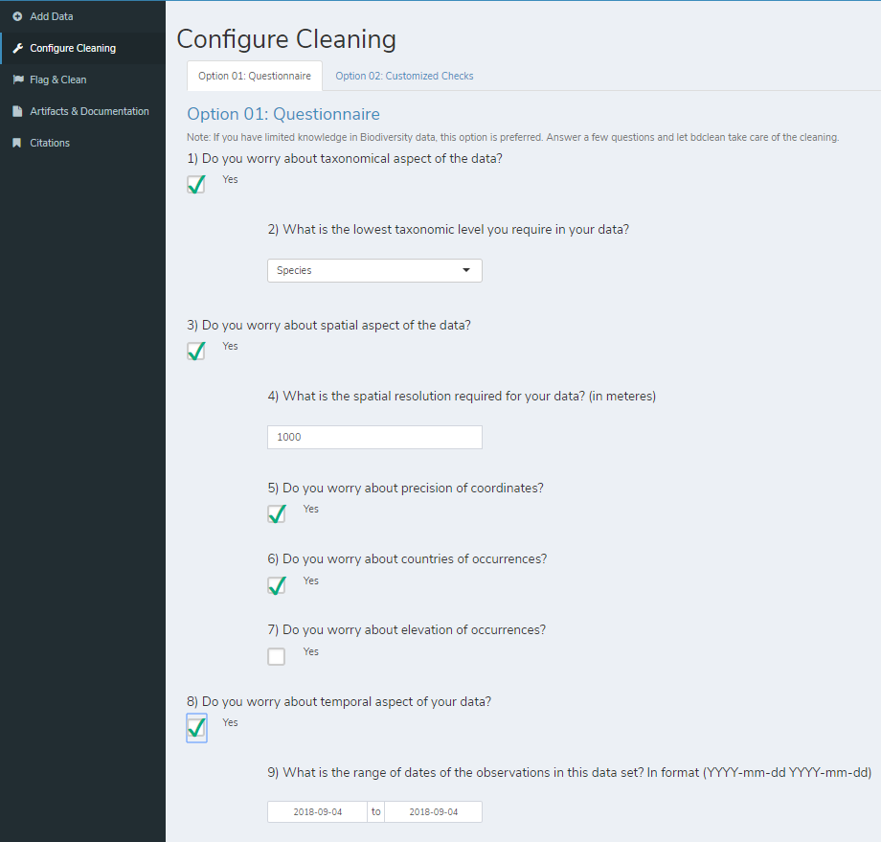

Slide 7
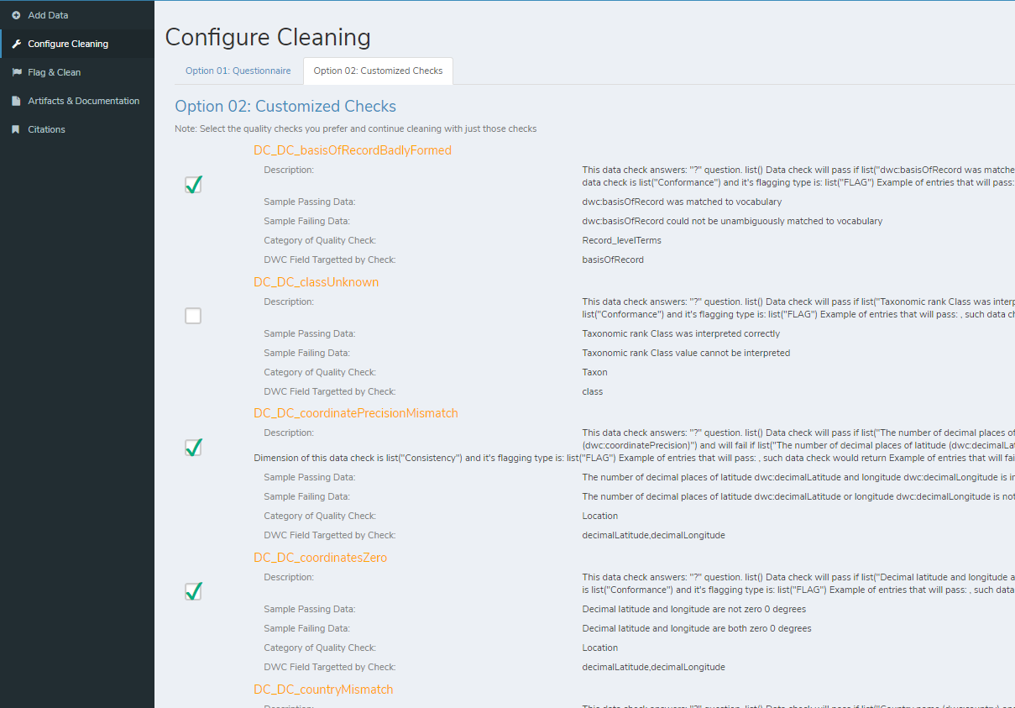

Slide 8
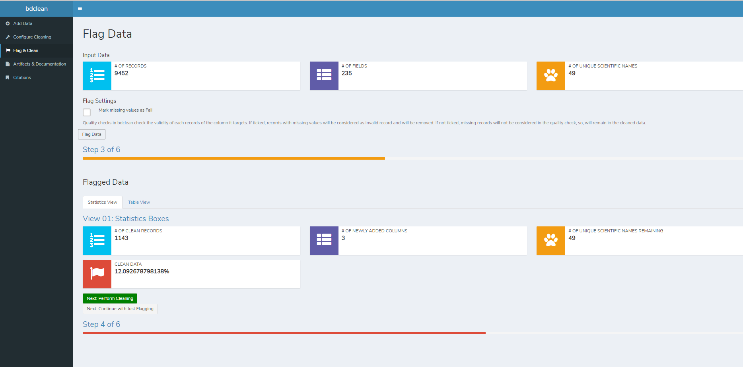

Slide 9
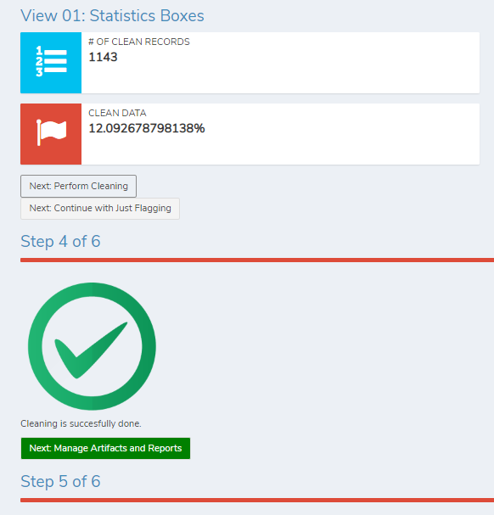

Slide 10








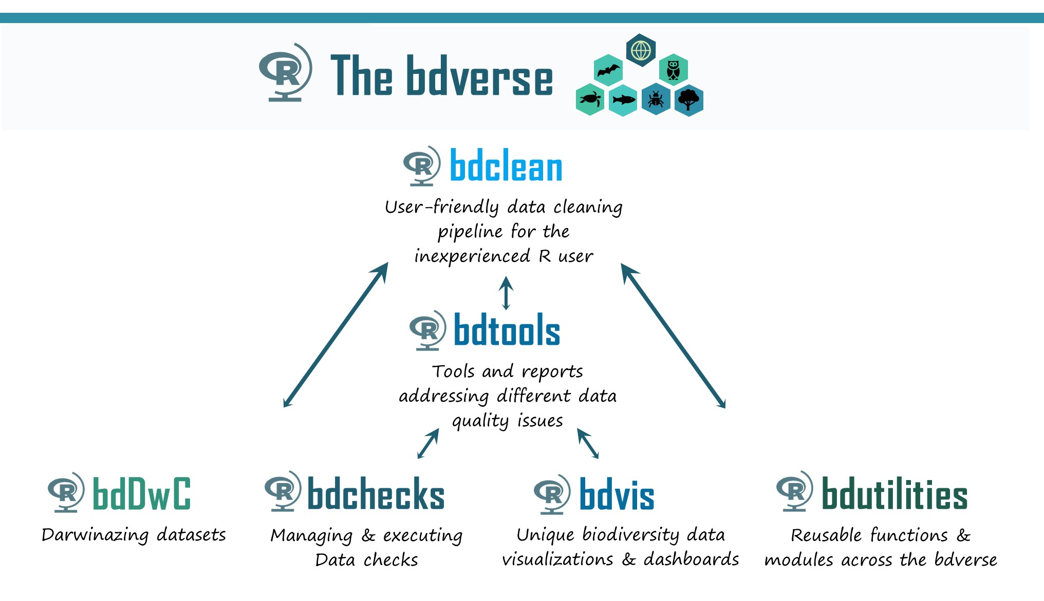
bdclean

Slide 13






This work is supported by the
Israel Science Foundation (ISF)
Grant No. 127/16
This work is supported by the
Israel Science Foundation (ISF)

Slide 14

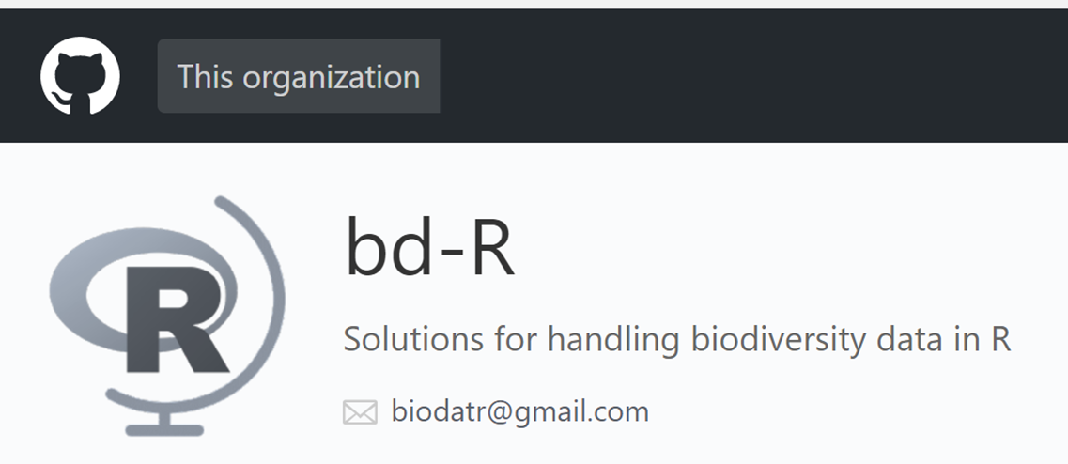


The bdverse
bdclean
User-friendly data cleaning pipeline for the inexperienced R user
bdtools
Tools and reports addressing different data quality issues
bdDwC
bdchecks
bdvis
bdutilities
Darwinazing datasets
Managing & executing data checks
Unique biodiversity data visualizations & dashboards
Reusable functions & modules across the bdverse
Notes:
list of components: a set of clear data checks, tax workflow, summary tables
Implementing flexibility
Hopefully in the future: customized workflow for : museum data, citizen science, marine organisms, invasive species

Slide 17
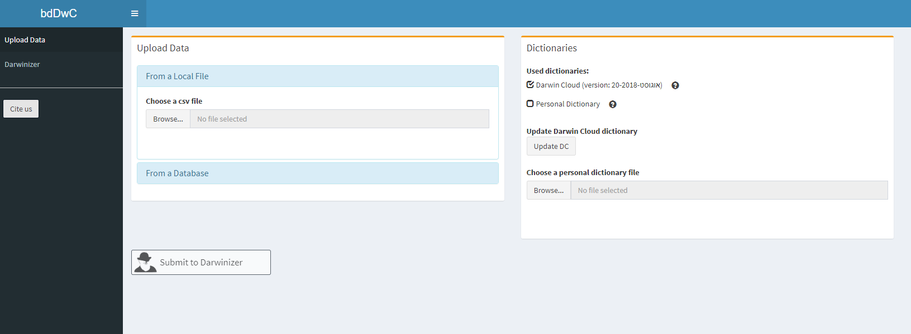
Upload or download data
Add dictionary
Tabs
Execute Darwinizer

Slide 18
Upload or download data
Add dictionary
Tabs
Execute Darwinizer

Slide 19
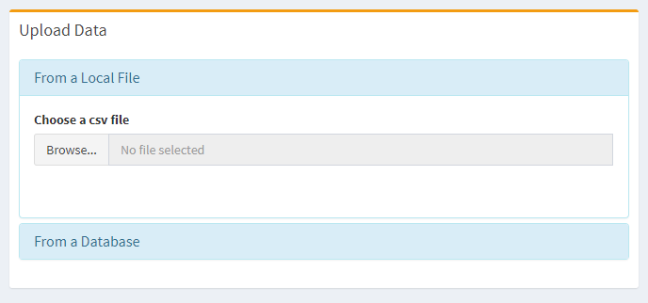

Slide 20
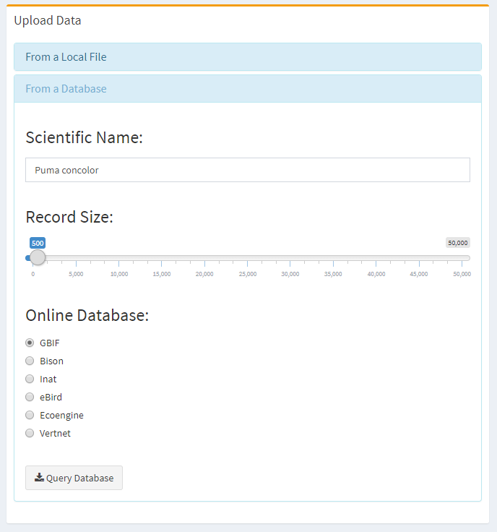

Slide 21

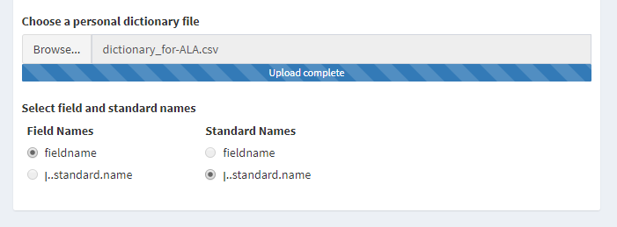


Slide 22
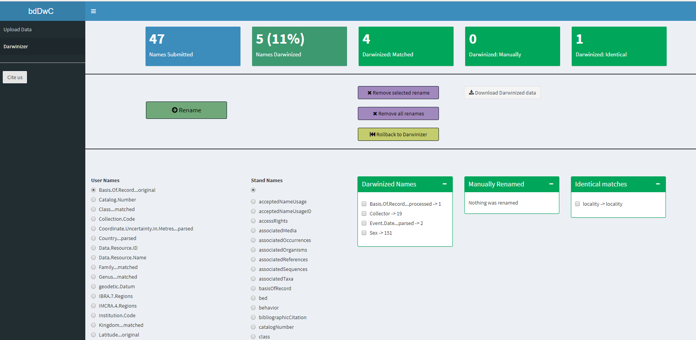
Statistics
Action buttons
Name conversion results
Manual renaming
Darwinized
Manual
Identical

Slide 23
Upload or download data
Add dictionary
Tabs
Execute Darwinizer

Slide 24
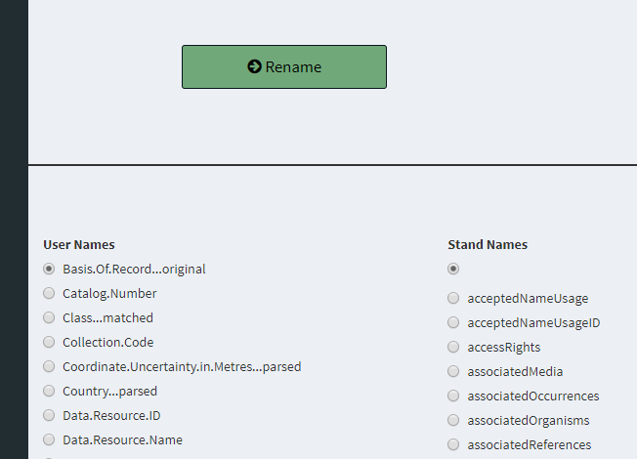
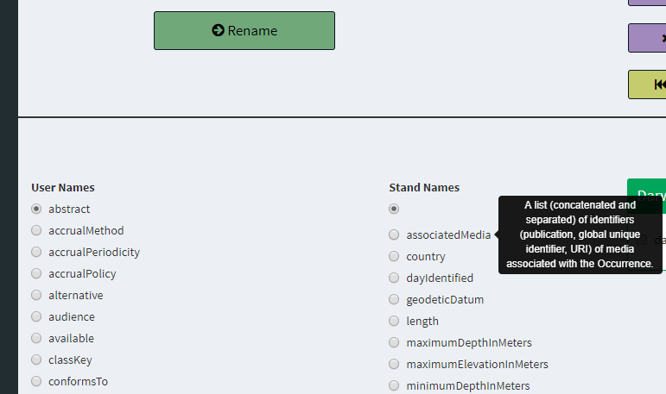

Slide 25
