Slide 1
Video Game Sales
A review of sales data of global video game releases
By Brittni Hedstrom

Slide 2
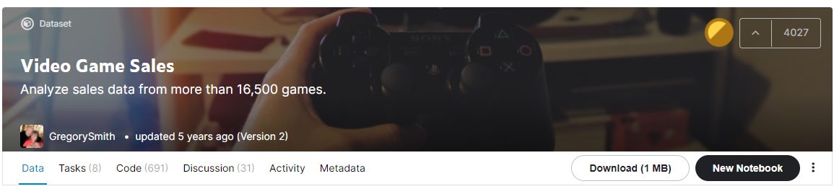
Intro and Background
The data utilized in this presentation is taken from an entry made by user GregorySmith in 2016.
Per his description of the data, “This dataset contains a list of video games with sales greater than 100,000 copies. It was generated by a scrape of vgchartz.com”.
Dates range from 1980-2010

Slide 3
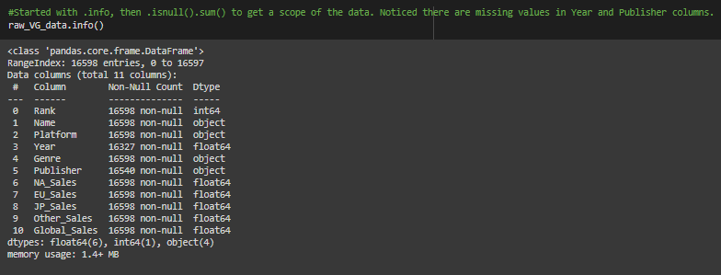
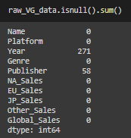
Cleaning the Data: Addressing Null Values
First thing I do is utilize .info() to get a scope of my data in order to find any null values. Although I can already see by looking in the Non-Null Count column that there is an inconsistency in the count, I like to confirm by using .isnull().sum() to confirm the number of missing values.

Slide 4
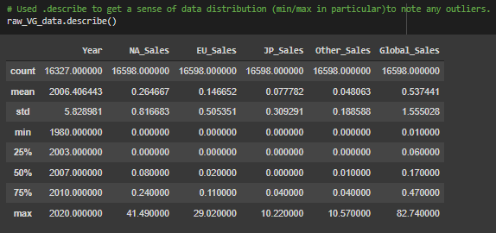
Reviewing the Data
Another step I like to include in the cleaning process is to get a scope of the data through .describe() which is the same data one could find in a box and whisker plot, but is quick enough for me to glean the same information. I will refer to this information in the next slide.

Slide 5

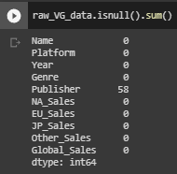
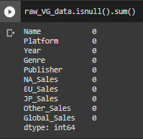
Addressing Null Values Cont’d
I decided to utilize the mean value for Year to replace the missing values in the interest of maintaining the integrity of the data without skewing it one way or another. I was able to find the mean value by using .describe to find that the mean year was 2006 and filled it in for each missing value by using .fillna().
By running .isnull().sum() again we can now see the null values in the Year column have successfully been filled in.
I simply did the same thing for Publisher, but instead used a string value of ‘No Publisher’ to replace the null values to notate the missing information.

Slide 6
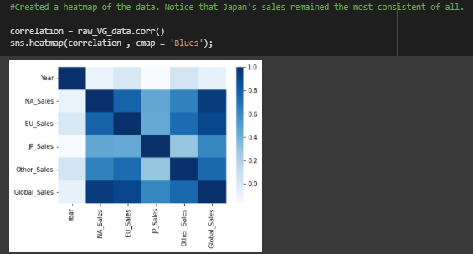
Visualizing the Data: Heatmap
I used a heatmap to see if there were any interesting trends in the data as far as the geographical sales were concerned.
The only thing I was able to really glean from it was that the Japan sales appeared to be the most stable compared to the other countries.

Slide 7
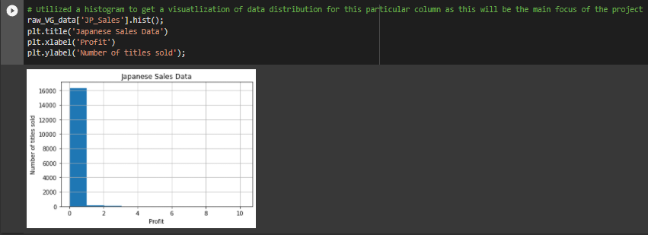
Visualizing the Data: Histogram
Focusing more on Japan’s sales, I graphed the columns data to see if there was anything else that might back up why their sales were more consistent, and looking at this graph, they seem to have one aspect of their market very clearly dominated.

Slide 8
One Note:
I would like to add that I noticed in the kaggle entry is that GregorySmith stated:
However, in my findings, there was indeed missing information for the Year and Publisher columns.. I am curious if that was an oversight on his end, or if the year and publisher were omitted because they were games that did not have a known origin.

