Slide 1
What is the smallest number of words that constitutes the largest portion of English literature?
Data-Driven Word Lists
Samy Babikerali, Gloria Chen, Bao Dinh, Dakota Ellis, Uyen Le
Notes:
Dakota

Slide 2
Key Terms
Word List
Headword
Corpus
English
Coverage
Frequency
Most significant words used by a language
Root of a word (example: Define, Definite,Definitely)
Library of texts
Language used in predominantly English books
Percentage of the corpus the headword appears in
Number of times the headword appears in the corpus
Notes:
Dakota

Slide 3
Why should we care?
Traditional word lists are outdated.
Current methods are inefficient.
Word lists are used to identify important vocabulary.
It’s a scientific competition
Notes:
Uyen
Traditional words lists are outdated → Making learning and communication harder
Headwords in dictionaries aren’t up-to-date, which can slightly create issues for users who want to use them for their needs and goals

Slide 4
General Service Lists
1953
2013
2014
Size: 2000
Coverage: 80%
Corpora: British National Corpus (2.5 Mils)
Size: 2494
Coverage: 84%
Corpora: LOB, BNC, BEO6, EnTenTen12 (12.1 Bils)
Size: 2801
Coverage: 90%
Corpora: Cambridge English Corpus (273 mils)
Notes:
Gloria

Slide 5
Optimized Data-Driven Model
Data science methods
Larger corpus
Fully quantitative, statistical analysis
Automated process
Notes:
Bao
Google Books corpus
Reduce subjective judgements with quantitative methods
Utilize statistical principles
Relationship between frequency distribution and word significance
Streamline the process
Create a viable word list with data science

Slide 6
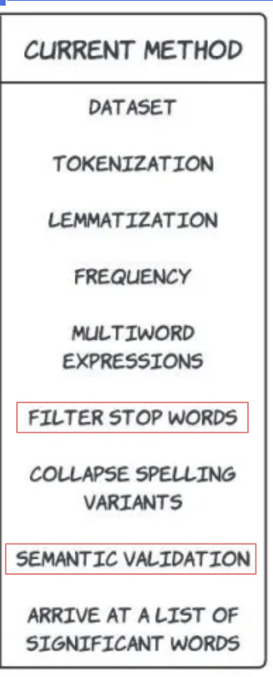
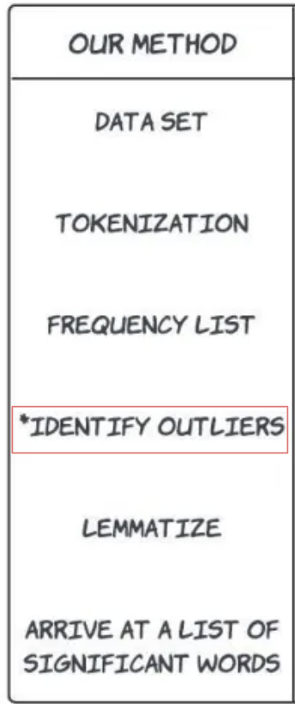

Slide 7
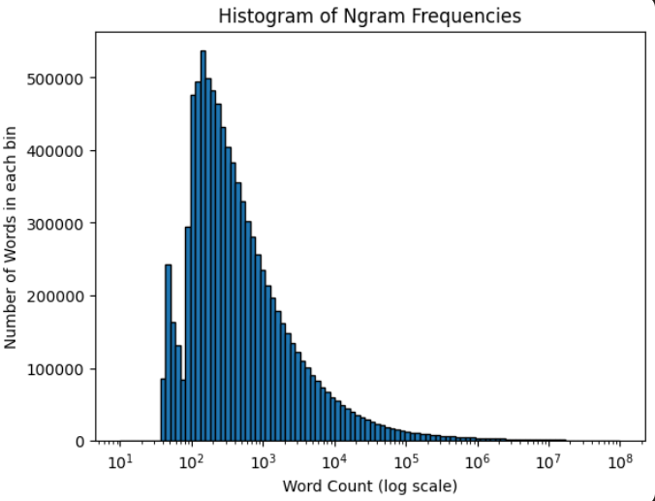
Frequency Word Count

Slide 8
Applications
Evaluating LLMs
Text Mining
Topic Modeling
Notes:
Samy
LLMs: evaluate the efficiency and outdatedness of LLMs in real-time
Delve, Embark, Drive insightful data-driven decisions, Deliver actionable insights through in-depth data analysis
Text Mining: the process of extracting useful information and insights from unstructured text data.
Topic Mining: use our methodology to identify topic tokens

Slide 9
Benefits
1. English learners will eventually end up with taxa that better align with their needs, are more helpful, and are more practical than previously available resources.
2. Lexicographers can pursue a cleaner and data-based approach to creating today’s learner dictionaries.
3. Teachers require the most up-to-date frequency-based word lists for an effective reading curriculum and curriculum design.
4. Researchers benefit from an innovative approach to analyzing the frequency of words, semantic domains, and language change between corpora.
Notes:
Samy
LLMs: evaluate the efficiency and outdatedness of LLMs in real-time
Delve, Embark, Drive insightful data-driven decisions, Deliver actionable insights through in-depth data analysis
Text Mining: the process of extracting useful information and insights from unstructured text data.
Topic Mining: use our methodology to identify topic tokens

Slide 10
Q & A

