Slide 1
GTBR
Gastric Tissue Biopsy Robot
（GTBR）
An AI-driven pathologist to
detect cancer cells exist in gastric tissue
By Baodong Zhang, graduation project in spiced academy

Slide 2
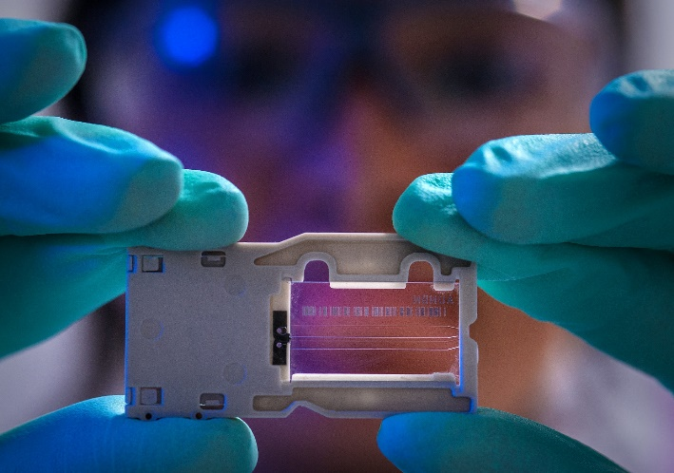
Gastric Tissue Biopsy Robot （GTBR）
An AI-driven pathologist to
detect cancer cells exist in gastric tissue
We are Short Of Pathologists
“The number of active pathologists in the U.S. plummeted between 2007 and 2017 by about 17.5% and puts the country at risk of a shortage in the future, though a smaller workforce is currently handling a bigger load of cases.” according to a study published on May 31 in JAMA Network Open.
Earlier cancer detection in gastroscopy
The need for rapid and precise pathological diagnosis

Slide 3
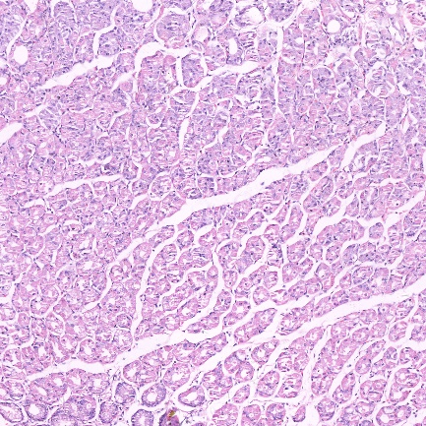
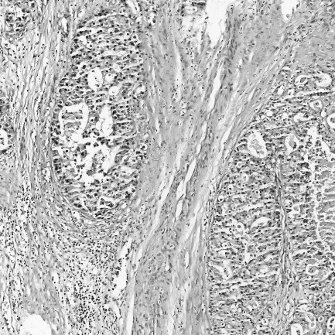
Gastric Tissue Biopsy Robot（GTBR）
Data preparation
A gastric tissue biopsy (stomach biopsy) is a procedure used to diagnose a range of conditions. In this application, we focus on stomach cancer detection.
560 pcs images of pathological section of gastric cancer
140 pcs images of pathological section of non cancer gastric
Data Augmentation
560 pcs ------> 3361 pcs
140 pcs ----- > 2800 pcs Totally 6161pcs
Change image size
2048 x 2048 ---------> 2014 x 1024
Train the model with RGB and grayscale image

Slide 4
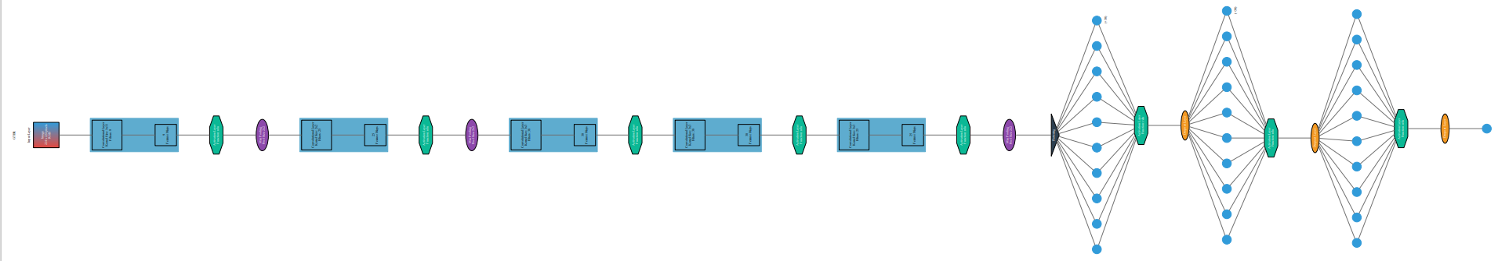
Gastric Tissue Biopsy Robot （GTBR）
Base Model
pip3 install ann_visualizer
pip install graphviz
validation_split in training：
loss: 6.7656e-08 - accuracy: 0.4998 –
val_loss: 6.8815e-08 - val_accuracy: 0.5287
model.evaluate(X_test_array, y_test)
loss: 6.8815e-08 - accuracy: 0.5475
Green button: activation layer relu
Purple button: max pooling
Yellow button: drop out
Black triangle: flattening

Slide 5
Gastric Tissue Biopsy Robot （GTBR）
Transfer Learning Model
Base model : ResNet50V2
Three hidden layer with drop out or BatchNormalization
Before output layer is GAP
Output layer has 1 neuron with sigmoid activation
accuracy: 0.9293 - val_loss: 0.0000e+00 - val_accuracy: 0.9485
#model.evaluate(X_test_array, y_test)
loss: 0.0000e+00 - accuracy: 0.9446

Slide 6
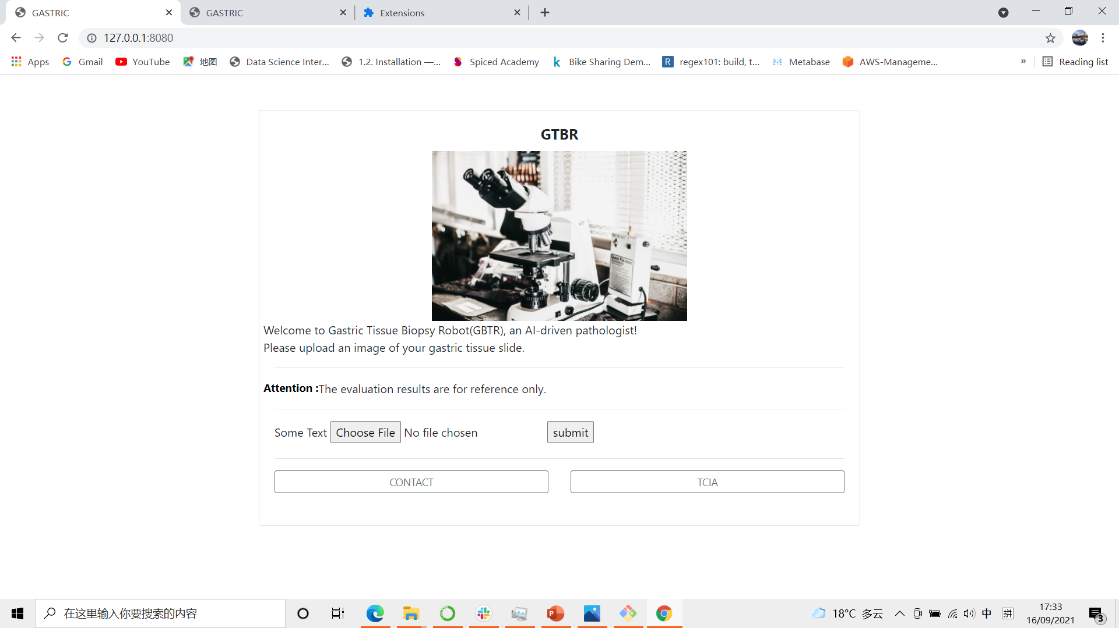
Web Application
Web APP with Flask
Inspired by SkinCheck project of Leona
https://github.com/leona-ha/Skin-Screening_Web-App

Slide 7
Gastric Tissue Biopsy Robot （GTBR）
Thanks
Thanks to Spicy Academy and my cohort classmates. specially
Marija
Kristian
Tom
Dina
Sara
Rene
Jinglin
And all the other teacher and classmates…
I will life long appreciate that the Arbeitsamt Pankow provides financial support.

Slide 8
Transfer Learning Model
Model: "sequential_10"
_________________________________________________________________
Layer (type) Output Shape Param #
=================================================================
resnet50v2 (Functional) (None, 7, 7, 2048) 23564800
_________________________________________________________________
dense_34 (Dense) (None, 7, 7, 60) 122940
_________________________________________________________________
dropout_21 (Dropout) (None, 7, 7, 60) 0
_________________________________________________________________
dense_35 (Dense) (None, 7, 7, 50) 3050
_________________________________________________________________
batch_normalization_24 (Batc (None, 7, 7, 50) 200
_________________________________________________________________
dense_36 (Dense) (None, 7, 7, 50) 2550
_________________________________________________________________
batch_normalization_25 (Batc (None, 7, 7, 50) 200
_________________________________________________________________
global_average_pooling2d_3 ( (None, 50) 0
_________________________________________________________________
dense_37 (Dense) (None, 1) 51
=================================================================
Total params: 23,693,791
Trainable params: 23,648,151
Non-trainable params: 45,640

Slide 9
Gastric Tissue Biopsy Robot （GTBR）
Base Model
Model: "sequential"
_________________________________________________________________
Layer (type) Output Shape Param #
=================================================================
conv2d (Conv2D) (None, 54, 54, 9) 3276
_________________________________________________________________
activation (Activation) (None, 54, 54, 9) 0
_________________________________________________________________
max_pooling2d (MaxPooling2D) (None, 27, 27, 9) 0
_________________________________________________________________
conv2d_1 (Conv2D) (None, 26, 26, 25) 925
_________________________________________________________________
activation_1 (Activation) (None, 26, 26, 25) 0
_________________________________________________________________
max_pooling2d_1 (MaxPooling2 (None, 13, 13, 25) 0
_________________________________________________________________
conv2d_2 (Conv2D) (None, 11, 11, 38) 8588
_________________________________________________________________
activation_2 (Activation) (None, 11, 11, 38) 0
_________________________________________________________________
conv2d_3 (Conv2D) (None, 9, 9, 38) 13034
_________________________________________________________________
activation_3 (Activation) (None, 9, 9, 38) 0
_________________________________________________________________
conv2d_4 (Conv2D) (None, 7, 7, 25) 8575
_________________________________________________________________
activation_4 (Activation) (None, 7, 7, 25) 0
_________________________________________________________________
max_pooling2d_2 (MaxPooling2 (None, 3, 3, 25) 0
_________________________________________________________________
flatten (Flatten) (None, 225) 0
_________________________________________________________________
dense (Dense) (None, 40) 9040
_________________________________________________________________
activation_5 (Activation) (None, 40) 0
_________________________________________________________________
dropout (Dropout) (None, 40) 0
_________________________________________________________________
dense_1 (Dense) (None, 40) 1640
_________________________________________________________________
activation_6 (Activation) (None, 40) 0
_________________________________________________________________
dropout_1 (Dropout) (None, 40) 0
_________________________________________________________________
dense_2 (Dense) (None, 10) 410
_________________________________________________________________
activation_7 (Activation) (None, 10) 0
_________________________________________________________________
dropout_2 (Dropout) (None, 10) 0
_________________________________________________________________
dense_3 (Dense) (None, 1) 11
_________________________________________________________________
activation_8 (Activation) (None, 1) 0
=================================================================
Total params: 45,499
Trainable params: 45,499
Non-trainable params: 0

