Slide 1
GTBR
Gastric Tissue Biopsy Robot
（GTBR）
An AI-driven pathologist to
detect cancer cells exist in gastric tissue
By Baodong Zhang, graduation project in spiced academy

Slide 2
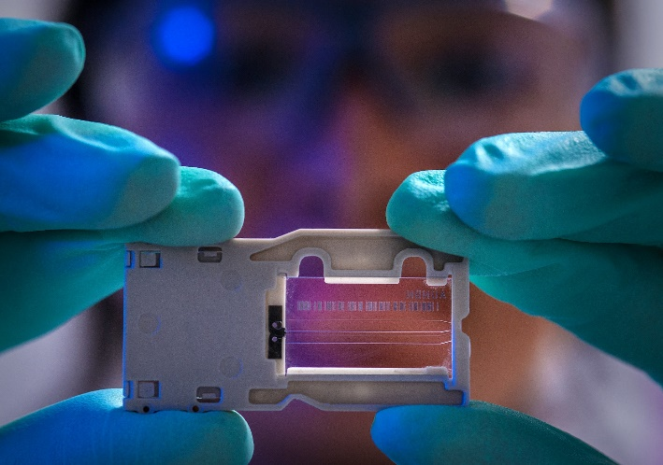
Gastric Tissue Biopsy Robot （GTBR）
An AI-driven pathologist to
detect cancer cells exist in gastric tissue
We are Short Of Pathologists
“The number of active pathologists in the U.S. plummeted between 2007 and 2017 by about 17.5% and puts the country at risk of a shortage in the future, though a smaller workforce is currently handling a bigger load of cases.” according to a study published on May 31 in JAMA Network Open.
Earlier cancer detection in gastroscopy
The need for rapid and precise pathological diagnosis during surgery

Slide 3
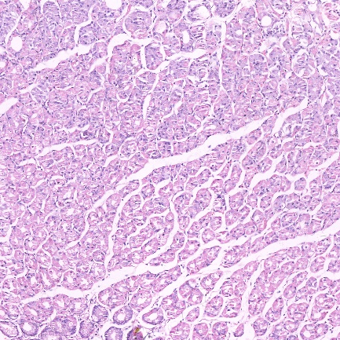
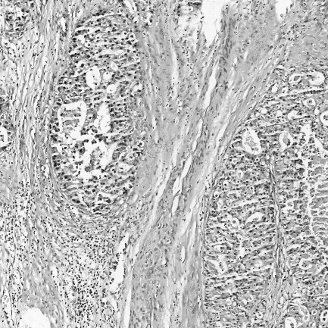
Gastric Tissue Biopsy Robot（GTBR）
Data preparation
A gastric tissue biopsy (stomach biopsy) is a procedure used to diagnose a range of conditions. In this application, we focus on stomach cancer detection.
560 pcs images of pathological section of gastric cancer
140 pcs images of pathological section of non cancer gastric
Data Augmentation
560 pcs ------> 3361 pcs
140 pcs ----- > 2800 pcs Totally 6161pcs
Change image size
2048 x 2048 ---------> 2014 x 1024
Train the model with RGB and grayscale image

Slide 4
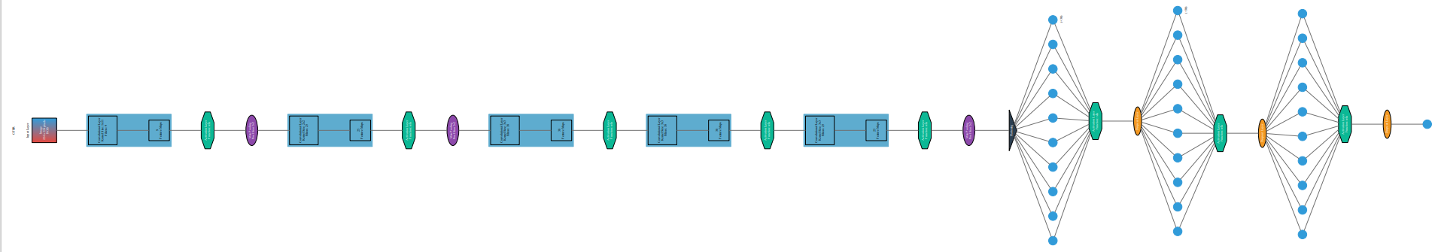
Gastric Tissue Biopsy Robot （GTBR）
Base Model
pip3 install ann_visualizer
pip install graphviz
validation_split in training：
loss: 6.7656e-08 - accuracy: 0.4998 –
val_loss: 6.8815e-08 - val_accuracy: 0.5287
model.evaluate(X_test_array, y_test)
loss: 6.8815e-08 - accuracy: 0.5475
Green button: activation layer relu
Purple button: max pooling
Yellow button: drop out
Black triangle: flattening

Slide 5
Gastric Tissue Biopsy Robot （GTBR）
Transfer Learning Model
Base model : ResNet50V2
Three hidden layer with drop out or BatchNormalization
Before output layer is GAP
Output layer has 1 neuron with sigmoid activation
accuracy: 0.9293 - val_loss: 0.0000e+00 - val_accuracy: 0.9485
#model.evaluate(X_test_array, y_test)
loss: 0.0000e+00 - accuracy: 0.9446

Slide 6
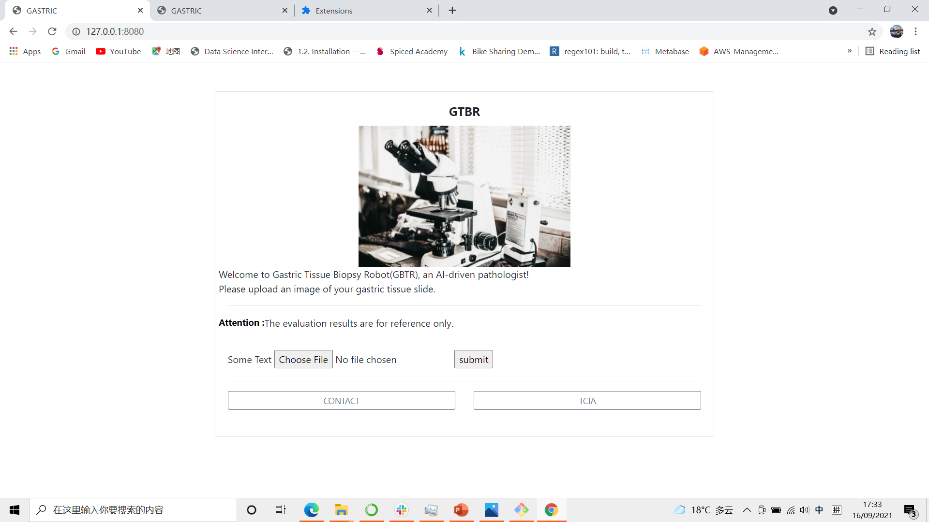
Web Application
Web APP with Flask
Inspired by SkinCheck project of Leona
https://github.com/leona-ha/Skin-Screening_Web-App

Slide 7
Gastric Tissue Biopsy Robot （GTBR）
Thanks
Thanks to Spicy Academy and my cohort classmates. specially
Marija
Kristian
Tom
Dina
Sara
Rene
Jinglin
And all the other teacher and classmates…
I will life long appreciate that the Arbeitsamt Pankow provides financial support.

Slide 8
Transfer Learning Model
Model: "sequential_10"
_________________________________________________________________
Layer (type) Output Shape Param #
=================================================================
resnet50v2 (Functional) (None, 7, 7, 2048) 23564800
_________________________________________________________________
dense_34 (Dense) (None, 7, 7, 60) 122940
_________________________________________________________________
dropout_21 (Dropout) (None, 7, 7, 60) 0
_________________________________________________________________
dense_35 (Dense) (None, 7, 7, 50) 3050
_________________________________________________________________
batch_normalization_24 (Batc (None, 7, 7, 50) 200
_________________________________________________________________
dense_36 (Dense) (None, 7, 7, 50) 2550
_________________________________________________________________
batch_normalization_25 (Batc (None, 7, 7, 50) 200
_________________________________________________________________
global_average_pooling2d_3 ( (None, 50) 0
_________________________________________________________________
dense_37 (Dense) (None, 1) 51
=================================================================
Total params: 23,693,791
Trainable params: 23,648,151
Non-trainable params: 45,640

Slide 9
Gastric Tissue Biopsy Robot （GTBR）
Base Model
Model: "sequential_9"
_________________________________________________________________
Layer (type) Output Shape Param #
=================================================================
conv2d_22 (Conv2D) (None, 54, 54, 96) 34944
_________________________________________________________________
activation_27 (Activation) (None, 54, 54, 96) 0
_________________________________________________________________
max_pooling2d_17 (MaxPooling (None, 27, 27, 96) 0
_________________________________________________________________
batch_normalization_16 (Batc (None, 27, 27, 96) 384
_________________________________________________________________
conv2d_23 (Conv2D) (None, 17, 17, 256) 2973952
_________________________________________________________________
activation_28 (Activation) (None, 17, 17, 256) 0
_________________________________________________________________
max_pooling2d_18 (MaxPooling (None, 8, 8, 256) 0
_________________________________________________________________
batch_normalization_17 (Batc (None, 8, 8, 256) 1024
_________________________________________________________________
conv2d_24 (Conv2D) (None, 6, 6, 384) 885120
_________________________________________________________________
activation_29 (Activation) (None, 6, 6, 384) 0
_________________________________________________________________
batch_normalization_18 (Batc (None, 6, 6, 384) 1536
_________________________________________________________________
conv2d_25 (Conv2D) (None, 4, 4, 384) 1327488
_________________________________________________________________
activation_30 (Activation) (None, 4, 4, 384) 0
_________________________________________________________________
batch_normalization_19 (Batc (None, 4, 4, 384) 1536
_________________________________________________________________
conv2d_26 (Conv2D) (None, 2, 2, 256) 884992
_________________________________________________________________
activation_31 (Activation) (None, 2, 2, 256) 0
_________________________________________________________________
max_pooling2d_19 (MaxPooling (None, 1, 1, 256) 0
_________________________________________________________________
batch_normalization_20 (Batc (None, 1, 1, 256) 1024
_________________________________________________________________
flatten_8 (Flatten) (None, 256) 0
_________________________________________________________________
dense_30 (Dense) (None, 4096) 1052672
_________________________________________________________________
activation_32 (Activation) (None, 4096) 0
_________________________________________________________________
dropout_18 (Dropout) (None, 4096) 0
_________________________________________________________________
batch_normalization_21 (Batc (None, 4096) 16384
_________________________________________________________________
dense_31 (Dense) (None, 4096) 16781312
_________________________________________________________________
activation_33 (Activation) (None, 4096) 0
_________________________________________________________________
dropout_19 (Dropout) (None, 4096) 0
_________________________________________________________________
batch_normalization_22 (Batc (None, 4096) 16384
_________________________________________________________________
dense_32 (Dense) (None, 1000) 4097000
_________________________________________________________________
activation_34 (Activation) (None, 1000) 0
_________________________________________________________________
dropout_20 (Dropout) (None, 1000) 0
_________________________________________________________________
batch_normalization_23 (Batc (None, 1000) 4000
_________________________________________________________________
dense_33 (Dense) (None, 1) 1001
_________________________________________________________________
activation_35 (Activation) (None, 1) 0
=================================================================
Total params: 28,080,753
Trainable params: 28,059,617
Non-trainable params: 21,136
________________________________

