Slide 1
SLEAP Tracking ---- Introduction and Tutorial
Xiaoyu Tong, Lin Lab
07.29.2021

Slide 2
Overview
SLEAP GUI supports frame labeling, model training, pose prediction and track visualization. However, the training and prediction processes require GPUs. So we will do the labeling and result visualization in local, and training and prediction on Google Colab.

Slide 3
Flow chart
One time operation: SLEAP installation
Procedures to track a new set of videos with two black mice:
Tracking using existing SLEAP model on Colab
Visualize tracking results and label poorly tracked frames using SLEAP locally
Generate new labeled package and retain the SLEAP model on Colab
Repeat step 1 and 2 until tracking results are satisfying (typically need 100 labeled frames from 3-4 videos).
Fix identity swap using python
Visualize fixed tracking results with SLEAP locally
Generate cvs file containing tracking results with python
Generate mat file containing tracking results using Matlab and visualize with behaviorAnnotator.

Slide 4
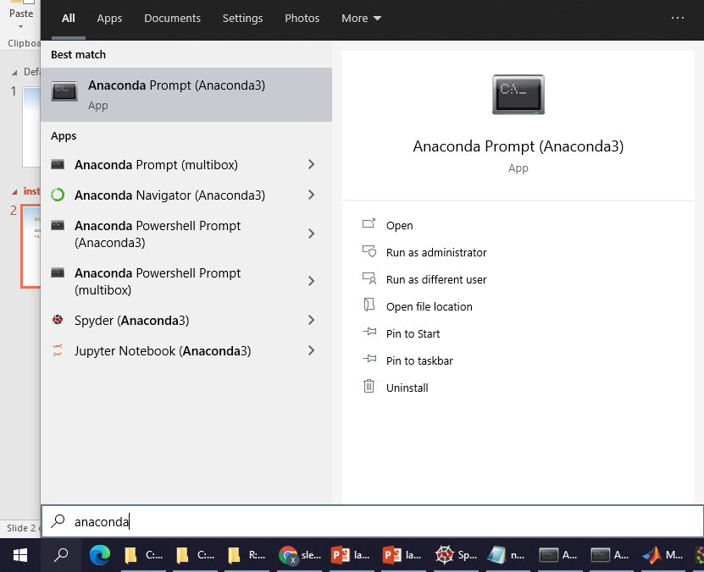
Installation
Actions:
1. Launch Anaconda prompt
Click!
You can search it in system search bar

Slide 5
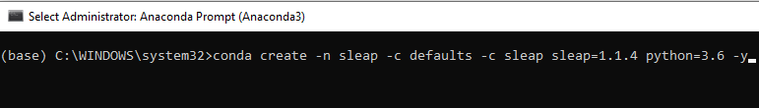
Installation
Actions:
1. Launch Anaconda prompt
2. In Anaconda prompt, type and run:
conda create -n sleap -c defaults -c sleap sleap=1.1.4 python=3.6 -y

Slide 6
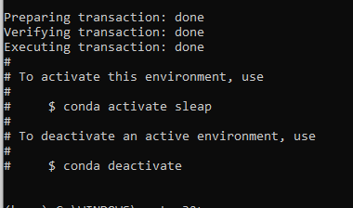
Installation
Actions:
1. Launch Anaconda prompt
2. In Anaconda prompt, type and run:
conda create -n sleap -c defaults -c sleap sleap=1.1.4 python=3.6 -y
You should see something like this when it is done. If so, let’s open SLEAP to verify that the installation is successful.

Slide 7
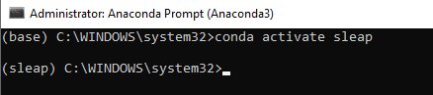

Launch SLEAP
Actions:
1. Activate SLEAP environment:
type and run “conda activate sleap”
You can observe that the environment (shown in the leading parentheses of each line) changes from “base” to “sleap”
You need to activate the environment each time you launch Anaconda, or whenever you notice that the environment is not “sleap”

Slide 8
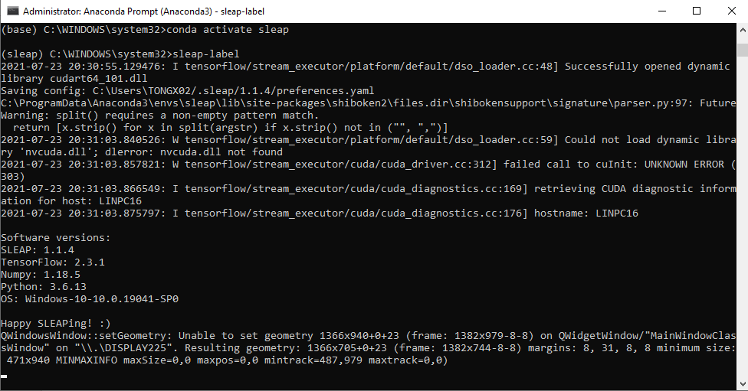
Launch SLEAP
Actions:
2. Launch SLEAP:
type and run “sleap-label”
You will see lots of messages in the backend. No worries about them.

Slide 9
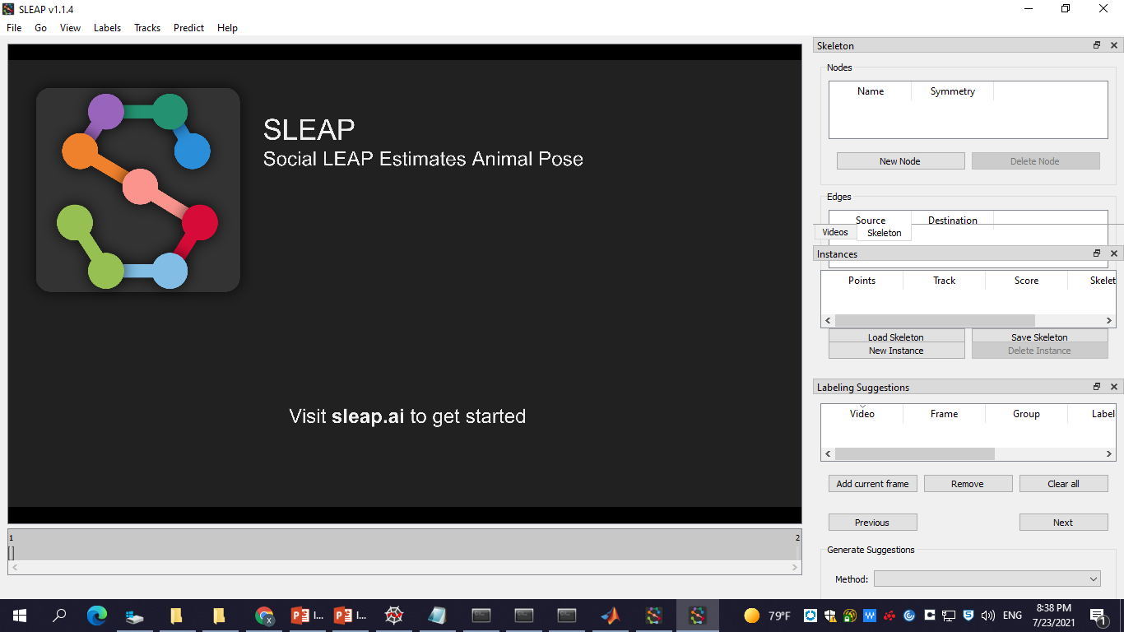
Launch SLEAP
Actions:
2. Launch SLEAP:
type and run “sleap-label”
If you see the SLEAP GUI, congratulations that your installation is successful!

Slide 10
Postfix Identities of Predicted Instances
Actions:
1. Run automatic identity postfix algorithm
Launch anaconda prompt
-> conda activate sleap
-> python
-> import sys
-> sys.path.append(‘the folder where
SLPtool.py locates’)
-> import SLPtool
->import os
-> os.chdir(‘the folder where the SLPfile is located’)
-> SLPtool.fixIDswap (SLPfile)
SLPfile is the path to the .slp file you generated from tracking process. The algorithm will generate a new .slp file, named “***_fixed.slp”, beside the original .slp file. The fixed .slp file can be opened with SLEAP as a normal SLEAP project.
The processing may be slow. It can take 5-10 minutes
(SLPtool.py available in R:\linlab\linlabspace\Xiaoyu\User Guide\SLEAP)

Slide 11
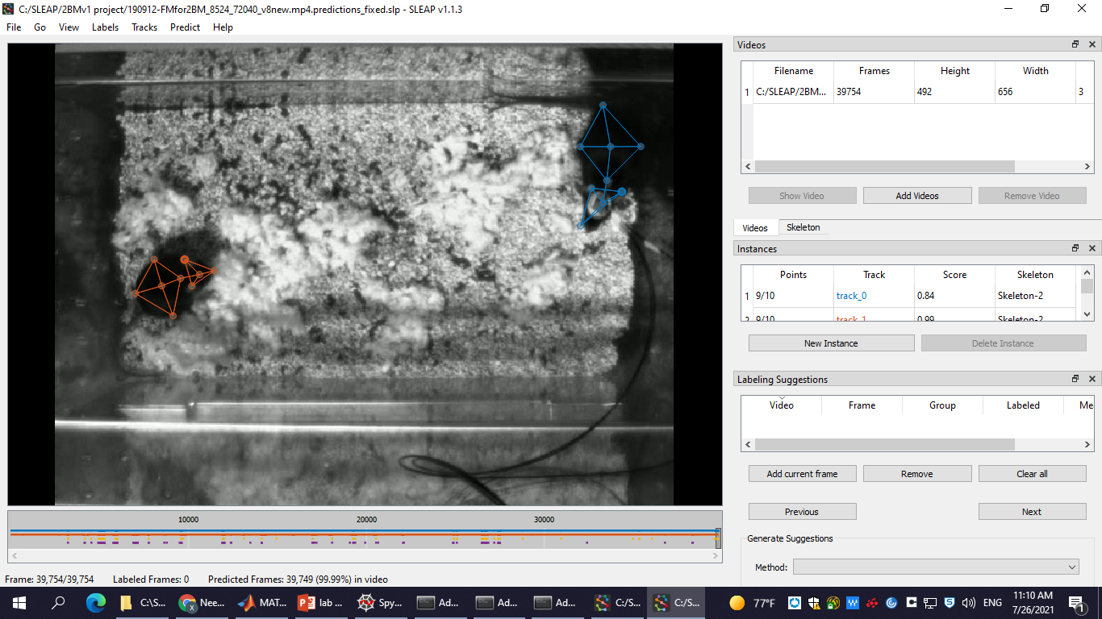
Postfix Identities of Predicted Instances
Actions:
2. Examine the fixed instances in SLEAP (load fixed.slp with SLEAP)
Track 0: reliable predictions of implanted mouse
Track 1: reliable predictions of non-implanted mouse
Track 2: unreliable predictions of implanted mouse
Track 3: unreliable predictions of non-implanted mouse
Error rates (approx.): reliable predictions: <0.5%
unreliable predictions: ~3%

Slide 12
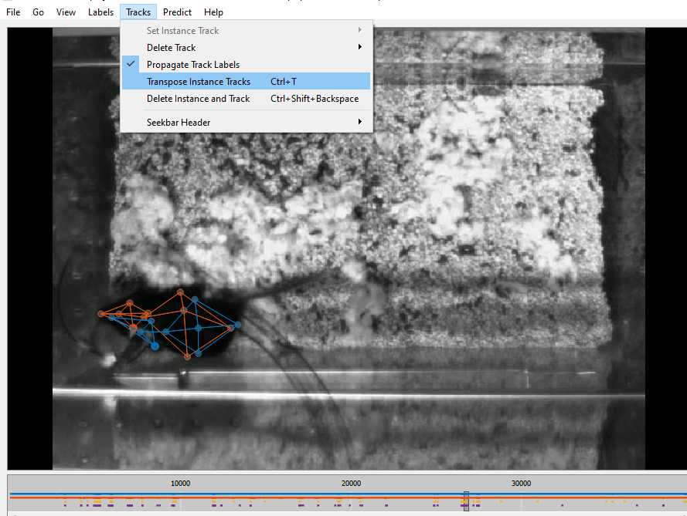
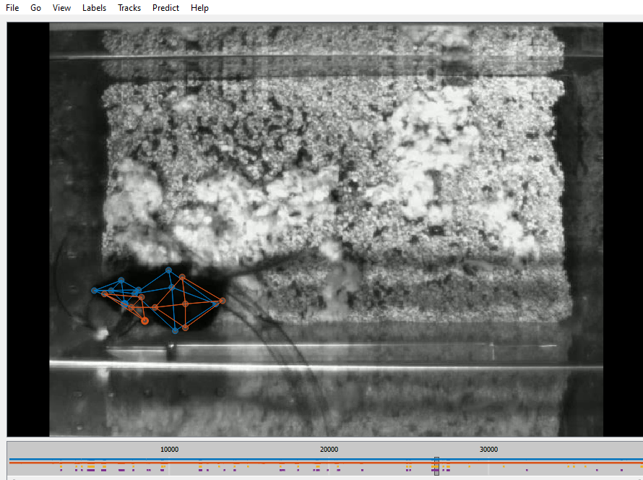
Postfix Identities of Predicted Instances
Actions:
3. Manually fix instances that are still problematic (if needed)
In subsequent analysis (behavior prediction), reliable and unreliable tracks will be treated equally, so no worries about changing unreliable tracks to reliable tracks
To fix a swap, press Ctrl + T to exchange identities of instances. Directly pressing the hot keys will work. No need to navigate in the tool bar. Save the project when you are done.

