Slide 1
Using unittest framework to get you up and running in C

Slide 2
Abstract
The C language is used by many different developers to write code for many different applications and targets, from small embedded microprocessors to large server farms. Linux itself uses several different styles of C code between User Space, Kernel, and Kernel Driver development, and even many other computer languages, like Python, are themselves written in C.
When developing new code, or isolation issues in existing code, it is often useful to break problems up into smaller problems and play with just a portion of a set of code to do “what if” tests or to try different approaches. Running these smaller “tests” can be difficult if you are working in a cross compiled development system or developing a portion of a system mode driver. In fact just writing a main() function to run your tests can be a chore and take you away from thinking about the problem being solved.
An automated testing framework, one that writes the main and test runners for you, can be leveraged to do quick code isolation or module development with the added benefit of producing persistent documented insight into your code that others can reference and run in the future.

Slide 3
TDD light
The Goat would not approve.
Using a testing framework obviously aids in the adoption of Test, or Behavior, Driven Development (TDD or BDD), but the real world often leads us off the righteous path. I started using the presented workflow because I often did not have a working target system or I just want to see how a certain algorithm was constructed or to understand the parameters of some interface.
Later I was running into the problem of debugging code and doing integration without having a working target, or having a working target but without a tool chain that supported on target debugging.
Leveraging the tools of unit testing using a generic C99 compliant compiler to unit test the modules and drive more complex integration testing gave confidence that large portions of the code where “correct” when the system test was finally possible. (I understand that this is sort of the point of unit tests, but we came to it sort of backwards from how TDD is often taught)
I call this TDD light because while TDD often strives for “full coverage” of tests, I am often happy just demonstrating a few nominal paths while knowing at least I have a running framework if I need to dive deeper.

Slide 4
Proposal
How to use the open source CEEDLING tool build better tested and documented C code.
Setting up the CEEDLING tool
First project example
How to apply the tool to different uses
  New module development
  Understanding and debugging exiting code
  Isolating modules (mocking)

Slide 5
My Background
Embedded C programmer since 1986
  Currently switch between Python and C
Do most of work in C99
Not a GUI guy
Not a Ruby guy
Not associated with Ceedling project
  Been using it since 2017

Slide 6
Other Motivations
Need firmware running on day 1
Shared hardware not always available
Need to debug a complex or destructive behavior without damaging hardware.
  Debugging OTP or emergency logic
Documenting how code actually works
  Living document

Slide 7
Work Flow
”Test driven light”, save your work at each step
Create new module
Use test file to flesh out header declarations
  Write your basic behavior in the tests
    Iterate your prototypes for behavior
  Use module:stub to make definitions*
  Verify your tests fail but compile
  Add behavior to definitions
    Iterate with new behaviors/tests
* stub is a work in progress

Slide 8
First Example
The Ceedling command
  Outside of project
    Make new project
    Update existing project
  Inside of project
    Run tests
    Manage modules

Slide 9
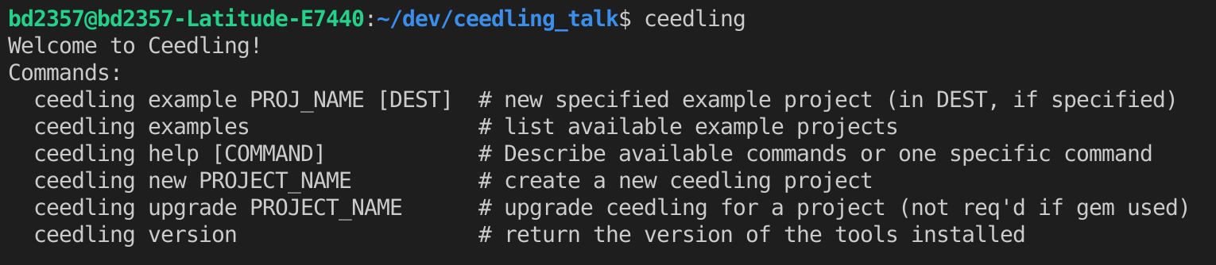
Ceedling Outside a Project

Slide 10
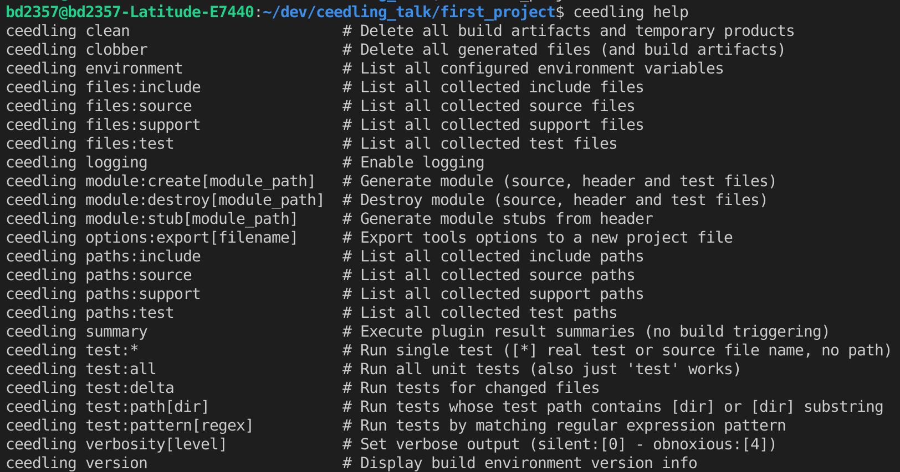
Ceedling Project Help

Slide 11
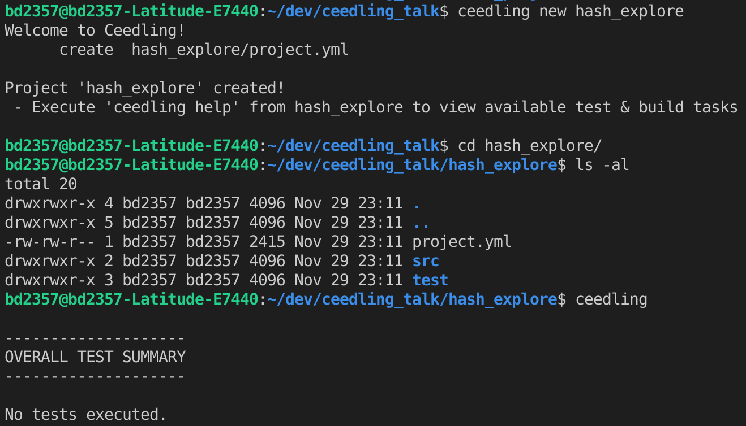
Create new project

Slide 12
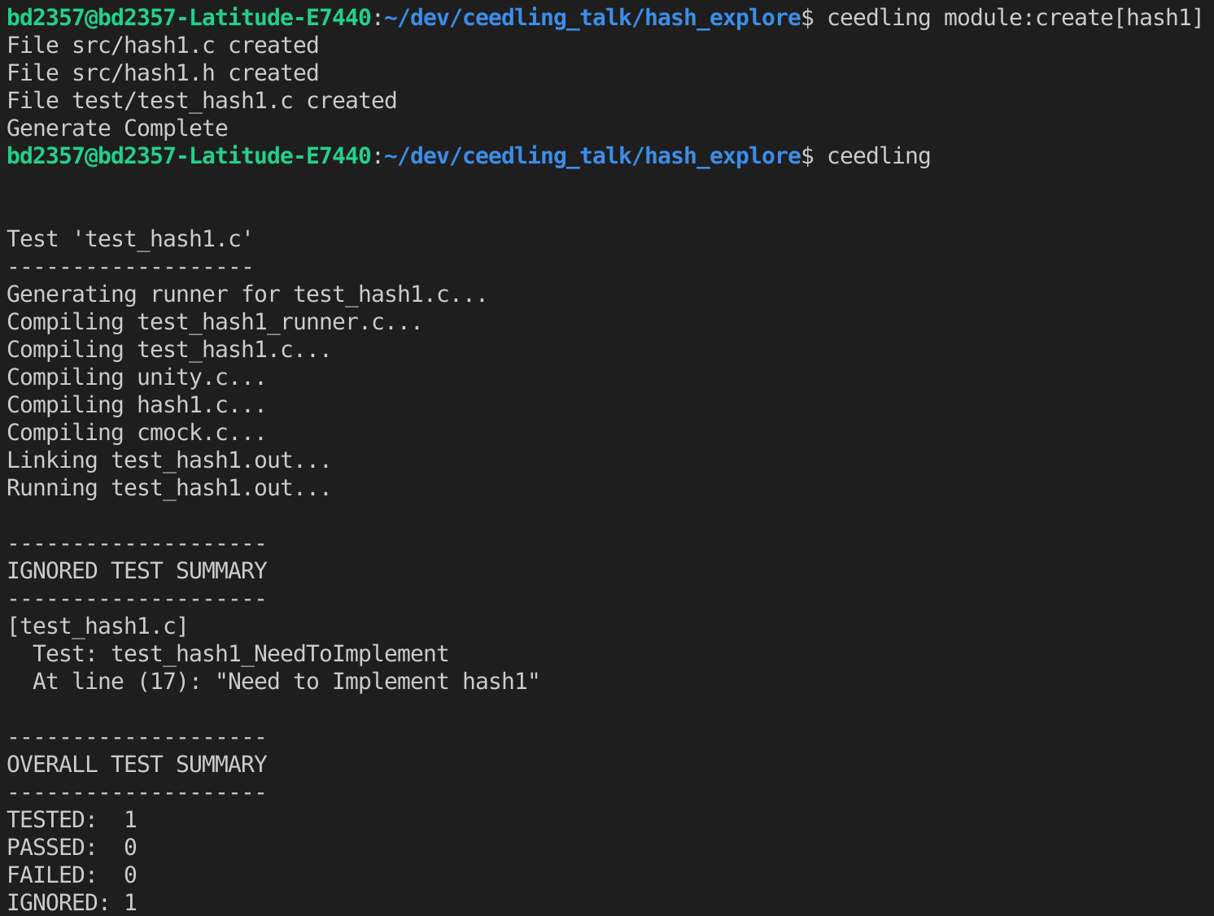
Create and test Module

Slide 13
Module Generator
File Templates
  In the project.yml or
  Edit the master Template
Relative to folder with test project

Slide 14
Retrofit Existing Project
Setting paths in project.yml
  Single folders or recursive
Mutliple project.yml files
  Seperate sub project folder
  Use a defines.h
    Configure your mocks
  Use compile time switches in yml file

Slide 15
Other Considerations
Testing pointers
  Default tries to compare referenced object
    This breaks forward reference
    Fix in yml file
Other Compilers
  You can define your own tool chain
  I have not needed to do this yet
Unit test reports
  Are configurable

Slide 16
Compound Literals* are your friend
Very useful in Setup for clarity
Don’t be afraid of structures by value
  Very useful in multi thread cases
Minor penalty in size
https://godbolt.org/z/Gba3M1ccW
* https://gcc.gnu.org/onlinedocs/gcc-4.3.2/gcc/Compound-Literals.html

Slide 17
Embedded considerations
Simulating Hardware
  Encapsulate register I/O
    Value logging
    Expects in Mocks
Encapsulate or Mock intrinsic functions
  Alternate macros based on TEST
  Mocks with stubs

Slide 18
Other Stuff
Also supports FFF
  Have not tried
Also supports GCOV
  Just started trying this
Need to workout github actions for ceedling
  Can only find one example and they ultimately punted to docker

Slide 19
Resources
http://www.throwtheswitch.org/ceedling - Ceedling web page
http://www.electronvector.com/ - Some extra explainers
https://github.com/bd2357/ceedling_talk - This Talk
https://gist.github.com/bd2357 - My GIST with Windows notes
Test Driven Development for Embedded C - Dated but still great
  (2011) James W. Grenning

