Slide 1
Twelve data API
By
Boris Larico Villagomez

Slide 2
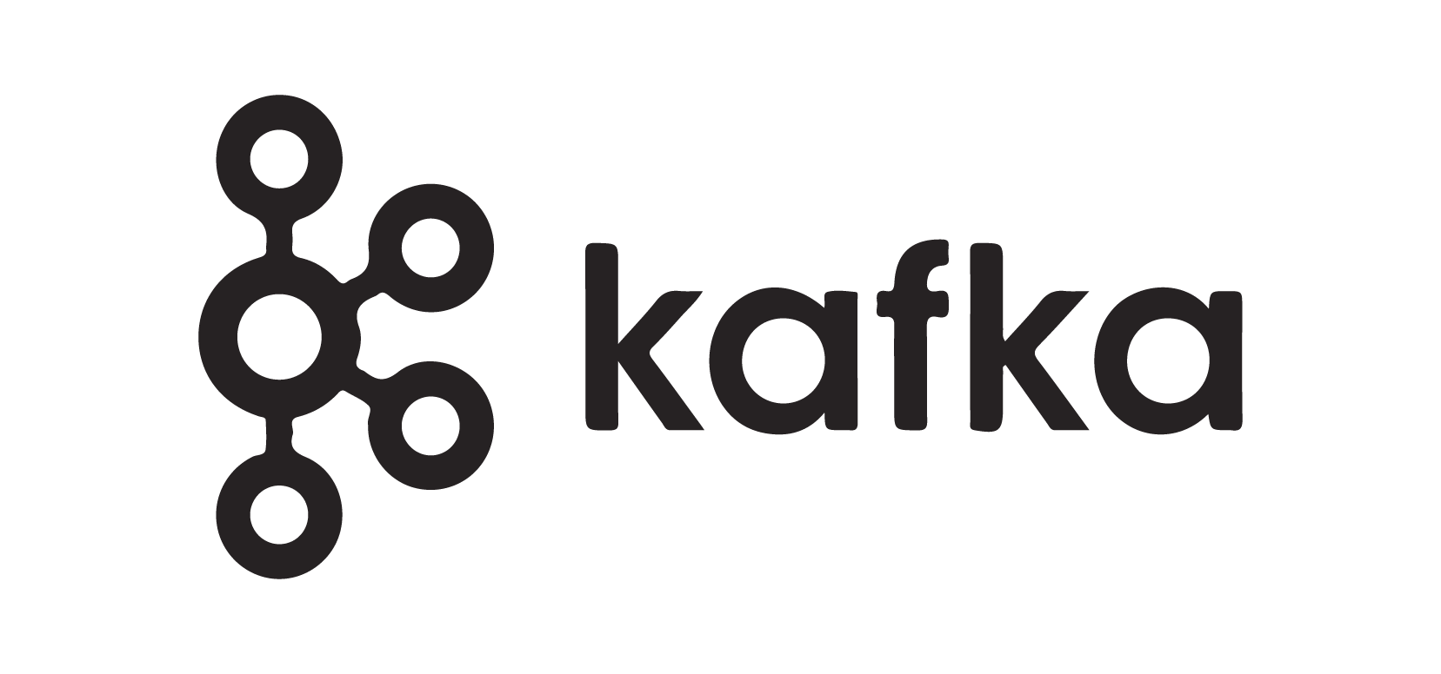
Overview
Proposal case
Overview of project
Why I chose certain approach
API call: Producer
Kafka cluster & Topic
HBase: Consumer
Spark: Consumer
Conclusion
Areas of improvement

Slide 3

Proposal
The financial market is the backbone of the economy, with millions of transactions occurring everyday.
My project aims to use real time financial market data to retrieve stock market data, store the information and to potentially find trends.
I will be focusing on using FOREX trading records of the three most popular currencies: USD, GBP and EUR

Slide 4

Project overview
Source: Twelve-data API
  Meta object with general information about request
  Time series containing Array of objects
  Date-time, Open, High, Low and Close
Kafka producer
  Batch pipeline
  Topic
Kafka consumer
  Print to the console
  Spark
  HBase

Slide 5
Approach
Maven project structure:
  Centralised dependency management
Java:
  Centr

