Slide 1
Proposal: Analysis of terrorist attacks
Team name: Anacondas
Sarah Grothus 12230007
Aliya Huseynova 12230214
Iroda Khamidova 12194918
Tural Alizada 12230118

Slide 2
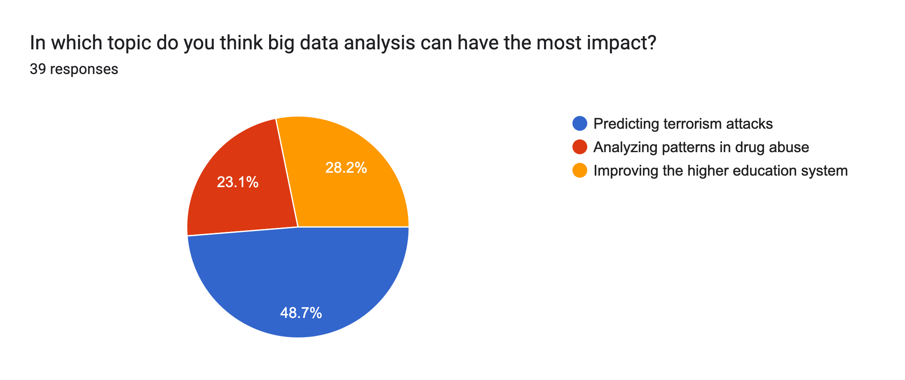
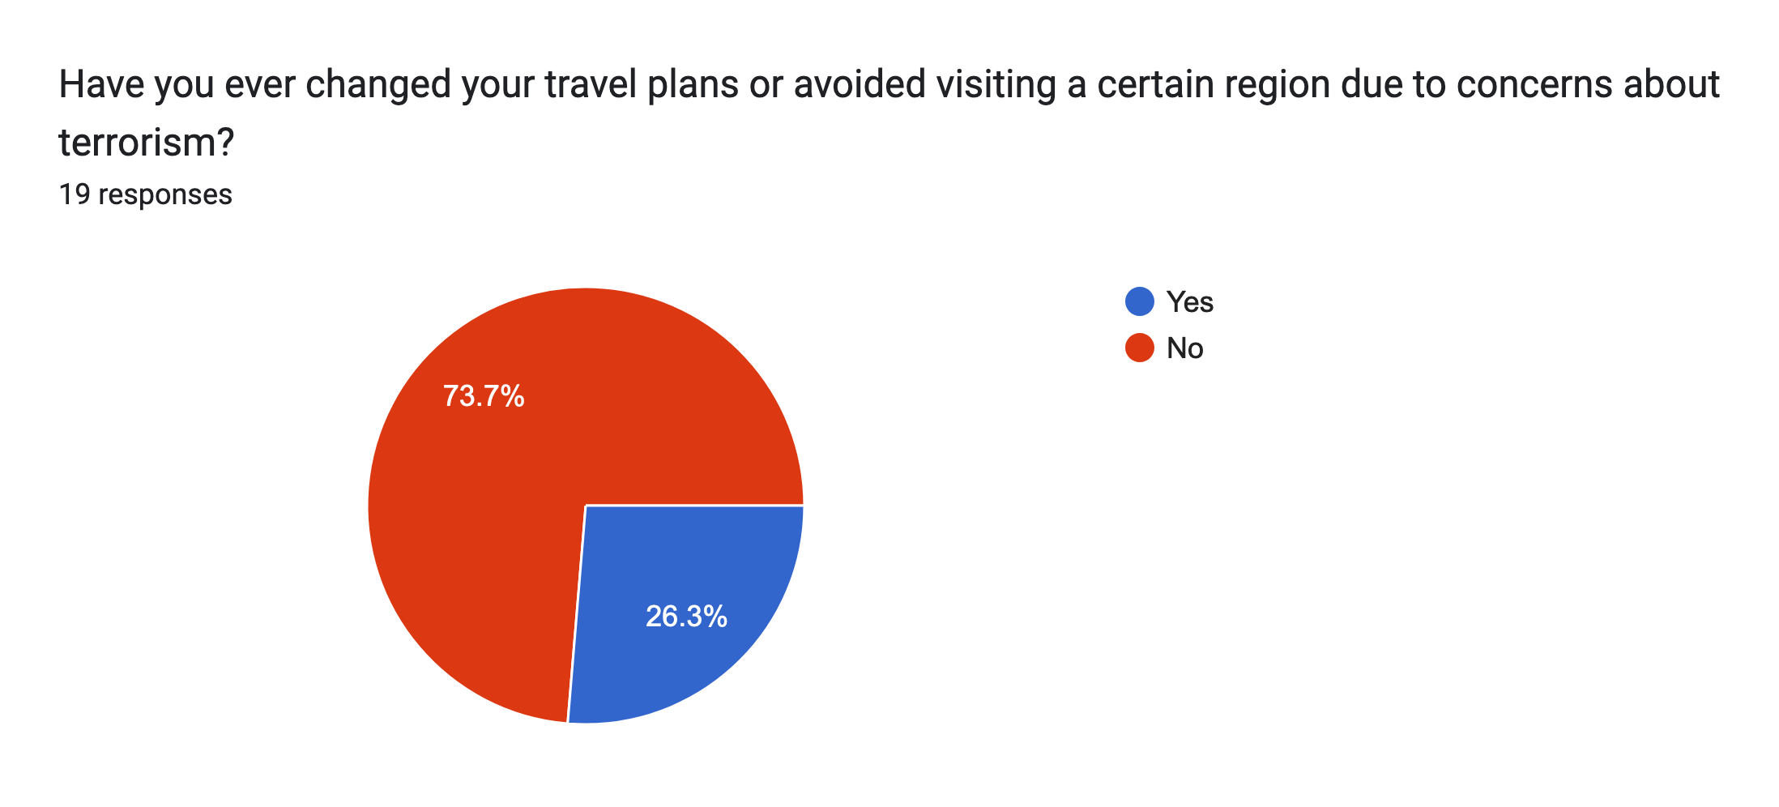
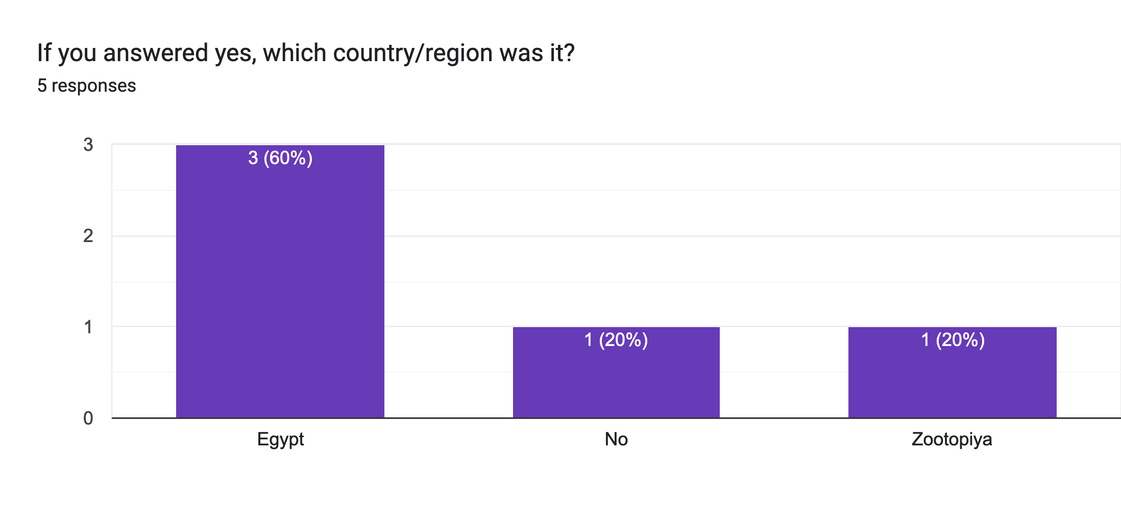
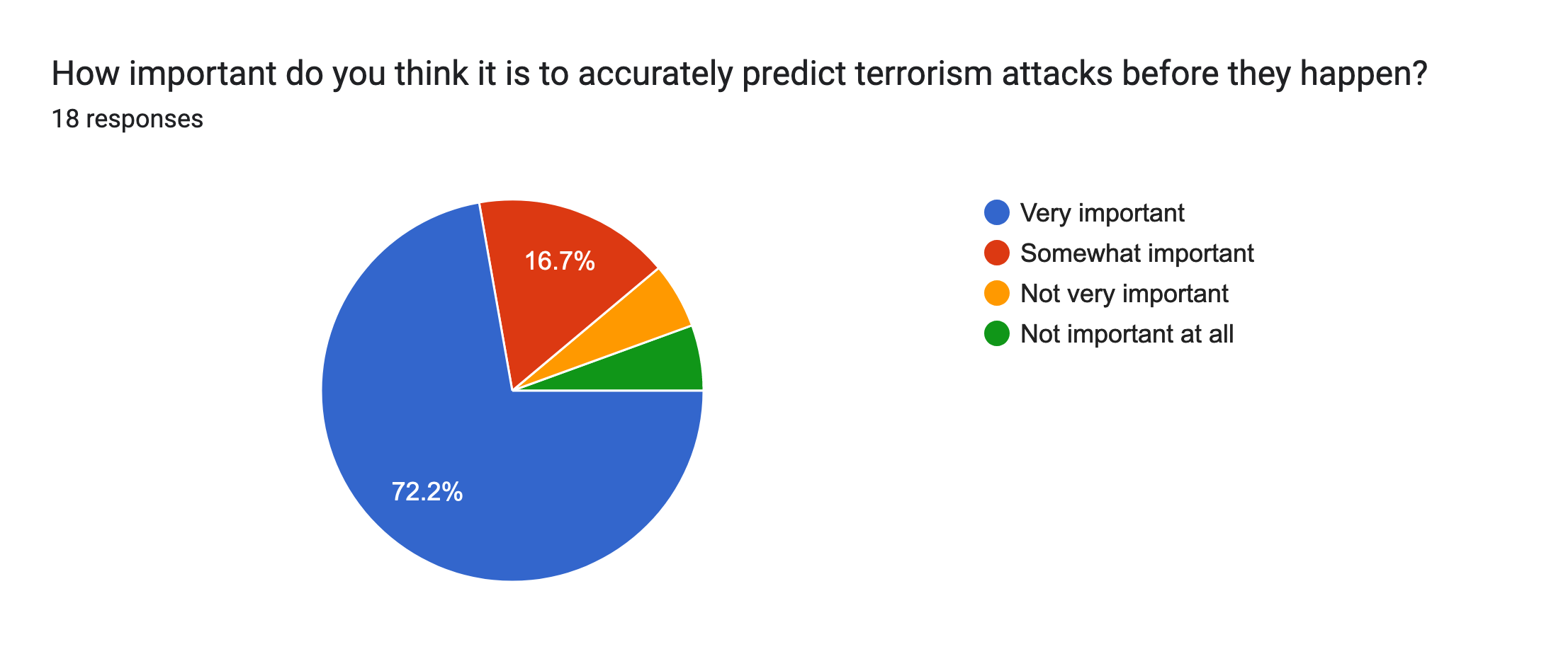
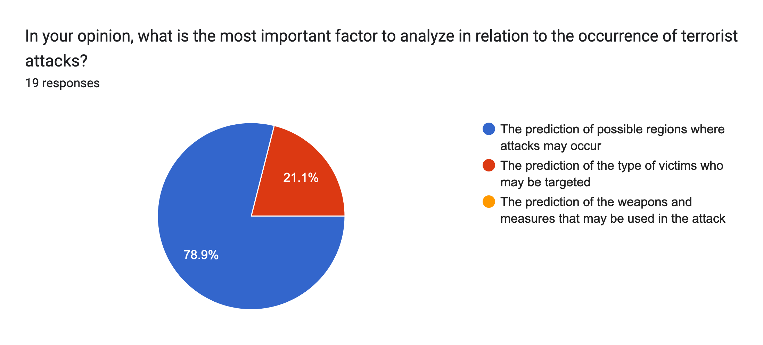
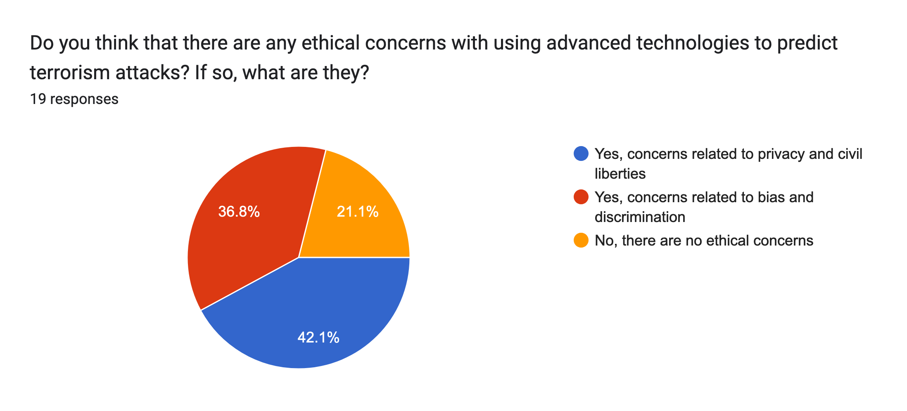
Survey results
Depending on the answer of the first question, users had to fill out different questions:
Predicting terrorism attacks → questions about terrorism
Analyzing patterns in drug abuse → questions about drug abuse
Improving higher education system → questions about higher education
9
11
19
Questions regarding terrorism:
3
1
1
14
14
5
15
4
7
4
8

Slide 3
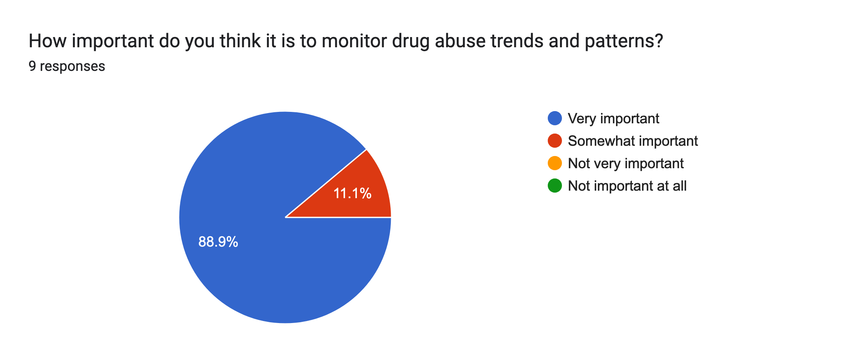
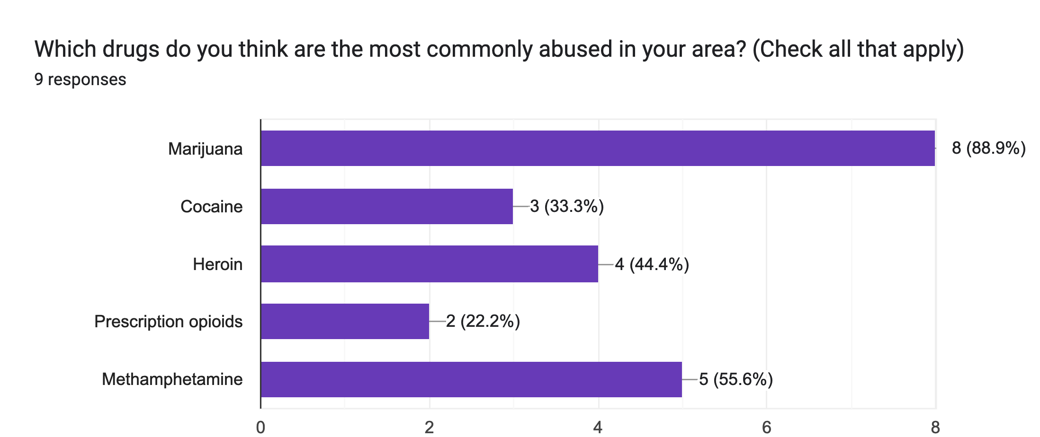
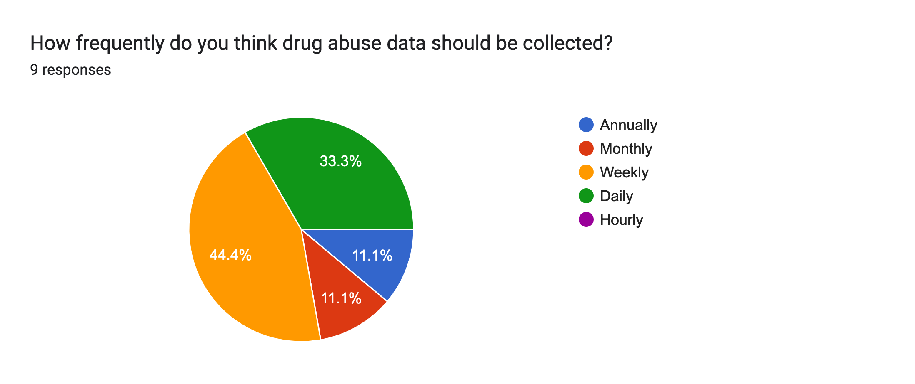
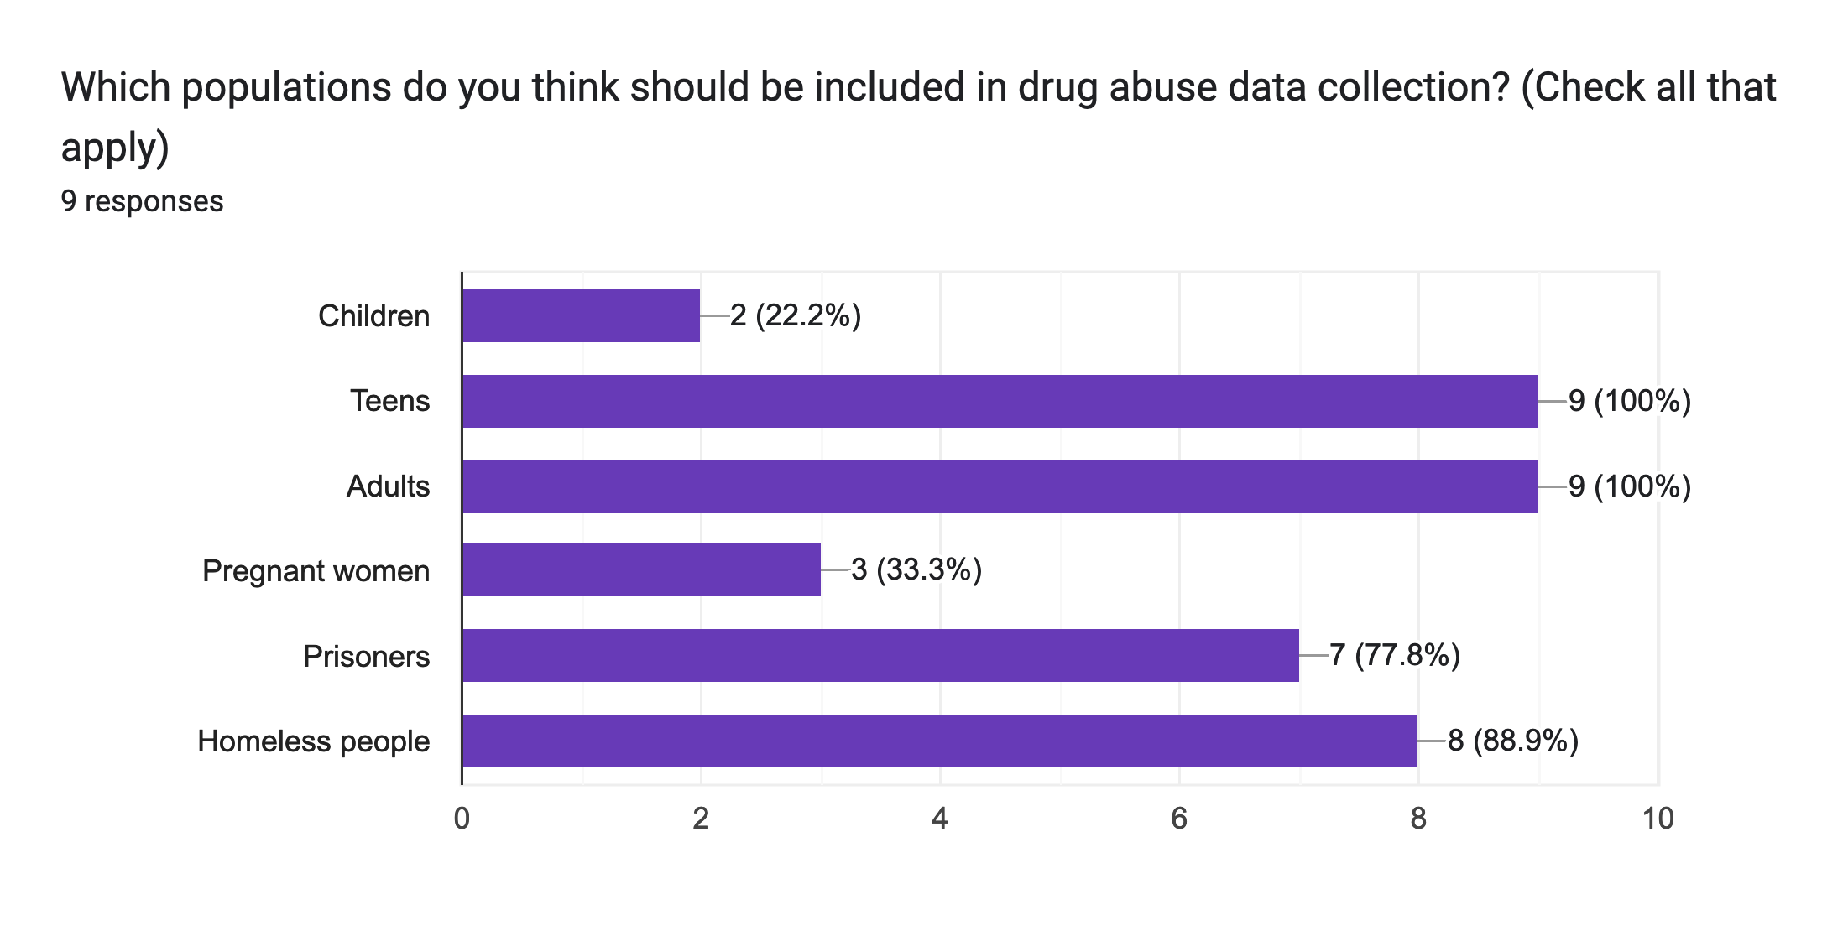
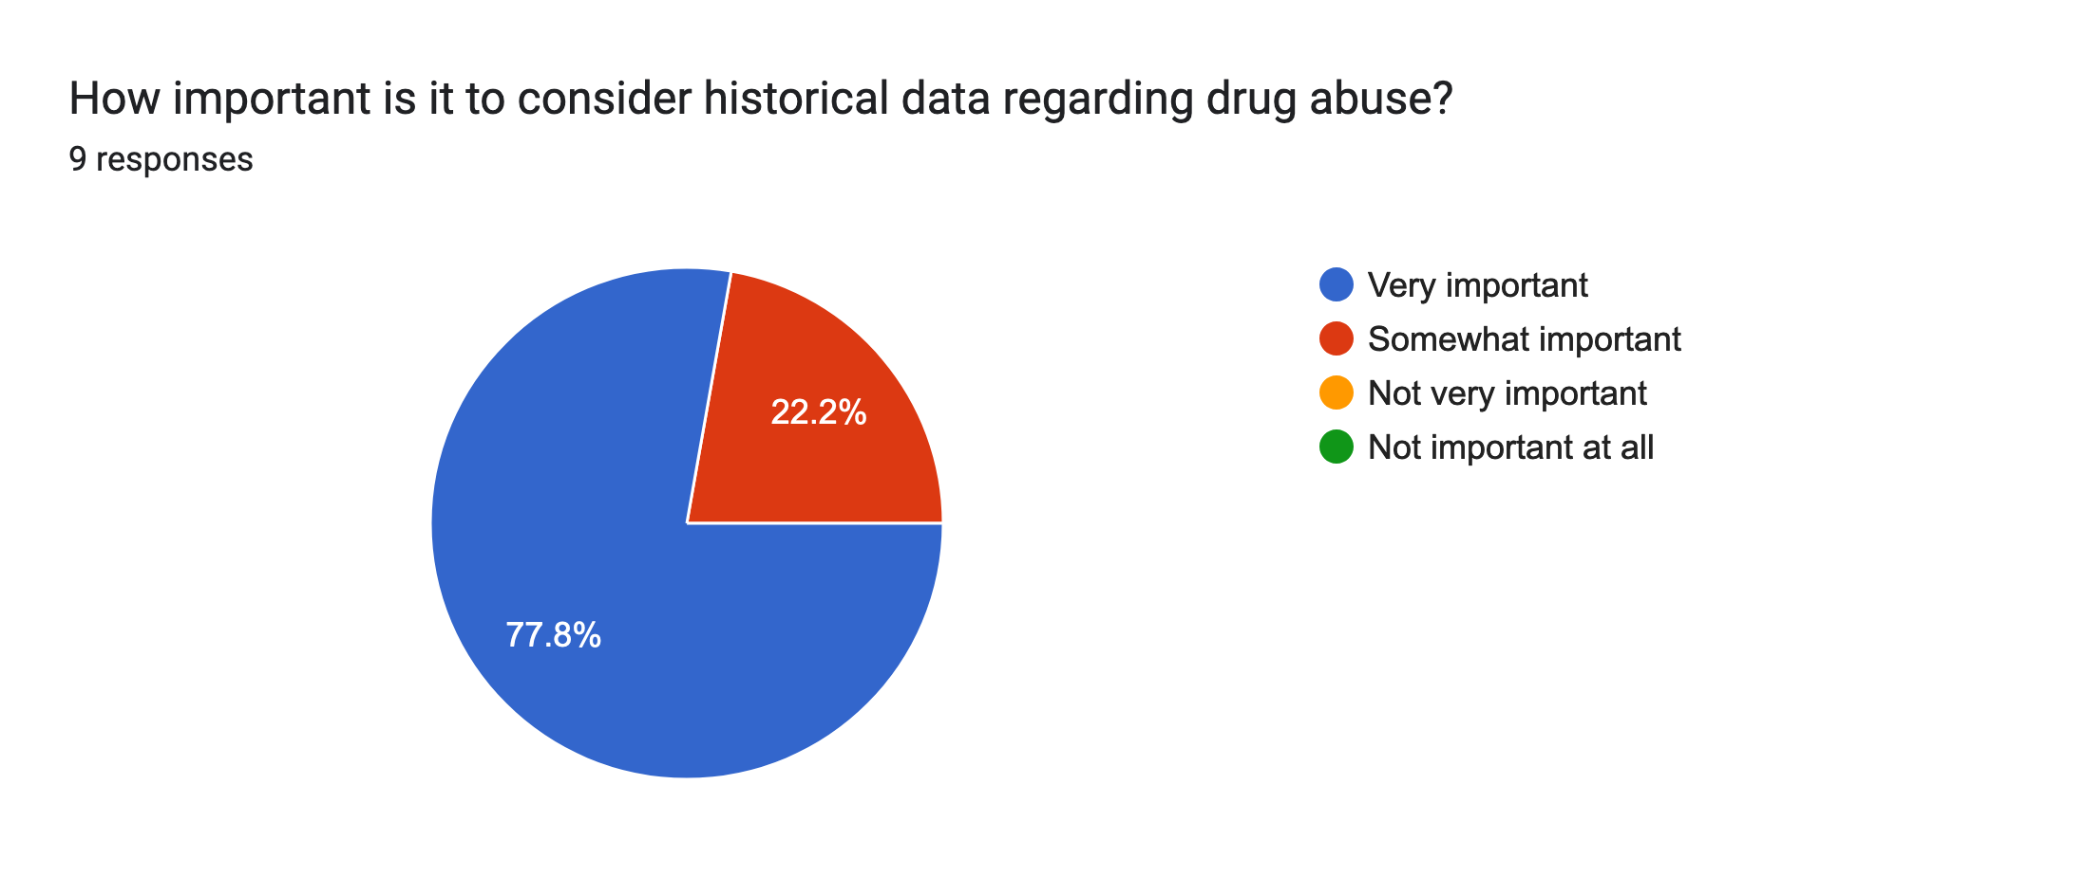
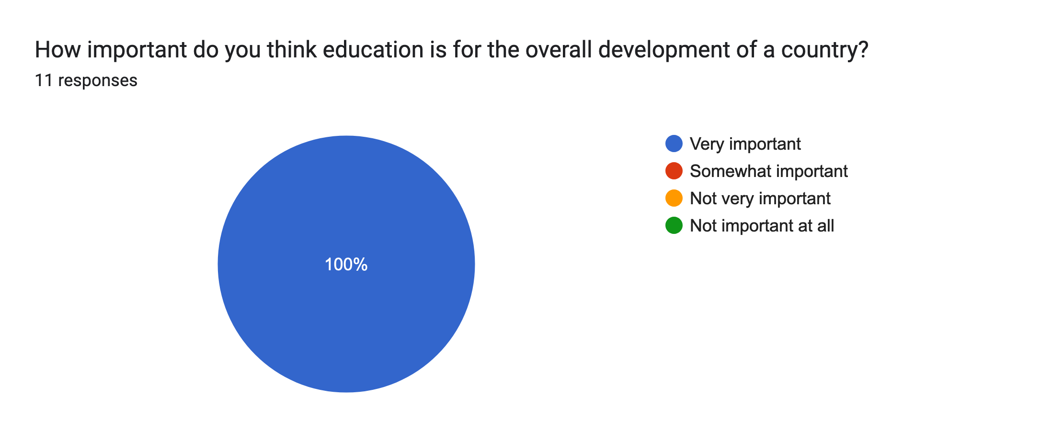
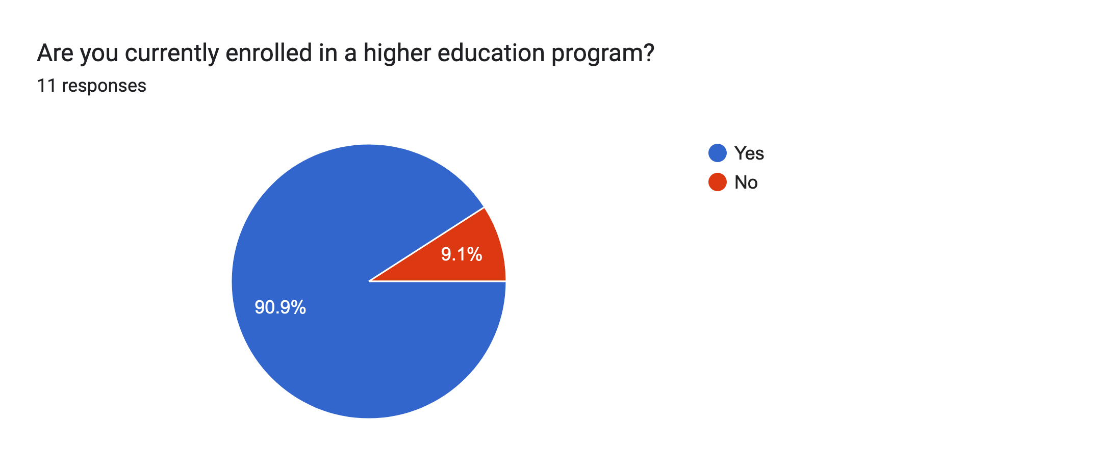
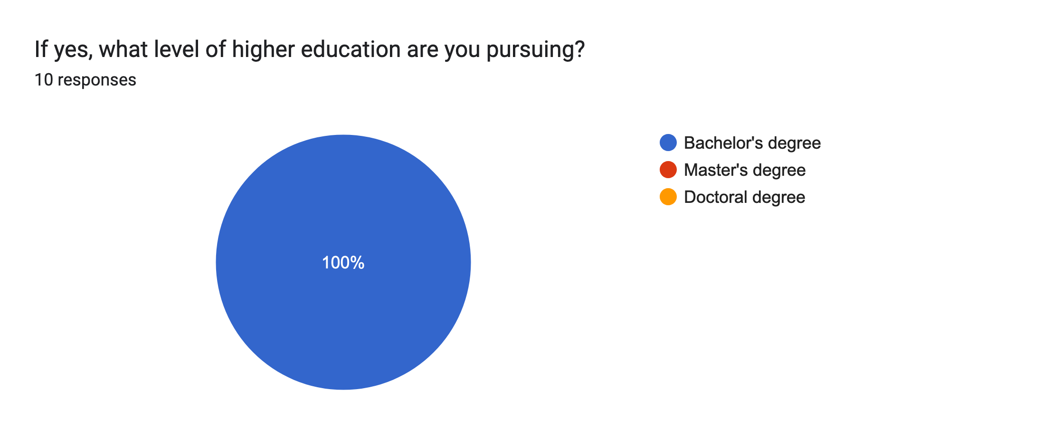
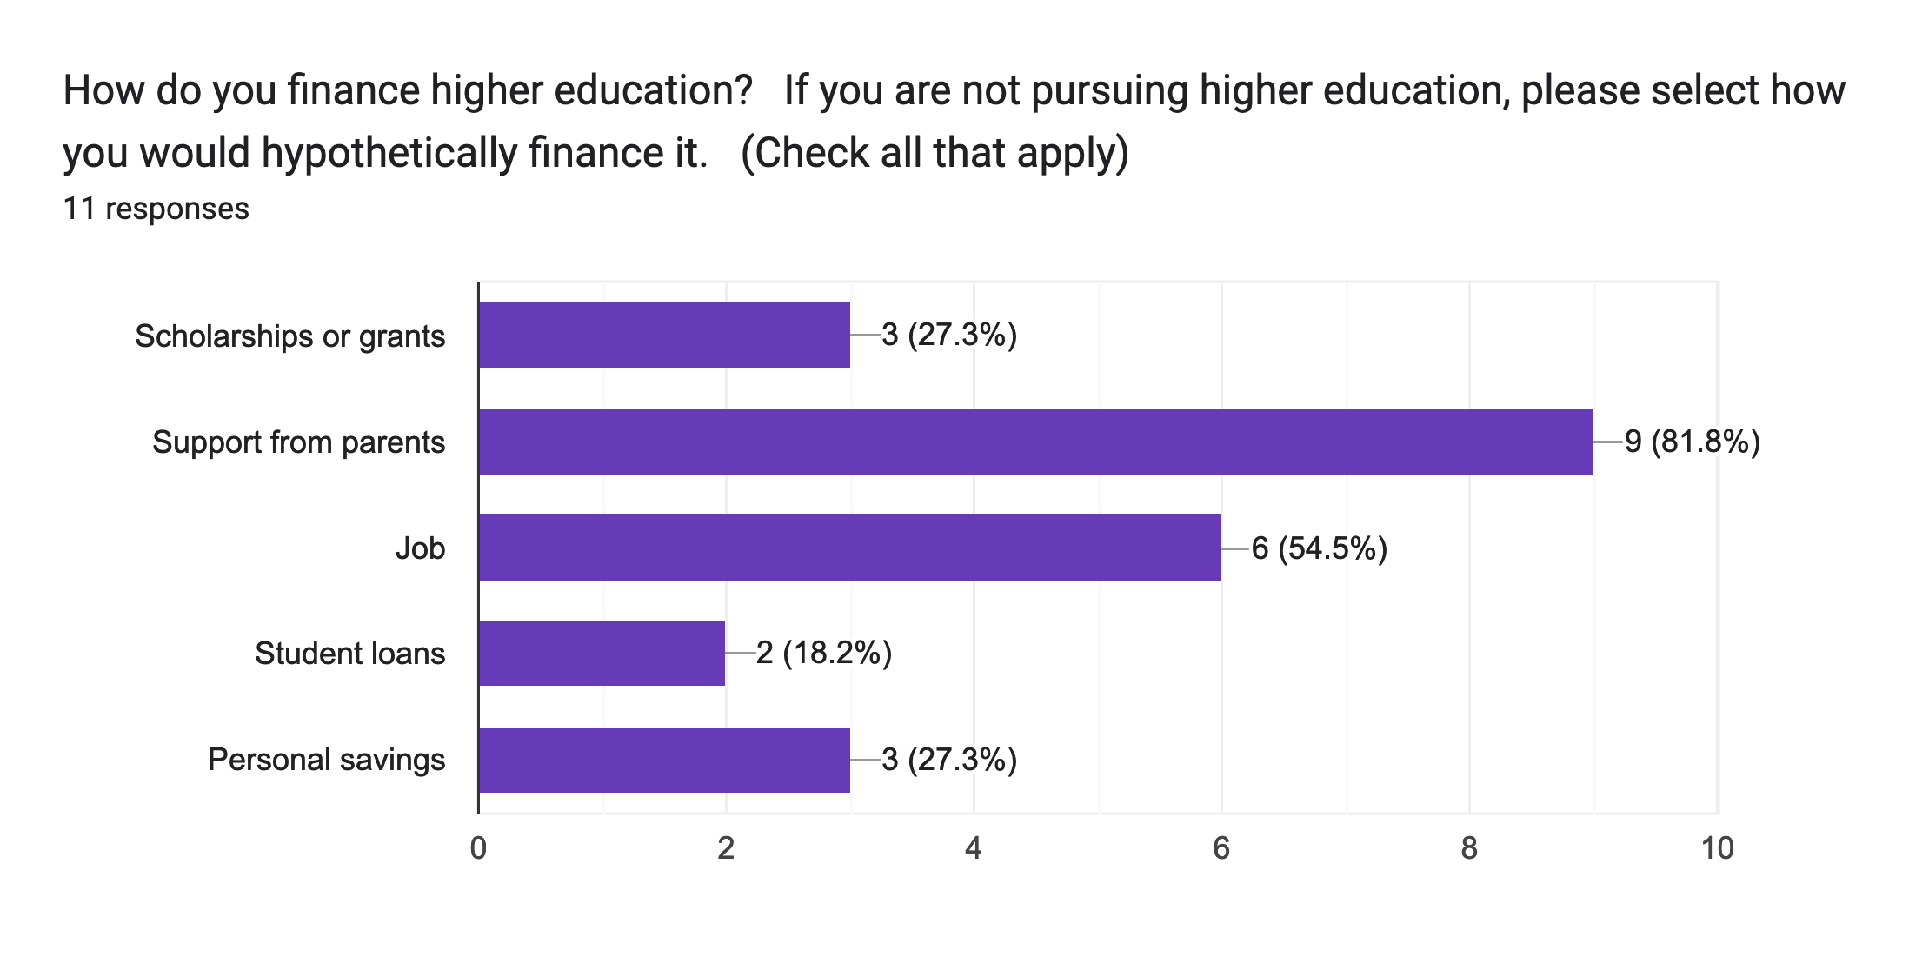
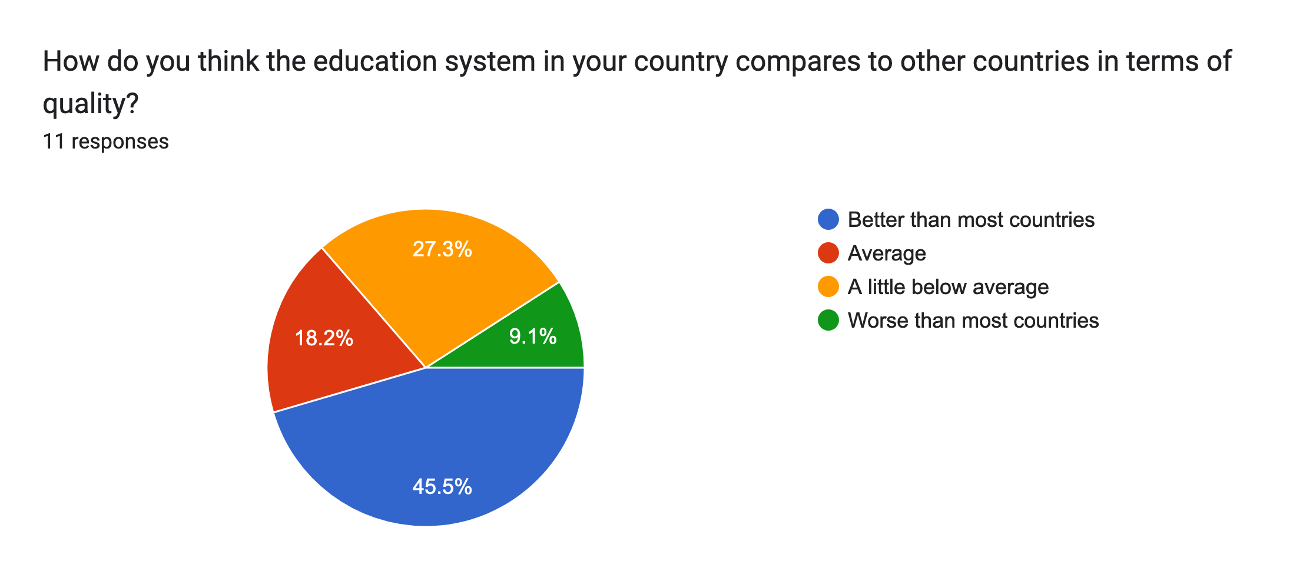
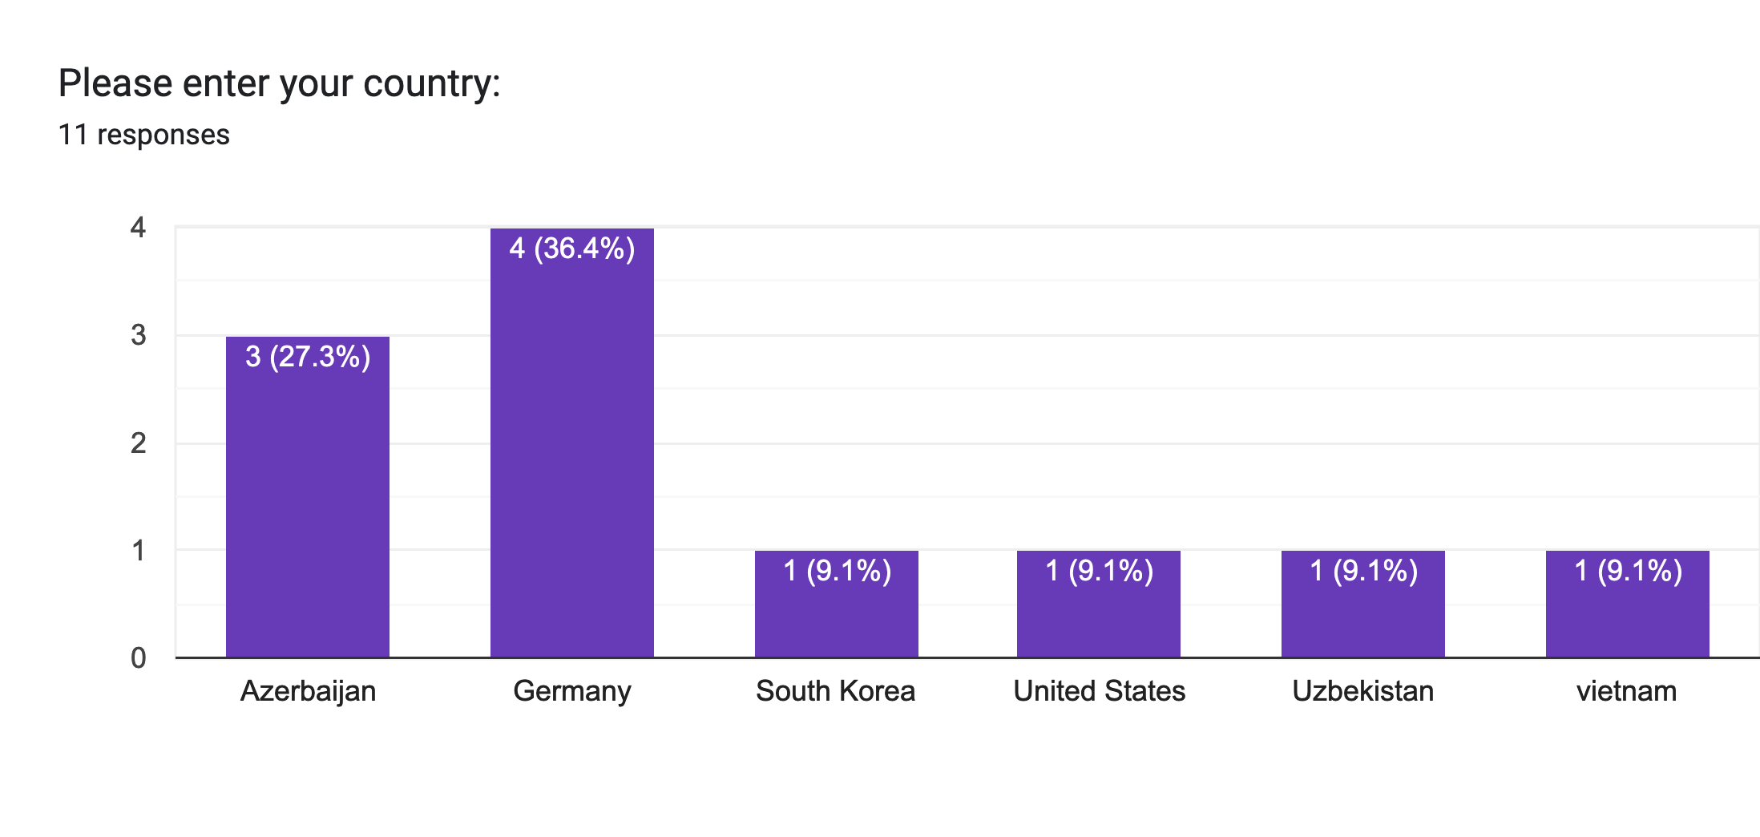
Survey results
Drug abuse
questions
Education
questions

Slide 4
Importance of predicting terrorism attacks & doing risk assessments
Why predicting terrorism attacks and taking risk assessments are important:
Preventing Loss of Life -> By identifying potential terrorist acts, government can take steps to lower risks and ensure that individuals and communities are safe.
Protecting Property and Infrastructure of the Area -> By conducting risk assessments, government can identify terrorist's possible target infrastructure and take steps to protect these areas.
Strengthening Country's National Security -> By identifying potential terrorist acts, government can strengthen the country's security level, and control it in best way.

Slide 5
How analyzing patterns can help in prediction process?
Identifying Target Areas ->Analyzing the location of past terrorist attacks
Predicting the Acts' Technique of Terrorist Groups -> Investigate the methods used by terrorist groups in the past can help to guess their possible future terrorism activities
Tracking the Activities of Popular Terrorist Groups -> Determining the activities of known terrorist groups may help government chase them and predict their future plans.

Slide 6
Analysis of Dataset
Source of dataset: Global Terrorism Database (GTD)
Open-source database which contains information on terrorist attacks from 1970 to June 2021
Collection of domestic, transnational, and international terrorist attacks containing more than 200,000 cases
Information available on date, location, types and details of weapons, target as well as when identifiable, group or individual attacker
At least information on 45 variables for each incident and on more than 120 variables for recent incidents
More than 4,000,000 news articles from over 25,000 news sources were reviewed to collect the data

Slide 7
PYTHON: analysis tools
Python, serving as a programming language, contains a big number of applications, which provide its users with data analysis tools.
Preprocessing text data: to process data before it gets analyzed - SpaCy and Natural Language Toolkit.
Topic modeling: to assist the topics of the texts - Gensim.
Named Entity Recognition: to recognize named entities in a text - NLTK and SpaCy.
Machine translation: to translate a file from one language to another - TensorFlow.

Slide 8
PYTHON and ChatGPT
Python offers its users easy-to-use and flexible environment, which can be efficiently used for data analysis programs.
ChatGPT, on the other hand, provides advanced natural language generation tools – in other words, it is being widely used by services, which require direct or indirect interaction with human being.
Python and ChatGPT:
consist of a big number of efficient tools, which alongside create beneficial environment for data analysis programs
provide the users with valid and effective analytical tools, which can be used even in exploring and discovering purposes

Slide 9

Thank you for attention :)

