Slide 1
BDA Mini Project
Members:
Ankit Parmar (19162121017)
Darshil patel(19162121018)
Manthan pandey(19162121016)

Slide 2
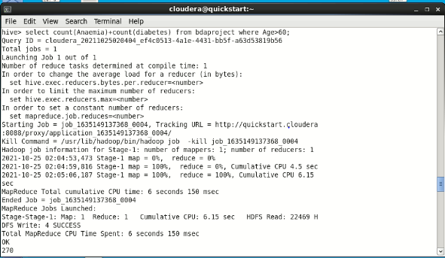
How many people above the age of 60 are both anaemic and diabetic?

Slide 3
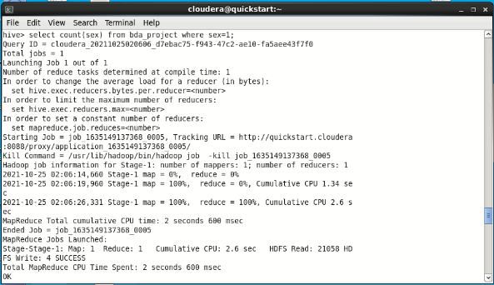
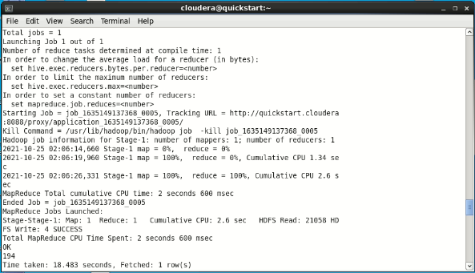
What percentage of women in the dataset do not smoke?

Slide 4
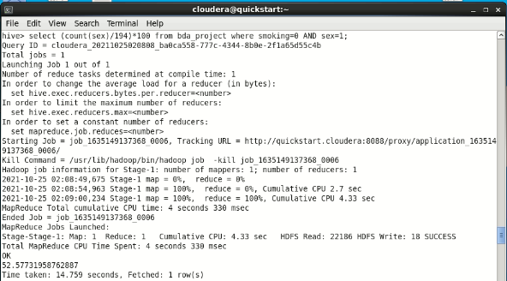

Slide 5
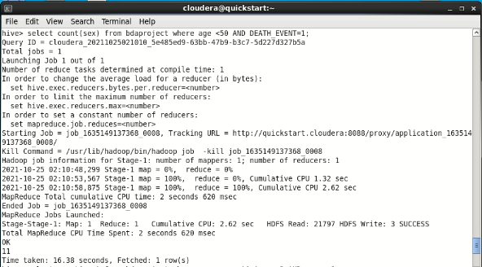
How many men and women below the age of 50 died?

Slide 6
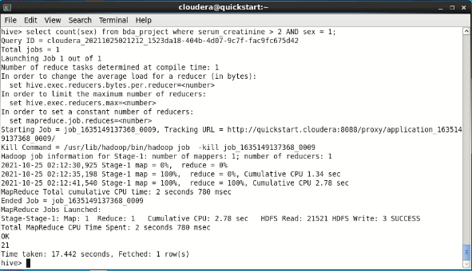
How many females have a serum_creatinine level of above 2?

Slide 7
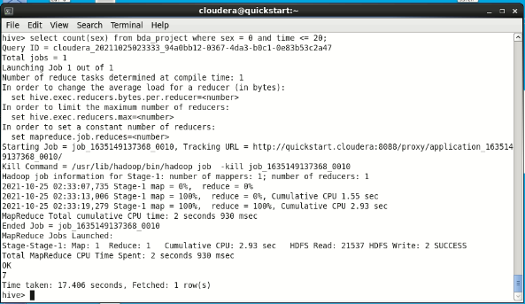
How many men have been called for a follow up in 20 days?

Slide 8
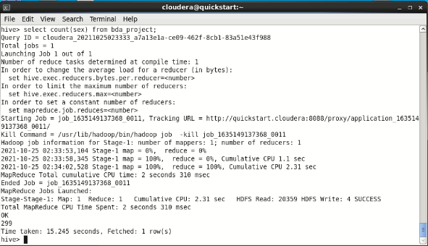
What percentage of people who weren’t anaemic, or diabetic and did not smoke, died?

Slide 9
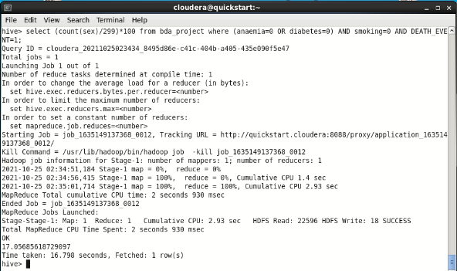

Slide 10
What percentage of people who have a high blood pressure did not die?

Slide 11
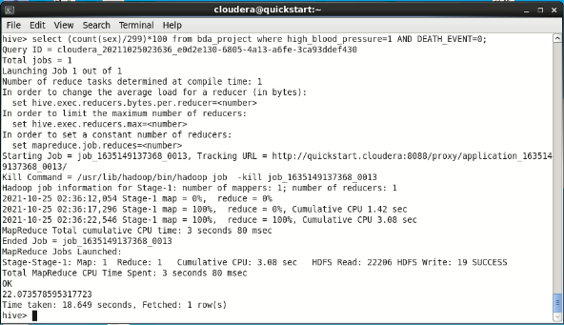

Slide 12
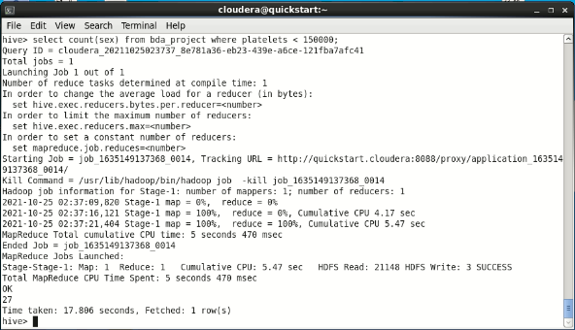
How many people have a platelet count of lesser than 150000?

Slide 13

How many men and women have high blood pressure?

Slide 14
Conclusion
Hive is a Data Warehousing package built on top of Hadoop used for data analysis. Hive also uses a language called HiveQL (HQL) which automatically translates SQL-like queries into MapReduce jobs. We have also learned various components of Hive like meta store etc.

