Slide 1
Personal Diary Management System
Personal Diary Management System is based on the concept to save and generate all the story of the user. The whole project is designed in ‘C++’ language and different variables and strings have been used for the development of this project. This project is easy to operate and understand by the users.

Slide 2
Objective
We have developed Personal Diary project to makes ease the work of users by this computerized software. By this application a user can store contact details, retrieve contact details and make dead line notes on single platform. Thus the user can manage his contacts and daily working schedules through this project.

Slide 3
Tools and technology
The whole project is made using C++ language.
It is made on Linux enviorment.
We used VMWare Workstation in this.

Slide 4
Implementation
So according to our code it will first ask us the activity we want to do.
So for an example I am pressing number 1 here
After pressing 1 it will first ask me to enter the date, and as an when I will enter the date it will allow me to enter the text in the diary.
After adding my text to my diary I will write DONE and when I will press enter it will bring me to the menu page and it will be automatically saved.
Let’s see this in the image below.

Slide 5
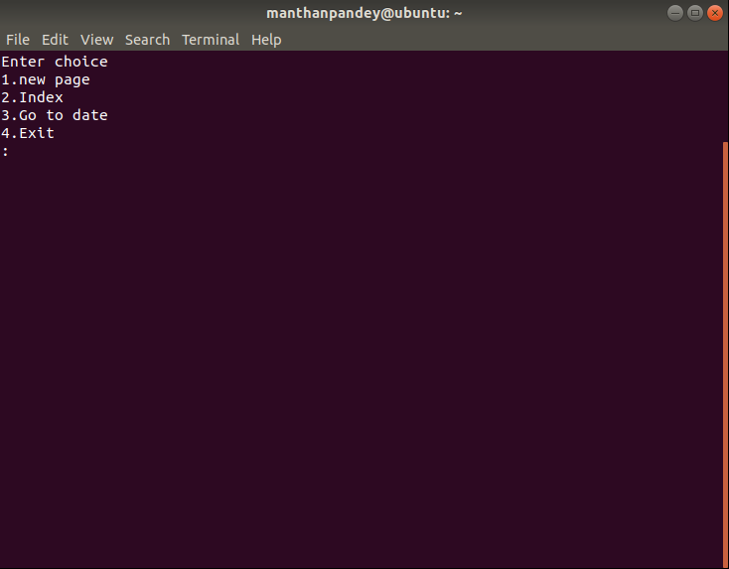
This is the normal menu page

Slide 6
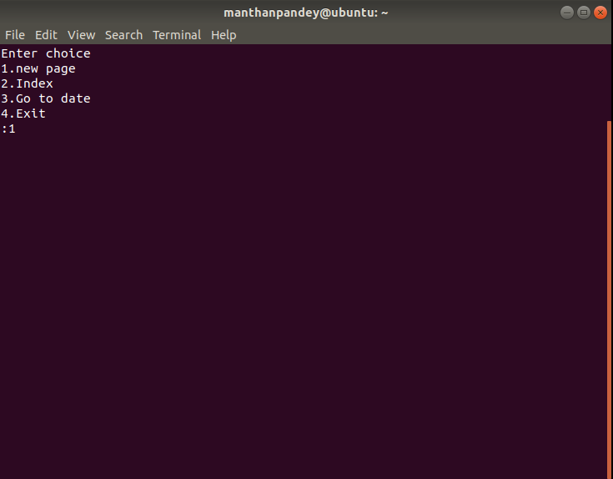
Here I will press 1 and it will take me to the writing Page

Slide 7
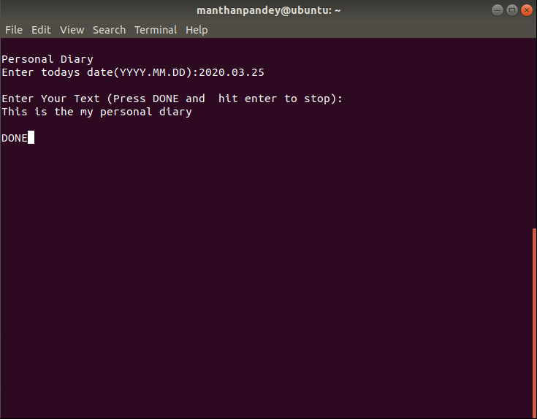

Slide 8

When I have written Done it will take me to the main menu

Slide 9
Conclusion
In this project, user can keep their personal record like they do in a diary. You can keep records of the important things you do in your daily life, like meetings and various other tasks.

