Slide 1

DynThings
Platform Concept

Slide 2
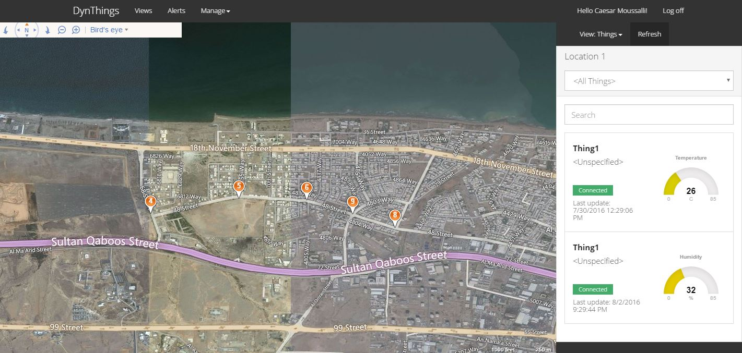
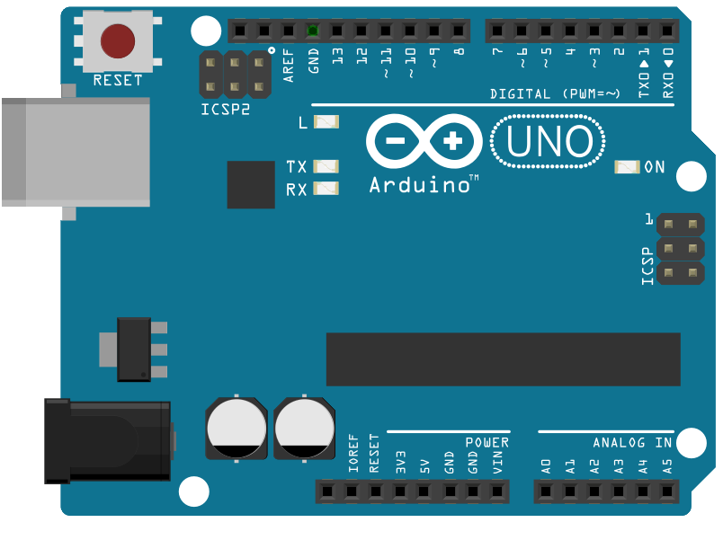
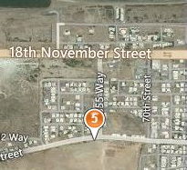
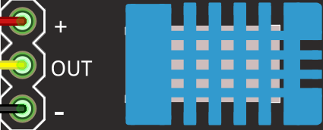

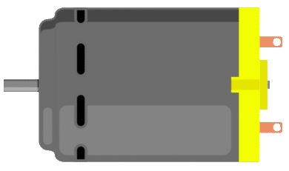
View
Device
Location
Sensors
Sensor reads (Input)
Actuators
Actuator commands(Ouput)
EndPoints
EndPoint Logs(Input)
Things
IOs (Inputs & Outputs)

