Slide 1
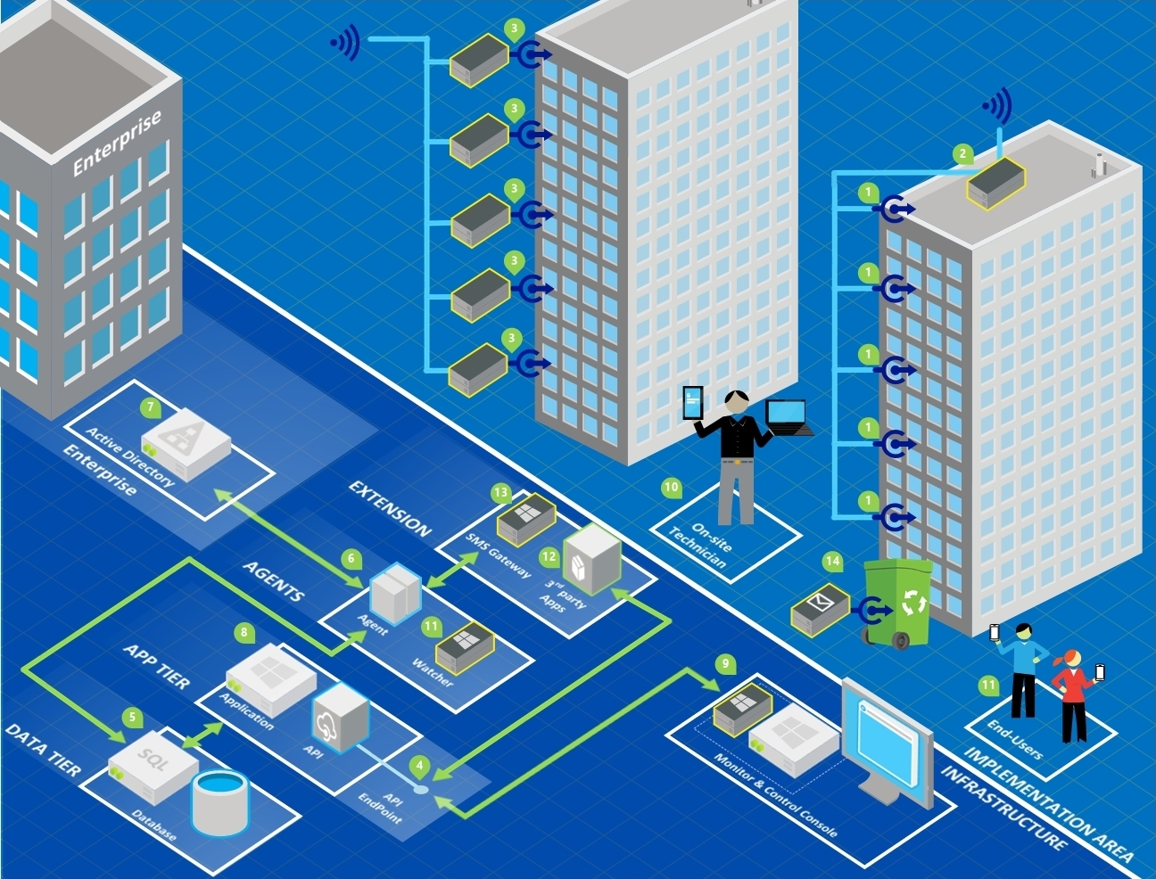
DynThings
Open Source IoT Platform
DynThings.com
It enables developers to rapidly create and deploy game-changing applications, solutions and experiences for today's smart, connected world.

Slide 2

Agenda
Why should I use DynThings Platform ?
Who is targeted by DynThings ?
Why Microsoft Technologies ?
Ok, tell me how does it work ?
Demo
Q & A

Slide 3
Why should I use DynThings Platform ?
Designed for Developers & End Users.
Developers can “Tweak the code”, “Customize” or ……
Easy to manage.
Re-assign endpoints to different Things.
Free, no hidden cost.
UI & UX based on top of Mid-layer architecture.

Slide 4
Who is targeted by DynThings ?
Organizations with Limited budget.
Organizations who want to OWN the platform.
IoT data gathering projects.
IoT projects with geolocation distributed EndPoints.
Organizations with Microsoft infrastructure and Echo System.

Slide 5
Why Microsoft Technologies ?
Majority of Organizations have Microsoft Infrastructure.
Microsoft is moving to Open Source.
Microsoft have the biggest echo-system.
C# + .Net = Support cross-platform.

Slide 6
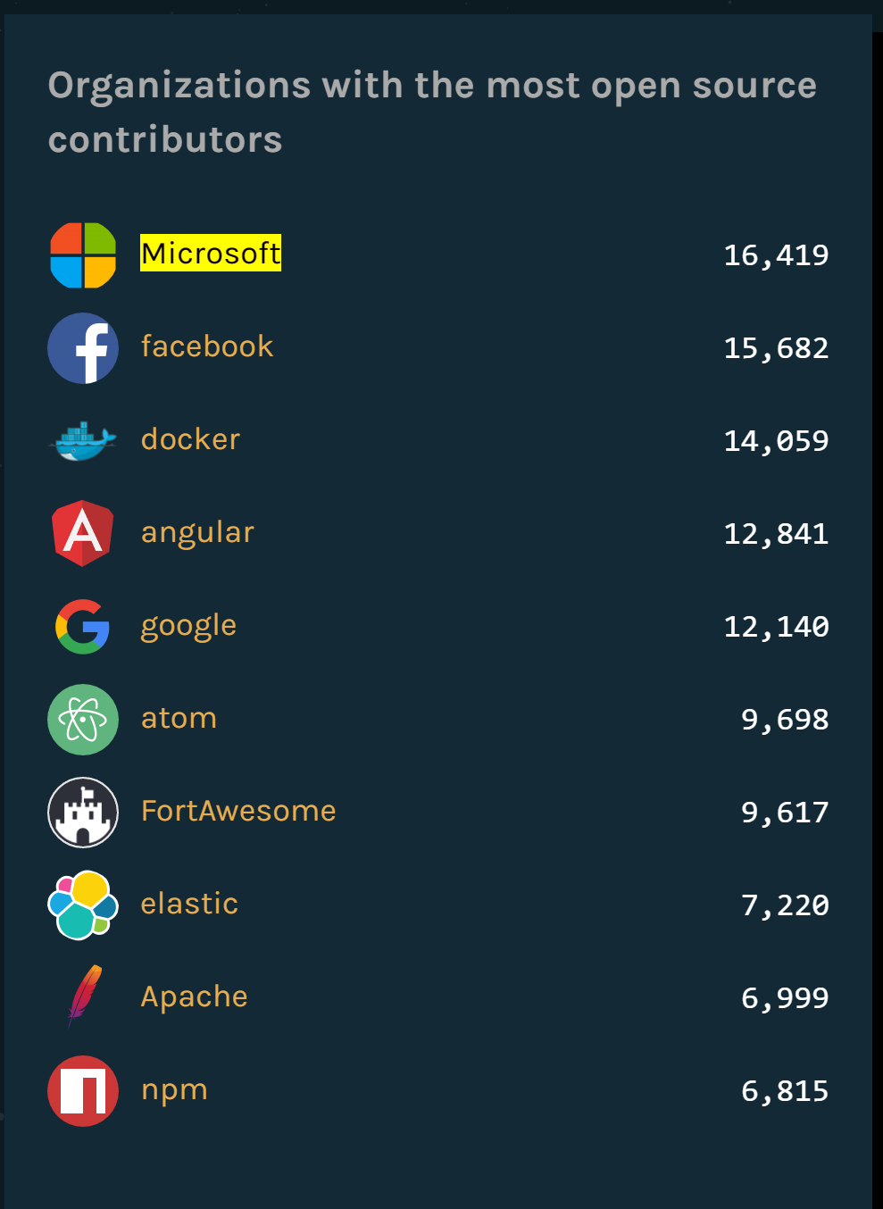

Slide 7
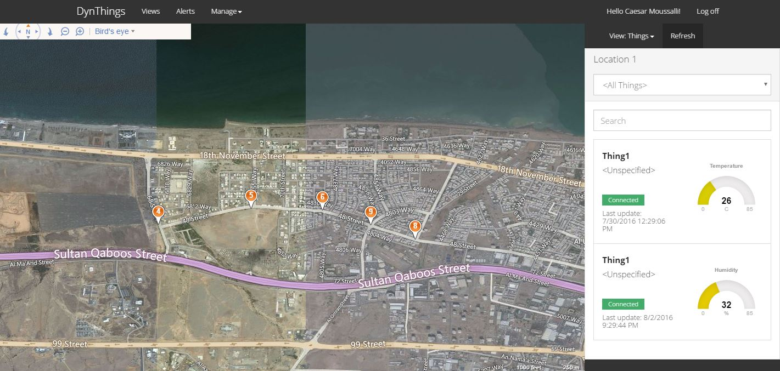
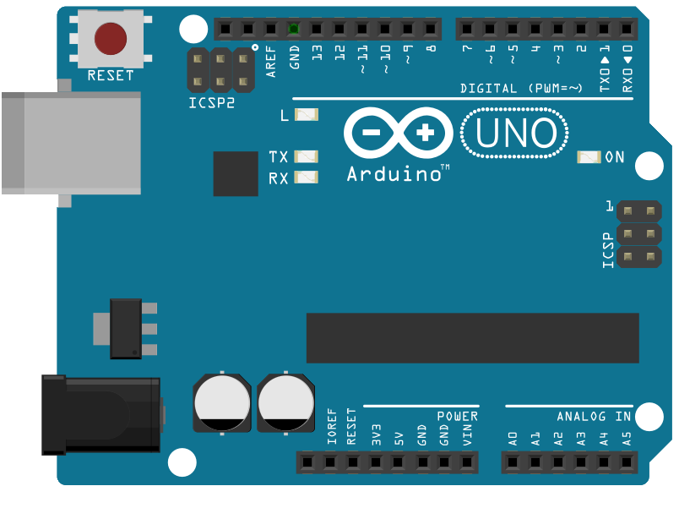
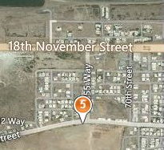

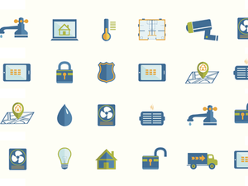
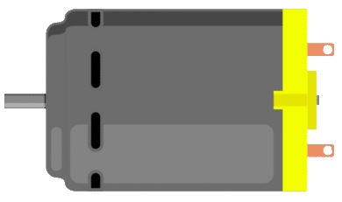
Ok, tell me how does it work ?
Device
View
Location
Sensors
Sensor reads (Input)
Actuators
Actuator commands(Ouput)
EndPoints
EndPoint Logs(Input)
Things
IOs (Inputs & Outputs)

Slide 8
# | Description
1 | EndPoints (Sensors & Actuators)
2 | Devices (single device per building)
3 | Sensors and Devices
4 | API Endpoint to support 3rd party applications
5 | Database (Microsoft SQL Server)
6 | Agent Service to Sync DynThings Users with the enterprise Active Directory
7 | The enterprise Active Directory
8 | DynThings Main Application
9 | Client Application designed for Monitor and Control rooms
10 | On site Technician can access the platform using the Mobile App.
11 | End-Users can access the platform using the Mobile App.
12 | 3rd party applications can communicate using API Endpoint
13 | SMS Gateway to send and receive IOs using SMS instead of

Slide 9

# | Description
1 | EndPoints (Sensors & Actuators)
2 | Devices (single device per building)
3 | Sensors and Devices
4 | API Endpoint to support 3rd party applications
5 | Database (Microsoft SQL Server)
6 | Agent Service to Sync DynThings Users with the enterprise Active Directory
7 | The enterprise Active Directory
8 | DynThings Main Application
9 | Client Application designed for Monitor and Control rooms
10 | On site Technician can access the platform using the Mobile App.
11 | End-Users can access the platform using the Mobile App.
12 | 3rd party applications can communicate using API Endpoint
13 | SMS Gateway to send and receive IOs using SMS instead of

