Slide 1

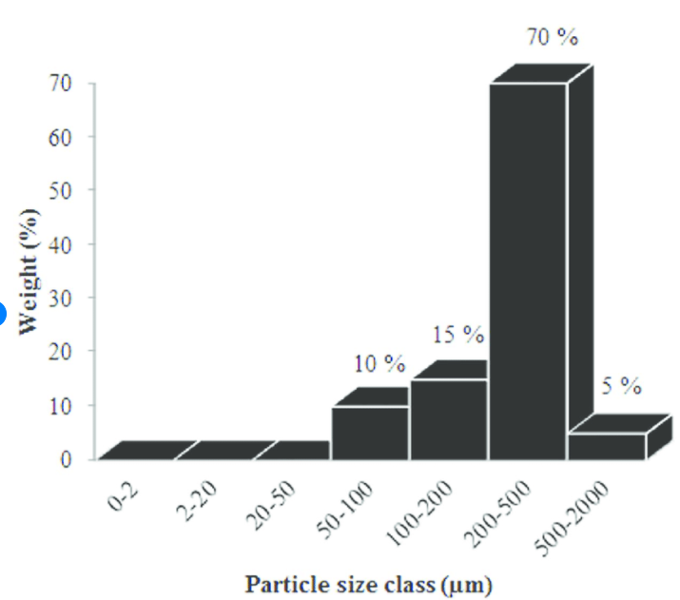

理论：到底什么是数据分析？
Good Quality or Bad Quality?
Entropy High(no info) → Low(more info)

Slide 2
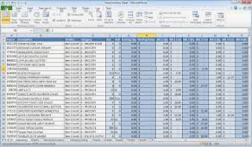
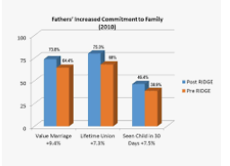
到底什么是数据分析？
Entropy High(no info) → Low(more info)

Slide 3
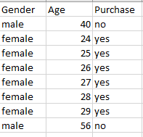
Dimension/Categorical vs Measure/Numerical
Dimension/Categorical
Measure/Numerical
Gender | Average Age
female | 26.5
male | 48
Data Preparation
Data Analysis
Data Visualization
Entropy High(no info) → Low(more info)

Slide 4
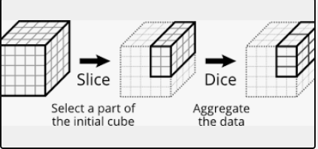
技术三板斧
三板斧：切，统计总和，比较

Slide 5


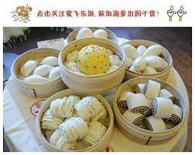
技术三板斧（面团版）
三板斧：切，统计总和，比较

Slide 6
Business Data analysis/商业数据分析
Category of jobs /银行招聘数据分析的部门分类
Sales/销售
Marketing/营销
Internal Audit/Risk/风控
Credit/信用
HR/人事

Slide 7
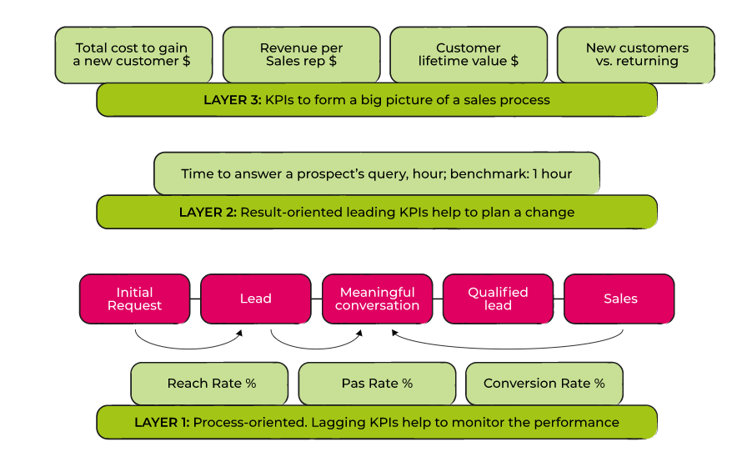
Business problems 1:Sales performance kpi
银行销售业务问题1：怎么提高销售业绩

Slide 8
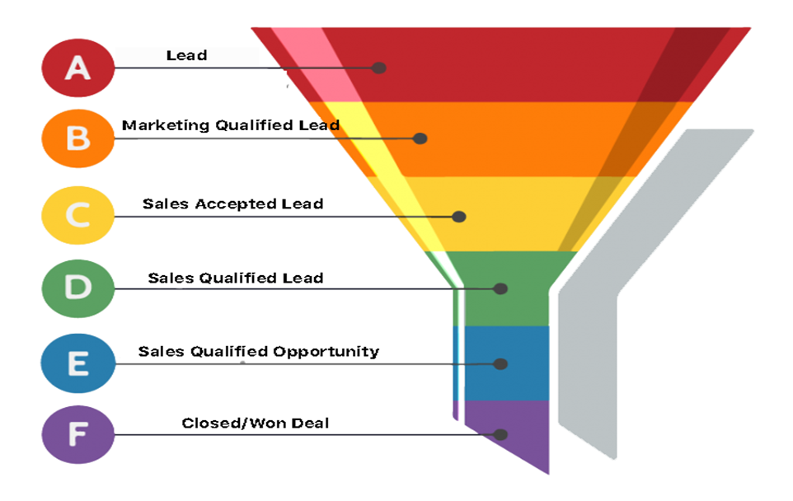
Sales conversion rate
销售人员客户转换率

Slide 9
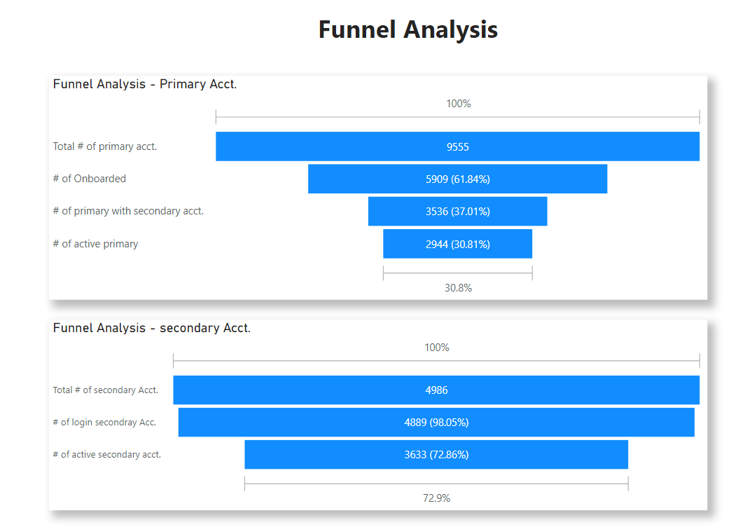
Funnel analysis
过滤分析
Analysis/分析: Primary onboard rate is around 62% and Primary with secondary accounts rate is around 37% and 31% of Primary actively using the product. Once secondary open accounts, their retention rate is much higher.
Recommendations/推荐: Compare the 31% retention rate with benchmark and direct marketing efforts accordingly.

Slide 10
Business problems 2: customer relationship
业务问题2：客户关系
The true success of sales is in building a customer relationship that spans for as long as possible. 销售业绩与客户关系的成功与否密切相关
That makes customer retention a high-priority goal. 留住客户是优先目标
Why should sales focus on customer retention as a metric for measuring sales success? 销售应该把留在客户作为一个标的来评测销售的成功与否
new customer acquisition is five times more costly when compared to the cost of retaining existing customers 获得新客户成本5倍高于留住一个老客户

Slide 11
Cohort analysis
A cohort is a group of users who share a common characteristic over a certain period of time. Cohort analysis is the study of the common characteristics of these users over a specific period.
一组有相同特征的在一段时间内的客户。Cohort是学习这些客户的特征
cohort analysis is commonly used to identify reasons why customers leave and what can be done to prevent them from leaving
Cohort 通常是用于找到客户为什么离开的原因
Acquisition Cohorts: This cohort divides users based on when they were acquired or signed up for a product. Depending on your product, user acquisition could be tracked daily, weekly, or monthly.
一种cohort 分析是按照开户时间来分析他们的行为

Slide 12
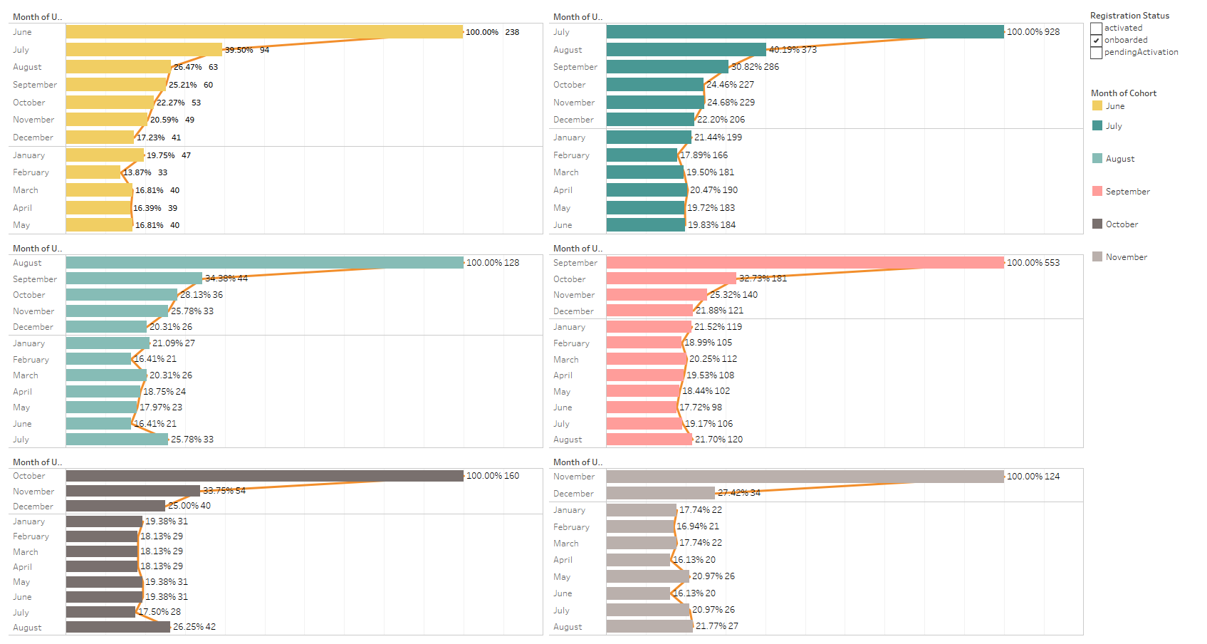
Cohort analysis
Assumptions: The Retention Rates were calculated based on “User Login Month”.
Analysis: The Retention Rates (Onboard June – Nov.) for primary accounts range from 16.8% to 26.3% . The rates tend to stabilize after 2-3 months.
Recommendations: time the marketing efforts based on the time window.

Slide 13
Business problems 3 :Marketing campaigns
业务问题3：怎么提高促销有效率
Marketing campaigns promote products through different types of media, such as television, radio, print, and online platforms.
促销活动通过不同的平台，比如电视，广播，网络，手机等平台
How to improve Marketing campaigns efficiency? Less investment more customers ?
怎么提高促销活动的效率，少花钱多办事？

Slide 14
RFM Analysis
RFM analysis is a powerful tool in marketing that helps marketers make the best of their advertising budget.
RFM 分析是一个分析有力的工具来帮助营销来优化广告预算
Recency, Frequency, Monetary Value (RFM)
RFM 是指新近度，频率，消费价值

Slide 15
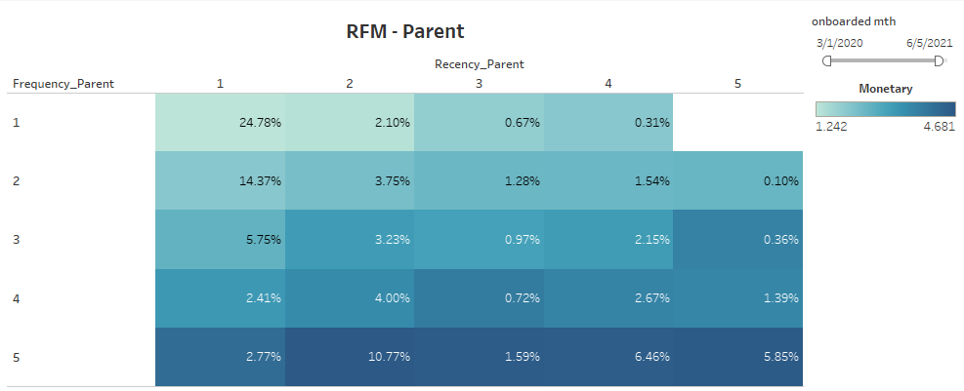
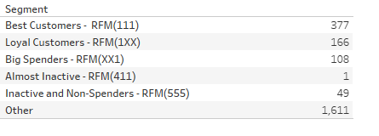
RFM
Analysis: From the RFM of heatmap (upper figure)we can see there are some segments with high R and high F with low M. Also in high R and low F and high M. Lower figure shows the segments based on the RFM.
Recommendations: direct the marketing efforts based on the segments. For examples aggressive incentives to Inactive customers.

Slide 16
Business Data analysis/商业数据分析
MARKETING/市场营销部门项目
Type of Marketing Campaigns/市场营销活动的主要种类
  Product Marketing Campaign/产品营销活动
  Acquisition Marketing Campaign/客户获得
  Customer retention Campaign/客户挽留
Budget/预算: Not all marketing campaigns require an incremental budget, but many still do. Factor in the agency, advertising, and freelance costs, if appropriate, and factor these numbers into any ROI analysis/投资回报分析 for your campaign.

Slide 17
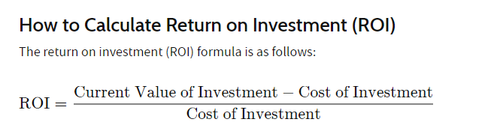
Business Data analysis /商业数据分析
MARKETING/市场营销部门项目
怎么算促销活动的回报？

Slide 18
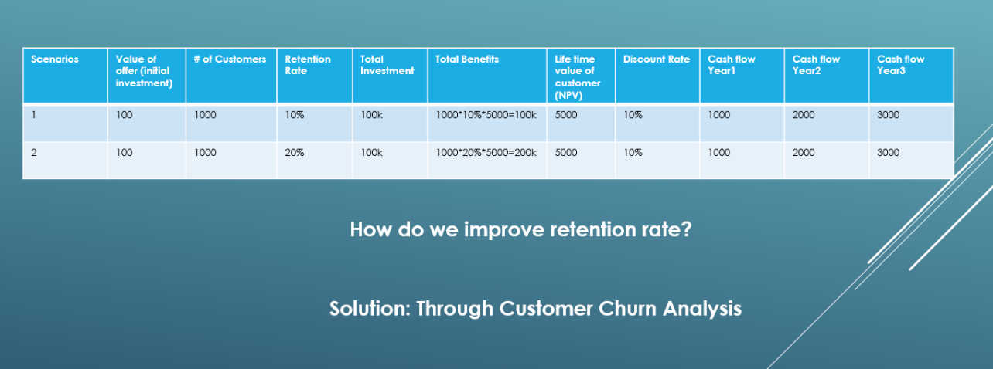
Business Data analysis /商业数据分析
ROI Financial analysis
随机
非随机

Slide 19

Credit Risk & Credit Losses
Business Data analysis /商业数据分析

Slide 20
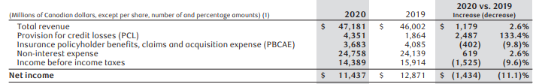
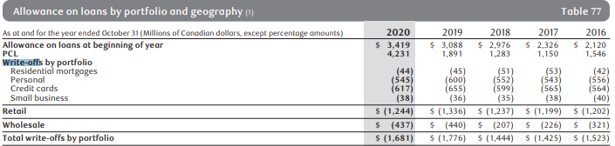
Credit Risk & Credit Losses
Business Data analysis /商业数据分析

Slide 21
Credit Risk & Credit Losses
Business Data analysis /商业数据分析
Credit risk refers to the potential for loss due to the failure of a borrower to make a payment when it is due
信贷风险是指客户还不起钱的风险
Credit losses: losses from delinquent and bad debt or other credit. 风险发生后，信贷风险变成信贷损失
Can we implement data-driven strategy to
1, Prevent Credit Losses?怎么防止信用借贷损失？
2, Mitigate Credit Risk (and better PCL estimation)? 减轻信用借贷风险
3, Improve Portfolio Performance?怎么提高借贷组合业绩

Slide 22
Business Data analysis/商业数据分析
银行内部审计和风险控制

Slide 23

Business Data analysis/商业数据分析
Business Problem statement
风险控制对银行的成功与失败至关重要！

Slide 24


Business Data analysis/商业数据分析
工作机会

Slide 25
Business Data analysis/商业数据分析
internal audit & RISK/风险和内部审计
内部审计internal audit ，是一种独立、客观的确认和咨询活动，它通过运用系统、规范的方法，审查和评价组织的业务活动、内部控制和风险管理risk management的适当性和有效性，以促进组织完善治理、增加价值和实现目标
内部审计internal audit在商业银行风险管理risk management中的作用
  客观识别和评估风险
  综合分析和计量风险
  风险预警

Slide 26
Business Data analysis/商业数据分析
internal audit and DATA /
风险和内部审计与数据的关系
Internal audit in the age of data analytics数据时代下的内部审计
  Fast-evolving technologies that generate-increasing amounts of data have created an opportunity机会 for internal audit departments to leverage data to evaluate risk and drive audit insight. As a result, data analytics is increasingly becoming an indispensable element不可分割的元素 of the internal audit toolset.
Data Analytics Transforms Internal Auditors Into Strategic Advisors策略顾问

Slide 27
Business Data analysis/商业数据分析
internal audit and DATA /
风险和内部审计与数据的关系
Audit Analytics & Financial Fraud Risk Analysis
审计分析和金融欺诈风险分析

Slide 28
Business Data analysis/商业数据分析
internal audit and DATA /
风险和内部审计与数据的关系
Findings 1
Fraud Risk?
Findings 2
Fraud Risk?
…
Findings 10000
Fraud Risk?

Slide 29
Business Data analysis/商业数据分析
internal audit and DATA /
风险和内部审计与数据的关系
Audit Analytics & Bankruptcy Analysis
审计分析和破产分析

Slide 30
internal audit & RISK/风险和内部审计
银行破产主要风险
Internal Risks:
i.Industry risk (IR) 行业风险:
Government policies and International agreements,
Cyclicality,
Degree of competition,
The price and stability of market supply,
The size and growth of market demand,
The sensitivity to changes in macroeconomic factors,
Domestic and international competitive power,
Product Life Cycle.
ii.Management risk(MR)管理风险:
Ability and competence of management,
Stability of management,
The relationship between management/ owner,
Human resources management,
Growth process/business performance,
Short and long term business planning,
achievement and feasibility.
iii.Financial Flexibility(FF)金融灵活性:
Direct financing,
Indirect financing,
Other financing
Internal Risks:
iv.Credibility (CR)可信度（信用）:
Credit history,
reliability of information,
The relationship with financial institutes.
v.Competitiveness (CO)竞争性:
Market position,
The level of core capacities,
Differentiated strategy,
vi.Operating Risk (OP)操作风险:
The stability and diversity of procurement,
The stability of transaction,
The efficiency of production,
The prospects for demand for product and service,
Sales diversification,
Sales price and settlement condition,
Collection of A/R,
Effectiveness of sale network.

Slide 31
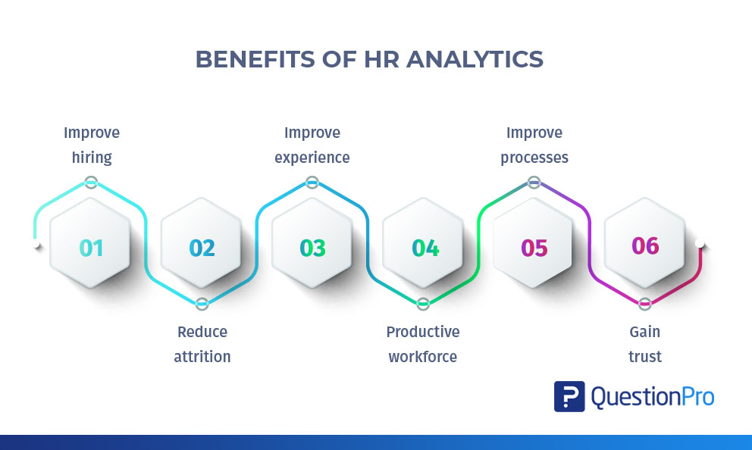
Business Data analysis /商业数据分析
HR/人事部门数据分析

Slide 32
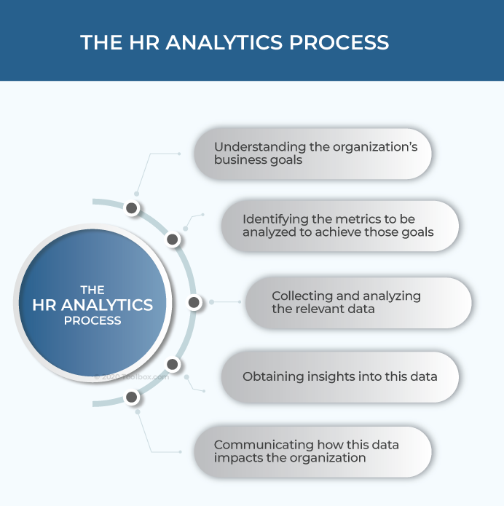
Business Data analysis /商业数据分析
HR/人事部门数据分析

Slide 33
Business Data analysis /商业数据分析
Bonus PROJECT 额外项目
A/B testing

