Slide 1
Thinking in SQL
Presentation to UGA
Notes:
Thank you for having me
When I was wan undergrad, we focused a lot on designing the database, understanding normal form, and basic querying. However, I can clearly remember the struggle I had in my database project. While our team did well on our project, and I could write a basic queries that joined tables and such, I still struggled and resisited getting better at SQL because I hadn’t been taught to think in it. It wasn’t until I was eight years out of undergrad that I met a co-worker who really clarified the way I approached queries and taught me to think in SQL. When you can think in SQL and you master it as a language, writing queries will be come effortless, you will be able to ask better questions about your oragnaization and provide unparalleled insight without having to wait on others to help you out.
In today’s talk, I’m going to talk about was that I learned not only how to think in SQL, but also some best practices for writing SQL that can facilitate that thinking.

Slide 2





Why SQL
Data is everywhere and it grows exponentially
SQL is the lingua franca of data
The better you are the more valuable you will be
Big data platforms include interfaces that accommodate SQL
Made Map-Reduce accessible by implementing ODBC in SQL
Notes:
So, why SQL. Well, Data is everywhere and it growing exponentially. Home Depot collects 80GB a day just through the clicks on our website not to mention sales, cost, and other supply chain data.
SQL is the linguq franca of data. The better you are at it, the more valuable you will be. Though MapReduce and other querying languages such as xpath, etc can be useful, SQL is still the king. Look a the platforms it covers.

Slide 3

SQL Superpowers!
Move faster & More Resourceful
Handle bigger data sets than spreadsheets
Collaborate more easily with co-workers
Work with more diverse set of tools (SAS, R, Tableau, etc)
Compared to point and click alone.
Notes:
If you know SQL it’s like you’ve got superpowers.
Cover the bullet points

Slide 4
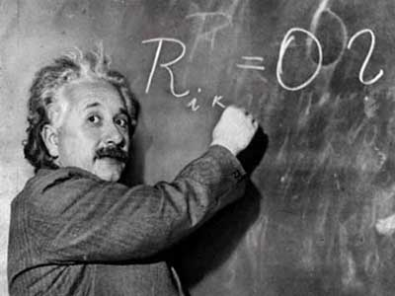

Data Jobs
Data Scientist
Data Janitor
Data is often very dirty; you have to clean it up before you can model it. SQL empowers you to work with and manipulate data so you can derive insight.
Notes:
Many of you have probably herad the term “data scientist”; that’s someone who leads analytic efforts by mining data for patterns and insight. I think of myself as a data scientist.
But about 80% of my time, I’m actually a data janitor.

Slide 5
Thinking in SQL: Bad vs. Good SQL
Bad SQL
Good SQL
Hard to Read
Inefficient use of database resources
Difficult to share with team or collaborate
Easy to read
Helps the database optimize its resources
Easy to share because people can read and understand the goal of the query

Slide 6
Bad SQL: A Simple Example
This query will work.
Where are the table relationships?
Where are the business conditions?
Could you make it out this easily if there were four or five tables?
Select s.*,l.item_id,l.item_price,l.item_qty,v.customer_name,v.customer_email from sales_hdr s, sales_detail l, (select customer_id from high_value_customer_v) v where and s.customer_id = v.customer_id and l.item_qty > 10 and l.item_price between 15 and 20 and s.sltrn_id = l.sltrn_id

Slide 7
Good SQL
Mirrors your entity relationship diagram
Clearly states what you are looking for
Includes comments
/*get customers for next marketing email round*/
Select s.*,l.item_id,l.item_price,l.item_qty,v.customer_name,v.customer_email from sales_hdr s inner join sales_detail l on s.sltrn_id = l.sltrn_id inner join (select customer_id from high_value_customer_v) v on s.customer_id = v.customer_id where l.item_qty > 10 and l.item_price between 15 and 20
Very useful if you have to change to outer joins (left and right)

Slide 8
Good SQL Structure
Comments
/*get customers for next marketing email round*/
Select s.*,l.item_id,l.item_price,l.item_qty,v.customer_name,v.customer_email from sales_hdr s inner join sales_detail l on s.sltrn_id = l.sltrn_id inner join (select customer_id from high_value_customer_v) v on s.customer_id = v.customer_id where l.item_qty > 10 and l.item_price between 15 and 20
Field section
Tables and Relationships
Business Rules

Slide 9
Entity Relationships
Central Table In Model
sales_hdr
sales_dtl
High_value_customer_v
Notes:
Your query should reflect your entity relationship model and the purpose of the information you are trying to gather.
The key to thinking in SQL
Know / write down/ state the goal of what you’re going after
Know what the central table / view / subquery of your data is
Know how to join other tables around it

Slide 10

Other Benefits Of Knowing Good SQL
Makes other data querying/manipulation languages and dialects easier to learn
Example: R
The R Project is a statistics language for working with data
Excel on Steroids!
Because you are writing what you are doing, other people can follow you and repeat what you have done (including yourself)!
Avoid VLOOKUP Danger
Data Manipulation Packages in R
Dplyr – data querying and processing flow
Sqldf – lets you work with R dataframes as though they were tables
Easier checking of your results …
Total Sales for Home Depot $83B, but my “90% of customers” query only returned $5.4B … ???????

Slide 11
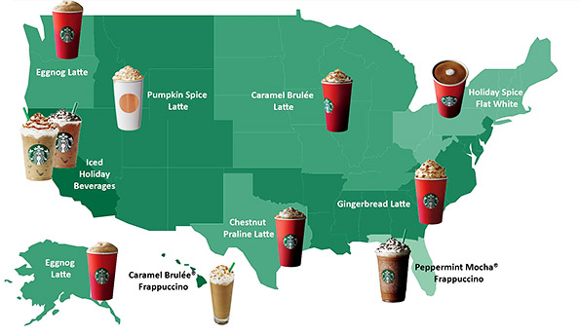

Starbucks Demo
Where should Starbucks go next?
The Home Depot >>>

Slide 12
Bag of Tricks
Use SQL to generate other SQL
Query the metadata - the list of tables and column names.
What if you needed to query every table which you created.
The right SQL script will create the queries for you.
Use Excel to generate scripts
Pull column names into a spreadsheet and formulas generate the SQL
No more VLOOKUPS – plug in R and use sqldf or dplyr
Formula Transcription Errors
Data type mixups can wreak havoc and errors in VLOOKUPS

Slide 13

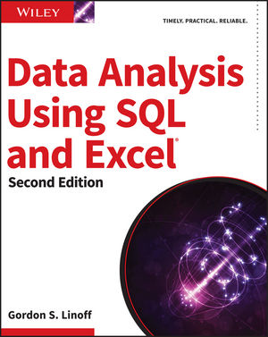
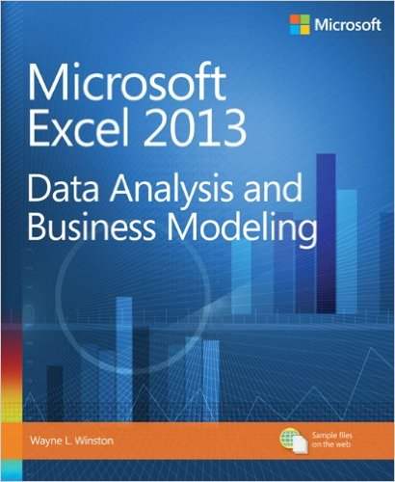

Closing Thoughts
SQL is a very powerful skill to have
Practice and Q.C. your results!
SQL and querying data is a mental exercise. You can get stronger
Know when to stop. (my rule no querying after 11 PM)
Recommended Training Books

Slide 14

Thinking in SQL
Thank You and Go Dawgs!

