Slide 1
STAT-515
APPLIED STATISTICS AND VISUALIZATIONS FOR ANALYTICS
MID-TERM PROJECT
The Top 25 Business Insurance Firms in the U.S.
DONE BY : BHARGAV DASARI

Slide 2
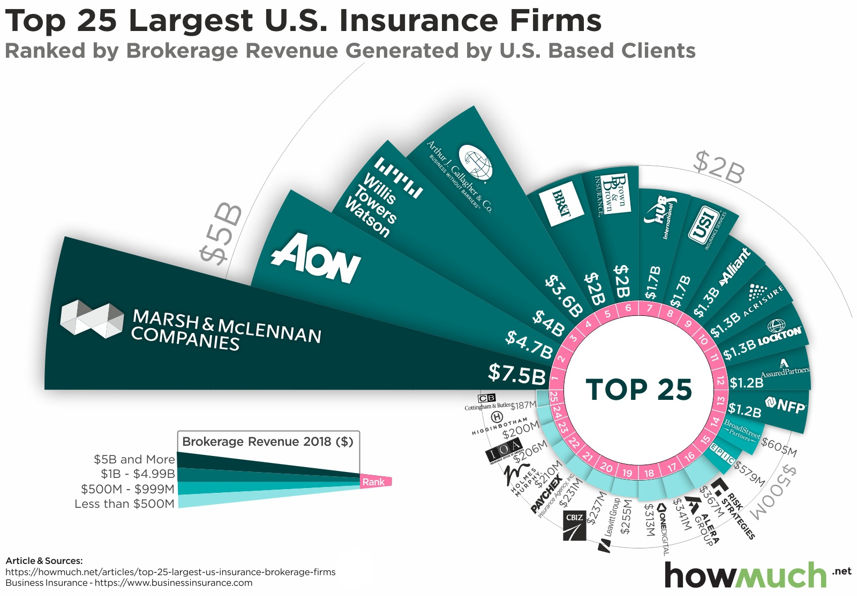
Source of Original Graph:
The original graph was taken from the article “The Top 25 Business Insurance Firms in the U.S.” on the howmuch.net website
Link: https://howmuch.net/articles/top-25-largest-us-insurance-brokerage-firms

Slide 3
Context:
The information for the visualization was sourced from an annual list compiled by Business Insurance, featuring the top 100 business insurance brokerages based on revenue.
The companies were ranked according to their 2018 cash flow, which was the most recent year for which complete data was available at the time of analysis.

Slide 4
Strengths:
Visual Impact: The chart immediately grabs attention due to the exploded segment, making it memorable.
Emphasizing a Segment: The explosion draws focus to a specific segment highlighting its significance.
Clear Ranking: The larger segments are easily distinguishable, allowing viewers to compare companies’ revenues.

Slide 5
Weakness:
Readability: Some company names and revenues are hard to read due to small font size and overlapping labels.
Precision: It lacks a scale or precise measurement, making it challenging to compare close revenue values accurately
Distortion: The explosion distorts the perception of relative sizes, potentially misleading viewers.

Slide 6
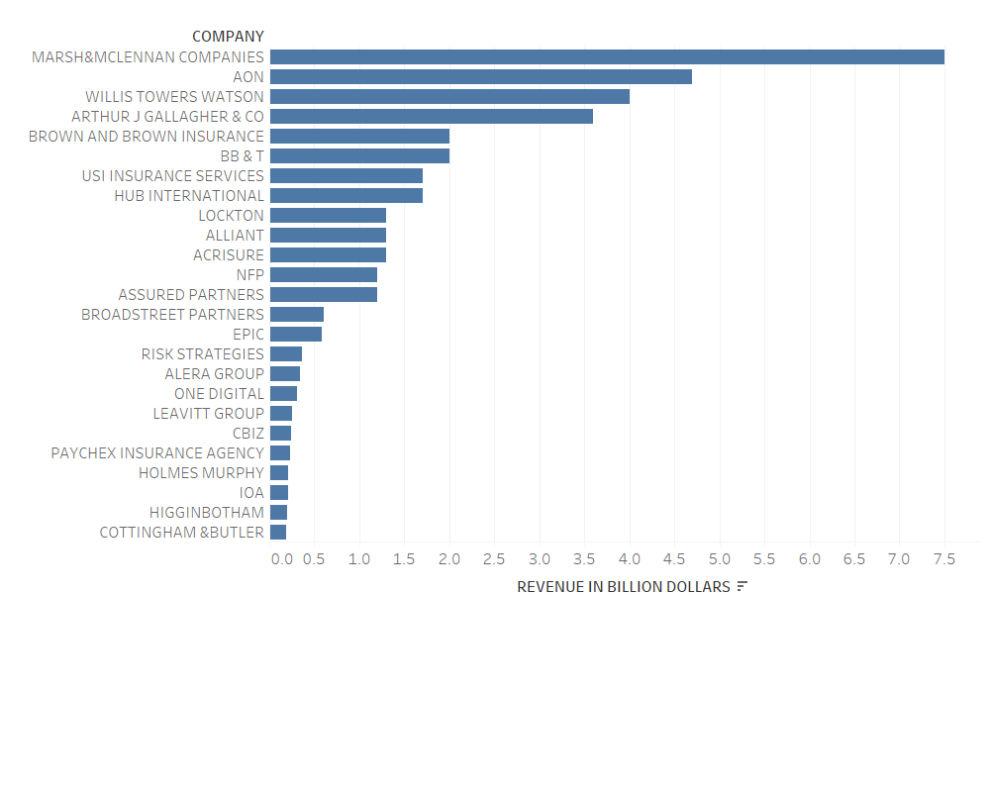
Converting data in graphs…
Used R and Tableau to convert data into graphs.
Data appears random rather than highlighting key trends and relationships

Slide 7
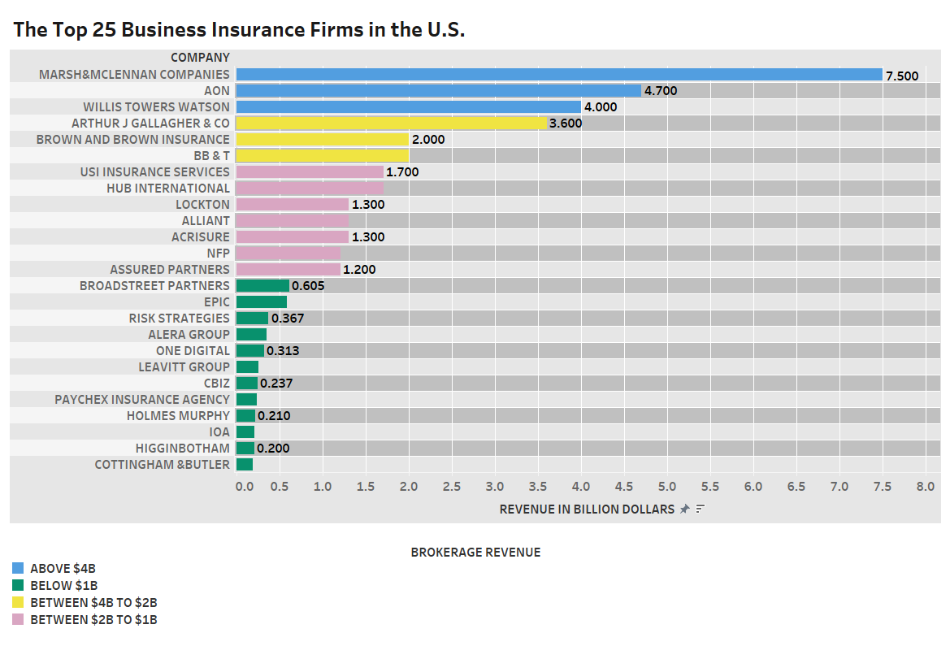
TABLEAU:
PROS
Super easy, spacious, and quick!
Able to blend in and play with data.
Graph is flawless
All the variables like companies, revenue, and legend position are arranged and adjusted easily with a few clicks.
CONS
Very less colors are available to color blind

Slide 8
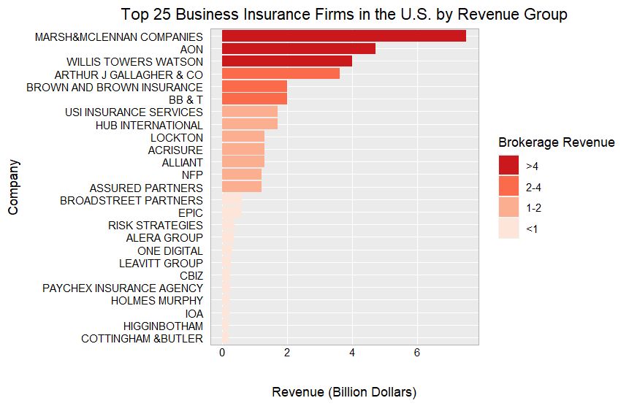
RStudio:
PROS
Easy to create graphs
Easy to reproduce the graph
Extensive packages of R helps create graphs as per our requirement
CONS
Requires more time
X axis values

Slide 9
Challenges faced….
Editing according to our needs
Grouping the data
Colour blind is limited to 10 colours tableau
Values on the x-axis in RStudio
Possible approaches…
To add more colors to color blind in the tableau
To refine values on x-axis in RStudio

Slide 10
Conclusion:
Graph in Tableau is the ultimate winner
No coding is required to create graphs in Tableau so people with minimum coding skills also can create visualizations
The variations can be directly analysed
Easy to make predictions.

