Slide 1
Randomized Approximation Algorithms for
Set Multicover Problems
with Applications to
Reverse Engineering of Protein and Gene Networks
Bhaskar DasGupta†
Department of Computer Science
Univ of IL at Chicago
dasgupta@cs.uic.edu
Joint work with Piotr Berman (Penn State) and Eduardo Sontag (Rutgers)
† Supported by NSF grants CCR-0206795, CCR-0208749 and a CAREER grant IIS-0346973

Slide 2
More interesting title for the theoretical computer science community:
Randomized Approximation Algorithms for
Set Multicover Problems
with Applications to
Reverse Engineering of Protein and Gene Networks

Slide 3
More interesting title for the biological community:
Randomized Approximation Algorithms for
Set Multicover Problems
with Applications to
Reverse Engineering of Protein and Gene Networks

Slide 4
Biological problem
via
Differential Equations
Linear Algebraic
formulation
Combinatorial
Algorithms
(randomized)
Combinatorial
formulation
Selection of
appropriate
biological experiments

Slide 5
Biological problem
via
Differential Equations
Linear Algebraic
formulation
Combinatorial
Algorithms
(randomized)
Combinatorial
formulation
Selection of
appropriate
biological experiments

Slide 6
1
m
1
n
1
m
1
1
1
A_{i}
=
×
B_{j}
n
n
n
C
=
A
×
B
unknown
initially unknown,
but can be queried
columns are linearly
independent
c_{1,j}
=0 ?
Get:
Zero structure
of j^{th} column
C_{j}
c_{2,j}
=0 ?
•
•
c_{i,j}
=0 ?
Query: j^{th} column
B_{j}
•
•
c_{n,j}
=0 ?

Slide 7
  Rough objective: obtain as much information about A performing as few queries as possible
  Obviously, the best we can hope is to identify A upto scaling

Slide 8
  Suppose we query columns B_{j} for j∈J = { j₁,…, j_{l} }
  Let J_{i}={j | j∈J and c_{ij}=0}
  Suppose |J_{i}| ≥ n-1.Then,each A_{i} is uniquely determined upto a scalar multiple (theoretically the best possible)
  Thus, the combinatorial question is:
    find J of minimum cardinality such that
    |J_{i}| ≥ n-1 for all i

Slide 9
Combinatorial Question
Input: sets J_{i} ⊆ {1,2,…,n} for 1 ≤ i ≤ m
Valid Solution: a subset Λ ⊆ {1,2,...,m} such that
∀ 1 ≤ i ≤ n : |J_{λ} : λ∈Λ and i∈J_{λ}| ≥ n-1
Goal: minimize |Λ|
This is the set-multicover problem with coverage factor n-1
More generally, one can ask for lower coverage factor, n-k for some k>1, to allow fewer queries but resulting in ambiguous determination of A

Slide 10
Biological problem
via
Differential Equations
Linear Algebraic
formulation
Combinatorial
Algorithms
(randomized)
Combinatorial
formulation
Selection of
appropriate
biological experiments

Slide 11
Time evolution of state variables (x₁(t),x₂(t),…,x_{n}(t)) given by a set of differential equations:
    ∂x₁/∂t = f₁(x₁,x₂,…,x_{n},p₁,p₂,…,p_{m})
∂x/∂t = f(x,p) ≡ …
    ∂x_{n}/∂t = f_{n}(x₁,x₂,…,x_{n},p₁,p₂,…,p_{m})
p=(p₁,p₂,…,p_{m}) represents concentration of certain enzymes
f(x∗,p∗)=0
p∗ is “wild type” (i.e. normal) condition of p
x∗ is corresponding steday-state condition

Slide 12
Goal
We are interested in obtaining information about the sign of ∂f_{i}/∂x_{j}(x∗,p∗)
e.g., if ∂f_{i}/∂x_{j} > 0, then x_{j} has a positive (catalytic) effect on the formation of x_{i}

Slide 13
Assumption
We do not know f, but do know that certain parameters p_{j} do not effect certain variables x_{i}
This gives zero structure of matrix C:
matrix C⁰=(c⁰_{ij}) with c⁰_{ij}=0 ≡ ∂f_{i}/∂x_{j}=0

Slide 14

m experiments
change one parameter, say p_{k} (1 ≤ k ≤ m)
for perturbed p ≈ p∗, measure steady state vector x = ξ(p)
estimate n “sensitivities”:
where e_{j} is the j^{th} canonical basis vector
  consider matrix B = (b_{ij})

Slide 15
In practice, perturbation experiment involves:
letting the system relax to steady state
measure expression profiles of variables x_{i} (e.g., using microarrys)

Slide 16
Biology to linear algebra (continued)
Let A be the Jacobian matrix ∂f/∂x
Let C be the negative of the Jacobian matrix ∂f/∂p
From f(ξ(p),p)=0, taking derivative with respect to p and using chain rules, we get C=AB.
This gives the linear algebraic formulation of the problem.

Slide 17
Set k-multicover (SC_{k})
Input: Universe U={1,2,…,n}, sets S₁,S₂,…,S_{m} ⊆ U,
integer (coverage) k≥1
Valid Solution: cover every element of universe ≥k times:
subset of indices I ⊆ {1,2,…,m} such that
∀x∈U |j∈I : x∈S_{j}| ≥ k
Objective: minimize number of picked sets |I|
k=1  simply called (unweighted) set-cover
a well-studied problem
Special case of interest in our applications:
k is large, e.g., k=n-1

Slide 18
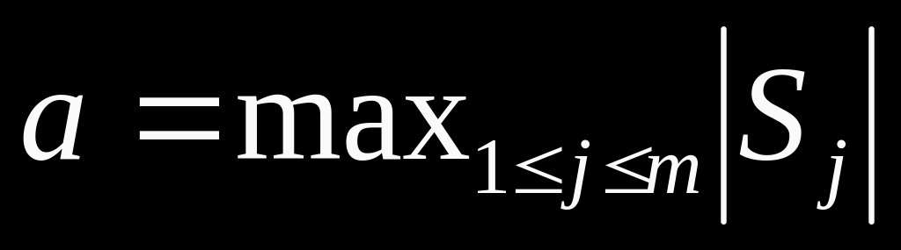
(maximum size of any set)
Known results
Set-cover (k=1):
Positive results
  can approximate with approx. ratio of 1+ln a
  (determinstic or randomized)
  Johnson 1974, Chvátal 1979, Lovász 1975
  same holds for k>1
  primal-dual fitting: Rajagopalan and Vazirani 1999
Negative result (modulo NP ≠ DTIME(n^{loglog} n) ):
  approx ratio better than (1-ρ)ln n is impossible in
  general for any constant 0<ρ<1 (Feige 1998)
  (slightly weaker result modulo P≠NP, Raz and Safra
  1997)

Slide 19
r(a,k)= approx. ratio of an algorithm as function of a,k
We know that for greedy algorithm r(a,k) ≤ 1+ln a
  at every step select set that contains maximum number of elements not covered k times yet
Can we design algorithm such that r(a,k) decreases with increasing k ?
  possible approaches:
    improved analysis of greedy?
    randomized approach (LP + rounding) ?
    …

Slide 20
Our results (very “roughly”)
      n = number of elements of universe U
      k = number of times each element must be covered
      a = maximum size of any set
Greedy would not do any better
  r(a,k)=Ω(log n) even if k is large, e.g, k=n
But can design randomized algorithm based on LP+rounding approach such that the expected approx. ratio is better:
  E[r(a,k)] ≈ max{2+o(1), ln(a/k)} (as appears in conference proceedings)
  ⇓ (further improvement (via comments from Feige))
  ≈ max{1+o(1), ln(a/k)}

Slide 21
More precise bounds on E[r(a,k)]
1+ln a if k=1
(1+e^{-(k-1)/5}) ln(a/(k-1)) if a/(k-1) ≥ e² ≈7.4 and k>1
min{2+2e^{-(k-1)/5},2+0.46 a/k} if ¼ < a/(k-1) < e² and k>1
1+2(a/k)^{½} if a/(k-1) < ¼ and k>1
E[r(a,k)]
ln(a/k)
approximate
not drawn to scale
4
2
1
a/k
0
¼
e²
a

Slide 22
Can E[r(a,k)] coverge to 1 at a faster rate?
Probably not...for example, problem can be shown to be APX-hard for a/k ≥ 1
Can we prove matching lower bounds of the form
max { 1+o(1) , 1+ln(a/k) } ?
Do not know...

Slide 23
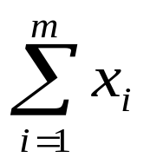
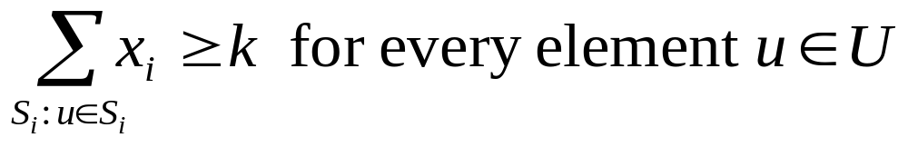
Our randomized algorithm
Standard LP-relaxation for set multicover (SC_{k}):
selection variable x_{i} for each set S_{i} (1 ≤ i ≤ m)
minimize
subject to:
0 ≤ x_{i} ≤ 1 for all i

Slide 24
Our randomized algorithm
Solve the LP-relaxation
Select a scaling factor β carefully:
    ln a if k=1
    ln (a/(k-1)) if a/(k-1)≥e² and k>1
    2 if ¼≤a/(k-1)<e² and k>1
    1+(a/k)^{½} otherwise
Deterministic rounding: select S_{i} if βx_{i}≥1
    C₀ = { S_{i} | βx_{i}≥1 }
Randomized rounding: select S_{i}∈{S₁,…,S_{m}}\C₀ with prob. βx_{i}
C₁ = collection of such selected sets
Greedy choice: if an element u∈U is covered less than k
    times, pick sets from {S₁,…,S_{m}}\(C₀ ∪C₁) arbitrarily

Slide 25
Most non-trivial part of the analysis involved proving the following bound for E[r(a,k)]:
E[r(a,k)] ≤ (1+e^{-(k-1)/5}) ln(a/(k-1)) if a/(k-1) ≥ e² and k>1
Needed to do an amortized analysis of the interaction between the deterministic and randomized rounding steps with the greedy step.
For tight analysis, the standard Chernoff bounds were not always sufficient and hence needed to devise more appropriate bounds for certain parameter ranges.

Slide 26
Thank you for your attention!

