Slide 1
Order independent structural alignment of circularly permutated proteins
T. Andrew Binkowski Bhaskar DasGupta⊥ Jie Liang‡
Bioengineering Computer Science Bioengineering
UIC UIC UIC
⊥Supported by NSF grants CCR-0296041, CCR-0206795, CCR-0208749 and CAREER
IIS-0346973
‡Supported by NSF grants CAREER DBI-0133856, DBI-0078270 and NIH grant
GM-68958

Slide 2
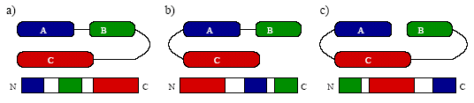
Circular Permutations
Ligation of the N and C termini of a protein and a concurrent cleavage elsewhere in the chain
Structurally similar, stable, and retain function
Occur in nature:
  Tandem repeats via duplication of the C-terminal of one repeat with the N-terminal of the next repeat
  Transposable elements lead to rearrangement of segments within the same gene
  Ligation and cleavage of the peptide chains during post-translational modification
Artificially created in lab:
  Protein folding studies

Slide 3
Why study them?
Important mechanism to generate new folds
Many inserted domains are circular permutations of homologues
Different domain orientations expose different surface regions for substrate binding
Circular permutations offer an efficient way to generate biologically important functional diversity

Slide 4
Current Methods of Identifying Circular Permutations
Sequence alignment:
  Post processing dynamic programming
  Customized algorithms
  Miss distantly related proteins
  Many false positives from tandem repeats
Structure alignment:
  No current methods of identification
  Current structural alignment methods do not work
    Continuous fragment assembly

Slide 5
Difficulty in Identifying Circular Permutations
Similar domains
Similar spatial arrangements
Discontinuity of primary sequence and domain ordering
Problems:
  “Breaks”
  reverse ordering (N->C)

Slide 6

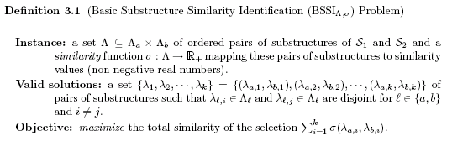
Basic Methodology
Our approach to provide an approximate solution to the BSSIΛ, σ problem is to adopt the approximation algorithm for scheduling split-interval graphs which is based on a fractional version of the local-ratio approach.
Fragments of the protein structure
Looking for fragments pair sets that maximize the total similarity

Slide 7
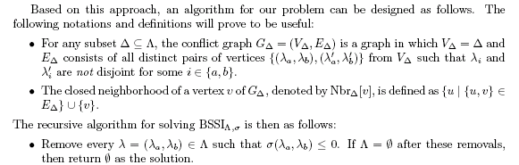
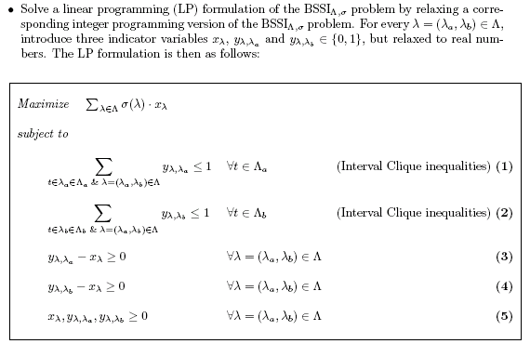
Non-overlapping fragments and define neighbors
Define linear programming variables for each fragment pair set
Substructure pairs are disjoint
Ensure consistency between set pairs and substructures
Non-negative values

Slide 8
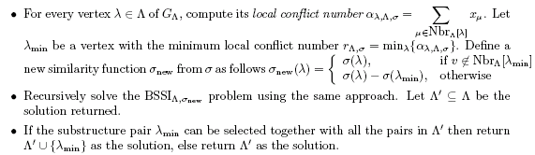
Compute local conflict and solve recursively
Identify non-overlapping fragment pair substructures that maximize the total similarity

Slide 9

Simplified Example
Exhaustively fragment and compare
Threshold
Delete all vertices with 0 weight
LP formulation
Algorithm guarantees:
Update:
Substructures with no neighbors
Superposition

Slide 10
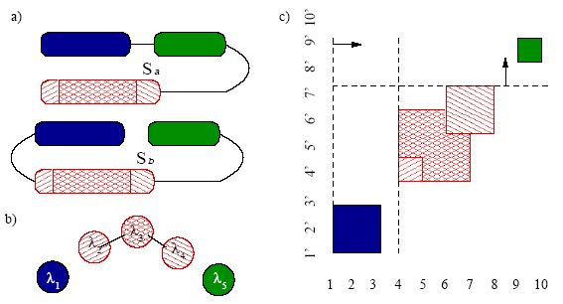


Fragment and Compare
Two proteins structures Sa and Sb
Systematically cut Sb into fragments (length 7-25)
Exhaustively compare to Sa fragments of equal length:
Fragment pair represented as a vertex in a graph
Threshold
6

Slide 11

Simplified Example
Similarity score for aligned fragments
Problem of identify best fragments:

Slide 12
Simplified Example
Exhaustively fragment and compare
Threshold
Delete all vertices with 0 weight
LP formulation
Algorithm guarantees:
Update:
Substructures with no neighbors
Superposition

Slide 13


LP Formulation
Conflict graph for the set fragments
Sweep line determines which vertices (fragments) overlap
A conflict is shown as an edge between vertices

Slide 14
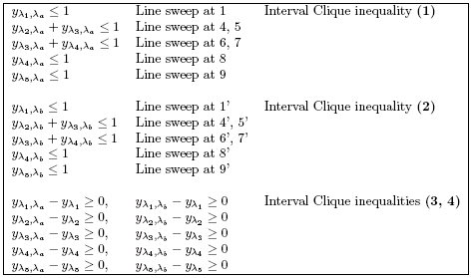
Simplified Example
Linear programming equations (MPS):
Solve using BPMPD

Slide 15
Simplified Example
Exhaustively fragment and compare
Threshold
Delete all vertices with 0 weight
LP formulation
Algorithm guarantees:
Update:
Substructures with no neighbors
Superposition

Slide 16
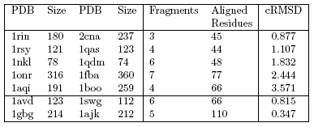
Results
Extracted known examples from literature
Natural and artificial (below line)

Slide 17
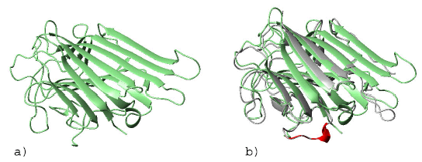
Lectins
Plant lectins interact with glycoproteins and glycolipids through the binding of various carbohydrates
The structures of lectin from garden pea (1rin) (a) and concanavalin A (2cna) (b)
  The permutation is a result of post-translational modifications
3 fragments align over 45 residues; 0.82˚A

Slide 18
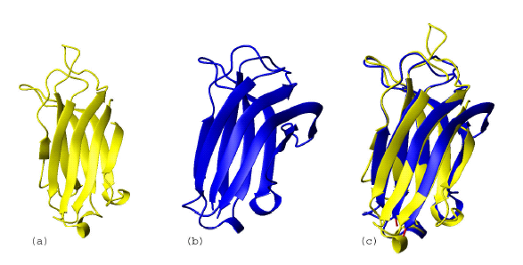
C2 Domains
The C2 domain is a Ca2+-binding module involved mainly in signal transduction
phospholipase Cγ C2 domain (1qas) (a) and synaptotagmin I C2 domain (1rsy) (b)
4 fragments, 44 residues at a root mean square distance of 1.1 ˚A.

Slide 19
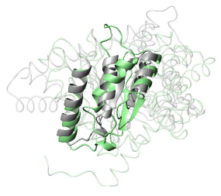
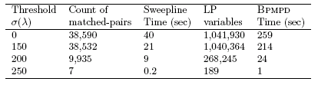
Adolse
Transaldolase, one of the enzymes in the non-oxidative branch of the pentose phosphate pathway
Transaldolase (1onr) and fructose-1,6-phosphate aldolase (1fba); 7 fragments; 77 residues; 2.4˚A.
In agreement with the manual alignments of Jia et. al., the best alignments occur when the first β strand of transaldolase is aligned to the third β strand of aldolase
Timing affected by many different factors:
  72 second to run

Slide 20
Conclusion, Future Work
The approximation algorithm introduced in this work can find good solutions for the problem of detecting circular permuted proteins
Future work:
  optimize the similarity scoring system for different tasks
  improve the sensitivity and specificity of detecting matched protein substructures.
  statistical measurement of significance of matched substructures

