Slide 1

On Approximating Four Covering/Packing Problems
Bhaskar DasGupta, Computer Science, UIC
Mary Ashley, Biological Sciences, UIC
Tanya Berger-Wolf, Computer Science, UIC
Piotr Berman, Computer Science, Penn State University
W. Art Chaovalitwongse, Industrial & Systems Engineering, Rutgers University
Ming-Yang Kao, Electrical Engineering and Computer Science, Northwestern University
This work is supported by research grant from NSF (IIS-0612044).

Slide 2
This is a theory talk. For our applied work on sibship reconstruction, see our applied papers such as
T. Y. Berger-Wolf, S. Sheikh, B. DasGupta, M. V. Ashley, I. C. Caballero and S. Lahari Putrevu, Reconstructing Sibling Relationships in Wild Populations, ISMB 2007 (Bioinformatics, 23 (13), pp. i49-i56, 2007)
W. Chaovalitwongse, T. Y. Berger-Wolf, B. DasGupta, and M. Ashley, Set Covering Approach for Reconstruction of Sibling Relationships, Optimization Methods and Software, 22 (1), pp. 11-24, 2007.

Slide 3
Four covering/packing problems under a general covering/packing framework:
Given
  elements
    each element has a non-negative weight
  subsets of elements (explicitly or implicitly)
    each subset has a non-negative weight
  maximum number of sets that can picked
  minimum number of times an element must occur in selected sets
  (possibly empty) collection of “forbidden” pairs of sets
    may not appear in the solution together
Goal
  select a sub-collection of sets:
    satisfies forbidden pair constraints
    optimizes a linear objective function of the weights of the selected sets and elements

Slide 4
For example, both the following standard problems fall under the above general framework:
  minimum weighted set-cover problem
  maximum weighted coverage problem

Slide 5
Our problems
Triangle Packing (TP)
Full Sibling Reconstruction (2-allele_{n,ℓ} and 4-allele_{n,ℓ} )
Maximum Profit Coverage (MPC)
2-Coverage

Slide 6
Approximation algorithms for optimization problems
(1+ε)-approximation
  polynomial-time algorithm
  at most (1+ε).OPT for minimization problems
  at least OPT/(1+ε) for maximization problems
(1+ε)-inapproximability under assumption such-and-such:
  (1+ε)-approximation not possible under assumption such-and-such

Slide 7
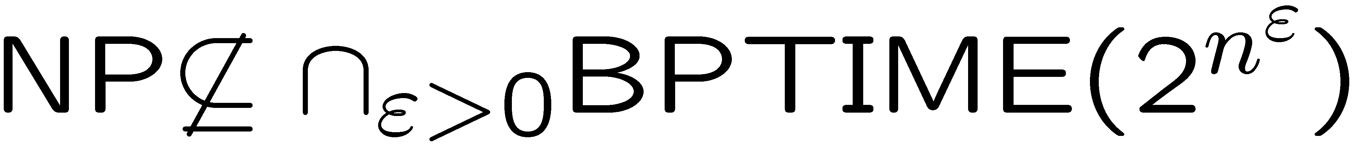
Standard complexity classes and assumptions
(for more details, see, for example, see Structural Complexity
by J. L. Balcazar and J. Gabarro)

Slide 8
Triangle Packing
Given
  undirected graph G
  a triangle is a cycle of 3 nodes
Goal
  find (pack) a maximum number of node- disjoint triangles in G

Slide 9
Triangle Packing (example)
One solution (1 triangle)
Better solution (2 triangles)

Slide 10
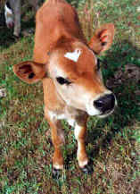
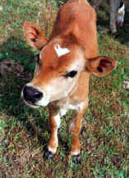
Full Sibling Reconstruction (informal motivation)
given children in wild population without known parents
group them into brothers and sisters (siblings)

Slide 11
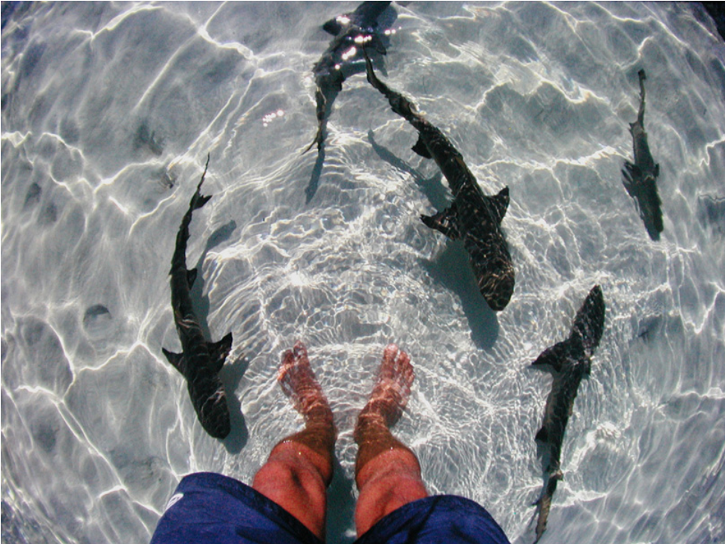
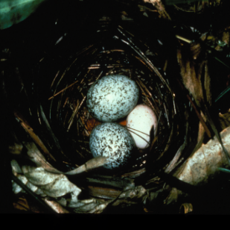
Biological Data
Codominant DNA markers - microsatellites
Mary Ashley studies the mating system of the Lemon sharks, Negaprion brevirostris
2 Brown-headed cowbird (Molothrus ater) eggs in a Blue-winged Warbler's nest

Slide 12
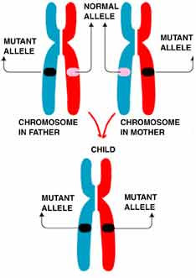
Full Sibling Reconstruction (motivation)
Simple Mendelian inheritance rules
father (...,...),(p,q),(...,...),(...,...) (...,...),(r,s),(...,...),(...,...) mother
(...,...),(...,...),(...,...),(...,...) child
Siblings: two children with the same parents
Question: given a set of children,
can we find the sibling groups?
allele
locus
one from father
one from mother

Slide 13
weaker enforcement of Mendelian inheritance
4-allele property
father (...,...),(p,q),(...,...),(...,...) (...,...),(r,s),(...,...),(...,...) mother
(...,...), (...,...), (...,...), (...,...)
(...,...), (...,...), (...,...), (...,...)
(...,...), (...,...), (...,...), (...,...)
(...,...), (...,...), (...,...), (...,...)
(...,...), (...,...), (...,...), (...,...)
one from father
one from mother
siblings
at most 4 alleles in this locus

Slide 14
stricter enforcement of Mendelian inheritance
2-allele property
father (...,...),(p,q),(...,...),(...,...) (...,...),(r,s),(...,...),(...,...) mother
(...,...), (...,...), (...,...), (...,...)
(...,...), (...,...), (...,...), (...,...)
(...,...), (...,...), (...,...), (...,...)
(...,...), (...,...), (...,...), (...,...)
(...,...), (...,...), (...,...), (...,...)
from father
from mother
if we reorder such that
left is from father and
right is from mother
then the left column of the
locus has at most 2 alleles
and the same for the right
column
siblings

Slide 15
Full Sibling Reconstruction (k-allele_{n,ℓ} for k∈{2,4})
(slightly more formal definitions)
Given:
  n children, each with ℓ loci
Goal:
  cover them with minimum number of (sibling) groups
  each group satisfies the k-allele property
Natural parameter (analogous to max set size in set cover)
  a, the maximum size of any sibling group

Slide 16
Maximum Profit Coverage (MPC)
Given:
m sets over n elements
each set has a non-negative cost
each element has a non-negative profit
Goal
find a sub-collection of sets that maximizes
(sum of profits of elements covered by these sets) – (sum of costs of these sets)
Natural parameter: a, maximum set size
Applications: Biomolecular clustering

Slide 17
2-coverage
(generalization of unweighted maximum coverage)
Given:
  m sets over n elements
  an integer k
Goal:
  select k sets
  maximize the number of elements that appear at least twice in the selected sets
Natural parameter: f, the frequency
maximum number of times any element occurs in various sets
Application: homology search (better seed coverage)

Slide 18
2-coverage
(generalization of unweighted maximum coverage)
Given:
  m sets over n elements
  an integer k
Goal:
  select k sets
  maximize the number of elements that appear at least twice in the selected sets
Natural parameter: f, the frequency
maximum number of times any element occurs in various sets

Slide 19
Summary of our results
Triangle packing:
  (1+ε)-inapproximable assuming RP ≠ NP
Our inapproximability constant ε is slightly larger than the previous best reported in Chlebìkovà and Chlebìk (Theoretical Computer Science, 354 (3), 320-338, 2006)

Slide 20
Summary of our results (continued)
2-allele_{n,ℓ} and 4-allele_{n,ℓ}
  a=3, ℓ=O(n³) : (1+ε)-inapproximable assuming RP ≠ NP
  a=3, any ℓ : (7/6)+ε-approximation
  a=4, ℓ=2 : (1+ε)-inapproximable assuming RP ≠ NP
  a=4, any ℓ : (3/2)+ε-approximation
  a=n^{δ}, ℓ=O(n²) : Ω(n^{ε})-inapprox assuming ZPP ≠ NP
    ∀ε
    0 < ε < δ < 1

Slide 21
Summary of our results (continued)
4-allele_{n,ℓ}
  a=6, ℓ=O(n) : (1+ε)-inapproximable assuming RP ≠ NP

Slide 22
Summary of our results (continued)
Maximum profit coverage (MPC):
  a ≤ 2 : polynomial time
  a ≥ 3, constant:
    NP-hard
    (0.5a + 0.5 +ε)-approximation
  arbitrary a
    Ω (a / ln a)-inapproximable assuming P ≠ NP
    (0.6454 a + ε)-approximation

Slide 23
Summary of our results (continued)
2-coverage:
  f=2
    (1+ε)-inapproximable assuming
    O(m^{0.33 – ε})-approximation
  arbitrary f
    O(m^{0.5})-approximation

Slide 24
(1+ε)-inapproximability for Triangle Packing (TP)
assuming RP ≠ NP, it is hard to distinguish if the number of disjoint triangles is
  ≤ 75k
  or, ≥ 76k ?
(for every k)

Slide 25
(1+ε)-inapproximability for Triangle Packing (TP)
We start with the so-called 3-LIN-2 problem
  given
    a set of 2n linear equations modulo 2 with 3 variables per equation
      x₁+x₂+x₅ = 0 (mod 2)
      x₂+x₃+x₇ = 1 (mod 2)
      : : : : : : : :
  goal
    assign {0,1} values to variables to maximize the number of satisfied equations
Well-known result by Hästad (STOC 1997):
for every constant ε<½ it is NP-hard to decide if we can satisfy
  ≥ (2–ε)n equations or
  ≤ (1+ε)n equations?

Slide 26
((76/75)-ε)-inapproximability for Triangle Packing (TP)
high-level ideas (details quite complicated)
3-LIN-2
2n equations
Triangle packing
228n nodes
  satisfy
  ≥ (2–ε)n equations or
  ≤ (1+ε)n equations?
≥ (76-ε)n triangles or
≤ (75+ε)n triangles?
randomized reduction (thus modulo RP ≠ NP)
uses amplifiers (random graphs with special properties)

Slide 27
Inapproximability of {2,4}-allele_{n,ℓ}
case: a=3 (smallest non-trivial) and ℓ = O(n³)
treat 2-allele_{n,ℓ} and 4-allele_{n,ℓ} in an unified framework:
  introduce 2-label-cover problem
    inputs are the same as in 2-allele_{n,ℓ} and 4-allele_{n,ℓ} except that
      each locus has just one value (label)
      a set is individuals are full siblings if on every locus they have at most 2 values
    can be shown to suffice for our purposes

Slide 28
Inapproximability of {2,4}-allele_{n,ℓ}
case: a=3 (smallest non-trivial) and ℓ = O(n³)
2-label-cover
n individuals
O(n³) loci
Triangle packing
n nodes
t triangles
  (n-t)/2 sibling groups
deterministic reduction
node ⇒ individual
each triangle ⇒ three individuals have at most two values on every locus
each non-triangle ⇒ three individuals have three values on some locus

Slide 29
((7/6)+ε)-approximation of {2,4}-allele_{n,ℓ} for a=3
need to use the result of Hurkens and Schrijver
  SIAM J. Discr. Math, 2(1), 68-72, 1989
  (1.5+ε)-approximation for triangle packing for any constant ε

Slide 30
Inapproximability of {2,4}-allele_{n,ℓ}
case: a=4 and ℓ=2 (both second smallest non-trivial values)
Inapproximability of {2,4}-allele_{n,ℓ}
case: a=6 and ℓ=O(n)
For both problems we reduce MAX-CUT on 3-regular (cubic) graphs

Slide 31
MAX-CUT on cubic graphs (3-MAX-CUT)
Input: a cubic graph (i.e., each node has degree 3)
Goal: partition the vertices into two parts to maximize the number of crossing edges
crossing edge

Slide 32
What is known about MAX-CUT on cubic graphs?
It is impossible to decide, modulo RP ≠ NP, whether a graph G with 336n vertices has
  ≤ 331n crossing edges, or
  ≥ 332n crossing edges
(Berman and Karpinski, ICALP 1999)

Slide 33
General ideas for both reductions
start with an input cubic graph G to MAX-CUT
construct a new graph G’ from G by:
  replacing each vertex by a small planar graph (“gadget”)
  replacing each edge by connecting “appropriate vertices” of gadget
construct an instance of sibling problem from G’:
  each edge is an individual
  loci are selected carefully to rule out unwanted combination of edges
show appropriate correspondence between:
  valid sibling groups
  valid ways of covering edges of G’ with correct combination of edges
  valid solution of MAX-CUT on G

Slide 34
Schematic representation of the idea
new individual (...,...),(...,...),...,(...,...)
connections
each edge
gadget
gadget

Slide 35
Inapproximability of {2,4}-allele_{n,ℓ}
case: a=n^{δ}, 0 < δ < 1 any constant
reduce the graph coloring problem:
given: an undirected graph
goal: color vertices with minimum number of colors
such that no two adjacent vertices have same
color

Slide 36
graph coloring example
3 colors necessary and sufficient

Slide 37
Independent set of vertices
a set of vertices with no edges between them

Slide 38
graph coloring is provably hard!!!
Known hardness result for graph coloring
(minor adjustment to the result by Feige and Kilian,
Journal of Computers & System Sciences,
57 (2), 187-199, 1998)
for any two constants 0 <ε <δ <1, minimum coloring of a graph G=(V,E) cannot be approximated to within a factor of |V|^{ε} even if the graph has no independent set of vertices of size ≤ |V|^{δ} unless NP⊆ZPP

Slide 39
graph coloring to sibling reconstruction
high level idea
node → individual
individual a : (...,...),(...,...),......,(...,...),(...,...)
individual b : (...,...),(...,...),......,(...,...),(...,...)
individual c : (...,...),(...,...),......,(...,...),(...,...)
individual d : (...,...),(...,...),......,(...,...),(...,...)
individual e : (...,...),(...,...),......,(...,...),(...,...)
individual f : (...,...),(...,...),......,(...,...),(...,...)
a
b
cannot
be in
same
group
c
d
e
f
edge {a,b} to “forbidden triplets”
{a,b,c},{a,b,d},{a,b,e},{a,b,f }
k colors ⇒ k sibling groups
≤ 2k’ colors ⇐ k’ sibling groups
(within a factor of 2 of each other)

Slide 40
Reminding Maximum Profit Coverage (MPC)
Given:
m sets over n elements
each set has a non-negative cost
each element has a non-negative profit
Goal
find a sub-collection of sets that maximizes
(sum of profits of elements covered by these sets) – (sum of costs of these sets)
Natural parameter: a, maximum set size

Slide 41
Ω(a / ln a)-inapproximability of Maximum Profit Coverage
Recall: a is the maximum set size
We reduce the Maximum Independent Set problem for a-regular graphs

Slide 42
Maximum Independent Set problem for a-regular graphs
Given: undirected graph
every node has degree a
Goal: find a maximum number of vertices with no edges among them
Known: Ω(a/ln a)-inapproximable assuming P ≠ NP
(Hazan, Safra and Schwartz, Computational Complexity, 15(1), 20-39, 2006)

Slide 43
Ω(a / ln a)-inapproximability of Maximum Profit Coverage
high-level idea (a=3)
elements a,b,c,d,e,f
each of profit 1
sets
S₀ = {d,a,f } of cost 2 (= a-1)
S₁ = {a,b,e} of cost 2
S₂ = {b,c,f } of cost 2
S₃ = {c,d,e} of cost 2
a 3-regular graph
0
a
1
e
d
b
f
3
2
c
edges adjacent to
vertex 2
independent set of size x ⇔ MPC has a total objective value of x

Slide 44
Approximation Algorithms for Maximum Profit Coverage
(0.5 a + 0.5 + ε)-approxmation for constant a
(0.6454 a)-approximation for any a
Idea:
use approximation algorithms for weighted set-packing
for fixed a, can enumerate all sets, thus easy using the result of Berman (Nordic Journal of Computing, 2000)
for non-fixed a, cannot write down all sets, do “implicit” enumeration via dynamic programming using ideas of Berman and Krysta (SODA 2003)

Slide 45

What is weighted set packing?
given: collection of sets, each set has a weight (real no),
s is the maximum number of elements in a set
goal: find a sub-collection of mutually disjoint sets of total maximum weight
Current best approach:
  realize that we are looking at maximum weight independent set in
  s-claw-free graph
3-claw-free
not 3-claw-free
human claw
(5-claw-free)

Slide 46
Reminding 2-coverage
Given:
  m sets over n elements
  an integer k
Goal:
  select k sets
  maximize the number of elements that appear at least twice in the selected sets
Natural parameter: f, the frequency
maximum number of times any element occurs in various sets

Slide 47
(1+α)-inapproximability of 2-coverage
assuming
Reduce the Densest Subgraph problem

Slide 48
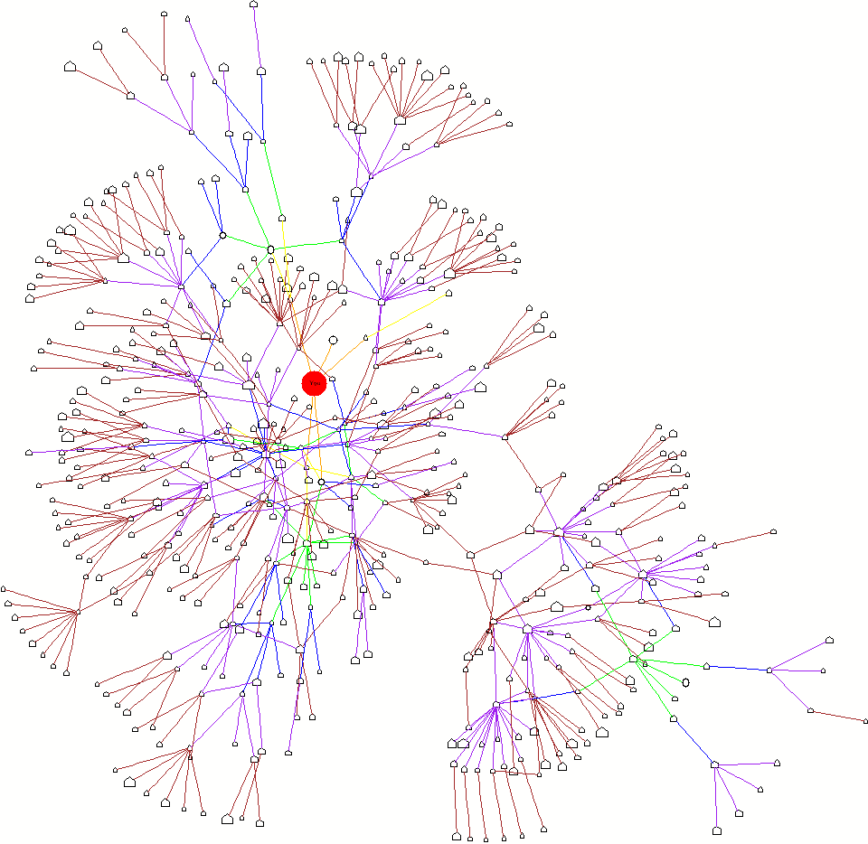
Densest Subgraph problem (definition)
given: a graph with n vertices
and a positive integer k
goal: pick k vertices such that the subgraph induced by these vertices has the maximum number of edges
densest subgraph on 50 nodes

Slide 49
Densest Subgraph problem
looks similar in flavor to clique problem
indeed NP-hard
but has eluded tight approximability results so far (unlike clique)
best known results (for some constant α>0)
  (1+ α)-inapproximability assuming
  [Khot, FOCS, 2004]
  n^{(1/3)-α} -approximation
  [Feige, Peleg and Kortsarz, Algorithmica, 2001]

Slide 50
Reducing Densest Subgraph to 2-coverage
(special case: f = 2)
elements: a, b, c, ....
sets:
S₁ = { a, b, c }
....
....
2
a
3
b
1
c
4
covering an element twice
⇔
picking both endpoints of an edge
reverse direction can also be done if one looks at “weighted”
version of densest subgraph

Slide 51
O(m^{½})-approximation for 2-coverage
Design O(k)-approximation
Design O(m/k)-approximation
Take the better

Slide 52


Thank you for your attention!
Questions?

