Slide 1
A Novel Method for
Signal Transduction Network Inference from Indirect Experimental Evidence
Bhaskar DasGupta
Department of Computer Science
University of Illinois at Chicago
Chicago, IL 60607-7053
dasgupta@cs.uic.edu

Slide 2
Acknowledgements
Collaborators: Piotr Berman (Penn State, CS)
Rèka Albert (Penn State, Physics and Biology)
Riccardo Dondi (Università degli Studi di Bergamo, Italy, CS)
Sema Kachalo (UIC, Bioengineering)
Eduardo Sontag (Rutgers, Mathematics)
Kelly Westbrook (Georgia State, CS)
Alexander Zelikovsky (Georgia State, CS)
Ranran Zhang (Penn State, Biology)
Grants: (NSF) IIS-0346973, DBI-0543365 (current)
CCR-0208749, CCR-0206795 (past)

Slide 3
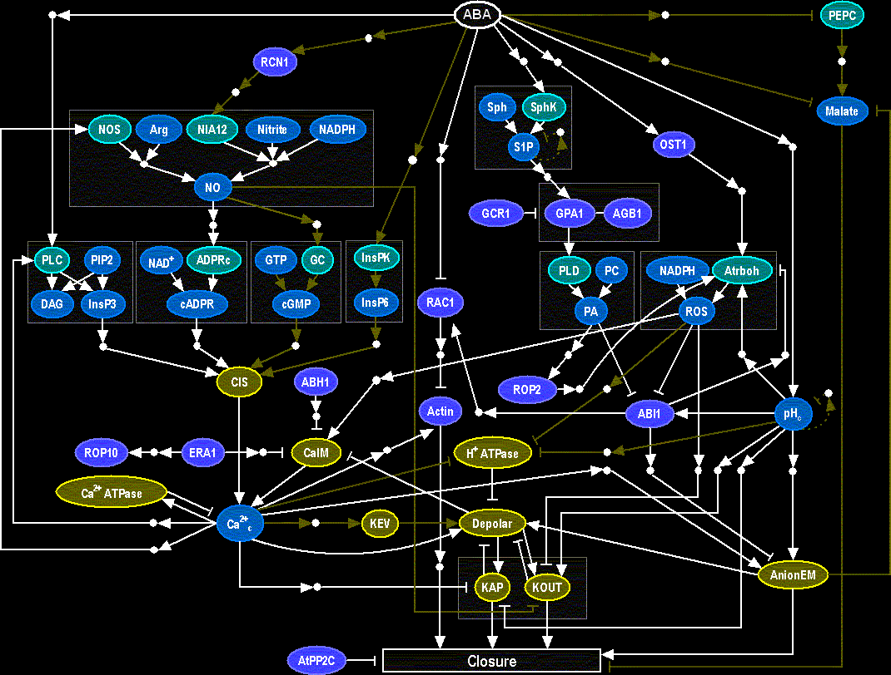
Signal Transduction Networks
Cell: complex interactions between its numerous constituents such as DNA, RNA, proteins and small molecules.
Cells use signaling pathways and regulatory mechanisms to coordinate multiple functions, allowing them to respond to and acclimate to an ever-changing environment.
Genome-wide experimental methods now identify interactions among thousands of proteins

Slide 4
Simplified picture of overall goal
(more details to follow...)
A→B
C→(D ┤E)
.
.
●
fast
●
??
●
●
direct and
double-causal
experimental
evidence
network
minimal complexity
biologically relevant

Slide 5
Nature of experimental evidence
biochemical (e.g., enzymatic activity, protein-protein interaction)
  direct interaction
pharmacological evidence
  not direct interaction
genetic evidence of differential responses to a stimulus
  can be direct, but most often double-causal

Slide 6
We describe a method for synthesizing double-causal (path-level) information into a consistent network
Our method significantly expands the capability for incorporating indirect (pathway-level) information. Previous methods of synthesizing signal transduction networks only include direct biochemical interactions, and are therefore restricted by the incompleteness of the experimental knowledge on pairwise interactions.

Slide 7
Informal graph-theoretic translation
Direct interaction
A promotes B or A→B ........................ A→B
A inhibits B or A┤B ........................ A→B
Indirect interactions (just one illustration)
C promotes the process through which A promotes B
is often represented in the form
0
1
pseudo-vertex
A
B
C

Slide 8
Two necessary problems for network synthesis
Pseudo-vertex collapse (PVC) ---- can be solved in poly time
Binary transitive reduction (BTR) --- NP-complete

Slide 9
Some notations/terminologies....
Graph G=(V,E) is by default a directed weighted graph
All edge weights are from {0,1}
Weight of a path is the sum of edge weights modulo 2
  u ⇒_{x} v denotes path from u to v of weight x
A subset of edges marked as “critical” (known direct interactions)
0 activation
1 inhibition

Slide 10
Pseudo-vertex collapse (PVC)
Intuitively, the PVC problem is useful for reducing the pseudo-vertex set to the the minimal set that maintains the graph consistent with all indirect experimental observations.
pseudo-vertices
u
out(u)=out(v)
in(u)=in(v)
v
new
psuedo-vertex
uv

Slide 11
Pseudo-vertex collapse (PVC), formally....
Input: graph G=(V,E), a subset V’⊆ V of “pseudo” vertices, rest “real” vertices
Definition: for any vertex v, in(v) = { (u,x) | u ⇒_{x} v, x∈{0,1} }
out(v) = { (u,x) | v ⇒_{x} u, x∈{0,1} }
collapsing two vertices u and v permissible provided
        both are not real vertices
        in(u)=in(v) and out(u)=out(v)
If permissible, the collapse of two vertices u and v creates a new vertex w,
makes every incoming (resp. outgoing) edges to (resp. from) either u or v
an incoming (resp. outgoing) edge from w, removes any parallel edge that
may result from the collapse operation and also removes both vertices u
and v.
Valid solution: graph G”=(V”,E”) obtained from G by a sequence of permissible collapse operations
Goal: minimize |E”|

Slide 12
A simplistic illustration of BTR (all activation edges)
critical edge
remove? no (critical edge)
remove? yes (not critical and
alternate path)
Intuitively, the BTR problem is useful for determining the sparsest
graph consistent with a set of experimental observations

Slide 13
Binary Transitive Reduction (BTR), formally....
Input:
graph G=(V,E)
A subset E_{c} ⊆ E of edges marked as “critical”
Valid solution: a subset of edges E’⊆E that maintains same “reachability”:
u ⇒_{x} v in G=(V,E) if and only if u ⇒_{x} v in G’=(V,E’)
Goal: minimize |E’|

Slide 14
Some biologists did look at very simplified or somewhat different version of BTR, e.g.:
A. Wagner, Estimating Coarse Gene Network Structure from Large-Scale Gene Perturbation Data, Genome Research, 12, pp. 309-315, 2002
  too special (reachability only), no efficient algorithms reported
T. Chen, V. Filkov and S. Skiena, Identifying Gene Regulatory Networks from Experimental Data, Third Annual International Conference on Computational Moledular Biology, pp. 94-103, 1999
  “excess edge deletion” problem, biologically too restrictive version
See the following excellent survey for more comprehensive information about biological network inference and modeling:
V. Filkov, Identifying Gene Regulatory Networks from Gene Expression Data, in Handbook of Computational Molecular Biology (edited by S. Aluru), Chapman & Hall/CRC Press, 2005
H. D. Jong, Modelling and Simulation of Genetic Regulatory Systems: A Literature Review, Journal of Computational Biology, Volume 9, Number 1, pp. 67-103, 2002

Slide 15
Very high level and vague description of the entire network synthesis process
BTR is used here
Synthesize direct interactions
Update on
new
experimental
data if needed
Optimize
Synthesize indirect interactions
Optimize
PVC is used here

Slide 16
excitory (inhibitory) connection encoded by edge label 0 (1)
[encode single causal relationships]
  1.1 Build networks for connections like A→B and A┤B noting each critical edge.
  1.2 Apply BTR
[encode double causal reltionships]
  2.1 For each double causal relationship of the form A → (B → C) with x,y∈{0,1}, add new nodes and/or edges as follows:
    if B → C ∈ E_{critical} then add A → (B → C)
    if no subgraph of the form (for some node D with b = a+b = y (mod 2) )
    then add the subgraph (where P is a new pseudo-node and b = a+b = y (mod 2) )
  2.2 Apply PVC
[final reduction] Apply BTR
x
y
y
x
y
A
a
x
b
B
D
C
A
x
a
b
B
P
C

Slide 17
All the steps in the network synthesis procedure except the steps that involve BTR can be solved exactly in polynomial time.
Thus, it behooves to look at BTR more closely.

Slide 18
But, before that, biological validation of the network synthesis approach is desirable
Need a network that uses double-causal experimental evidence.....

Slide 19
Here is one such network (plant signal transduction network).....
consistent guard cell signal transduction network for ABA-induced stomatal closure
  manually curated
  described in S. Li, S. M. Assmann and R. Albert, Predicting Essential Components of Signal Transduction Networks: A Dynamic Model of Guard Cell Abscisic Acid Signaling, PLoS Biology, 4(10), October 2006
  list of experimentally observed causal relationships collected by Li et al. and published as Table S1. This table contains
    around 140 interactions and causal inferences, both of type “A promotes B” and “C promotes process (A promotes B)”
  We augment this list with critical edges drawn from biophysical/biochemical knowledge on enzymatic reactions and ion flows and with simplifying hypotheses made by Li et al. both described in Text of S1

Slide 20
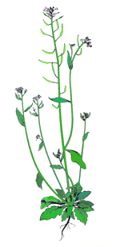
Arabidopsis thaliana is a small flowering plant that is widely used as a model organism in plant biology. Arabidopsis is a member of the mustard (Brassicaceae) family, which includes cultivated species such as cabbage and radish. Arabidopsis is not of major agronomic significance, but it offers important advantages for basic research in genetics and molecular biology
(source: http://www.arabidopsis.org/portals/education/aboutarabidopsis.jsp)

Slide 21
We also formalize an additional rule specific to the context of this network (and implicitly assumed by Li et al.) regarding enzyme-catalyzed reactions.
Graph-theoretic interpretation:
We have a subset E_{enzymatic}⊆E_{critical} of edges that are all labeled 0. Suppose that we have
a path A→x→B and an edge C→B∈ E_{enzymatic}. Then, we identify the node C with x by collapsing them together and set the parities of the edges A→(x=C) and (x=C)→ B based on the following two cases:
if a+b=0 (mod 2) then both A→(x=C) and (x=C)→ B have zero parities.
if a+b=1 (mod 2) then A→ (x=C) has parity 1 and (x=C)→B has parity 0
a
b
0

Slide 22
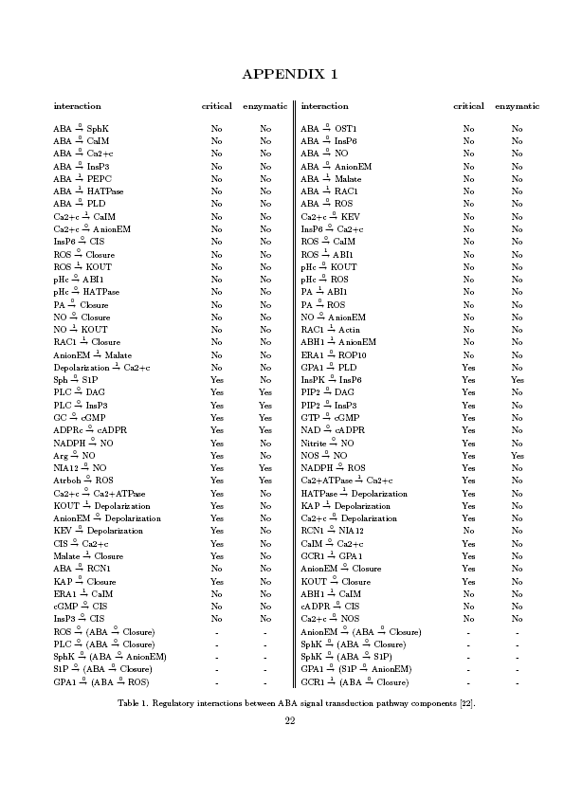
Regulatory interactions between ABA signal transduction pathway
components

Slide 23
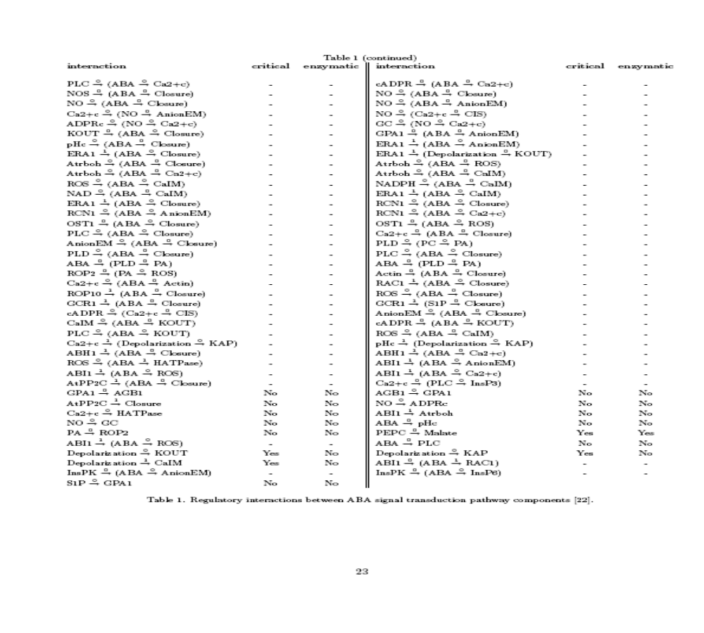
Regulatory interactions between ABA signal transduction pathway
components (continued)
ERA1 ┤(ABA → CalM)
NO → GC not critical and not enzymatic

Slide 24
Some nodes in the network
GCR1 putative G protein coupled receptor
OST1 protein
NO Nitric Oxide
ABH1 RNA cap-binding protein
RAC1 small GTPase protein
…

Slide 25
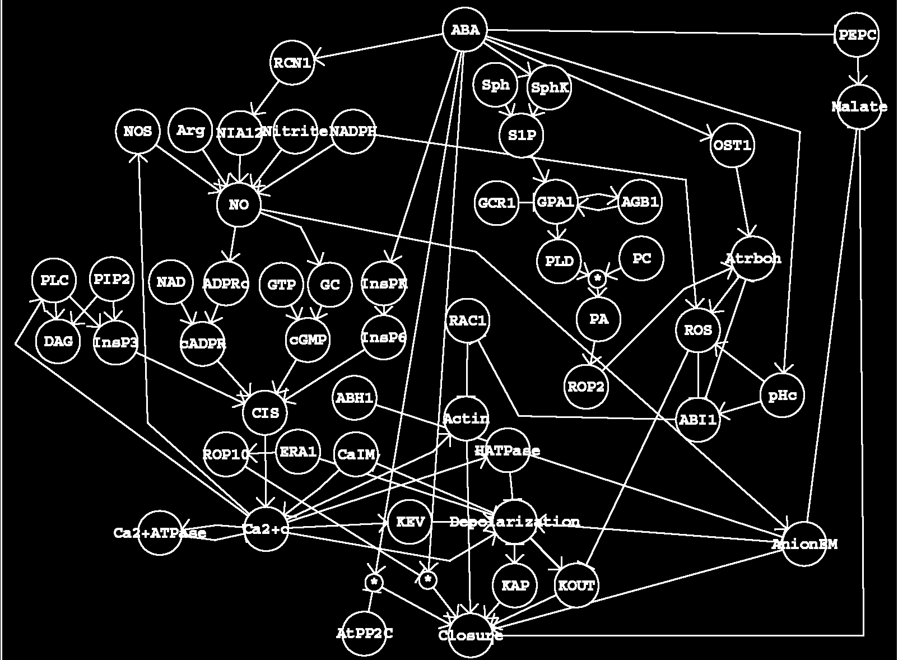
(left) Guard cell signal transduction network for ABA-induced stomatal closure manually curated by Li, Assmann and Albert [source: PloS Biology, 10 (4), 2006]. Most of the information is derived from the model species Arabidopsis thaliana.
( right) our developed automated network synthesis procedure produced a reduced (fewer edges) network while preserving all observed pathways [source: DasGupta’s group, Journal of Computational Biology and Bioinformatics]

Slide 26
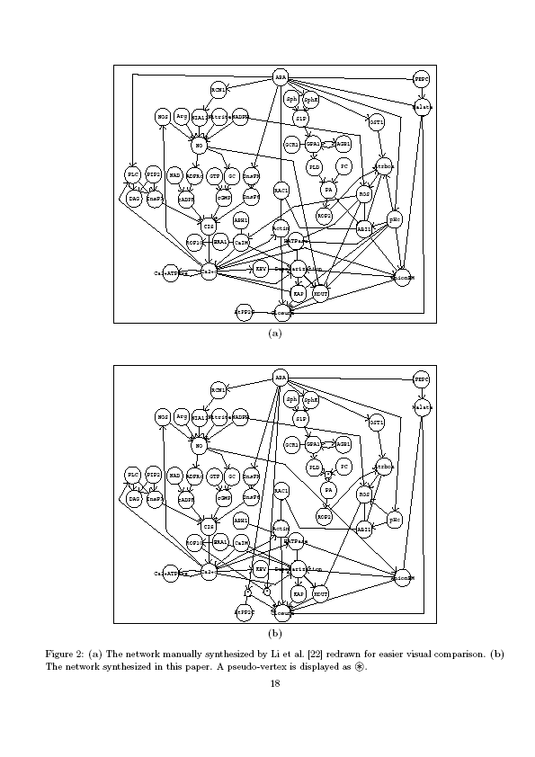

Slide 27
Summary of comparison of the two networks
Li et al. has 54 vertices and 92 edges
our network has 57 vertices but 84 edges
Both networks have identical strongly connected component of vertices
All the paths present in the Li et al.’s reconstruction are present in our network as well
The two networks have 71 common edges
It took a few seconds to synthesize our network

Slide 28
Summary of comparison of the two networks (continued)
Thus the two networks are highly similar but diverge on a few edges,
All these discrepancies are not due to algorithmic deficiencies but to human decisions.

Slide 29
Software is available at:
http://www.cs.uic.edu/~dasgupta/network-synthesis/
runs on any machine with MS Windows (Win32)
  click, save the executable and run
for linux/unix fans, source files for a non-graphic version of the program, that can be compiled and run from the console, can be obtained by sending an email to the authors

Slide 30
Other applications of the software
Synthesizing a Network for T Cell Survival and Death in Large Granular Lymphocyte Leukemia
Large Granular Lymphocytes (LGL) are medium to large size cells with eccentric nuclei and abundant cytoplasm.
LGL leukemia was initially described as a disordered clonal expansion of LGL and their invasions in the marrow, spleen and liver.

Slide 31
Synthesizing a Network for T Cell Survival and Death in Large Granular Lymphocyte Leukemia
Synthesized a cell-survival/cell-death regulation-related signaling network from the TRANSPATH 6.0 database, with additional information manually curated from literature search.
359 vertices of this network represent proteins/protein families and mRNAs participating in pro-survival and Fas-induced apoptosis pathways.
1295 edges represent regulatory relationships between nodes, including protein interactions, catalytic reactions, transcriptional regulation
Performing BTR with NET-SYNTHESIS reduced the total edge-number to 873
...... ongoing work

Slide 32
Data sources
Signal transduction pathway repositories such as
TRANSPATH (http://www.gene-regulation.com/pub/databases.html#transpath)
protein interaction databases such as the Search Tool for the Retrieval of Interacting Proteins (http://string.embl.de)
contain up to thousands of interactions, a large number of which are not supported by direct physical evidence. NET-SYNTHESIS can be used to filter redundant information while keeping all direct interactions.

Slide 33
Performance of our BTR algorithm on simulated signal transduction networks
But, what is a random biological network?

Slide 34
Biological networks are reported to be scale-free: e.g.,
N. Guelzim, S. Bottani, P. Bourgine, and F. Kepes, Topological and causal structure of the yeast transcriptional regulatory network, Nature Genet. 31, 60–63, 2002.
But, such claims are disputed in:
R. Khanin and E. Wit, How Scale-Free Are Biological Networks, Journal of Computational Biology, Vol. 13, No. 3 : 810 -818, 2006.

Slide 35
Based on the available information on topological properties of signal transduction networks, we selected following parameters for random signal transduction nets:
distribution of in-degree of the network is exponential:
Pr[in-degree=x]=L e^{-Lx}, ½ ≤ L ≤ ⅓, maximum in-degree is 12
distribution of out-degree is governed by a power-law:
x ≥ 1 : Pr[out-degree=x]=cx^{-c}; Pr[out-degree=0] ≥ c, 2 < c < 3
maximum out-degree is 200
varied the ratio of excitory to inhibitory edges between 2 and 4

Slide 36
Critical edges?
No known accurate estimates of percentage of total edges that are critical are available:
the curated network of Ma'ayan et al. (Science, 2005) is expected to have close to 100% critical edges as they specifically focused on collecting direct interactions only.
Protein interaction networks are expected to be mostly critical (Giot et al., Science, 2003; Han et al., Nature, 2004; Li et al., Science, 2004)
The so-called genetic interactions (e.g., synthetic lethal interactions) represent compensatory relationships, and only a minority of them are direct interactions.
Network inference (reverse engineering) approaches lead to networks whose interactions are close to 0% critical
We tried a few small and large values, such as 1%, 2% and 50%, for the percentage of edges that are critical to catch qualitatively all regions of dynamics of the network that are of interest.

Slide 37
Tested on about 550 random networks
  # of vertices in the range of about 100 to 1000
  running time for individual networks: seconds to at most a minute
  To verify the robustness of performance of our BTR algorithm we perturb most of these networks with increasing amounts of additional random edges chosen such they do not change the optimal solution of the original graph. Almost always the solution quality does not change because of this.

Slide 38
To generate random graphs with prescribed degree distributions, we use the procedure described in the following paper:
M. E. J. Newman, S. H. Strogatz and D. J. Watts.
Random graphs with arbitrary degree distributions and their applications, Phys. Rev. E, 64 (2), pp. 026118-026134, July 2001

Slide 39
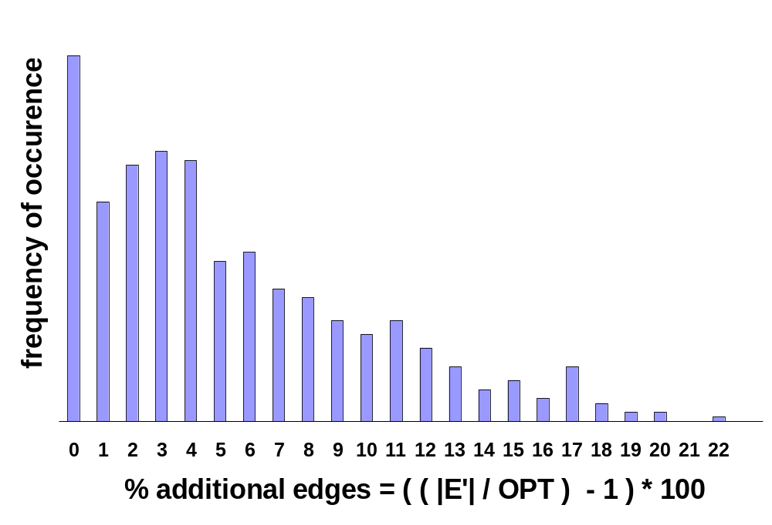
Performance of our implemented algorithm for BTR on simulated
networks
A plot of the empirical performance of our BTR algorithm on the 561 simulated interaction networks. E' is our solution, OPT is a lower bound on the minimum number of edges and 100×( (|E'|/OPT)-1) is the percentage of additional edges that our algorithm keeps. On an average, we use about 5.5% more edges than the trivial bound on the optimum (with about 4.8% as the standard deviation)

Slide 40
Now comes all the theory that helped us to design efficient algorithms for BTR

Slide 41
Some biologists did look at very simplified or somewhat different version of BTR, e.g.:
A. Wagner, Estimating Coarse Gene Network Structure from Large-Scale Gene Perturbation Data, Genome Research, 12, pp. 309-315, 2002
  too special (reachability only), no efficient algorithms
T. Chen, V. Filkov and S. Skiena, Identifying Gene Regulatory Networks from Experimental Data, Third Annual International Conference on Computational Moledular Biology, pp. 94-103, 1999
  “excess edge deletion” problem, biologically too restrictive version
See the following excellent survey for more comprehensive information about biological network inference and modeling:
V. Filkov, Identifying Gene Regulatory Networks from Gene Expression Data, in Handbook of Computational Molecular Biology (edited by S. Aluru), Chapman & Hall/CRC Press, 2005
H. D. Jong, Modelling and Simulation of Genetic Regulatory Systems: A Literature Review, Journal of Computational Biology, Volume 9, Number 1, pp. 67-103, 2002

Slide 42
But theoretical computer science community (and computer network community) has looked at versions of BTR from as early as 1972. For example......

Slide 43
Minimum Equivalent digraph (MED) problem
(special case of BTR, but very useful)
MED for acyclic graphs can be solved exactly in linear time
  A. Aho, M. R. Garey and J. D. Ullman, The transitive reduction of a directed graph, SIAM Journal of Computing, 1 (2), pp. 131-137, 1972
In general NP-hard, in fact a little bit harder (MAX-SNP-hard) if larger cycles are present, but.....
  Poly-time if all cycles are of length < 4
  2-approximation is easy
  1.617+ε-approximation is possible for any constant ε > 0
  recently 1.5-approximation was provided
    G. N. Frederickson and J. JàJà, Approximation algorithms for several graph augmentation problems, SIAM Journal of Computing, 10 (2), pp. 270-283, 1981
    S. Khuller, B. Raghavachari and N. Young, Approximating the minimum equivalent digraph, SIAM Journal of Computing, 24 (4), pp. 859-872, 1995
    S. Khuller, B. Raghavachari and N. Young, On strongly connected digraphs with bounded cycle length, Discrete Applied Mathematics, 69 (3), pp. 281-289, 1996
    A. Vetta, Approximating the minimum strongly connected subgraph via a matching lower bound, 12th ACM-SIAM Symposium on Discrete Algorithms, pp. 417-426, 2001

Slide 44
Weighted version of MED
(less special case of BTR, and again very useful)
at least as difficult as MED (obviously)
2-approximation is known
  G. N. Frederickson and J. JàJà, Approximation algorithms for several graph augmentation problems, SIAM Journal of Computing, 10 (2), pp. 270-283, 1981
  S. Khuller, B. Raghavachari and A. Zhu, A uniform framework for approximating weighted connectivity problems, 19th Annual ACM-SIAM Symposium on Discrete Algorithms, pp. 937-938, 1999

Slide 45
Why did these computer scientists look at these problems?
connectivity/robustness issues of computer networks
What kind of algorithmic methodologies did they use?
“cycle contraction” technique
“directed spanning arborescence” approach
“matching lower bound” method
potential method
…

Slide 46
But, why should we know about all this???

Slide 47
Our theoretical results build upon these previous works in a non-trivial manner:
BTR can be solved exactly in polynomial time if the graph has all cycles are of length ≤ 3
BTR can be 2-approximated
…

Slide 48
But, again, why should we know about the theory???

Slide 49
Our algorithms in the software used the theory (and, specifically, some details of complicated proofs in the theory)

Slide 50
Thank you for your attention!
Questions? Comments? Please write to:
dasgupta@cs.uic.edu
or visit
http://www.cs.uic.edu/~dasgupta

