Slide 1


Chapter 8
NP and Computational
Intractability
Slides by Kevin Wayne.
Copyright © 2005 Pearson-Addison Wesley.
All rights reserved.

Slide 2
8.3 Definition of NP

Slide 3
Decision Problems
Decision problem.
  X is a set of strings.
  Instance: string s.
  Algorithm A solves problem X: A(s) = yes iff s ∈ X.
Polynomial time. Algorithm A runs in poly-time if for every string s, A(s) terminates in at most p(|s|) "steps", where p(⋅) is some polynomial.
PRIMES: X = { 2, 3, 5, 7, 11, 13, 17, 23, 29, 31, 37, …. }
Algorithm. [Agrawal-Kayal-Saxena, 2002] p(|s|) = |s|⁸.
length of s

Slide 4
Definition of P
P. Decision problems for which there is a poly-time algorithm.
Problem | Description | Algorithm | Yes | No
MULTIPLE | Is x a multiple of y? | Grade school division | 51, 17 | 51, 16
RELPRIME | Are x and y relatively prime? | Euclid (300 BCE) | 34, 39 | 34, 51
PRIMES | Is x prime? | AKS (2002) | 53 | 51
EDIT-DISTANCE | Is the edit distance between x and y less than 5? | Dynamic programming | niether neither | acgggt ttttta
LSOLVE | Is there a vector x that satisfies Ax = b? | Gauss-Edmonds elimination

Slide 5
NP
Certification algorithm intuition.
  Certifier views things from "managerial" viewpoint.
  Certifier doesn't determine whether s ∈ X on its own;
  rather, it checks a proposed proof t that s ∈ X.
Def. Algorithm C(s, t) is a certifier for problem X if for every string s, s ∈ X iff there exists a string t such that C(s, t) = yes.
NP. Decision problems for which there exists a poly-time certifier.
Remark. NP stands for nondeterministic polynomial-time.
"certificate" or "witness"
C(s, t) is a poly-time algorithm and
|t| ≤ p(|s|) for some polynomial p(⋅).

Slide 6
Certifiers and Certificates: Composite
COMPOSITES. Given an integer s, is s composite?
Certificate. A nontrivial factor t of s. Note that such a certificate exists iff s is composite. Moreover |t| ≤ |s|.
Certifier.
Instance. s = 437,669.
Certificate. t = 541 or 809.
Conclusion. COMPOSITES is in NP.
boolean C(s, t) {
if (t ≤ 1 or t ≥ s)
return false
else if (s is a multiple of t)
return true
else
return false
}
437,669 = 541 × 809

Slide 7
Certifiers and Certificates: 3-Satisfiability
SAT. Given a CNF formula Φ, is there a satisfying assignment?
Certificate. An assignment of truth values to the n boolean variables.
Certifier. Check that each clause in Φ has at least one true literal.
Ex.
Conclusion. SAT is in NP.
instance s
certificate t

Slide 8
Certifiers and Certificates: Hamiltonian Cycle
HAM-CYCLE. Given an undirected graph G = (V, E), does there exist a simple cycle C that visits every node?
Certificate. A permutation of the n nodes.
Certifier. Check that the permutation contains each node in V exactly once, and that there is an edge between each pair of adjacent nodes in the permutation.
Conclusion. HAM-CYCLE is in NP.
instance s
certificate t

Slide 9
P, NP, EXP
P. Decision problems for which there is a poly-time algorithm.
EXP. Decision problems for which there is an exponential-time algorithm.
NP. Decision problems for which there is a poly-time certifier.
Claim. P ⊆ NP.
Pf. Consider any problem X in P.
  By definition, there exists a poly-time algorithm A(s) that solves X.
  Certificate: t = ε, certifier C(s, t) = A(s). ▪
Claim. NP ⊆ EXP.
Pf. Consider any problem X in NP.
  By definition, there exists a poly-time certifier C(s, t) for X.
  To solve input s, run C(s, t) on all strings t with |t| ≤ p(|s|).
  Return yes, if C(s, t) returns yes for any of these. ▪
Notes:
epsilon = empty string

Slide 10
The Main Question: P Versus NP
Does P = NP? [Cook 1971, Edmonds, Levin, Yablonski, Gödel]
  Is the decision problem as easy as the certification problem?
  Clay $1 million prize.
If yes: Efficient algorithms for 3-COLOR, TSP, FACTOR, SAT, …
If no: No efficient algorithms possible for 3-COLOR, TSP, SAT, …
Consensus opinion on P = NP? Probably no.
EXP
NP
EXP
P
P = NP
If P ≠ NP
If P = NP
would break RSA cryptography
(and potentially collapse economy)
Notes:
Cook formulated conjecture explicitly, others presented close approximations
“ The classes of problems which are respectively known and not known to have good algorithms are of great theoretical interest…. I conjecture that there is no good algorithm for the traveling salesman problem. My reasons are the same as for any mathematical conjecture: (i) It is a legitimate mathematical possibility and (ii) I do not know.” -- Jack Edmonds, 1966
If no, then computer scientists can say "I told you so"

Slide 11
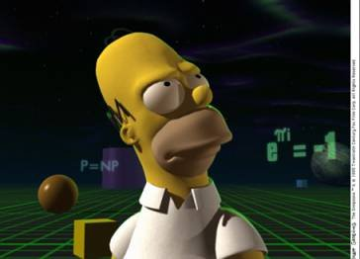
The Simpson's: P = NP?
Copyright © 1990, Matt Groening

Slide 12
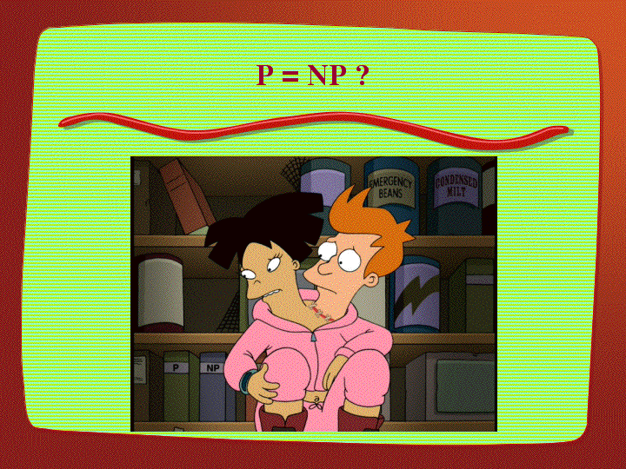
Futurama: P = NP?
Copyright © 2000, Twentieth Century Fox

Slide 13
Looking for a Job?
Some writers for the Simpsons and Futurama.
  J. Steward Burns. M.S. in mathematics, Berkeley, 1993.
  David X. Cohen. M.S. in computer science, Berkeley, 1992.
  Al Jean. B.S. in mathematics, Harvard, 1981.
  Ken Keeler. Ph.D. in applied mathematics, Harvard, 1990.
  Jeff Westbrook. Ph.D. in computer science, Princeton, 1989.

Slide 14
8.4 NP-Completeness

Slide 15
Polynomial Transformation
Def. Problem X polynomial reduces (Cook) to problem Y if arbitrary instances of problem X can be solved using:
  Polynomial number of standard computational steps, plus
  Polynomial number of calls to oracle that solves problem Y.
Def. Problem X polynomial transforms (Karp) to problem Y if given any input x to X, we can construct an input y such that x is a yes instance of X iff y is a yes instance of Y.
Note. Polynomial transformation is polynomial reduction with just one call to oracle for Y, exactly at the end of the algorithm for X. Almost all previous reductions were of this form.
Open question. Are these two concepts the same?
we require |y| to be of size polynomial in |x|
we abuse notation ≤ _{p} and blur distinction
Notes:
If Cook reduction = Karp reduction then co-NP = NP.

Slide 16
NP-Complete
NP-complete. A problem Y in NP with the property that for every problem X in NP, X ≤ _{p} Y.
Theorem. Suppose Y is an NP-complete problem. Then Y is solvable in poly-time iff P = NP.
Pf. ⇐ If P = NP then Y can be solved in poly-time since Y is in NP.
Pf. ⇒ Suppose Y can be solved in poly-time.
  Let X be any problem in NP. Since X ≤ _{p} Y, we can solve X in
  poly-time. This implies NP ⊆ P.
  We already know P ⊆ NP. Thus P = NP. ▪
Fundamental question. Do there exist "natural" NP-complete problems?
Notes:
why couldn't there be incomparable problems such that neither X <= Y nor Y <= X ?

Slide 17
Circuit Satisfiability
CIRCUIT-SAT. Given a combinational circuit built out of AND, OR, and NOT gates, is there a way to set the circuit inputs so that the output is 1?
output
∧
¬
∧
yes: 1 0 1
∧
∨
∨
1
0
?
?
?
hard-coded inputs
inputs

Slide 18
The "First" NP-Complete Problem
Theorem. CIRCUIT-SAT is NP-complete. [Cook 1971, Levin 1973]
Pf. (sketch)
  Any algorithm that takes a fixed number of bits n as input and produces a yes/no answer can be represented by such a circuit.
  Moreover, if algorithm takes poly-time, then circuit is of poly-size.
  Consider some problem X in NP. It has a poly-time certifier C(s, t).
  To determine whether s is in X, need to know if there exists a certificate t of length p(|s|) such that C(s, t) = yes.
  View C(s, t) as an algorithm on |s| + p(|s|) bits (input s, certificate t) and convert it into a poly-size circuit K.
    first |s| bits are hard-coded with s
    remaining p(|s|) bits represent bits of t
  Circuit K is satisfiable iff C(s, t) = yes.
sketchy part of proof; fixing the number of bits is important,
and reflects basic distinction between algorithms and circuits
Notes:
intellectual milestone in CS
by Savage's theorem, P = languages with uniformly polynomial circuits

Slide 19
Example
Ex. Construction below creates a circuit K whose inputs can be set so that K outputs true iff graph G has an independent set of size 2.
∧
independent set of size 2?
independent set?
¬
both endpoints of some edge have been chosen?
∨
∨
∨
set of size 2?
∧
∧
∧
∨
u
∧
∧
∧
v
w
G = (V, E), n = 3
u-v
u-w
v-w
u
v
w
1
0
1
?
?
?
hard-coded inputs (graph description)
n inputs (nodes in independent set)

Slide 20
Establishing NP-Completeness
Remark. Once we establish first "natural" NP-complete problem,
others fall like dominoes.
Recipe to establish NP-completeness of problem Y.
  Step 1. Show that Y is in NP.
  Step 2. Choose an NP-complete problem X.
  Step 3. Prove that X ≤ _{p} Y.
Justification. If X is an NP-complete problem, and Y is a problem in NP with the property that X ≤ _{P} Y then Y is NP-complete.
Pf. Let W be any problem in NP. Then W ≤ _{P} X ≤ _{P} Y.
  By transitivity, W ≤ _{P} Y.
  Hence Y is NP-complete. ▪
by definition of
NP-complete
by assumption

Slide 21
3-SAT is NP-Complete
Theorem. 3-SAT is NP-complete.
Pf. Suffices to show that CIRCUIT-SAT ≤ _{P} 3-SAT since 3-SAT is in NP.
  Let K be any circuit.
  Create a 3-SAT variable x_{i} for each circuit element i.
  Make circuit compute correct values at each node:
    x₂ = ¬ x₃ ⇒ add 2 clauses:
    x₁ = x₄ ∨ x₅ ⇒ add 3 clauses:
    x₀ = x₁ ∧ x₂ ⇒ add 3 clauses:
  Hard-coded input values and output value.
    x₅ = 0 ⇒ add 1 clause:
    x₀ = 1 ⇒ add 1 clause:
  Final step: turn clauses of length < 3 into
  clauses of length exactly 3. ▪
output
x₀
∧
x₁
x₂
∨
¬
x₅
x₄
x₃
0
?
?

Slide 22
NP-Completeness
Observation. All problems below are NP-complete and polynomial reduce to one another!
by definition of NP-completeness
CIRCUIT-SAT
3-SAT
3-SAT reduces to INDEPENDENT SET
INDEPENDENT SET
DIR-HAM-CYCLE
GRAPH 3-COLOR
SUBSET-SUM
VERTEX COVER
HAM-CYCLE
PLANAR 3-COLOR
SCHEDULING
SET COVER
TSP
Notes:
Karp analyzed most juicy open problem in discrete math – showed most were NP-complete
x -> y means x reduces to y (if you can solve y, then you can solve x)
Then to join the NP complete club, you need a reduction from SAT (or any other current member) to you

Slide 23
Some NP-Complete Problems
Six basic genres of NP-complete problems and paradigmatic examples.
  Packing problems: SET-PACKING, INDEPENDENT SET.
  Covering problems: SET-COVER, VERTEX-COVER.
  Constraint satisfaction problems: SAT, 3-SAT.
  Sequencing problems: HAMILTONIAN-CYCLE, TSP.
  Partitioning problems: 3D-MATCHING 3-COLOR.
  Numerical problems: SUBSET-SUM, KNAPSACK.
Practice. Most NP problems are either known to be in P or NP-complete.
Notable exceptions. Factoring, graph isomorphism, Nash equilibrium.
Notes:
Nash equilibria in two-person non-zero-sum game always exist, but major open question to *find* such a solution in poly-time. [Is there a corresponding decision problem or is only the search problem interesting from a computational complexity viewpoint?]

Slide 24
Extent and Impact of NP-Completeness
Extent of NP-completeness. [Papadimitriou 1995]
  Prime intellectual export of CS to other disciplines.
  6,000 citations per year (title, abstract, keywords).
    more than "compiler", "operating system", "database"
  Broad applicability and classification power.
  "Captures vast domains of computational, scientific, mathematical endeavors, and seems to roughly delimit what mathematicians and scientists had been aspiring to compute feasibly."
NP-completeness can guide scientific inquiry.
  1926: Ising introduces simple model for phase transitions.
  1944: Onsager solves 2D case in tour de force.
  19xx: Feynman and other top minds seek 3D solution.
  2000: Istrail proves 3D problem NP-complete.
Notes:
Ernst Ising proposed simple model for phase transitions that is of fundamental importance in physics.
One of most exiting periods in statistical mechanics when Norwegian chemist Lars Onsager (and Nobel laureate) discovered solution to Ising model of ferromagnetism on 2D lattice.
Result energized many of the most brilliant physicist and mathematicians for solution to more realistic 3D model.
Spin glass Ising model from statistical mechanics (2d version unrealistic, 3d is the one everyone wanted to sovle)

Slide 25
More Hard Computational Problems
Aerospace engineering: optimal mesh partitioning for finite elements.
Biology: protein folding.
Chemical engineering: heat exchanger network synthesis.
Civil engineering: equilibrium of urban traffic flow.
Economics: computation of arbitrage in financial markets with friction.
Electrical engineering: VLSI layout.
Environmental engineering: optimal placement of contaminant sensors.
Financial engineering: find minimum risk portfolio of given return.
Game theory: find Nash equilibrium that maximizes social welfare.
Genomics: phylogeny reconstruction.
Mechanical engineering: structure of turbulence in sheared flows.
Medicine: reconstructing 3-D shape from biplane angiocardiogram.
Operations research: optimal resource allocation.
Physics: partition function of 3-D Ising model in statistical mechanics.
Politics: Shapley-Shubik voting power.
Pop culture: Minesweeper consistency.
Statistics: optimal experimental design.

Slide 26
8.9 co-NP and the Asymmetry of NP

Slide 27
Asymmetry of NP
Asymmetry of NP. We only need to have short proofs of yes instances.
Ex 1. SAT vs. TAUTOLOGY.
  Can prove a CNF formula is satisfiable by giving such an assignment.
  How could we prove that a formula is not satisfiable?
Ex 2. HAM-CYCLE vs. NO-HAM-CYCLE.
  Can prove a graph is Hamiltonian by giving such a Hamiltonian cycle.
  How could we prove that a graph is not Hamiltonian?
Remark. SAT is NP-complete and SAT ≡ _{P} TAUTOLOGY, but how do we classify TAUTOLOGY?
not even known to be in NP

Slide 28
NP and co-NP
NP. Decision problems for which there is a poly-time certifier.
Ex. SAT, HAM-CYCLE, COMPOSITES.
Def. Given a decision problem X, its complement X is the same problem with the yes and no answers reverse.
Ex. X = { 0, 1, 4, 6, 8, 9, 10, 12, 14, 15, … }
Ex. X = { 2, 3, 5, 7, 11, 13, 17, 23, 29, … }
co-NP. Complements of decision problems in NP.
Ex. TAUTOLOGY, NO-HAM-CYCLE, PRIMES.

Slide 29
NP = co-NP ?
Fundamental question. Does NP = co-NP?
  Do yes instances have succinct certificates iff no instances do?
  Consensus opinion: no.
Theorem. If NP ≠ co-NP, then P ≠ NP.
Pf idea.
  P is closed under complementation.
  If P = NP, then NP is closed under complementation.
  In other words, NP = co-NP.
  This is the contrapositive of the theorem.

Slide 30
Good Characterizations
Good characterization. [Edmonds 1965] NP  co-NP.
  If problem X is in both NP and co-NP, then:
    for yes instance, there is a succinct certificate
    for no instance, there is a succinct disqualifier
  Provides conceptual leverage for reasoning about a problem.
Ex. Given a bipartite graph, is there a perfect matching.
  If yes, can exhibit a perfect matching.
  If no, can exhibit a set of nodes S such that |N(S)| < |S|.

Slide 31
Good Characterizations
Observation. P ⊆ NP  co-NP.
  Proof of max-flow min-cut theorem led to stronger result that max-flow and min-cut are in P.
  Sometimes finding a good characterization seems easier than finding an efficient algorithm.
Fundamental open question. Does P = NP  co-NP?
  Mixed opinions.
  Many examples where problem found to have a non-trivial good characterization, but only years later discovered to be in P.
    linear programming [Khachiyan, 1979]
    primality testing [Agrawal-Kayal-Saxena, 2002]
Fact. Factoring is in NP  co-NP, but not known to be in P.
if poly-time algorithm for factoring,
can break RSA cryptosystem

Slide 32
PRIMES is in NP ∩ co-NP
Theorem. PRIMES is in NP ∩ co-NP.
Pf. We already know that PRIMES is in co-NP, so it suffices to prove that PRIMES is in NP.
Pratt's Theorem. An odd integer s is prime iff there exists an integer 1 < t < s s.t.
Input. s = 437,677
Certificate. t = 17, 2² × 3 × 36,473
Certifier.
- Check s-1 = 2 × 2 × 3 × 36,473.
- Check 17^{s-1} = 1 (mod s).
- Check 17^{(s-1)/2} ≡ 437,676 (mod s).
- Check 17^{(s-1)/3} ≡ 329,415 (mod s).
- Check 17^{(s-1)/36,473} ≡ 305,452 (mod s).
prime factorization of s-1
also need a recursive certificate
to assert that 3 and 36,473 are prime
use repeated squaring
Notes:
certificate is t, all prime divisors of s-1, AND a recursive certificate that each of the prime divisors is in fact prime
this can all be done in O(n^4) time – see 10.2, Papadimitiou

Slide 33
FACTOR is in NP ∩ co-NP
FACTORIZE. Given an integer x, find its prime factorization.
FACTOR. Given two integers x and y, does x have a nontrivial factor less than y?
Theorem. FACTOR ≡ _{P} FACTORIZE.
Theorem. FACTOR is in NP ∩ co-NP.
Pf.
  Certificate: a factor p of x that is less than y.
  Disqualifier: the prime factorization of x (where each prime factor is less than y), along with a certificate that each factor is prime.
Notes:
certificate is t, all prime divisors of s-1, AND a recursive certificate that each of the prime divisors is in fact prime
this can all be done in O(n^4) time – see 10.2, Papadimitiou

Slide 34
Primality Testing and Factoring
We established: PRIMES ≤ _{P} COMPOSITES ≤ _{P} FACTOR.
Natural question: Does FACTOR ≤ _{P} PRIMES ?
Consensus opinion. No.
State-of-the-art.
  PRIMES is in P.
  FACTOR not believed to be in P.
RSA cryptosystem.
  Based on dichotomy between complexity of two problems.
  To use RSA, must generate large primes efficiently.
  To break RSA, suffixes to find efficient factoring algorithm.
proved in 2001

Slide 35
Extra Slides

Slide 36
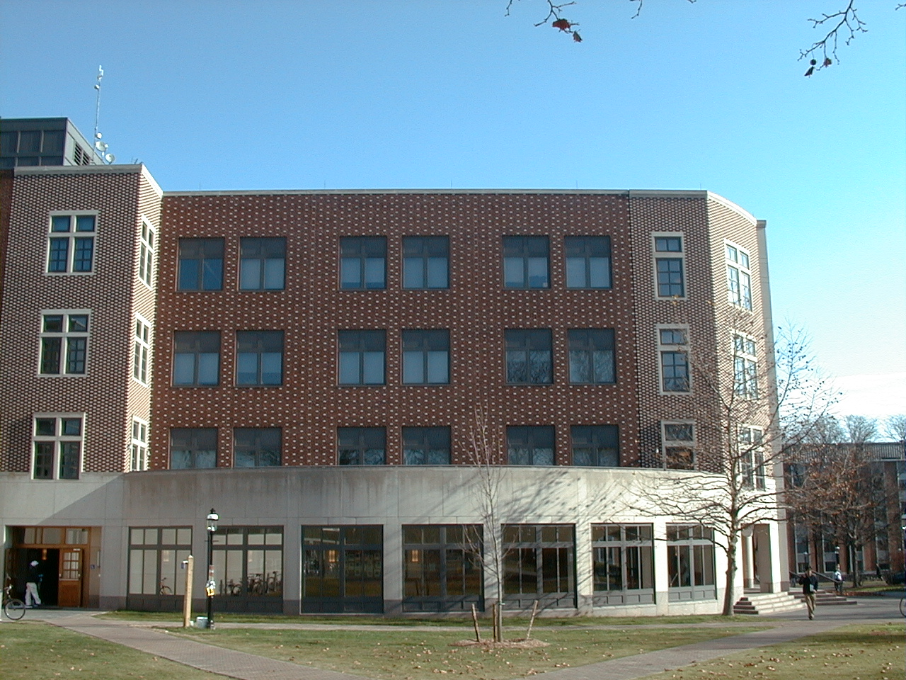
Princeton CS Building, West Wall
Notes:
photo by Kevin, circa 2001

Slide 37
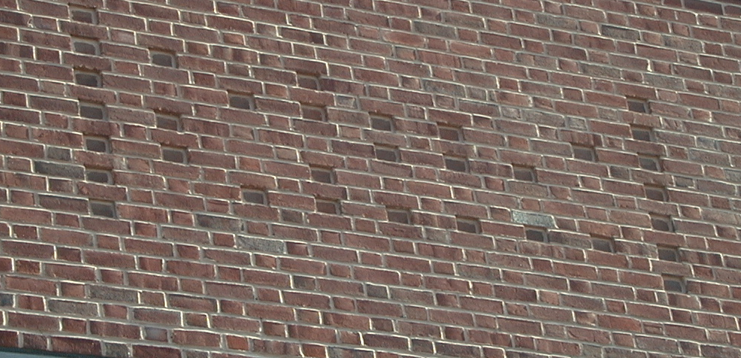
Princeton CS Building, West Wall
Character
ASCII
Bits
P
80
1010000
=
61
0111101
N
78
1001110
P
80
1010000
?
63
0111111
Notes:
taken from inside the Engineering library facing cs building

Slide 38
How To Give a PowerPoint Talk
Not
(commercial break)
Notes:
I used these slides to take a break during a lecture when I had laryngitus. I didn't say a single word, but students found it quite amusing.

Slide 39
A Note on Terminology
Knuth. [SIGACT News 6, January 1974, p. 12 – 18]
Find an adjective x that sounds good in sentences like.
  EUCLIDEAN-TSP is x.
  It is x to decide whether a given graph has a Hamiltonian cycle.
  It is unknown whether FACTOR is an x problem.
Note: x does not necessarily imply that a problem is in NP, just that every problem in NP polynomial reduces to x.

Slide 40
A Note on Terminology
Knuth's original suggestions.
  Hard.
  Tough.
  Herculean.
  Formidable.
  Arduous.
Some English word write-ins.
  Impractical.
  Bad.
  Heavy.
  Tricky.
  Intricate.
  Prodigious.
  Difficult.
  Intractable.
  Costly.
  Obdurate.
  Obstinate.
  Exorbitant.
  Interminable.
but Hercules known
for strength not time

Slide 41
A Note on Terminology
Hard-boiled. [Ken Steiglitz] In honor of Cook.
Hard-ass. [Al Meyer] Hard as satisfiability.
Sisyphean. [Bob Floyd] Problem of Sisyphus was time-consuming.
Ulyssean. [Don Knuth] Ulysses was known for his persistence.
but Sisyphus never finished his task
and finished!

Slide 42
A Note on Terminology: Made-Up Words
Supersat. [Al Meyer] Greater than or equal to satisfiability.
Polychronious. [Ed Reingold] Enduringly long; chronic.
PET. [Shen Lin] Probably exponential time.
GNP. [Al Meyer] Greater than or equal to NP in difficulty.
like today's lecture
depending on P=NP conjecture: provably exponential time,
or previously exponential time
costing more than GNP to resolve

Slide 43
A Note on Terminology: Consensus
NP-complete. A problem in NP such that every problem in NP polynomial reduces to it.
NP-hard. [Bell Labs, Steve Cook, Ron Rivest, Sartaj Sahni]
A decision problem such that every problem in NP reduces to it.
NP-hard search problem. A problem such that every problem
in NP reduces to it.
not necessarily in NP
not necessarily a yes/no problem
"creative research workers are as full of ideas for new terminology as they are empty of enthusiasm for adopting it." -Don Knuth

