Slide 1
On Communication Protocols that Compute Almost Privately
      Bhaskar DasGupta
      Department of Computer Science
      University of Illinois at Chicago
      dasgupta@cs.uic.edu
  Joint work with
    Marco Comi, Michael Schapira and Venkatakumar Srinivasan
    (UIC) (Princeton) (UIC)
  Preliminary version appeared in SAGT 2011
UIC IGERT Talk

Slide 2
WARNING !!!
This is a theoretical investigation
We are NOT
  building any system
  doing any simulation work
  developing any software
UIC IGERT Talk

Slide 3


Traditional two-party communication complexity
Has a rich history
starting with the paper
by Andy Yao in 1979
Alice
Bob
(communication protocol)
rounds of alternate
communication of
small information
(e.g., 1 bit, 2 bits)
n-bit binary
x
n-bit binary
y
both
wants to compute
f (x,y)
given
function
UIC IGERT Talk

Slide 4

Privacy in two-party communication complexity
Alice
hypothetical
eavesdropper
Bob
(communication protocol)
x
protocol reveals as little information as
possible about private inputs beyond
what is necessary for computing f to:
  both Alice and Bob,
  as well as to any eavesdropper
y
both
wants to compute
f (x,y)
UIC IGERT Talk

Slide 5
Conflicting goals in privacy preservation
Alice and Bob need to communicate for computing f
But, Alice and Bob would prefer not to communicate too much information about their private inputs x and y
UIC IGERT Talk

Slide 6



A Natural Generalization to more than 2 parties
party₁
function to compute
f (x₁,x₂,x₃,x₄)
x₁
round
robin
party₄
common
channel
party₂
x₄
x₂
party₃
x₃
UIC IGERT Talk

Slide 7
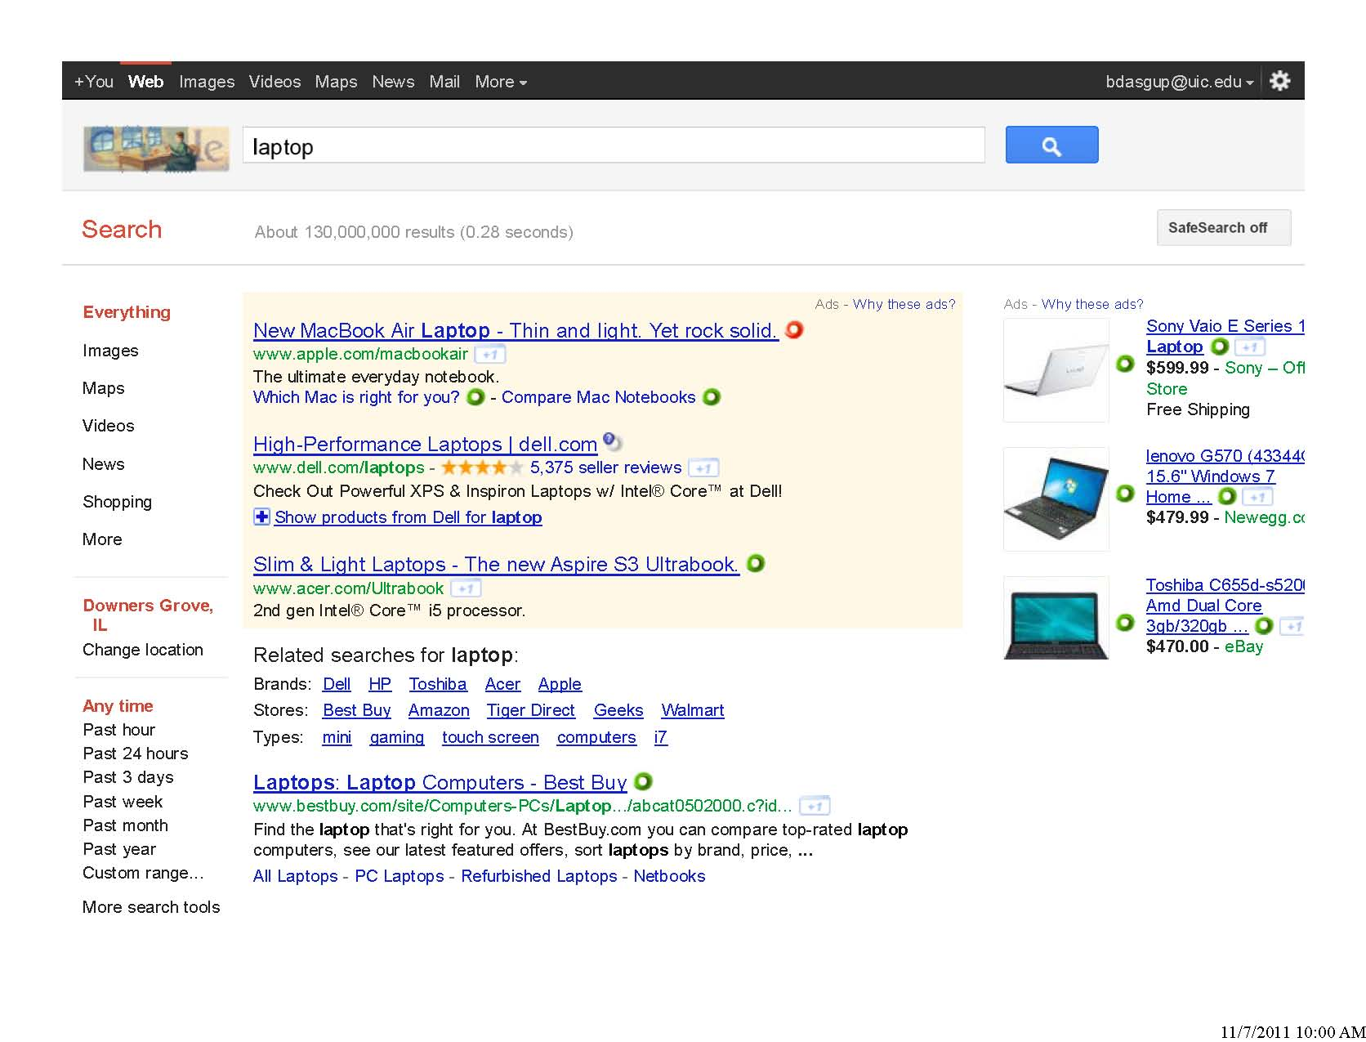
Original Motivation for studying approximate privacy framework
(Feigenbaum, Jaggard and Schapira, 2010)
Google
Advertisers
UIC IGERT Talk

Slide 8
Traditional goals:
  maximize revenue
  design truthful mechanism
  (no bidder can gain by lying)
  etc.
information
about bids
outcome
(winner)
x₁
1
2
⁞
n
auction
mechanism
x₂
f (x₁,x₂,…,x_{n})
x_{n}
Bidders
(e.g. advertisers)
Our complementary goal (privacy)
bidders want to reveal as little information
as necessary to the auctioneer
UIC IGERT Talk

Slide 9


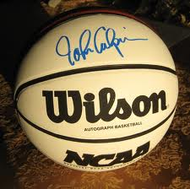
Example: 2nd price Vickrey auction via a straightforward protocol
7 $
1 $
6 $
5 $
6 $ 6 $ 6 $
3 $ 3 $ 3 $
4 $ 4 $ 4 $
7 $ 7 $ 7 $
2 $ 2 $ 2 $
5 $ 5 $ 5 $
1 $ 1 $ 1 $
winner
pays 6 $
2 $
Bad privacy:
auctioneer knows almost everybody’s bid
thus, could set a lower reserve price for
a similar item in the future
auction item
UIC IGERT Talk

Slide 10
Perfect Privacy
Desirable: protocols that preserve privacy perfectly
  protocols revealing no information about the parties' private inputs beyond that implied by the outcome of the computation
  can be quantified in several ways (e.g., via information-theoretic measures)
    e.g., Bar-Yehuda, Chor, Kushilevitz and Orlitsky, 1993
    Kushilevitz, 1992
Perfect privacy is often:
  impossible, or
  costly to achieve (e.g., requiring impractically extensive communication steps)
UIC IGERT Talk

Slide 11
Approximate Privacy
(topic of our talk)
Our talk deals with the approximate privacy framework of
Feigenbaum, Jaggard and Schapira, 2010
Quantifies approximate privacy via the privacy approximation ratios (PAR) of protocols
UIC IGERT Talk

Slide 12
Some terminologies
Protocol
  a priori fixed set of rules for communication
Transcript of a protocol
  total information (e.g., bits) exchanged during an execution of the protocol
Function
  whatever we need to compute
UIC IGERT Talk

Slide 13
Privacy approximation ratios (PAR)
Informally, PAR captures this objective
  observer of protocol cannot distinguish the real inputs of the two communicating parties from as large a set as possible of other inputs
To capture this intuition, Feigenbaum et al. makes use of the machinery of communication-complexity theory to provide a geometric and combinatorial interpretation of protocols
They formulated worst-case and average-case version of PAR and studied the tradeoff between privacy preservation and communication complexity for several functions
UIC IGERT Talk

Slide 14
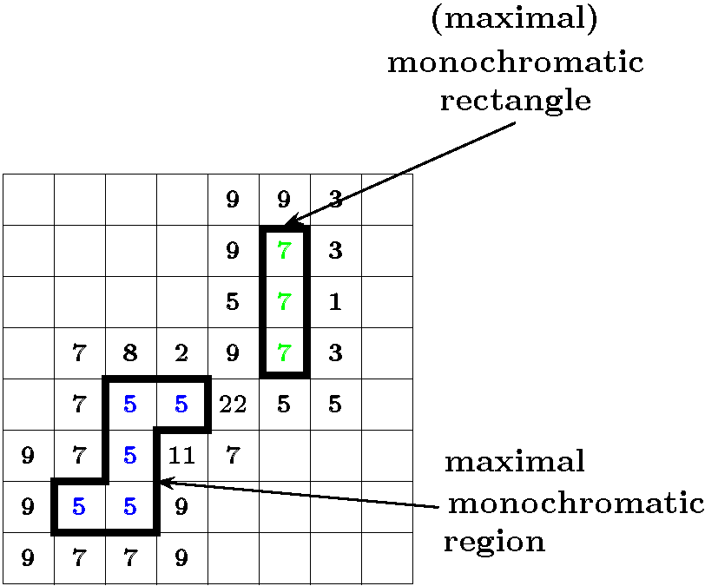

Some communication complexity definitions
f(c,e)= 8
a b c d e f g h
000 001 010 011 100 101 110 111
y
a b c d e f g h
000 001 010 011 100 101 110 111
x
UIC IGERT Talk

Slide 15
Tiling functions
  Encompasses several well-studied functions
  (e. g., Vickrey's 2nd-price auction)
  Informally, in a 2-variable tiling function f the output space is a collection of disjoint combinatorial rectangles (where f has the same value) in the 2-dimensional plane
UIC IGERT Talk

Slide 16
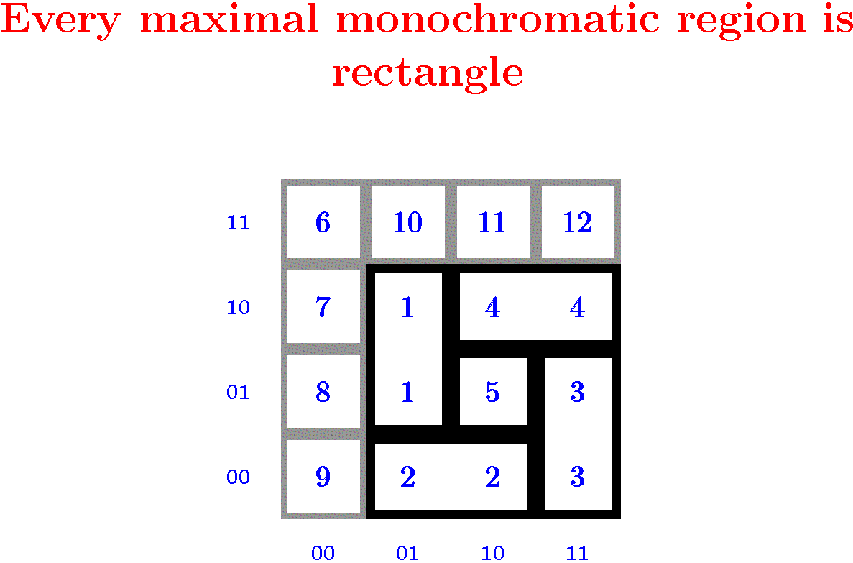
Tiling function
f(x,y)
y
x
UIC IGERT Talk

Slide 17
Example of a non-tiling function
f(x,y)
2 | 2 | 1 | 1
2 | 1 | 1 | 1
1 | 1 | 1 | 1
1 | 1 | 1 | 1
11
10
01
00
y
00 01 10 11
x
UIC IGERT Talk

Slide 18
Dissection protocols
A natural class of protocols
Each parties' inputs have a natural total ordering, e.g.
  private input of party is in some range of integers { L, L+1,…,M }
Protocol allows to ask each party questions of the form
  “Is your input between the values α and β ?”
  (under this natural order over possible inputs)
UIC IGERT Talk

Slide 19
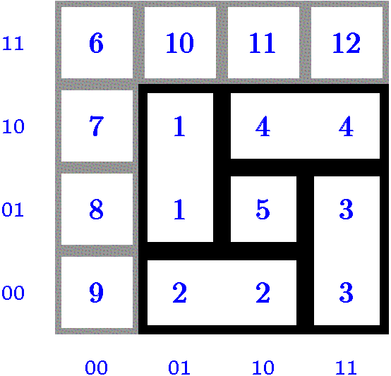
One Run of Dissection Protocol
f(x,y)
Alice
y = 00
This monochromatic
rectangle got
partitioned
Bob
x = 11
UIC IGERT Talk

Slide 20
One Run of Bisection Protocol (special case of dissection protocol)
f(x,y)
Alice
y = 00
Bob
x = 11
UIC IGERT Talk

Slide 21
Bisection protocol
representation of all possible executions
Dissection protocol
representation of all possible executions
UIC IGERT Talk

Slide 22
Why cutting a monochromatic rectangle is bad?
y₂
f has same output
for all x₁ ≤ x ≤ x₂ and y₁ ≤ y ≤ y₂
y’
y₁
x₁
x₂
But, observing the protocol
allows one to distinguish
between these inputs
(extra information revealed)
UIC IGERT Talk

Slide 23


Worst Case PAR illustration
protocol
partition
1
cell
monochromatic
region of 7 cells
worst-case PAR = = 7
UIC IGERT Talk

Slide 24
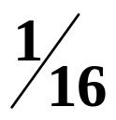

6 cells
2 cells
1
3
10
10
Average Case PAR illustration
for uniform distribution
Average Case PAR illustration
for almost uniform distribution
1
3
10
10
y
1
3
10
10
2
2
2
4
probability of each cell =
± ε
x
(
)
contribution of a cell = ×
± ε
add contributions of all cells
UIC IGERT Talk

Slide 25
High-level Overview of Our Results
We study approximate privacy properties (PAR values) of
  dissection protocols
  for computing tiling functions
(and, some generalizations)
UIC IGERT Talk

Slide 26
High-level Overview of Our Results
2-party computation
Boolean tiling functions:
Every Boolean tiling function admits a dissection
protocol that is perfectly privacy preserving (PAR=1)
Not true otherwise
(even if the function output is ternary)
UIC IGERT Talk

Slide 27
Every Boolean tiling function admits a dissection
protocol that is perfectly privacy preserving (PAR=1)
Proof idea
there is always a “perfect” cut
(and, induction)
UIC IGERT Talk

Slide 28
High-level Overview of Our Results
2-party computation
Non-Boolean tiling functions: average PAR
Every tiling function admits a dissection protocol that achieves a
constant PAR in the average case
the parties' private values are drawn from an
uniform or almost uniform
probability distribution
UIC IGERT Talk

Slide 29
2-party, constant average case PAR
Uses some known geometric results
Binary space partition (BSP) of rectangles
each final region contains one piece
Known result: there exists a BSP such that every rectangle is partitioned
no more than 4 times
UIC IGERT Talk

Slide 30
High-level Overview of Our Results
2-party computation
Non-Boolean tiling functions: worst-case PAR
∃ tiling functions for which no dissection protocol can achieve
a constant PAR in the worst-case
UIC IGERT Talk

Slide 31
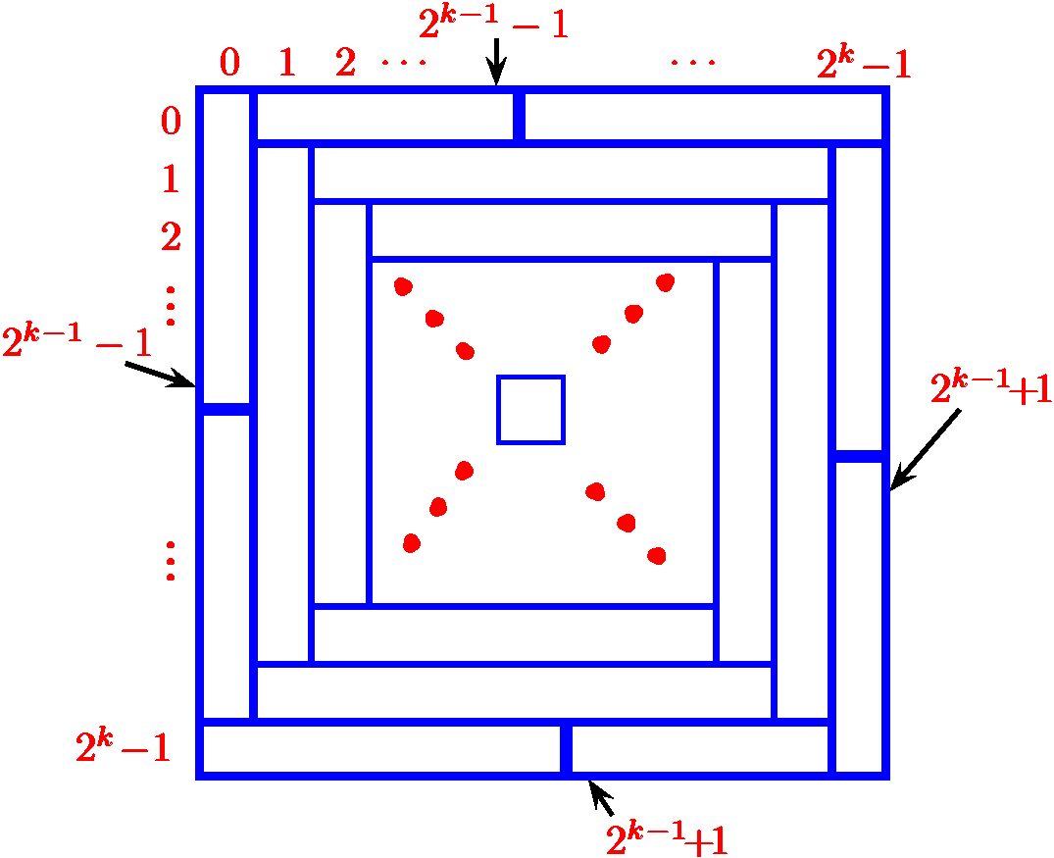
2 party, large worst-case PAR function
not drawn
to scale
0
0
0
0
0
0
1 1 1 1 1 1 1 1
0 0 0 0 0 0 0 0 0 0 0
2
2
2
2
2
2
2
2
2
2
2
3 3 3 3 3 3 3 3 3 3 3 3 3 3 3 3
1
1
1
1
1
1
0
0
0
0
0
0
0
0
1 1 1 1 1 1 1 1 1 1 1 1
2
2
2
2
2
2
2
2
2
2
2
0
0
0
0
0
0
0
0
First
communication
1
1
1
1
1
1
0
0
0
0
0
0
large PAR
large PAR
1 1 1 1 1 1 1 1 1 1 1 1
3 3 3 3 3 3 3 3 3 3 3 3 3 3 3 3
0 0 0 0 0 0 0 0 0 0 0
1 1 1 1 1 1 1 1
UIC IGERT Talk

Slide 32
High-level Overview of Our Results
d-party computation, d > 2
We exhibit a 3-dimensional tiling function for which every dissection protocol exhibits exponential average- and worst-case PAR
even when an unlimited number of communication
steps is allowed
UIC IGERT Talk

Slide 33
3 party, large PAR
UIC IGERT Talk

Slide 34
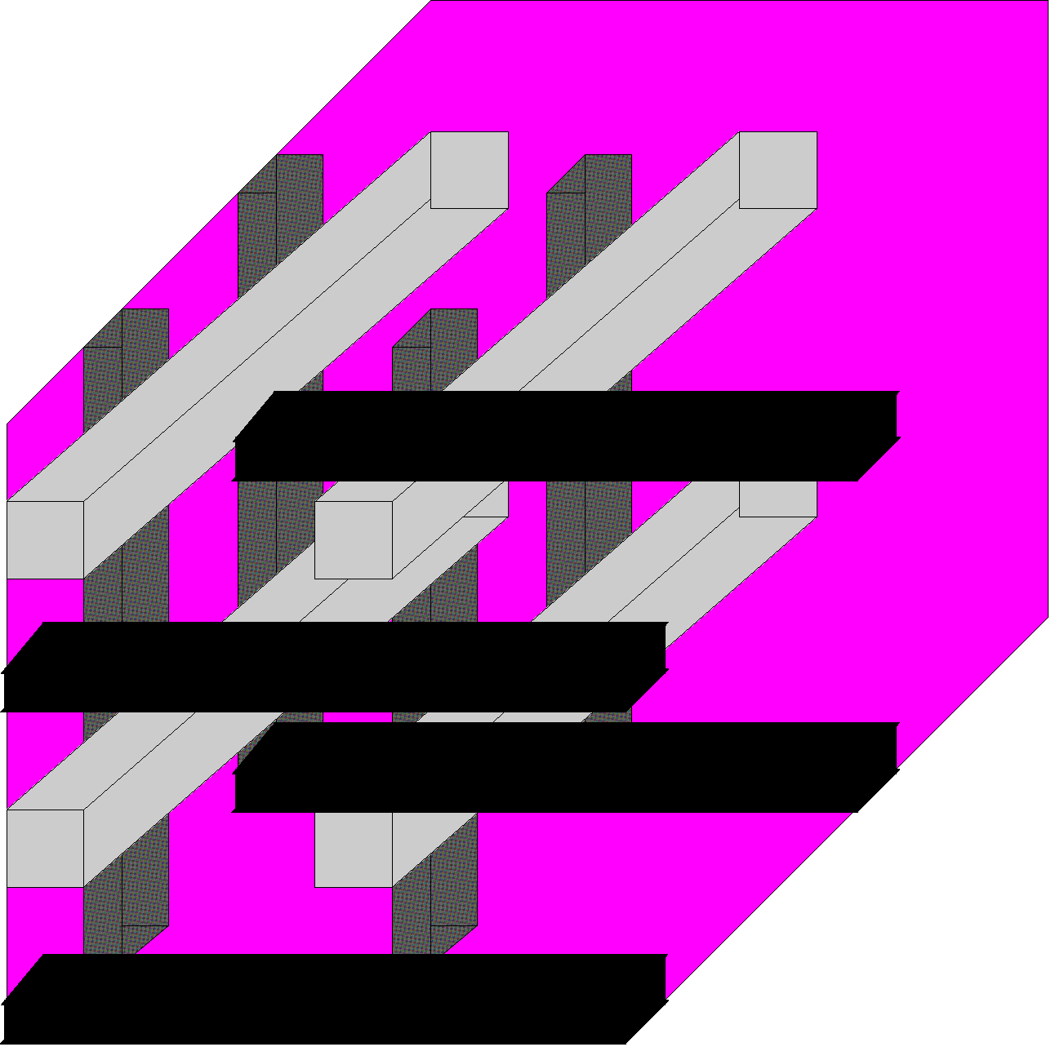



3-dimensional tiling function
UIC IGERT Talk

Slide 35

One hypothetical
communication step
Lots of steps are necessary
Why ?
Lots of monsters
No two can be together
Each step cuts
lots of rectangles
UIC IGERT Talk

Slide 36
High-level Overview of Our Results
Other results for 2-party computation
We explain how our constant average-case PAR result for tiling
functions can be extended to a family of “almost” tiling functions.
UIC IGERT Talk

Slide 37
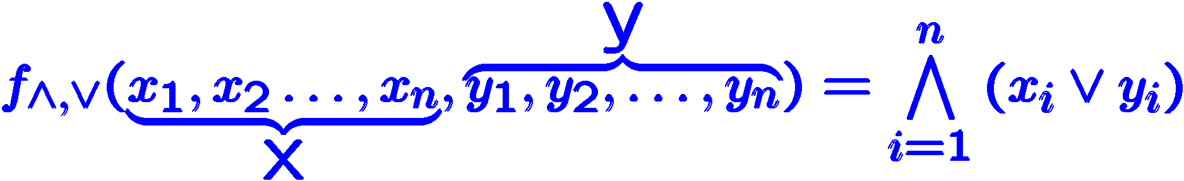
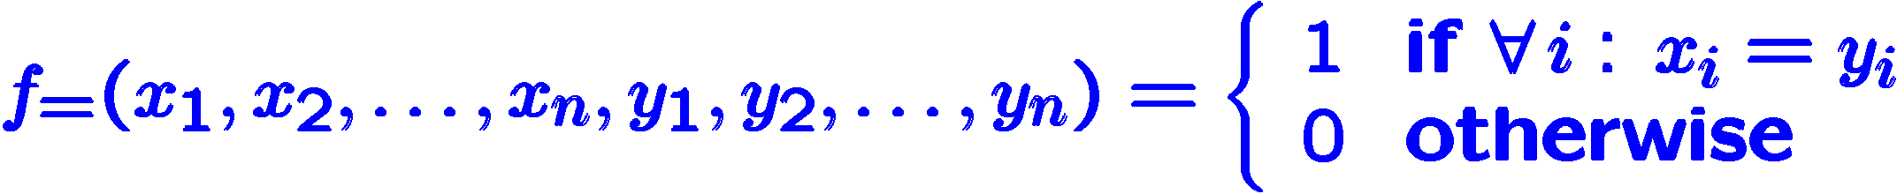
High-level Overview of Our Results
Average and worst-case PAR for two specific functions
under bisection protocol
Set covering
set-covering type of functions are useful for studying the differences between deterministic and non-deterministic communication complexities
Equality
equality function provides a useful test-bed for evaluating privacy preserving protocols
UIC IGERT Talk

Slide 38
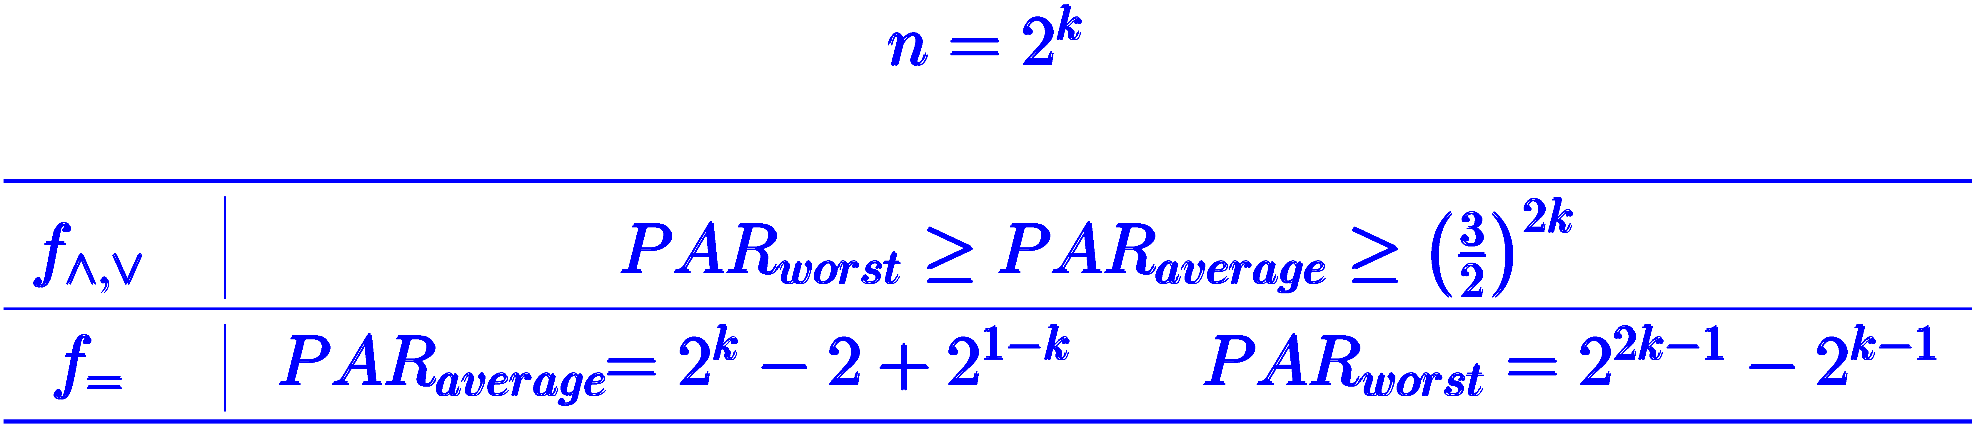
Average and worst-case PAR for two specific functions
under bisection protocol
UIC IGERT Talk

Slide 39



UIC IGERT Talk

