Slide 1

Combinatorial Reconstruction of Sibling Relationships in Absence of Parental Data
Brothers!
?
?
Tanya Y Berger-Wolf (DIMACS and UIC CS)
Bhaskar DasGupta (UIC CS)
Wanpracha Chaovalitwongse (DIMACS and Rutgers IE)
Mary Ashley (UIC Biology)

Slide 2
The Problem
Animal Locus 1 Locus 2
allelel1/allele2
1 149/167 243/255
2 149/155 245/267
3 149/177 245/283
4 155/155 253/253
5 149/155 245/267
6 149/155 245/277
7 149/151 251/255
8 149/173 255/255
Sibling Groups:
2, 3, 4, 5
2, 3, 4, 6
1, 7, 8

Slide 3
Why Reconstruct Sibling Relationships?
Used in: conservation biology, animal management, molecular ecology, genetic epidemiology
Necessary for: estimating heritability of quantitative characters, characterizing mating systems and fitness.
But: hard to sample parent/offspring pairs. Sampling cohorts of juveniles is easier

Slide 4
Previous Work:
Statistical estimate of pairwise distance and maximum likelihood clustering into family groups:
(Blouin et al. 1996; Thomas and Hill 2002; Painter 1997; Smith et al. 2001; Wang 2004)
Graph clustering algorithms to form groups from pairwise likelihood distance graph:
(Beyer and May, 2003)
Use 4-allele Mendelian constraint and brute force find groups (non-optimal) that satisfy it:
(Almudevar and Field, 1999)

Slide 5
Our Approach: Mendelian Constrains
4-allele rule: a group of siblings can have no more than 4 different alleles in any given locus
155/155, 149/155, 149/151, 149/173
2-allele rule: let a be the number of distinct alleles present in a given locus and R be the number of distinct alleles that either appear with three different alleles in this locus or are homozygous. Then a group of siblings must satisfy a + R ≤ 4
155/155, 149/155, 149/151

Slide 6
Our Algorithm—Template:
Construct possible sets S₁, S₂, …, S_{m}
that satisfy 2-allele (weaker 4-allele) rule
For each individual x find its set S_{j}
Find minimum set cover from sets
S₁, S₂, …, S_{m} of all the individuals.
Return sets in the cover as sibling groups

Slide 7
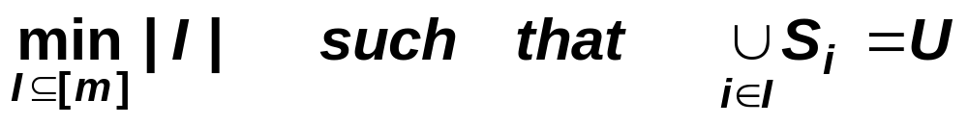
Aside: Minimum Set Cover
Given: universe U = {1, 2, …, n}
collection of sets S = {S₁, S₂,…,S_{m}}
where S_{i} subset of U
Find: the smallest number of sets in S
whose union is the universe U
Minimal Set Cover is NP-hard
(1+ln n)-approximable (sharp)

Slide 8
Our Algorithm—2-allele:
Construct possible sets S₁, S₂, …, S_{m}
that satisfy 2-allele rule:
for each locus independently create all sets that satisfy a+R ≤ 4, combine loci
(all the individuals are already assigned to sets from step 1)
Find minimum set cover from sets
S₁, S₂, …, S_{m} of all the individuals.
Return sets in the cover as sibling groups

Slide 9
Our Algorithm—4-allele:
Construct possible sets S₁, S₂, …, S_{m}
that satisfy 4-allele rule (must exist since each pair of individuals forms a valid set)
loc1 loc2 loc1 loc2
ind1 1/1 2/3 set(1,2) = {1,4} {2,3,5,6}
ind2 1/4 5/6
For each individual x add it to S_{j} only if it
its alleles for each locus are in the set of alleles for that locus in S_{j}
Find minimum set cover from sets
S₁, S₂, …, S_{m} of all the individuals.
Return sets in the cover as sibling groups

Slide 10
Experimental Protocol:
Create females and males, randomly pair them into couples, produce offspring, giving each juvenile one of each parent’s allele in each locus randomly.
The parameter ranges for the study :
Number of adult females F = 10, males M = 10
Number of loci sampled l = 2; 4; 6; 10
Num of alleles per locus a = 2; 5; 10; 20
Factor of the number of juveniles as the number of females j = 1; 2; 5; 10
Max number of offspring per couple
      o = 2; 5; 10; 30; 50

Slide 11
Algorithm Evaluation:
Use 4-allele algorithm on simulated juvenile population (using CPLEX 9.0 MIP solver to optimally solve Min Set Cover).
Compare results to the true known sibling groups.
Evaluate accuracy using a generalization of Gusfields’s partition distance (Information Proc. Letters, 2002)

Slide 12
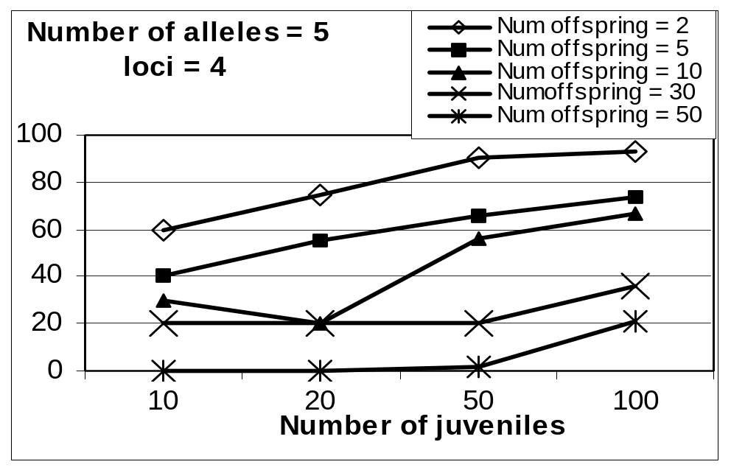
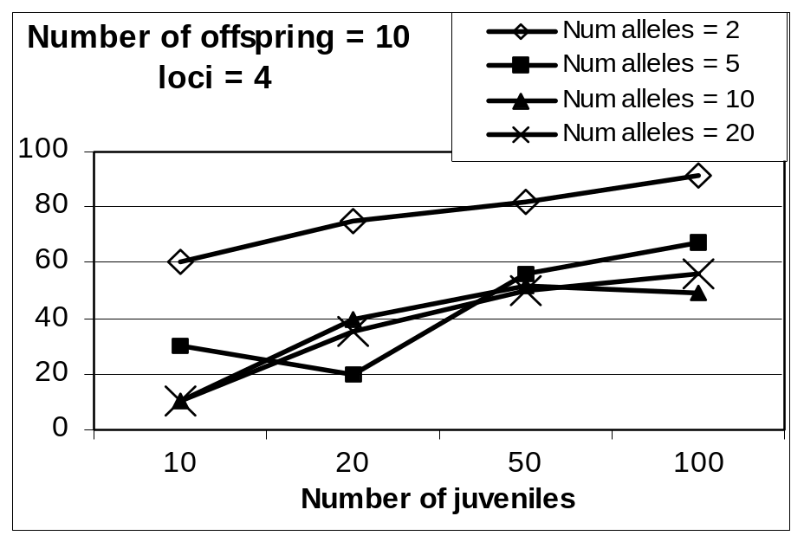
Results
As expected, the error
increases as the number of
juveniles increases

Slide 13
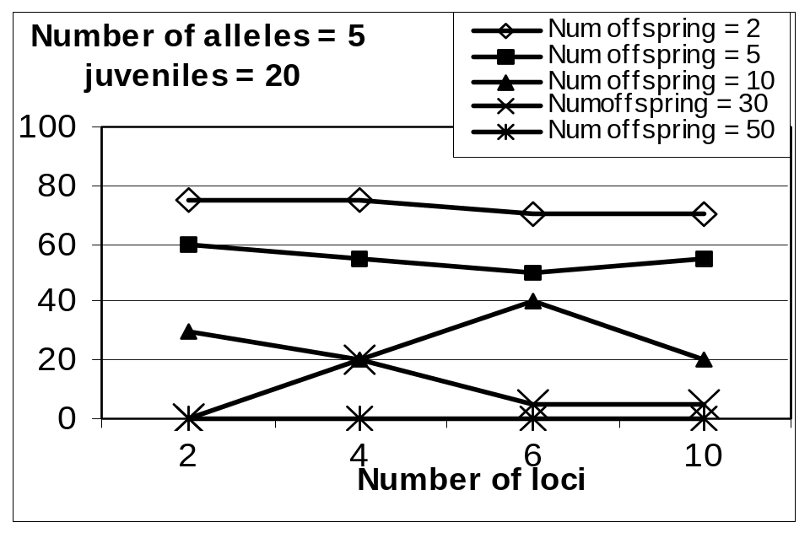
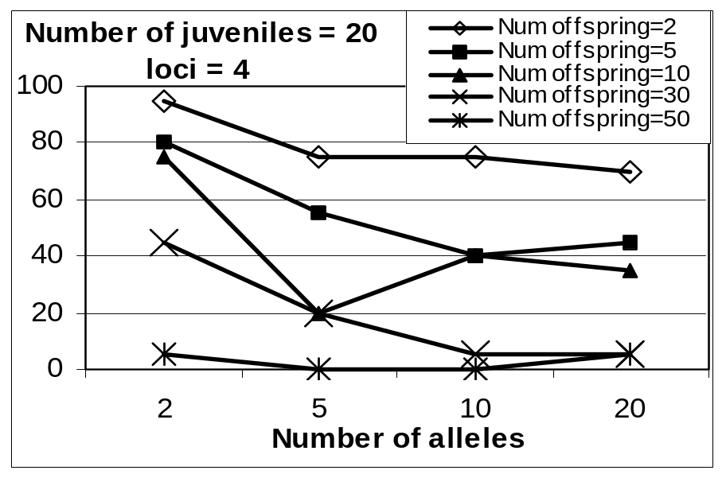
Results
Surprisingly, and unlike any statistical and likelyhood method, the error does not depend on the number of loci and allele frequency

Slide 14
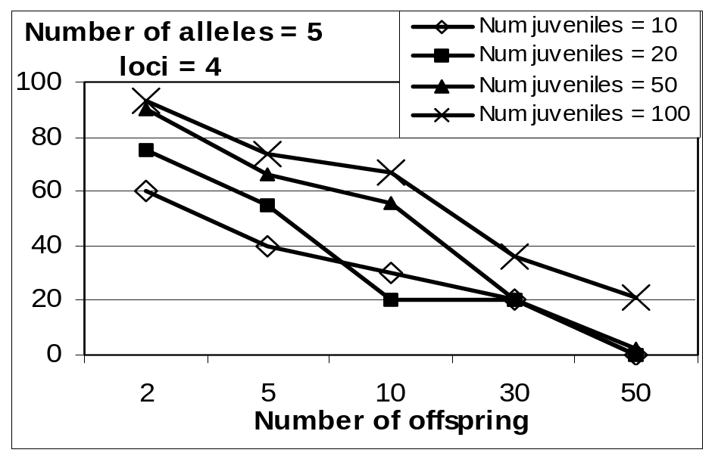
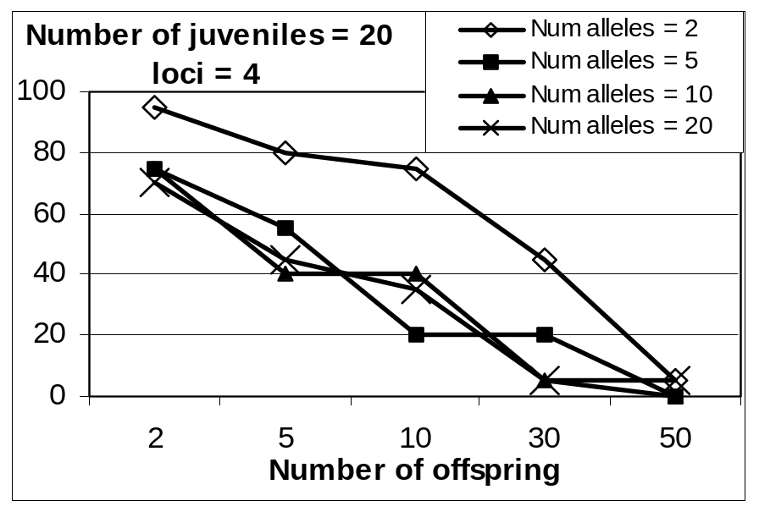
Results
The error decreases as the number of true siblings increases.
(When few siblings we underestimate number of sibling groups)

Slide 15
Conclusions
Ours is a fully combinatorial method. Uses simple Mendelian constraints, no statistical estimates or a priori knowledge about data
Even the very weak 4-allele constraint shows good trends (no dependence on number of loci sampled or allele frequency)
Need to evaluate the 2-allele algorithm on simulated and real data and compare to other sibship reconstruction algorithms

