Slide 1
On “Systemic” Vulberability of Banking Networks
Bhaskar DasGupta
Department of Computer Science
University of Illinois at Chicago
dasgupta@cs.uic.edu
Joint work with Piotr Berman, Lakshmi Kaligounder and
Marek Karpinski

Slide 2
In market-based economies, financial systems perform important financial functions of borrowing from surplus units and lending to deficit units
Financial stability is the ability of the financial systems to absorb shocks and perform its key functions, even in stressful situations
Threats on the stability of a financial system may severely affect the functioning of the entire economy

Slide 3
Study of instability of a market-based financial system due to factors such as debt financing of investments
Can be traced back to earlier works of the economists such as
Irving Fisher (1933)
John Keynes (1936)
during the 1930's Great Depression era
Became relevant again due to the recent financial debacle

Slide 4
It has been argued by some economists (e.g., by Hyman Minsky (1977) ) that
such instabilities are inherent in many modern capitalist economies
(i.e., they are “systemic”)

Slide 5
Economic instability
devastating collapse of stock market (black Tuesday)
major bank failures
high unemployment
great depression in 1930’s
why?
systemic ?
conspiracy ?
due to government spending ?
rare random event, just happens
early 1980’s recession
(smaller scale)
collapse of stock market
collapse of real estate
major bank failures averted by government loan
high unemployment
2007 recession

Slide 6
An observation (on US economic system)
great depression in 1930’s (starts in 1929)
Glass–Steagall Act (1933) to control speculation by banks
separated consumer banking and investment banking
prohibited bank holding company from owning other
financial companies
Gramm–Leach–Bliley Act (1999)
removed separation between investment and consumer banking
2007 recession
cause-and-effect or just random co-incidence ?

Slide 7
Natural Question
Is this instability
“systemic”, e.g., caused by repeal of Glass–Steagall act and subsequently developed specific properties of banking networks that allowed the ripple effect?
or, caused by “a few” banks that are “too big to fail” and “a few individually greedy executives”?
or, lack of oversight of regulatory authorities?
or, all of the above?
or, just a random occurrence?

Slide 8
lack of oversight of regulatory authorities?
(is it fair to blame the FEDs ?)
could a regulatory authority have predicted the current economic crisis? (assuming that they had access to all necessary data)
stability can be computed efficiently
e.g., polynomial-time
perhaps fair to blame the FEDs
stability is hard to compute, e.g.,
NP-hard, inapproximable (in polynomial time), PSPACE-hard etc.
perhaps not fair to blame the FEDs
by effective computations of the stability of the relevant banking networks

Slide 9
To investigate these types of questions, one must first settle questions of the following type:
What is the model of the banking network that is studied?
How exactly failures of individual banks propagated through the network to other banks?
What is an appropriate stability measure and what are the computational properties of such a measure?

Slide 10
As prior researchers such as Allen and Babus (2008) correctly pointed out:
graph theoretic concepts may provide a conceptual framework within which various patterns of connections between banks can be described and analyzed in a meaningful way
e.g., by modeling banking networks as a directed network in which
nodes represent the banks
links represent the direct exposures between banks

Slide 11
Formalization of models proposed by prior researchers such as:
Nier, Yang, Yorulmazer and Alentorn,
Network models and financial stability,
Journal of Economics Dynamics and Control, 31, 2033-2060, 2007
Eboli, Systemic Risk in Financial Network: a Graph Theoretical Approach,
Mimeo, Univ. di Chieti, Pescara, 2004

Slide 12
we formalize ex ante graph-theoretic models for banking networks to study idiosyncratic shock transmission
originally suggested by
Eboli (2004)
Nier, Yang, Yorulmazer and Alentorn (2007)
directed graph with several parameters
shock refers to loss of externals assets
network can be
homogeneous (external assets distributed equally among banks)
heterogeneous (otherwise)
more details
to follow

Slide 13
Two basic types of model
Homogeneous networks
all banks have roughly same external assets
no bank is too big to fail
Heterogeneous networks
different banks have differing external assets
there may be banks that are too big

Slide 14
Bank₂
borrowed from
Bank₁
edge-weighted
directed graph
Bank₂
Bank₁
7.001
2.1
Bank₃
3
more details
to follows
???
5.3
Bank₄
Bank₅

Slide 15
Is borrowing good or bad ?
Good:
Bank can borrow (from other bank), invest, get 10000% return, grows its asset, stockholders are elated
Bad:
Bank can borrow (from other bank), invest, looses all money, goes bankrupt since cannot pay back loan, stockholders file lawsuit

Slide 16
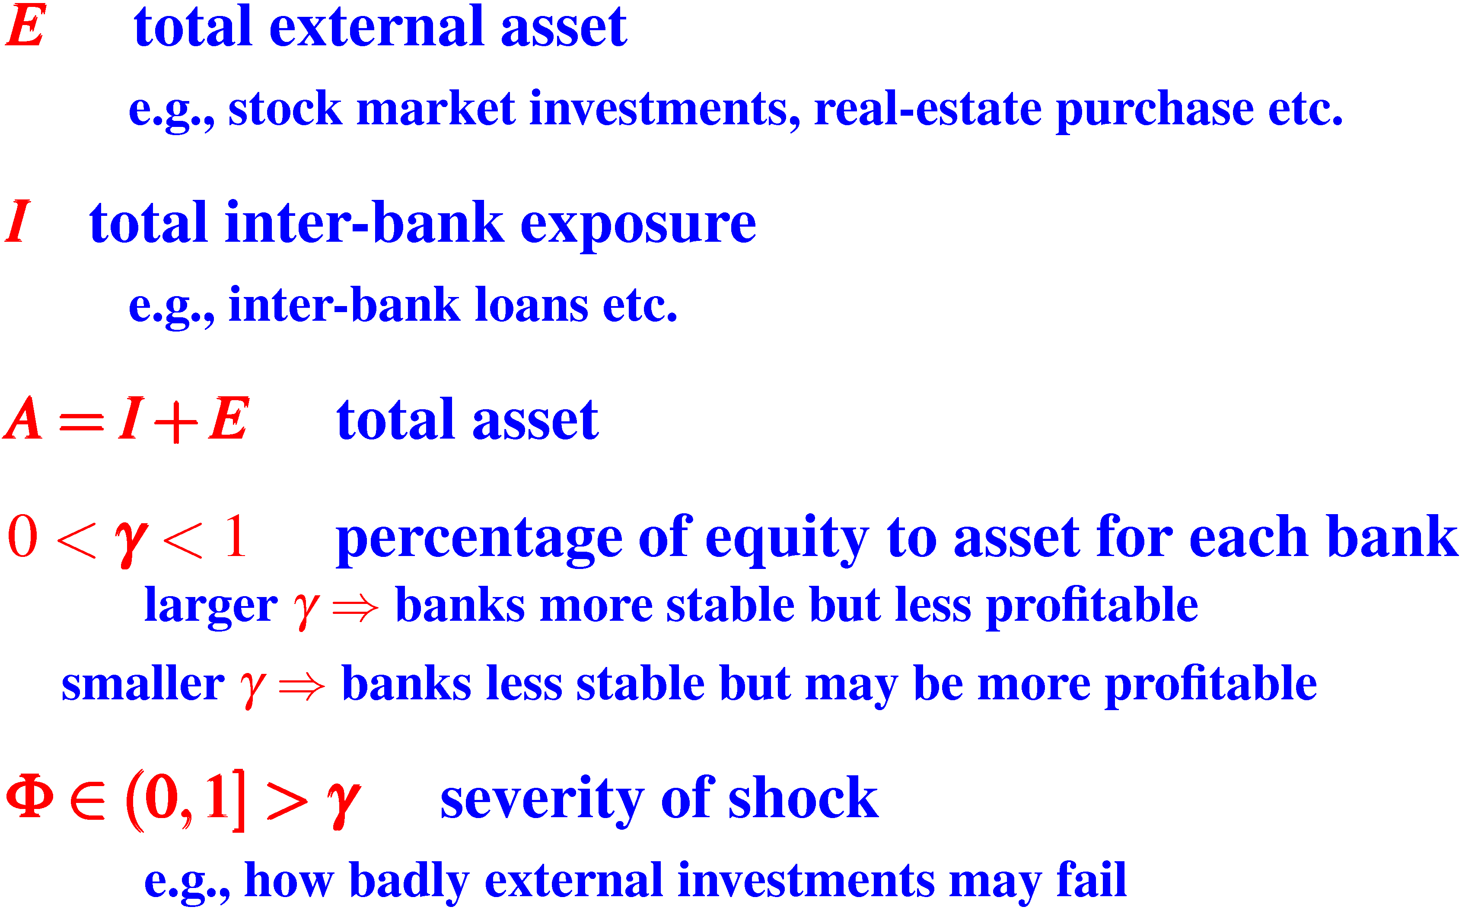
Global parameters for the banking system

Slide 17

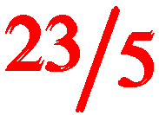
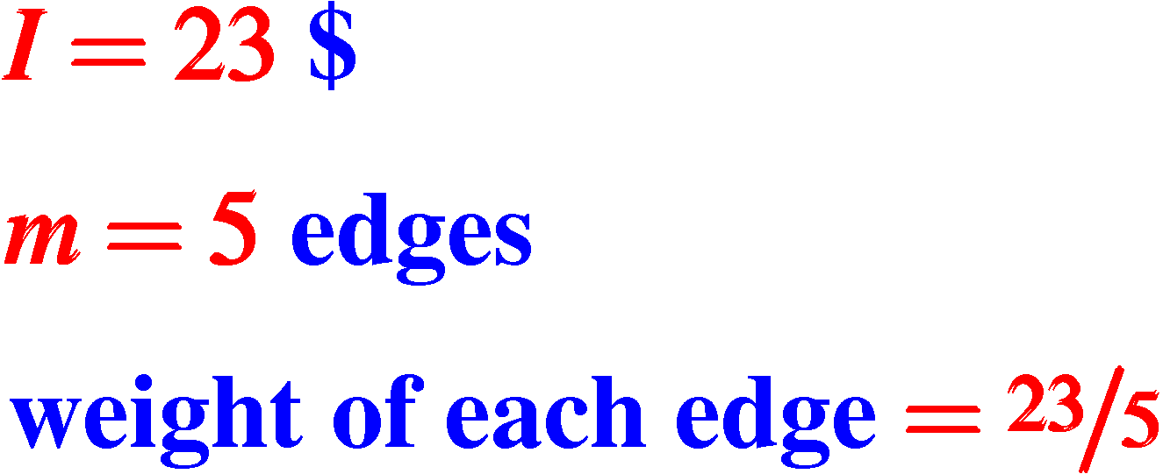
Division of total interbank exposure I
homogeneous model
I is distributed equally over all edges
total internal asset I
number of edges m
each edge

Slide 18
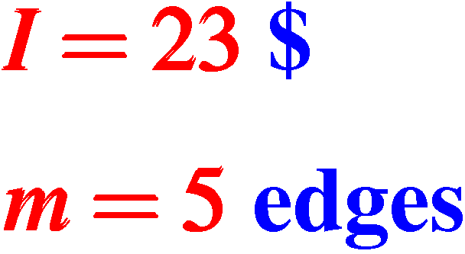
Division of total interbank exposure I
heterogeneous model
I is distributed un-equally over all edges
5
3
10
4
1

Slide 19

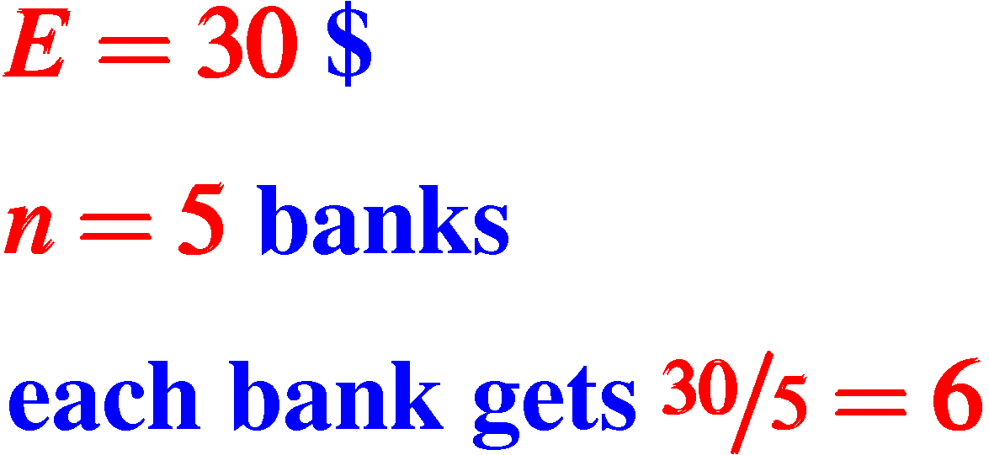
Division of total external asset E
homogeneous model
E is distributed equally over all nodes

Slide 20
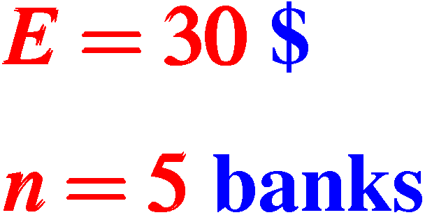
Division of total external asset E
heterogeneous model
E is distributed un-equally over all nodes
too big
to fail??
10
5
3
4
1

Slide 21
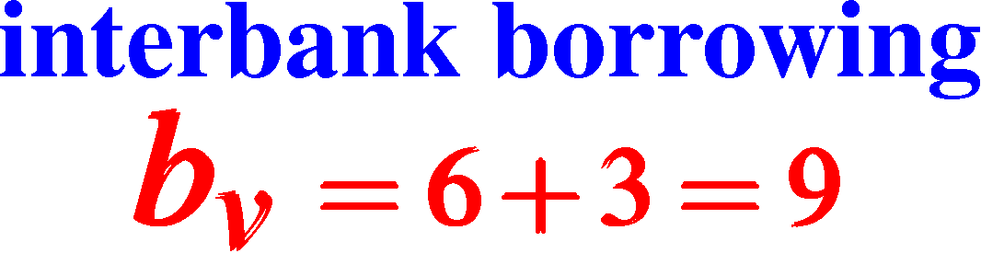
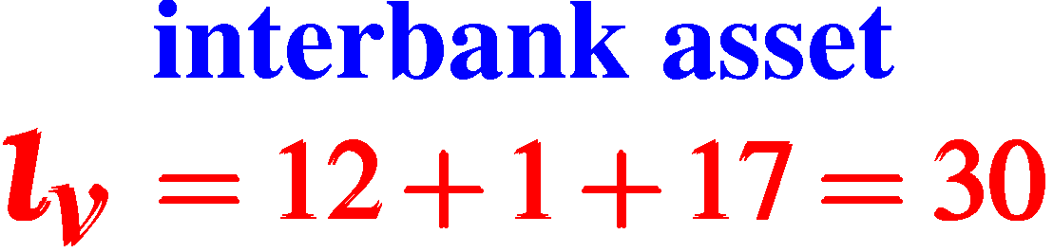
Terminologies from financial accounting
12
6
bank_{v}
v
1
3
17

Slide 22
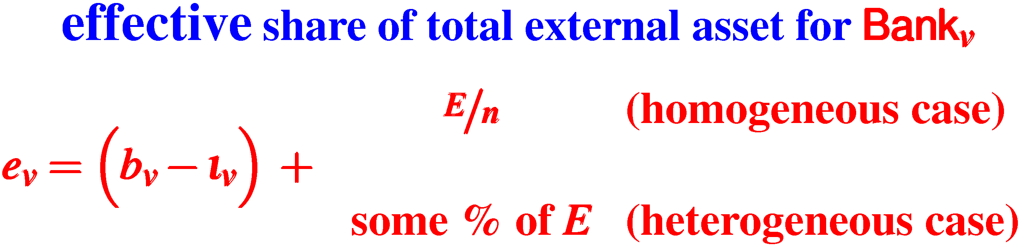
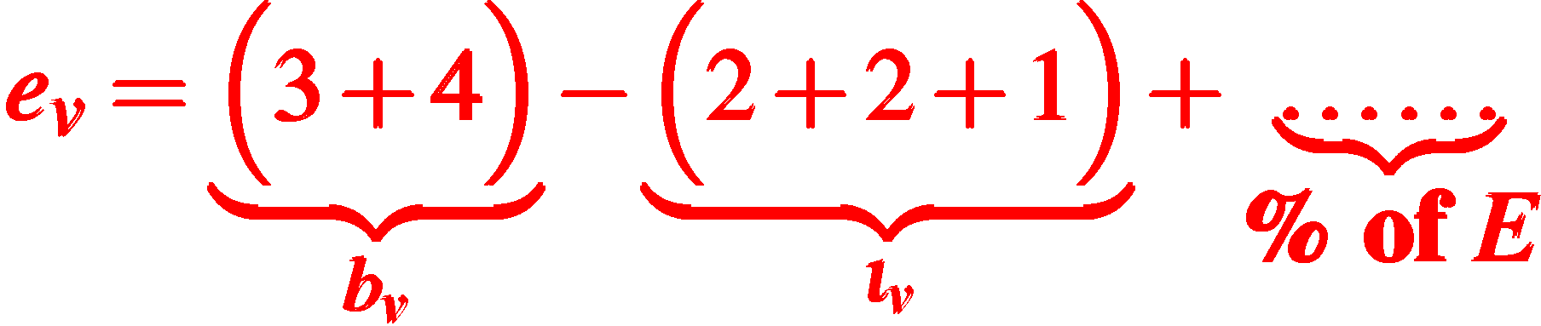
Accounting (continued)
adjusted based on
borrowing and lending
distribution
of E
2
3
bank_{v}
2
4
1

Slide 23
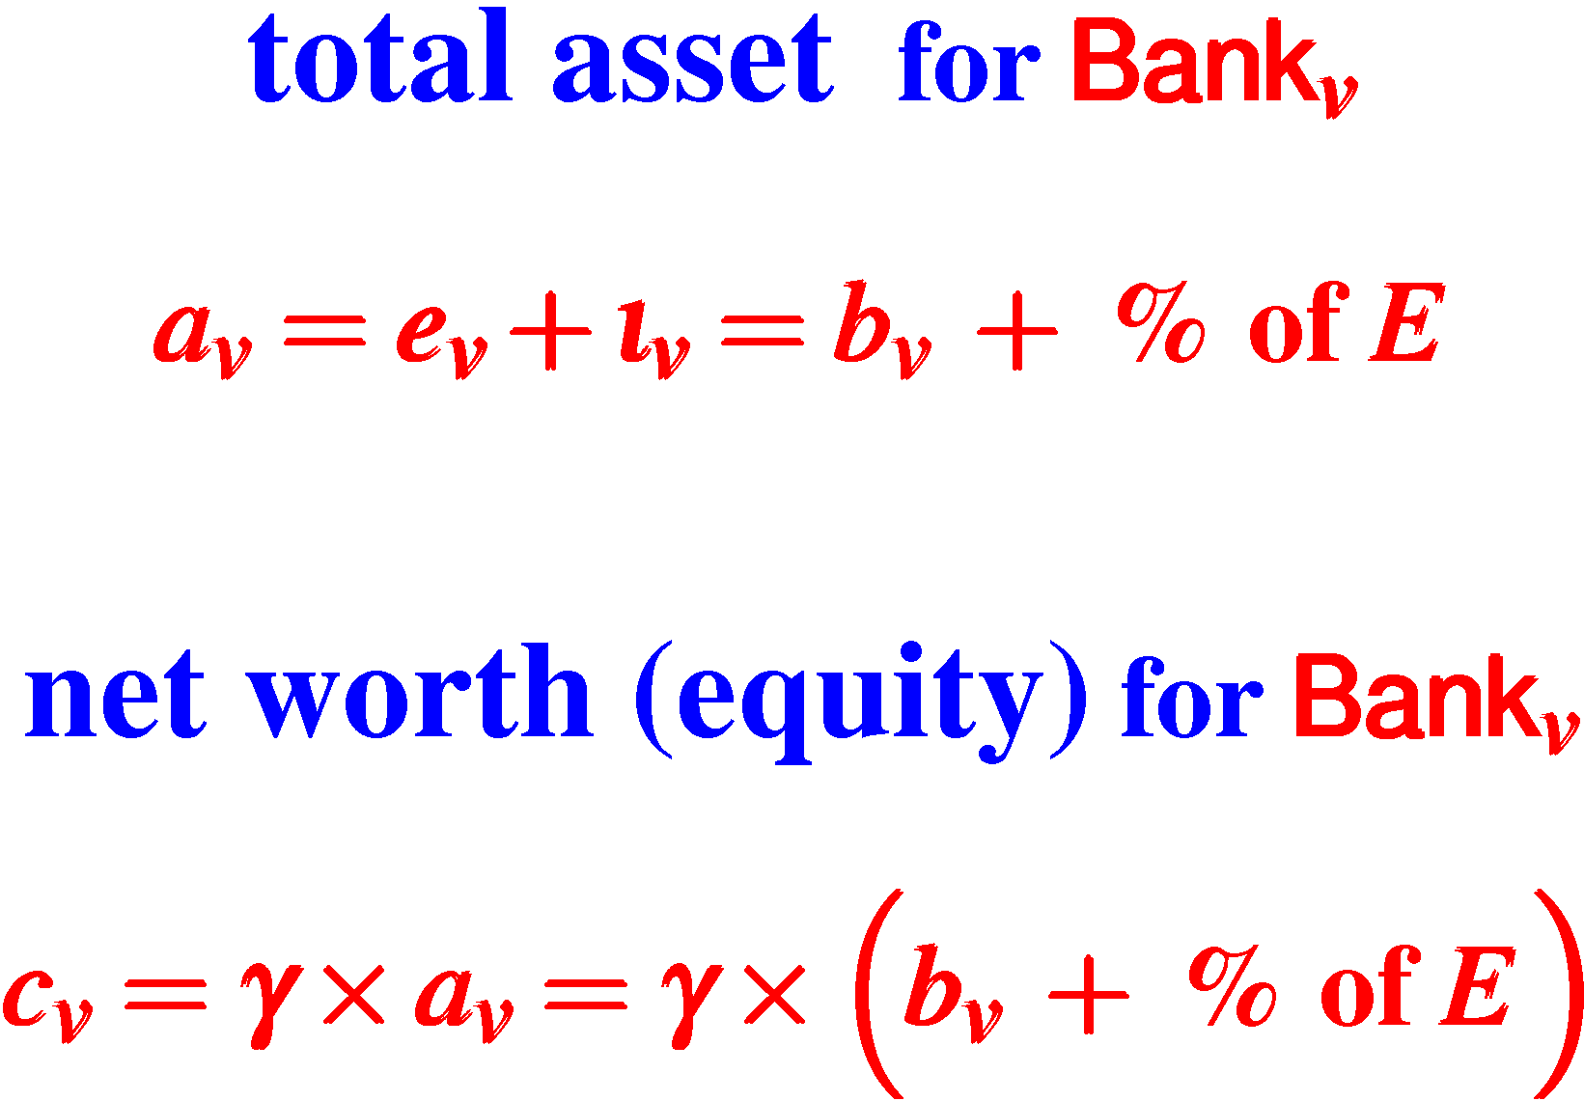
Accounting (continued)
percentage of
equity to asset
0 < γ < 1
higher γ ⇒ more stable bank, less profitable
lower γ ⇒ less stable bank, perhaps more profitable
often, a minimum γ mandated by FEDs

Slide 24
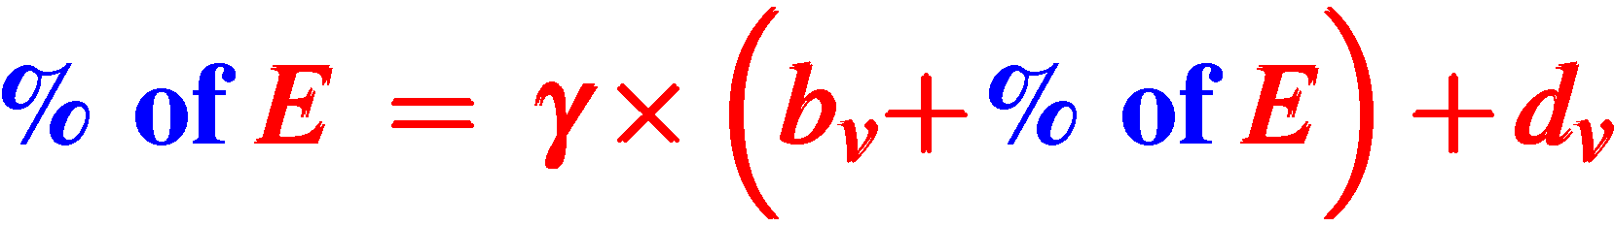
Accounting (continued)
d_{v} = total customer deposit at bank_{v}
Banks maintain balance sheet equation
total liability = total asset

Slide 25
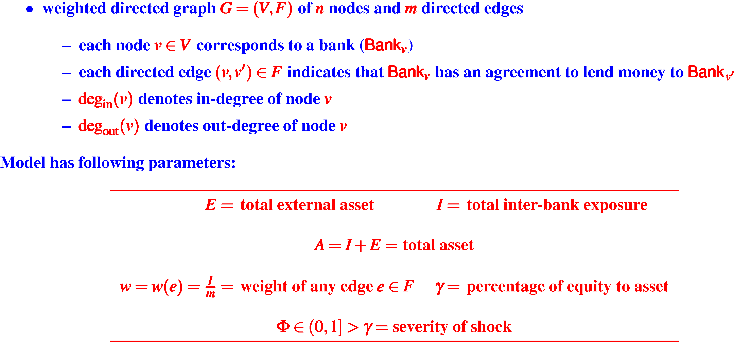
Summary of homogeneous network model and parameters

Slide 26
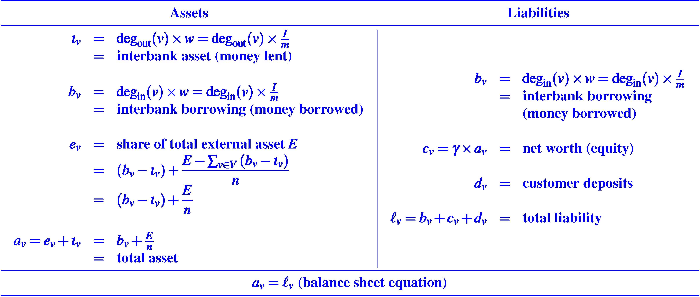
Summary of balance sheet for each node (bank) v for homogeneous model
homogeneous model is thus specified by the 4-tuple < G,γ,β,E >

Slide 27
This model ignores loss of customer deposit if a bank fails
Why?
we are only interested in bank failures, not customer grievances
customer deposits are assumed to be insured
by FDIC or similar agency who has unlimited money
currently, up to $250 K per account holder insured by FDIC (in USA)
additional insurances can be purchased
FDIC often reimburses even if over the limit

Slide 28
Our goal is to estimate the “stability” of a banking network
How?
the so-called “stress test”
give some banks a “shock”
see if some of them fail
see how these failures lead to failures of other banks
Next:
how does stress (“shock”) originate?
how does stress (“shock”) propagate?
precise details
to follow

Slide 29
Initiation of idiosyncratic shock
(Nier, Yang, Yorulmazer and Alentorn, 2008; Eboli, 2004)
initial failures are caused by idiosyncratic shocks which can occur due to operations risks (frauds) or credit risks
has the effect of reducing the external assets of a selected subset of banks perhaps causing them to default
While aggregated or correlated shocks affecting all banks simultaneously is relevant in practice, idiosyncratic shocks are a cleaner way to study the stability of the topology of the banking network

Slide 30
Initiation of idiosyncratic shock of magnitude ϕ
(more formally)
Select a subset of nodes (banks) V_{shock} ⊂ V
For all nodes v ∈ V_{shock} simultaneously decrease their external assets from e_{v} by s_{v} = ϕ e_{v}
parameter 0 < ϕ ≤ 1 determines the “severity” of the shock
If s_{v} ≤ c_{v} bank_{v} continues to operate but with lower external asset
If s_{v} > c_{v} bank_{v} defaults (i.e., stops functioning)
and propagates “shock”
to be
discussed soon

Slide 31



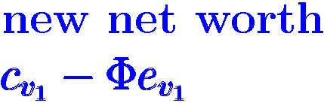







shock
v₃
v₂
v₁
v₇
v₄
shock
v₆
v₅
shock
Pictorial illustration of initiation of idiosynchratic shock

Slide 32
Next obvious question
How do such shocks propagate through the network ?

Slide 33
Shock propagation equations
( time variable t )
Four notational conventions:
c_{v}(t) : c_{v} at time t
V_{alive}(t) : set of not failed nodes (banks) at time t
E_{alive}(t) : edges between nodes in V_{alive}(t)
deg_{in}(v,t) : in-degree of node v at time t (homogeneous)
“weighted” in-degree of node v at time t (heterogeneous)
(failed banks are removed from the network)
time begins at, say, t=0

Slide 34
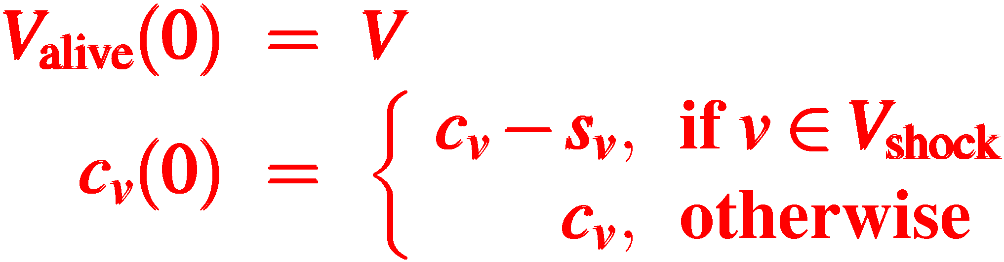
Big bang shock at t=0
banking “universe” starts
all banks
initially alive
net worth for shocked
banks decrease

Slide 35
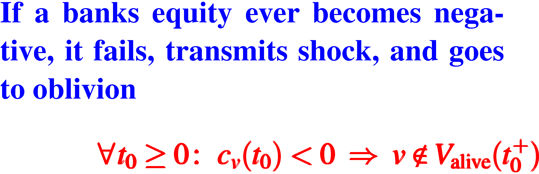
Condition for failure of “components” of universe
(i.e., condition of “bankruptcy” of banks)
control-theoretic notation
t₀⁺ means all time beyond t₀

Slide 36
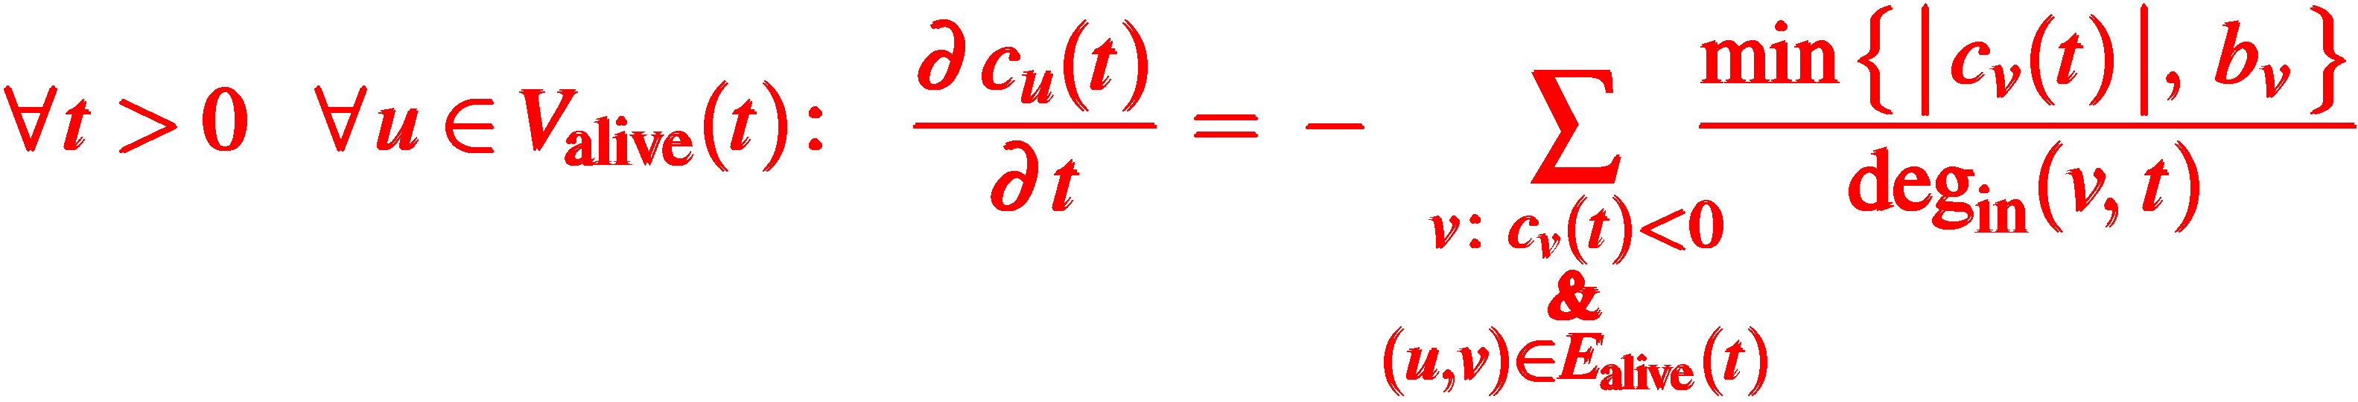
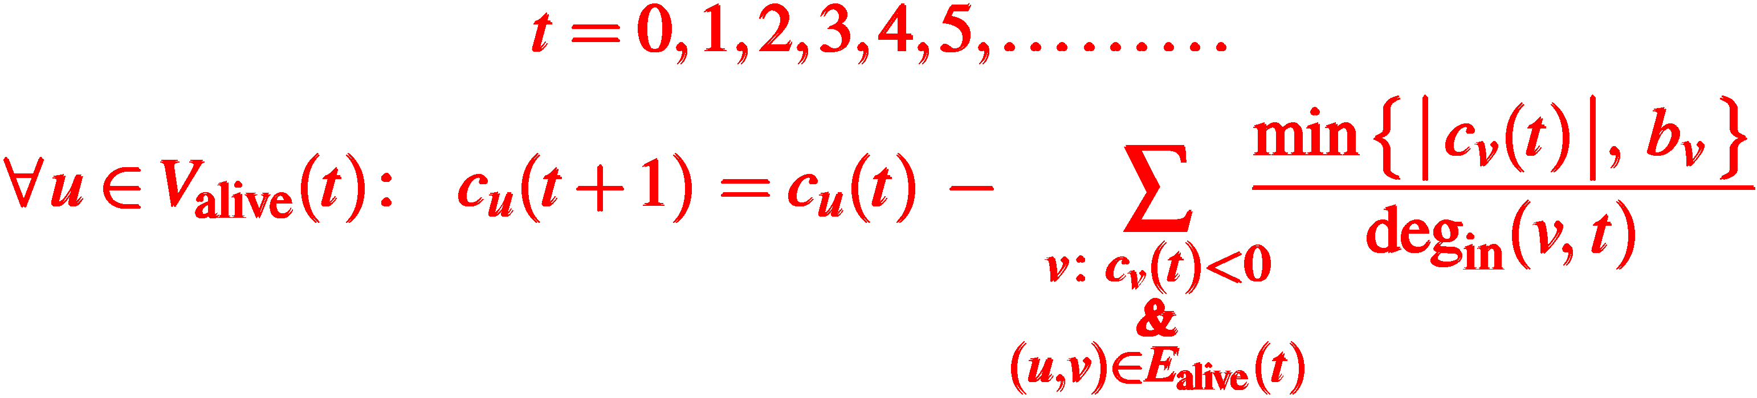
Evolution of “banking universe”
(i.e., shock transmission equation)
continuous time
differential equations
discrete time
difference equations
explanation of equation
on next slide

Slide 37
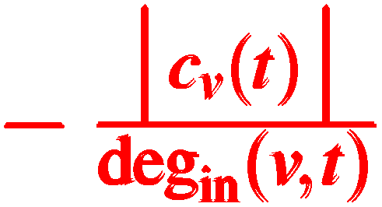

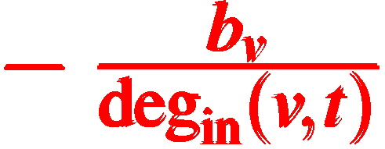
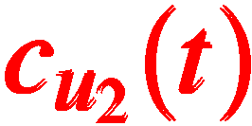
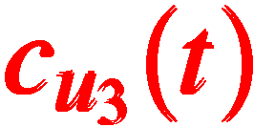
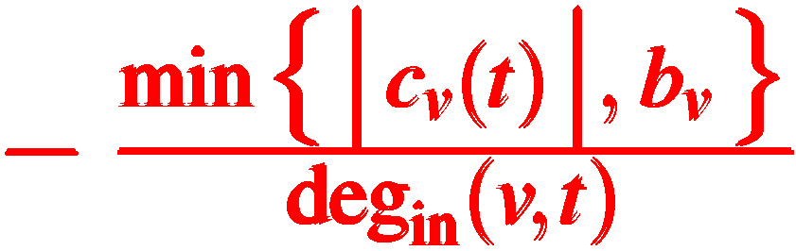
Illustration of the discrete-time shock transmission equation for node v
(from time t to time t+1)
distributed
equitably among
creditors
dead
if I owe
a total of 10 $
I cannot transmit
a total loss of
more than 10 $
alive
u₁
v
deg_{in}(v,t)=3
alive
u₂
u₃
alive
alive
alive
loss

Slide 38
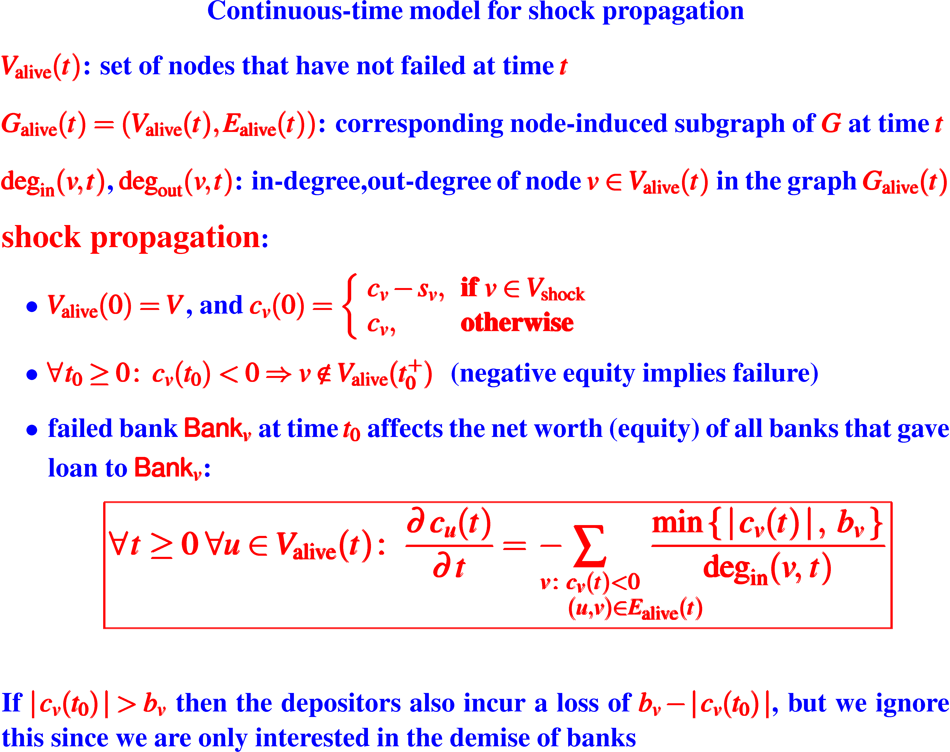

Slide 39
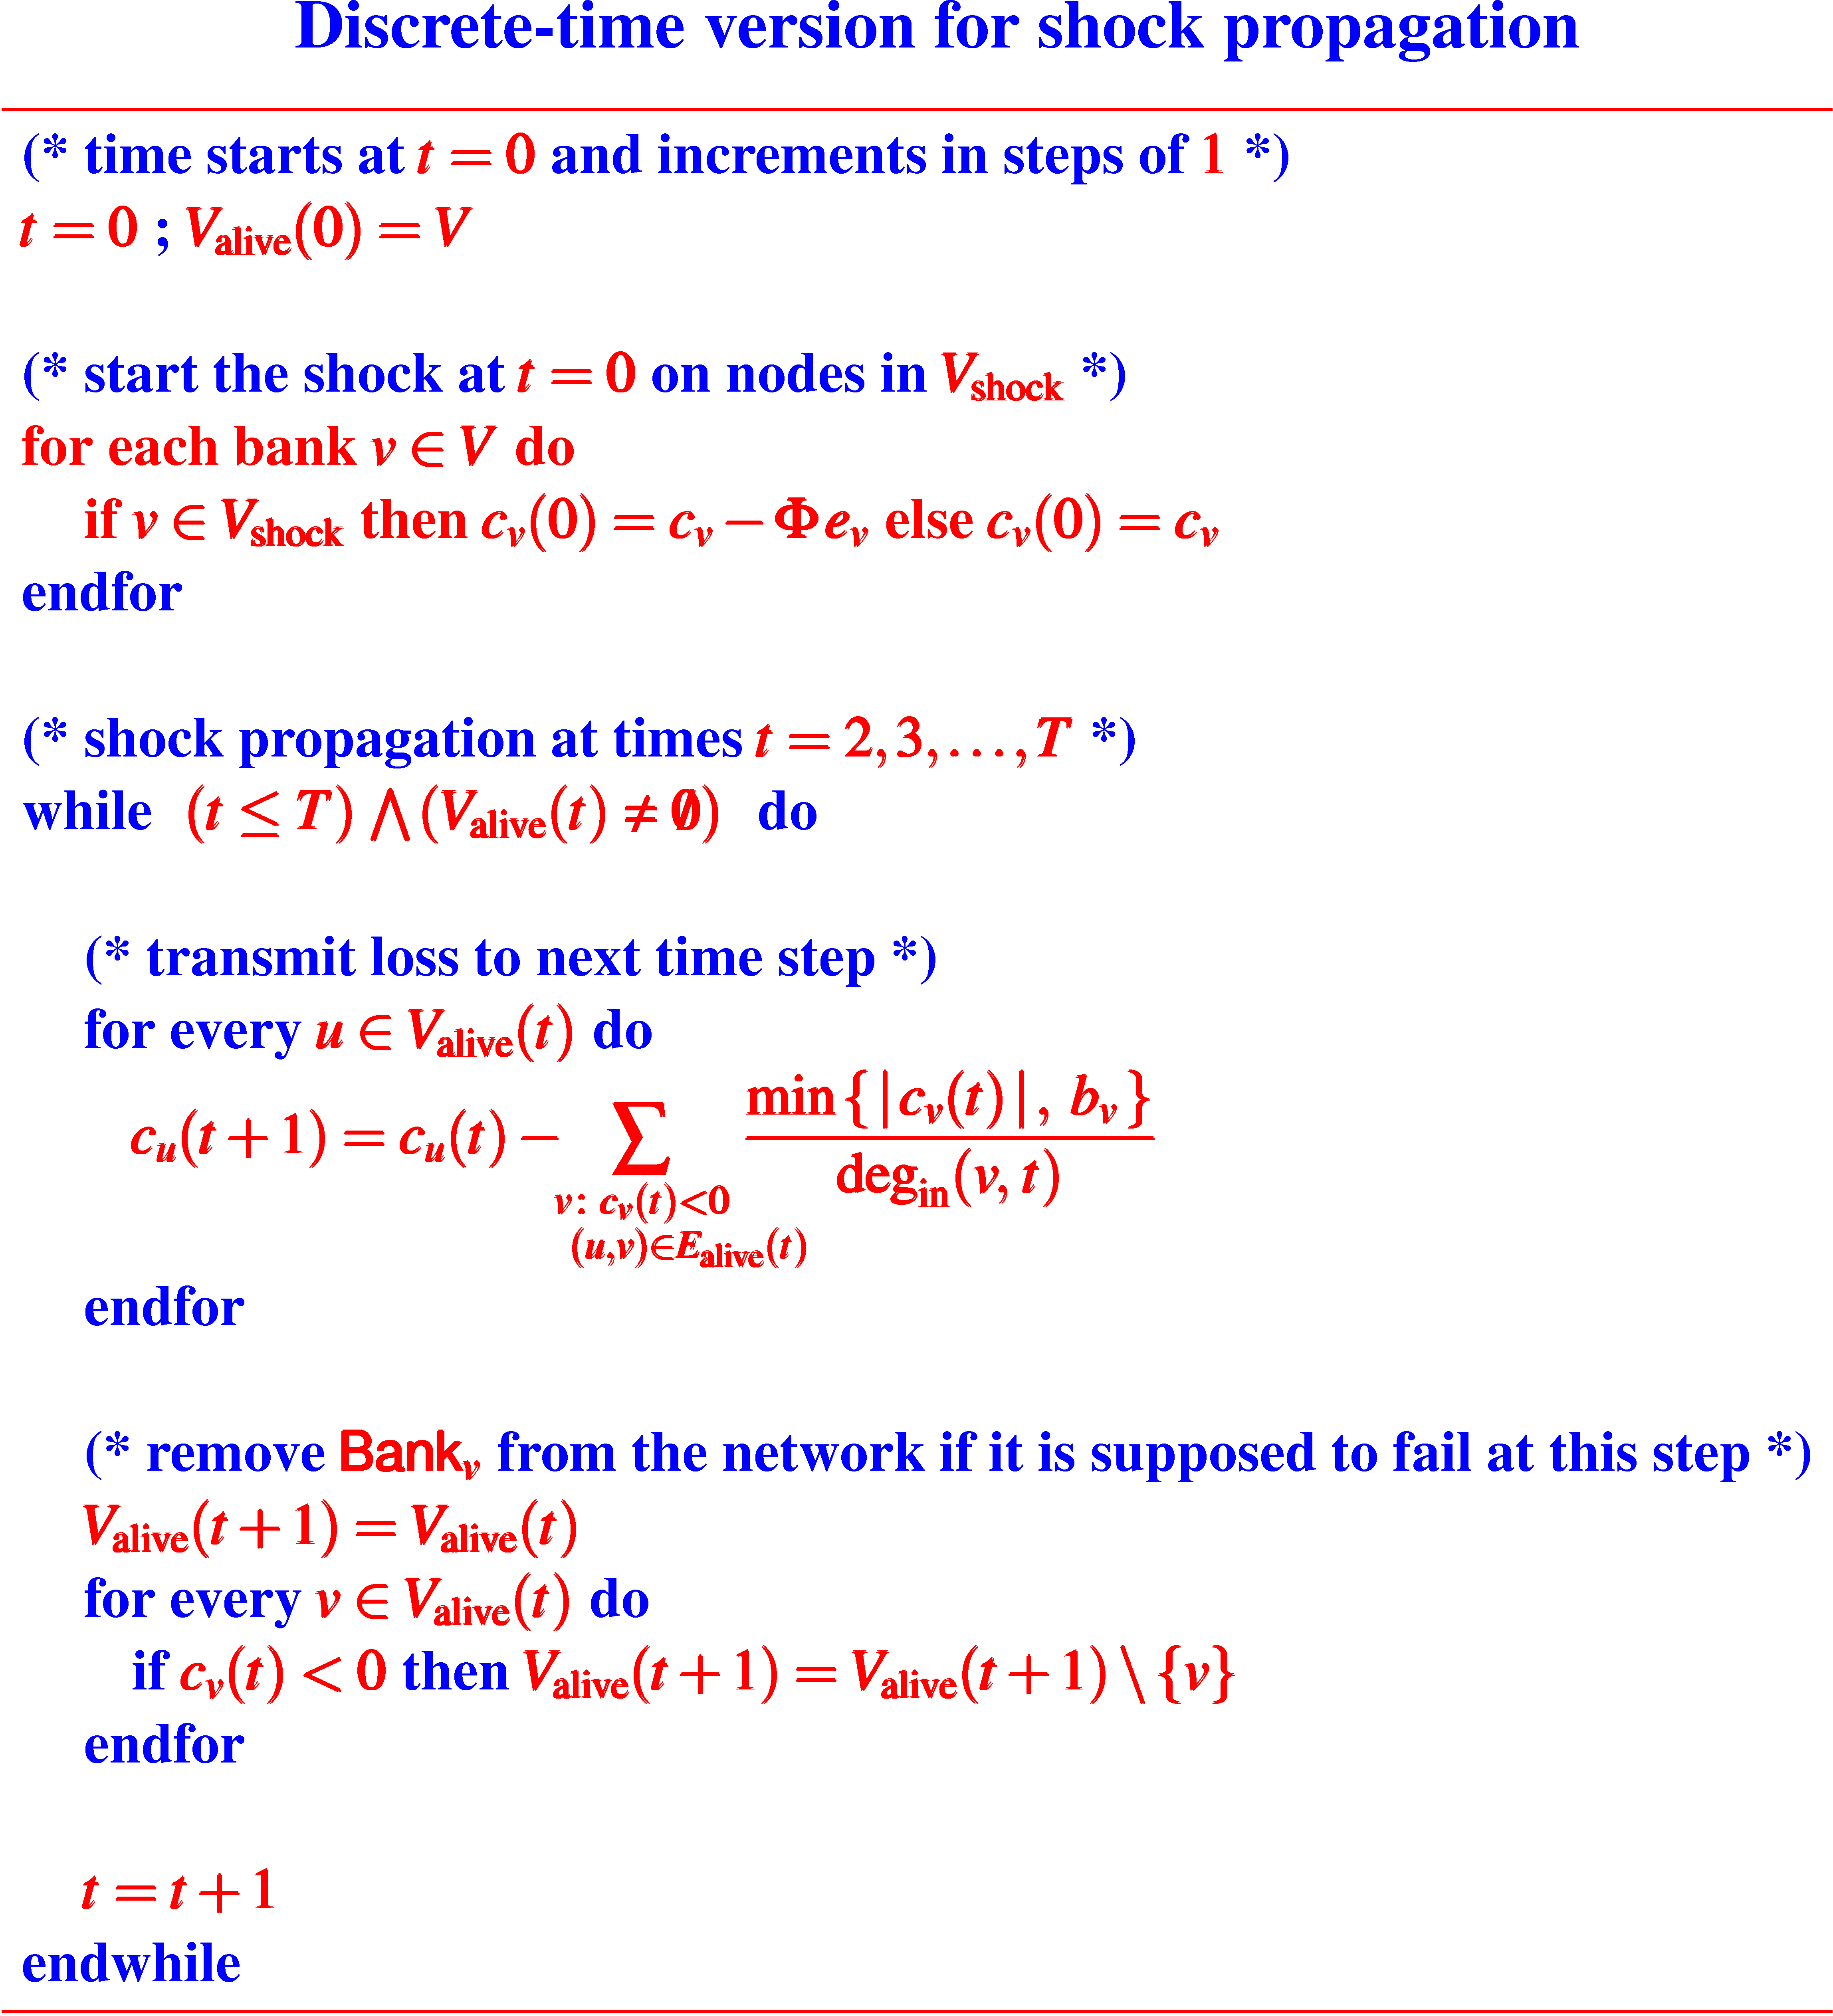
Discrete time 0,1,2,…,T
Differential equation ⇒ Difference equation

Slide 40
Of course, there are many ways one can define stability measure of banking networks
We will consider two such measures

Slide 41
In the field of combinatorial problems, an optimization problem has often its natural “combinatorial dual”
and, they are often well-known and investigated
Minimum set cover problem
objective: select a minimum number of sets
constraint: cover every element
(combinatorial dual)
Maximum κ-coverage problem
objective: cover a maximum number of elements
constraint: select κ sets
hardness of the
two problems are
provably not the same

Slide 42
More examples of “combinatorial dual”
Art Gallery Problems
Given the map of an art gallery
Place a minimum number of guards
Such that the entire area is covered
(combinatorial dual)
Given the map of an art gallery
Place κ guards for given κ
Such that the area covered is maximized

Slide 43
More examples of “combinatorial dual”
Knapsack problems (“thief’s dilemma”)
(Integer) Knapsack
Thief has a knapsack of capacity W
Thief wants to take items such that
they can fit in the knapsack
their total value is maximized
(Dual knapsack problem)
Thief will steal only if it is profitable
total value of items taken ≥ P
What should be the minimum size of his knapsack ?

Slide 44
Stability Index SI*(G,T)
minimum percentage of nodes that need to be shocked to make the entire network fail within time T
99% stability is good
1% stability is not so good
Dual Stability Index DSI*(G,T,κ)
If I am allowed to shock κ nodes, then what is the maximum number of all nodes that I can kill?
useful if the entire network cannot be put to death easily
pictorial illustration
follows next
D for “dual”

Slide 45
SI*(G,T) and DSI*(G,T,κ)
Two types of deaths of a banking network
T=1 Violent death!! Happens too soon.
T>1 Slow poisoning. Slow but steady.

Slide 46
2
shock
0.4
0.8
0.7
2
t = 0
t = 1
shock
1.5
0.8
violent death
0.2
1.8
1.3
0.9
shock
2
1
1
shock
0.7
shock
2
2
equity

Slide 47
2
shock
0.1
0.95
t = 2
0.7
2
t = 1
t = 0
shock
0.25
0.95
1.5
slow poisoning
0.25
0.2
1.8
1.3
0.9
1
1
shock
0.7
shock
2
2

Slide 48
Models for propagation of beneficial or harmful attributes have been investigated in the past in several other contexts:
influence maximization in social networks
e.g., [Kempe, Kleinberg and Tardos, KDD, 2003], [Chen, SODA, 2008], [Chen, Wang and Yang, KDD, 2009], [Borodin, Filmus and Oren, WINE, 2010]
disease spreading in urban networks
e.g. [Eubank, Guclu, Kumar, Marathe, Srinivasan, Toroczkai, and Wang, Nature, 2004], [Coelho, Cruz and Codeço, Source Code for Biology and Medicine, 2008], [Eubank, Japanese Journal of Infectious Diseases, 2005]
percolation models in physics and mathematics
e.g., see the book [Stauffer and Aharony, Introduction to Percolation Theory, 2nd edition, CRC Press, 1994]
However, the model for shock propagation in banking networks is fundamentally very different from all these models
detailed comparison omitted due to lack of time

Slide 49
Our theoretical results (theorems, lemmas etc.)
(proofs are complicated and not discussed)
Theorem:
SI*(G,1) cannot be approximated in polynomial time within a factor of (1 − ε) ln n, for any constant ε >0, unless NP ⊆ DTIME(n^{log log n})
homogeneous network
T=1
violent death
quasi-polynomial time
(class of problems solvable in n^{log log n} time)
reduction is from the dominating set problem for graphs

Slide 50
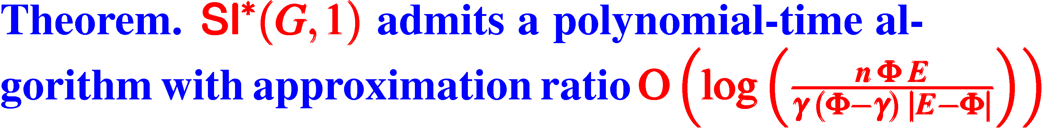
Our theoretical results (theorems, lemmas etc.)
(proofs are complicated and not discussed)
homogeneous network
almost log n
reformulate the problem to that of computing an optimal solution of a
polynomial-size integer linear programming (ILP)
use the greedy approach of [Dobson, 1982] for approximation
careful calculation of the size of the coefficients of the ILP ensures the desired
approximation bound

Slide 51
Our theoretical results (theorems, lemmas etc.)
(proofs are complicated and not discussed)
homogeneous network
(informally)
cannot be approximated too close to optimal
Theorem:
Computing SI*(G, any T>1) is APX-hard even if the banking
network G is a DAG with deg_{in}(v) ≤ 3 and deg_{out}(v) ≤ 2 for
every node v
Directed Acyclic Graph

Slide 52
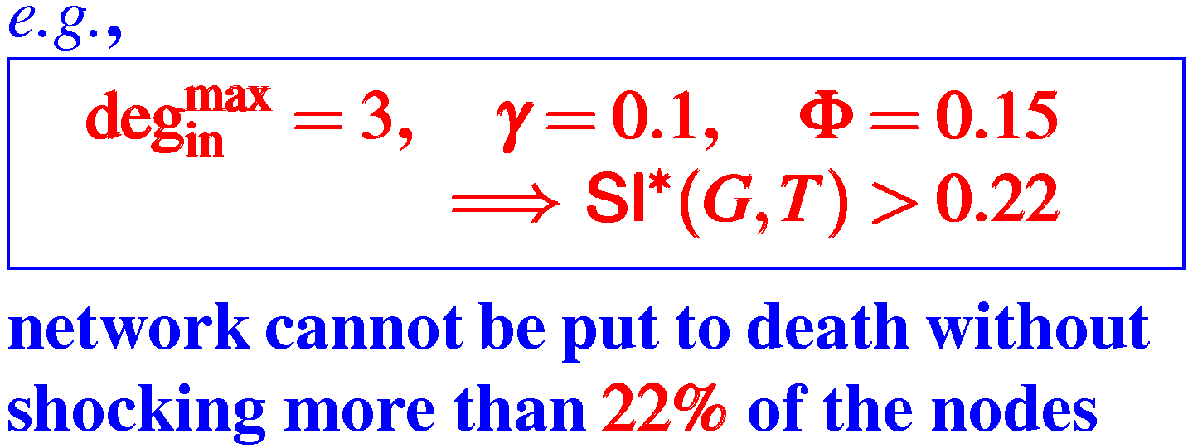
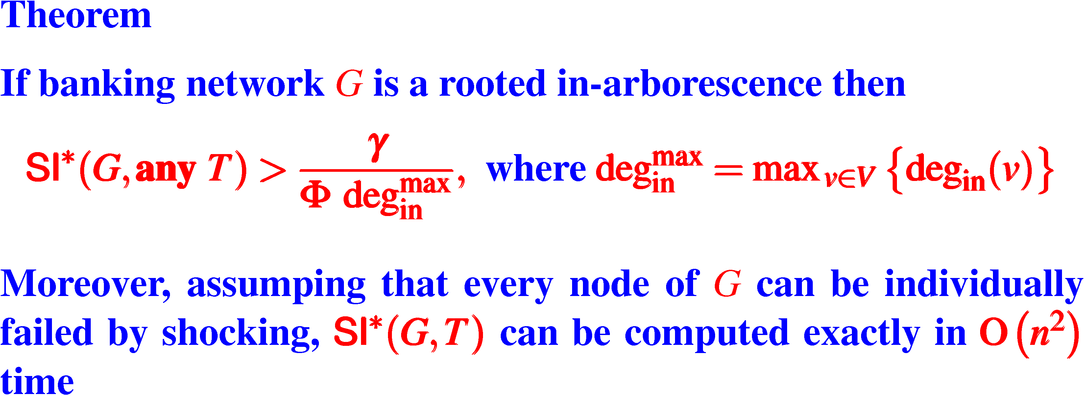
Our theoretical results (theorems, lemmas etc.)
homogeneous network
example
maximum in-degree
of nodes in G

Slide 53
Our theoretical results (theorems, lemmas etc.)
(proofs are complicated and not discussed)
heterogeneous network
notice:
any T>0
Theorem:
SI*(G, any T) cannot be approximated in polynomial time within a factor of (1 − ε) ln n, for any constant ε >0, unless NP ⊆ DTIME(n^{log log n})
quasi-polynomial time
(class of problems solvable in n^{log log n} time)

Slide 54
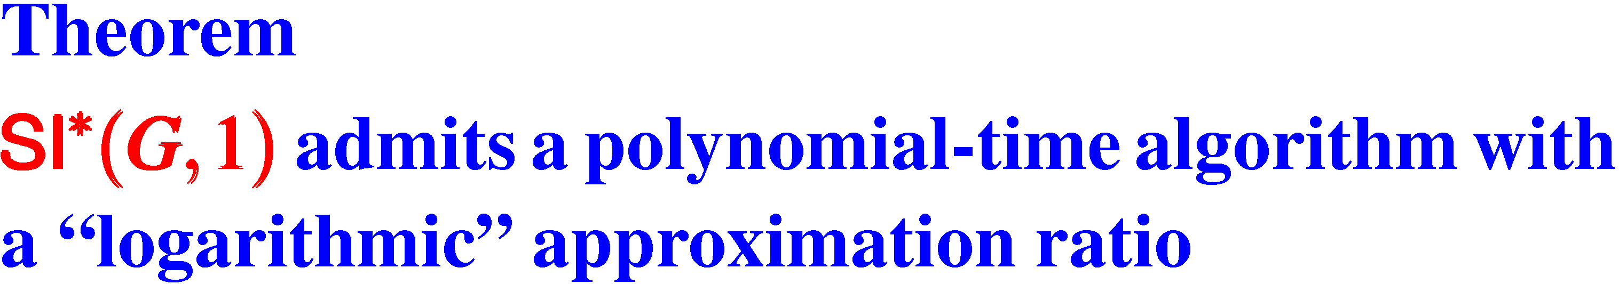
Our theoretical results (theorems, lemmas etc.)
(proofs are complicated and not discussed)
heterogeneous network
logarithmic in relevant parameters
exact details omitted due to lack of time

Slide 55
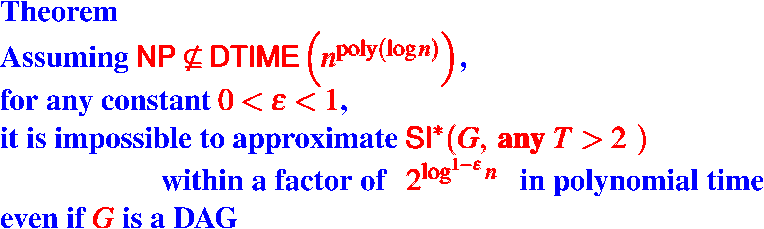
Our theoretical results (theorems, lemmas etc.)
(proofs are complicated and not discussed)
heterogeneous network
proof is highly technical
reduction is from the MINREP problem
MINREP problem can be thought as an abstraction of Raz's parallel repetition theorem
poly (log n) = polynomial in log n
e.g., log³n, log¹⁰n etc.
class of problems solvable in n^{poly(og n)} time
super-poly-logarithmic !!!

Slide 56
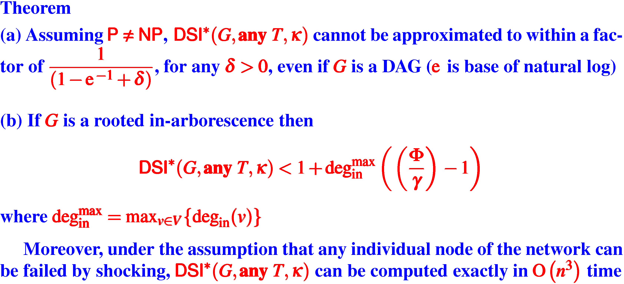
Our theoretical results (theorems, lemmas etc.)
(proofs are complicated and not discussed)
homogeneous network
note: dual stability index
maximum in-degree
of nodes in G

Slide 57
Our theoretical results (theorems, lemmas etc.)
(proofs are complicated and not discussed)
heterogeneous network
Theorem
Under a complexity-theoretic assumption for densest sub-hypergraph problem,
DSI*(G,1,κ) cannot be approximated within a ratio of n^{δ} for some constant δ > 0
even if G is a DAG
note: dual stability index

Slide 58
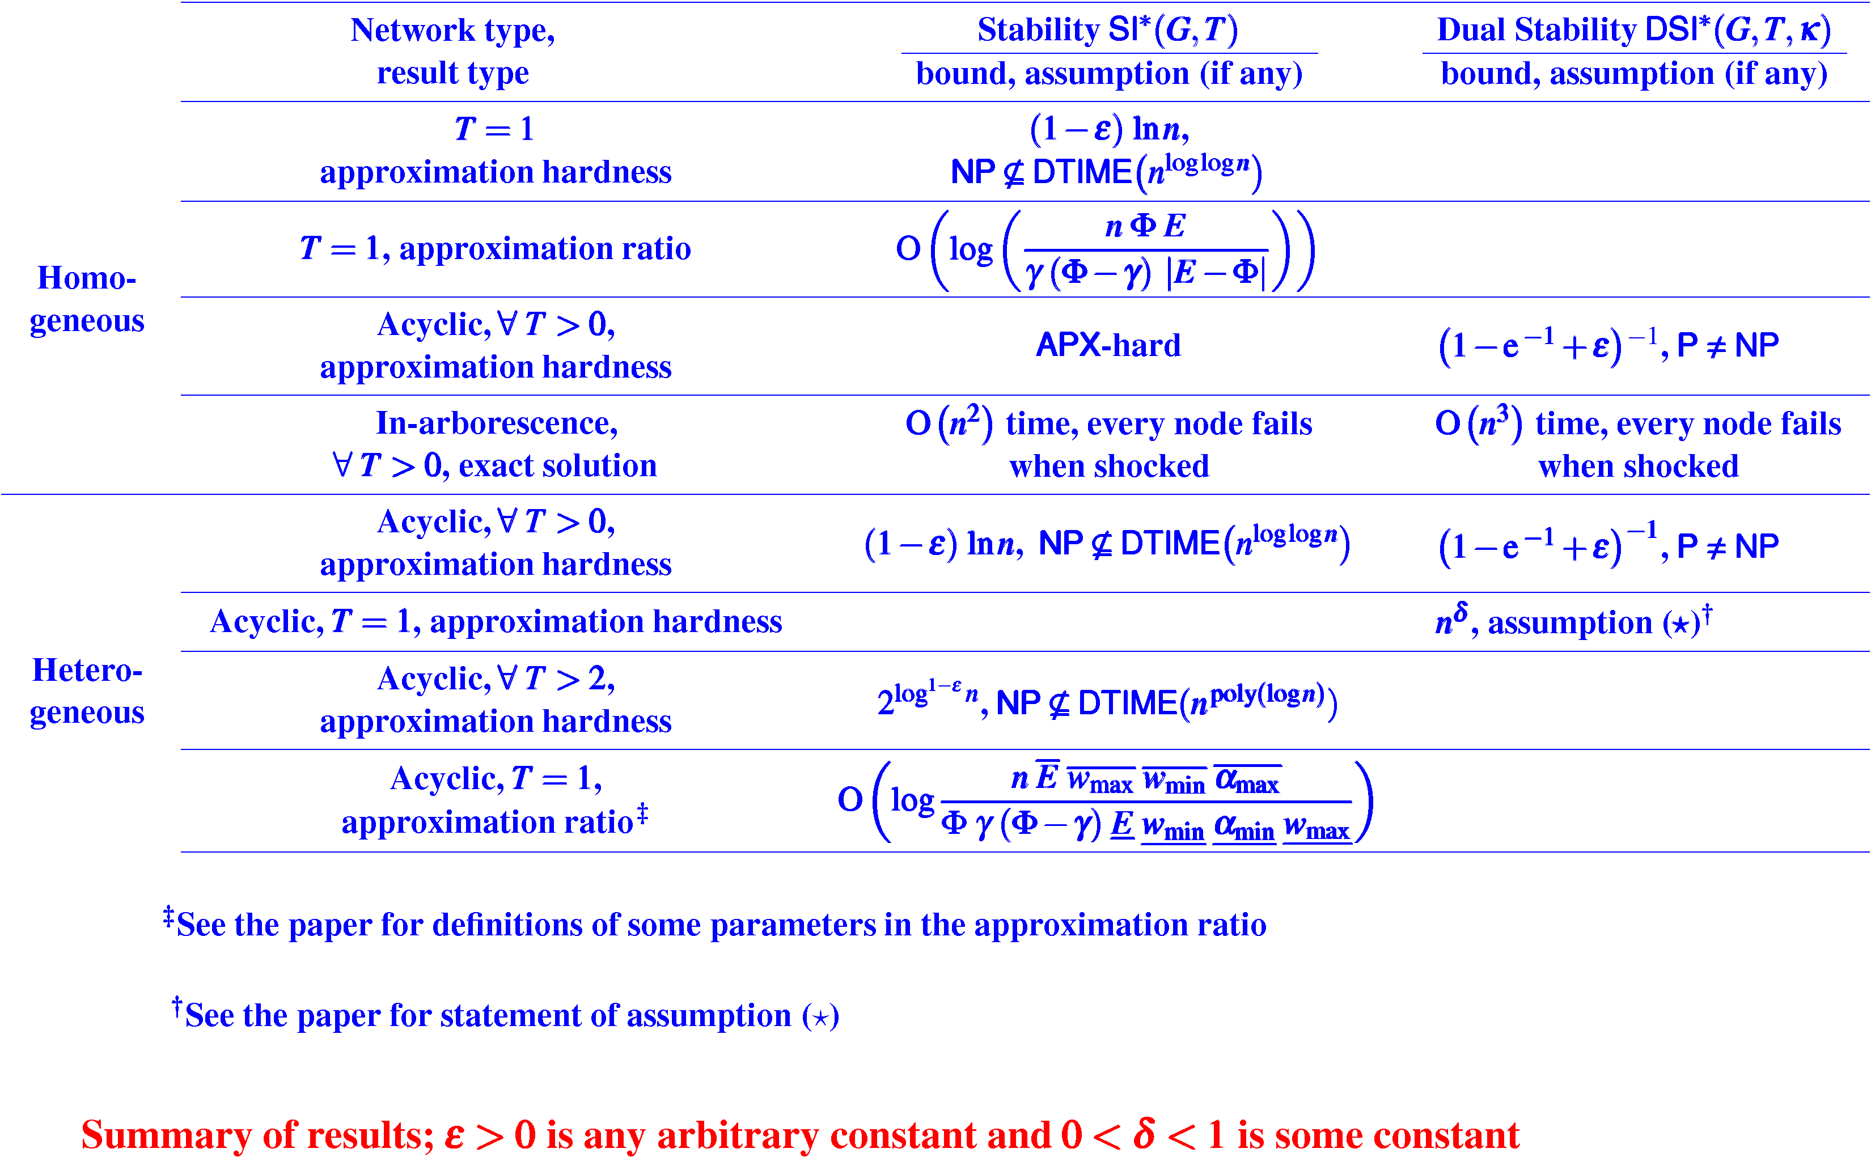

Slide 59
Some observations based on our current results and their proofs

Slide 60
Are banking networks inherently unstable?
No, if the networks are more like small-degree in-arborescence
Otherwise, could be, even if there are no cyclical dependencies

Slide 61
Observation based on our proofs
It seems instability arises if many banks have a borrowing chain from the same bank
“in-phase’ shocks
may amplify

Slide 62
Observation based on our proofs
Larger is the ratio
it is more likely that the network is more stable

Slide 63
Observation based on our proofs
Network is likely to be more stable if all banks have roughly the same external assets

Slide 64
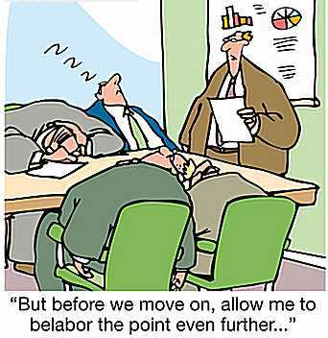

Thank you for your attention!
Questions?
64
Notes:
64

