Slide 1
Primer Selection Methods for Detection of Genomic Inversions and Deletions via PAMP
Bhaskar DasGupta,
University of Illinois at Chicago
Jin Jun, and Ion Mandoiu
University of Connecticut

Slide 2
Outline
Introduction
Anchored Deletion Detection
Inversion Detection
Conclusions

Slide 3
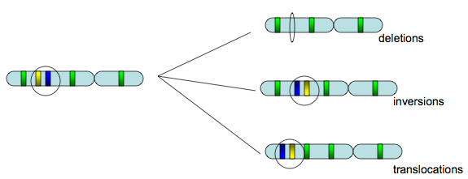
Genomic Structural Variation
Deletions
Inversions
Translocations, insertions, fissions, fussions…
Notes:
Due to technical difficulties in detecting smaller deletions, tumor heterogeneity, and
the necessity to purify cancer cells from normal cells, which was done by time consuming and labor
intensive genetics and molecular cloning on established cancer cell lines

Slide 4
Primer Approximation Multiplex PCR (PAMP)
Introduced by [Liu&Carson 2007]
Experimental technique for detecting large-scale cancer genome lesions such as inversions and deletions from heterogeneous samples containing a mixture of cancer and normal cells
Can be used for
  Tracking how genetic breakpoints are generated during cancer development
  Monitoring the status of cancer progression with a highly sensitive assays

Slide 5
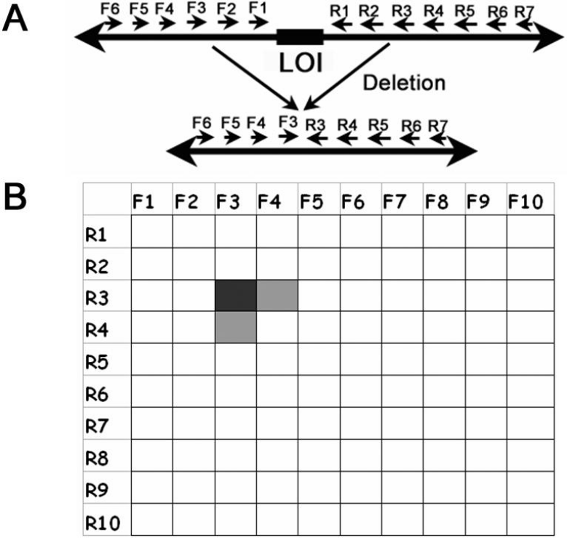
PAMP details
A. Large number of multiplex PCR primers selected s.t.
  There is no PCR amplification in the absence of genomic lesions
  A genomic lesion brings one or more pairs of primers in the proximity of each other with high probability, resulting in PCR amplification
B. Amplification products are hybridized to a microarray to identify the pair(s) of primers that yield amplification
Liu&Carson 2007

Slide 6
Outline
Introduction
Anchored Deletion Detection
Inversion Detection
Conclusions

Slide 7
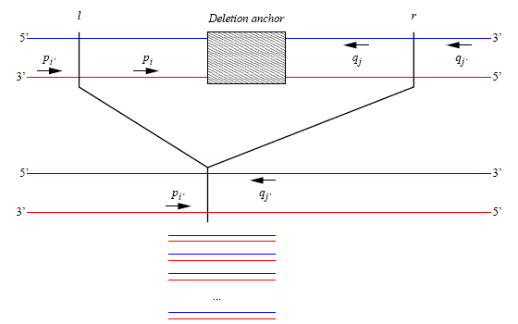
Anchored Deletion Detection
Assume that the deletion spans a known genomic location (anchored deletions)
[Bashir et al. 2007] proposed ILP formulations and simulated annealing algorithms for PAMP primer selection for anchored deletions
Notes:
→ Multiplex PCR primer selection problem

Slide 8
Criteria for Primer Selection
Standard criteria for multiplex PCR primer selection
  Melting temperature, T_{m}
  Lack of hairpin secondary structure, and
  No dimerization between pairs of primers
    Single pair of dimerizing primers is sufficient to negate the amplification [Bashir et al. 2007]
Notes:
Constraints → optimization

Slide 9
Optimization Objective
Multiplex PCR primer set selection
  Minimize number of primers and/or multiplex PCR reactions needed to amplify a given set of discrete amplification targets
PAMP primer set selection
  Minimize the probability that an unknown genomic lesion fails to be detected by the assay
Notes:
PAMP can use max # primers i.e. multiplex degree as constraint
→ Probabilistic model is needed

Slide 10
PCR Amplification Efficiency Model
Exponential decay in amplification efficiency above a certain product length
PCR amplification
success
probability
1
0
L
Distance between
two primers
0-1 Step model (used in our simulations)
PCR amplification
success
probability
1
0
L
L+1
Distance between
two primers

Slide 11
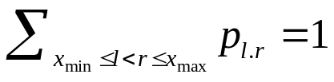
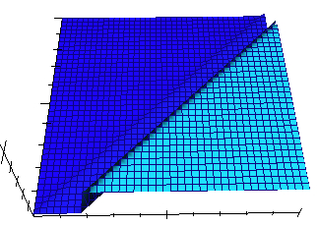
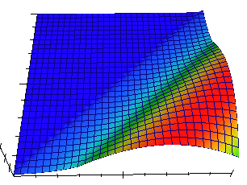
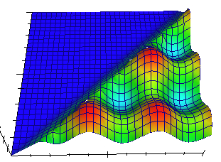
Probabilistic Models for Lesion Location
p_{l,r}: probability of having a lesion with endpoints, l and r
  where
Simple model: uniform distribution
  p_{l,r}=h if r-l>D, 0 otherwise
Function of distance
  p_{l,r}=f(r-l)
  e.g. a peak at r-l=d
Function of hotspots
  High probability around
  hotspots
  e.g. two (pairs of) hotspots
l
l
h
x_{min}
r
x_{max}
r-l=d
D
l
r
Hot-
spots
r
Hotspots

Slide 12
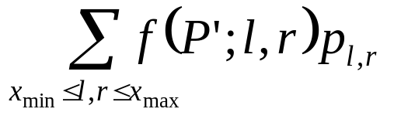
PAMP Primer Selection Problem for Anchored Deletion Detection (PAMP-DEL)
Given:
  Sets of forward and reverse candidate primers, {p₁,p₂,…,p_{m}} and {q₁,q₂,…,q_{n}}
  Set E of primer pairs that form dimers
  Maximum multiplexing degrees N_{f} and N_{r}, and amplification length upper-bound L
Find: Subset P’ of at most N_{f} forward and at most N_{r} reverse primers such that
  P’ does not include any pair of primers in E
  P’ minimizes the failure probability
    where f(P’;l,r) = 1 if P’ fails to yield a PCR product when the deletion with endpoints (l,r) is present in the sample, and f(P’;l,r) = 0 otherwise.

Slide 13
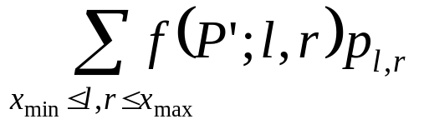
ILP Formulation for PAMP-DEL
r
(l-1-x_{i’} )+(y_{j’} -r-1) = L
y_{j’}
Deletion
anchor
x_{i’}
l₁
r₁
y_{j’}
f(P’;l,r)=1
5’
3’
r₁
p_{i’}
p_{i}
q_{j}
q_{j’}
3’
5’
y_{j}
(l₁-1-x_{i’} )+(y_{j’} -r₁-1) > L
Failure
l
x_{i’}
x_{i}
l₁
Notes:
Right -> left explanation
Explain xi and yi

Slide 14
ILP Formulation for PAMP-DEL
r
(l-1-x_{i’} )+(y_{j’} -r-1) = L
y_{j’}
Deletion
anchor
r₂
x_{i’}
l₂
r₂
y_{j’}
f(P’;l,r)=0
5’
3’
p_{i’}
p_{i}
q_{j}
q_{j’}
3’
5’
y_{j}
(l₂-1-x_{i’} )+(y_{j’} -r₂-1) ≤ L
Success
l
x_{i’}
l₂
x_{i}
0/1 variables
  f_{i} (r_{i}) to indicate when p_{i} (respectively q_{i}) is selected in P’,
  f_{i,j} (r_{i,j}) to indicate that p_{i} and p_{j} (respectively q_{i} and q_{j}) are consecutive primers in P’,
  e_{i,i‘,j,j‘} to indicate that both (p_{i}, p_{i’}) and (q_{j}, q_{j’}) are pairs of are consecutive primers in P’

Slide 15
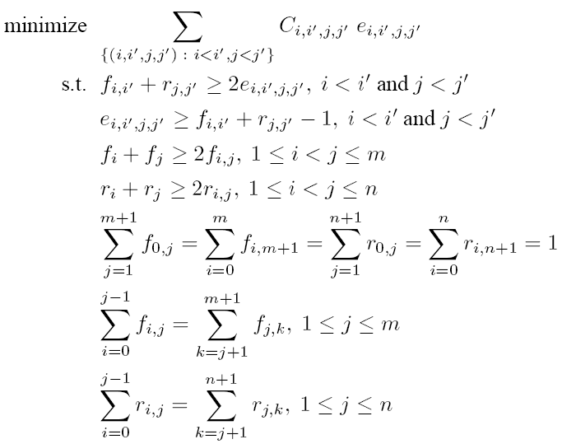
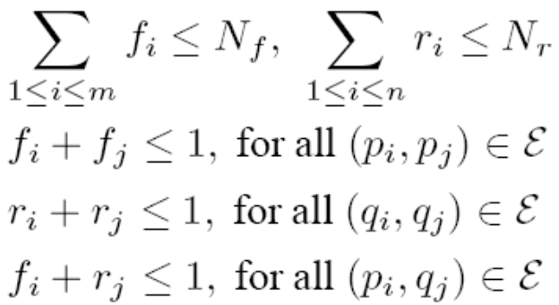
ILP Formulation for PAMP-DEL (2)
Failure probability
f_{0,i}
f_{i,j}
f_{j,k}
f_{i,m+1}
. . .
. . .
p₀
p_{i}
p_{j}
p_{k}
p_{m+1}
Compatibility constraints
:
:
:
:
Max. multiplex degree
constraints
No dimerization
constraints
Path connecting constraints
Notes:
PAMP-DEL ILP cannot solve the mid-sized problem instance.
→ PAMP-1SDEL introduced

Slide 16
PAMP-1SDEL
One-sided version of PAMP-DEL in which one of the deletion endpoints is known in advance
  Introduced by [Bhasir et al. 2007]
Assume we know the left deletion endpoint
  Let x₁<x₂<…<x_{n} be the hybridization positions for the reverse candidate primers q₁,…, q_{n}
C_{i,j}: probability that a deletion whose right endpoint falls between x_{i} and x_{j} does not result in PCR amplification
r_{i}, r_{i,j}: 0/1 decision variables similar to those in PAMP-DEL ILP

Slide 17
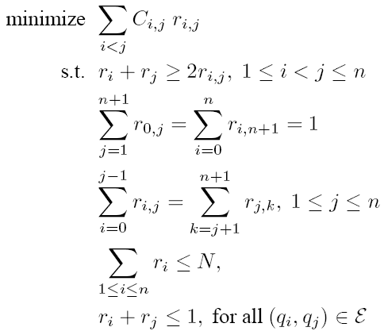
PAMP-1SDEL ILP

Slide 18
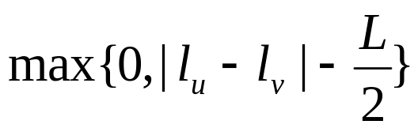
Comparison to Bashir et al. Formulation
PAMP-DEL formulation in Bashir et al.
  Each primer responsible for covering L/2 bases
  Covered area by adjacent primers u, v:
dimerization
0
L
2L
2.5L
3L
Forward primers
l₁
l₂
Unconvered
area
Failure
prob.
1/2
0
Forward primers + l₁
L/2
Forward primers + l₂
L/2

Slide 19
Approximation Analysis
Lemma 1. Assuming the UNIQUE GAMES conjecture, PAMP-1SDEL (and hence, PAMP-DEL) cannot be approximated to within a factor of 2-ε for any constant ε>0.
Proof
  By reducing the vertex cover problem to PAMP-1SDEL
Lemma 2. There is a 2-approximation algorithm for the special case of PAMP-1SDEL in which candidate primers are spaced at least L bases apart and the deletion endpoint is distributed uniformly within a fixed interval (x_{min}, x_{max}].
Notes:
→ However PAMP-1SDEL can be solved for practical sized problem instances in reasonable time, actually very fast

Slide 20
PAMP-DEL Heuristics
ITERATIVE-1SDEL
  Iteratively solve PAMP-1SDEL with fixed primers from previous PAMP-1SDEL
  Fixed N_{f} (N_{r}) at each step
INCREMENTAL-1SDEL
  ITERATIVE-1SDEL but with incremental multiplexing degrees
    E.g. k/2k·N_{f}, (k+1)/2k·N_{f}, … , N_{f}
      where k is the number of steps
Notes:
→
In early stage, one side ILP could select primers biased to that side.
Also if large number of primers were selected in the early stage, there could be higher chance of getting dimerization with them.
This could lead oscillation of # selected primers between two sides.
→ Compare these 3 algorithms

Slide 21
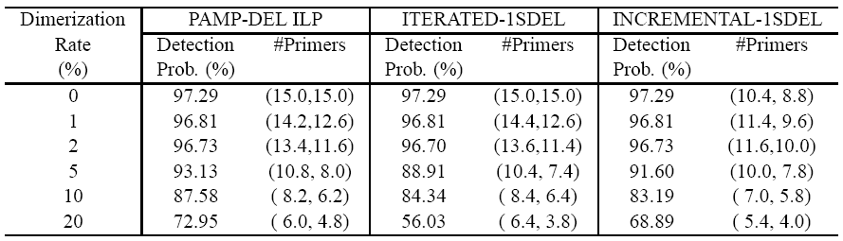
Comparison of PAMP-DEL Heuristics
m=n=N_{f}=N_{r}=15, x_{max}-x_{min}=5Kb, L=2Kb, 5 random instances
PAMP-DEL ILP can handle only very small problem
Both ITERATED-1SDEL and INCREMENTAL-1SDEL solutions are very close to optimal for low dimerization rates
For larger dimerization rates INCREMENTAL-1SDEL detection probability is still close to optimal
Notes:
Instance size is 2*5Kb
Position based simulation.
Why 100% by locating each primer in each L/2 → positions of primers

Slide 22
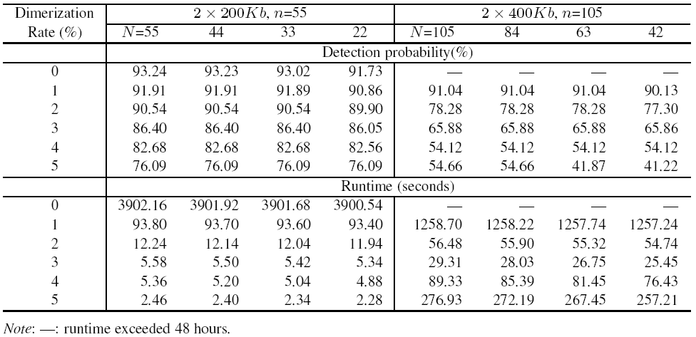
INCREMENTAL-1SDEL Scalability
L=20Kb, 5 random instances

Slide 23
Outline
Introduction
Anchored Deletion Detection
Inversion Detection
Conclusions

Slide 24
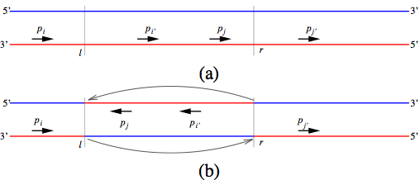
Inversion Detection
Notes:
Need to replace with high resolution diagram

Slide 25
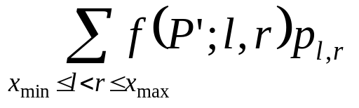
PAMP Primer Selection Problem for Inversion Detection (PAMP-INV)
Given:
  Set P of candidate primers
  Set E of dimerizing candidate primer pairs
  Maximum multiplexing degree N and amplification length upper-bound L
Find: a subset P’ of P such that
  |P’| ≤ N
  P’ does not include any pair of primers in E
  P’ minimizes the failure probability
    where f(P’;l,r)=1 if P’ fails to yield a PCR product when the inversion with endpoints (l,r) is present in the sample, and f(P’;l,r)=0 otherwise.

Slide 26
ILP Formulation for PAMP-INV
r
x_{i}
l
x_{j}
r
f(P';l',r')=1
5’
3’
x_{j’}
p_{i}
p_{i’}
p_{j}
p_{j’}
3’
5’
r
f(P';l,r)=0
x_{j}
5’
3’
(l-1-x_{i})+(r-x_{j}) = L
p_{i}
p_{j}
p_{i’}
p_{j’}
3’
5’
l
x_{i}
l
x_{i’}
(l-1-x_{i} )+(r-x_{j}) ≤ L
Success
0/1 variables
  e_{i} =1 iff p_{i} is selected in P’,
  e_{i,j} =1 iff p_{i} and p_{j} are consecutive primers in P’,
  e_{i,i‘,j,j‘} =1 iff (p_{i}, p_{i’}) and (p_{j}, p_{j’}) are pairs of are consecutive primers in P’

Slide 27
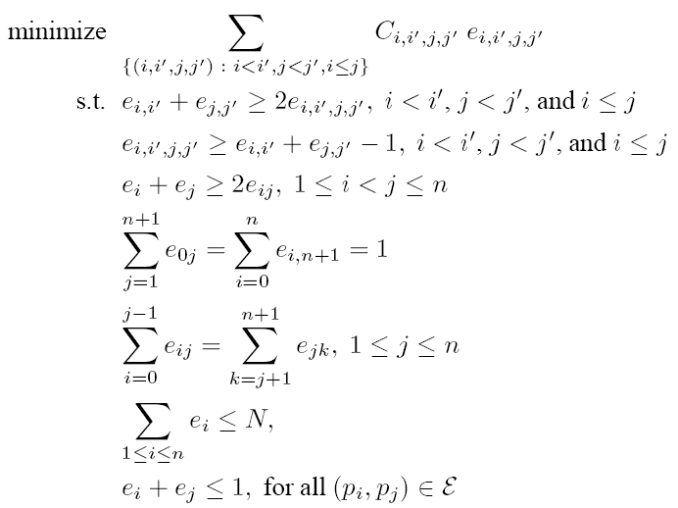
ILP Formulation for PAMP-INV (2)
Notes:
Need to explain this ILP

Slide 28
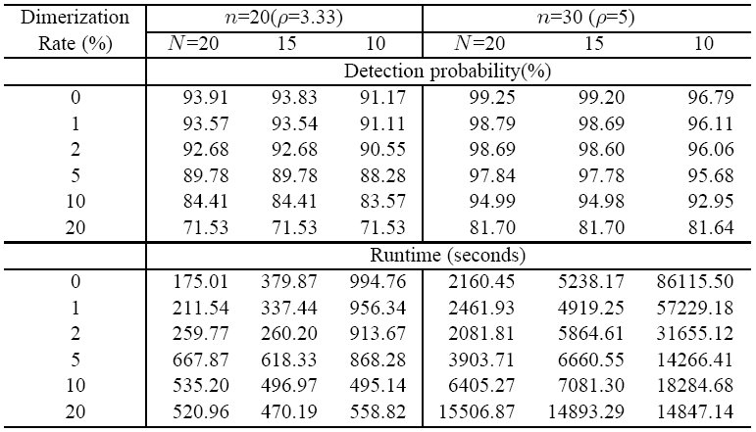
Detection Probability and Runtime for PAMP-INV ILP
x_{max}-x_{min} =100Kb
L=20Kb
5 random instances
PAMP-INV ILP can be solved to optimality within a few hours
Runtime is relatively robust to changes in dimerization rate, candidate primer density, and constraints on multiplexing degree.

Slide 29
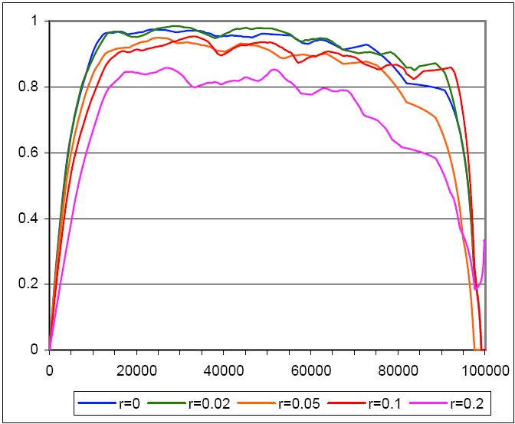
Effect of Inversion Length and Dimerization Rate
x_{max}-x_{min}=100Kb, L=20Kb, n=30, dimerization rate r between 0 and 20% and N=20
Detection probability is relatively insensitive to Length of Inversion

Slide 30
Outline
Introduction
Anchored Deletion Detection
Inversion Detection
Conclusions

Slide 31
Summary
ILP formulations for PAMP primer selection
  Anchored deletion detection (PAMP-DEL)
  1-sided anchored deletion detection (PAMP-1SDEL)
  Inversion detection (PAMP-INV)
  Practical runtime for mid-sized PAMP-INV ILP, highly scalable PAMP-1SDEL ILP
Heuristics for PAMP-DEL based on PAMP-1SDEL ILP
  Near optimal solutions with highly scalable runtime

Slide 32
Thank you for your attention

