Slide 1
Randomized Approximation Algorithms for
Set Multicover Problems
with Applications to
Reverse Engineering of Protein and Gene Networks
Piotr Berman* Bhaskar DasGupta† Eduardo Sontag‡
Penn State Univ Univ of IL at Chicago Rutgers University
berman@cse.psu.edu dasgupta@cs.uic.edu sontag@control.rutgers.edu
* Supported by NSF grant CCR-O208821
† Supported by NSF grants CCR-0206795, CCR-0208749
and a career grant IIS-0346973
‡ Supported by NSF grant CCR-0206789

Slide 2
More interesting APPROX-ian title?
Randomized Approximation Algorithms for
Set Multicover Problems
with Applications to
Reverse Engineering of Protein and Gene Networks

Slide 3
Set k-multicover (SC_{k})
Input: Universe U={1,2,…,n}, sets S₁,S₂,…,S_{m} ⊆ U,
integer (coverage) k≥1
Valid Solution: cover every element of universe ≥k times:
subset of indices I ⊆ {1,2,…,m} such that
∀x∈U |j∈I : x∈S_{j}| ≥ k
Objective: minimize number of picked sets |I|
k=1  simply called (unweighted) set-cover
a well-studied problem
Special case of interest in our applications:
k is large, e.g., k=n-1

Slide 4
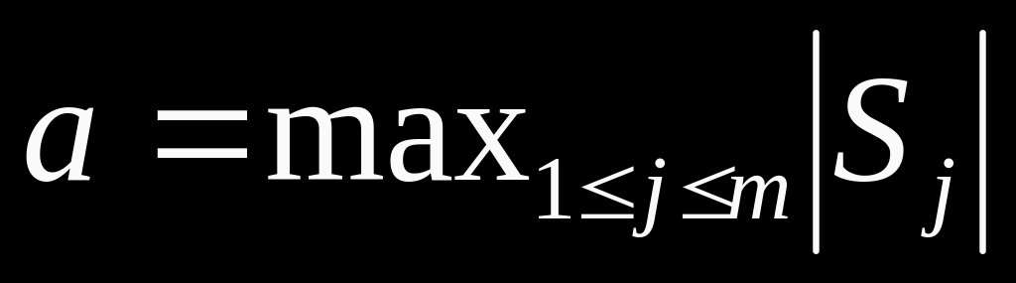
(maximum size of any set)
Known results
Set-cover (k=1):
Positive results
  can approximate with approx. ratio of 1+ln a
  (determinstic or randomized)
  Johnson 1974, Chvátal 1979, Lovász 1975
  same holds for k>1
  primal-dual fitting: Rajagopalan and Vazirani 1999
Negative result (modulo NP ≠ DTIME(n^{loglog} n) ):
  approx ratio better than (1-ρ)ln n is impossible in
  general for any constant 0<ρ<1 (Feige 1998)
  (slightly weaker result modulo P≠NP, Raz and Safra
  1997)

Slide 5
r(a,k)= approx. ratio of an algorithm as function of a,k
We know that for greedy algorithm r(a,k) ≤ 1+ln a
  at every step select set that contains maximum number of elements not covered k times yet
Can we design algorithm such that r(a,k) decreases with increasing k ?
  possible approaches:
    improved analysis of greedy?
    randomized approach (LP + rounding) ?
    …

Slide 6
Our results (very “roughly”)
      n = number of elements of universe U
      k = number of times each element must be covered
      a = maximum size of any set
Greedy would not do any better
  r(a,k)=Ω(log n) even if k is large, e.g, k=n
But can design randomized algorithm based on LP+rounding approach such that the expected approx. ratio is better:
  E[r(a,k)] ≈ max{2+o(1), ln(a/k)} (as appears in the proceedings)
  ⇓ (further improvement (via comments from Feige))
  ≈ max{1+o(1), ln(a/k)}

Slide 7
More precise bounds on E[r(a,k)]
1+ln a if k=1
(1+e^{-(k-1)/5}) ln(a/(k-1)) if a/(k-1) ≥ e² ≈7.4 and k>1
min{2+2e^{-(k-1)/5},2+0.46 a/k} if ¼ < a/(k-1) < e² and k>1
1+2(a/k)^{½} if a/(k-1) < ¼ and k>1
E[r(a,k)]
ln(a/k)
approximate
not drawn to scale
4
2
1
a/k
0
¼
e²
a

Slide 8
Can E[r(a,k)] coverge to 1 at a faster rate?
Probably not...for example, problem can be shown to be APX-hard for a/k ≥ 1
Can we prove matching lower bounds of the form
max { 1+o(1) , 1+ln(a/k) } ?
Do not know...

Slide 9
Greedy would not do any better
  (r(a,k)=Ω(log n) even if k is large, e.g, k=n)
Try to extend the example in Johnson’s 1974 paper
One complication: a set cannot be selected more than once
(thus cannot just duplicate sets)

Slide 10
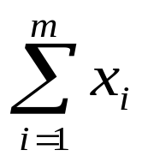
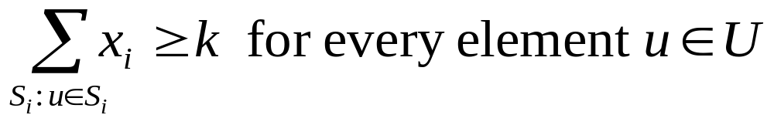
Our randomized algorithm
Standard LP-relaxation for set multicover (SC_{k}):
selection variable x_{i} for each set S_{i} (1 ≤ i ≤ m)
minimize
subject to:
0 ≤ x_{i} ≤ 1 for all i

Slide 11
Our randomized algorithm
Solve the LP-relaxation
Select a scaling factor β carefully:
    ln a if k=1
    ln (a/(k-1)) if a/(k-1)≥e² and k>1
    2 if ¼≤a/(k-1)<e² and k>1
    1+(a/k)^{½} otherwise
Deterministic rounding: select S_{i} if βx_{i}≥1
    C₀ = { S_{i} | βx_{i}≥1 }
Randomized rounding: select S_{i}∈{S₁,…,S_{m}}\C₀ with prob. βx_{i}
C₁ = collection of such selected sets
Greedy choice: if an element u∈U is covered less than k
    times, pick sets from {S₁,…,S_{m}}\(C₀ ∪C₁) arbitrarily

Slide 12
Most non-trivial part of the analysis involved proving the following bound for E[r(a,k)]:
E[r(a,k)] ≤ (1+e^{-(k-1)/5}) ln(a/(k-1)) if a/(k-1) ≥ e² and k>1
Needed to do an amortized analysis of the interaction between the deterministic and randomized rounding steps with the greedy step.
For tight analysis, the standard Chernoff bounds were not always sufficient and hence needed to devise more appropriate bounds for certain parameter ranges.

Slide 13
Motivations/Applications (finally!): simplest case
First a linear algebraic formulation:
described in terms of two matrices A∈ℜ^{n×n} and B∈ℜ^{n×m}
  A is unknown
  B is initially unknown, but its columns B₁,B₂,…,B_{m} can be queried
  Columns of B are in general position (linearly independ.)
  Zero structure of C=AB=(c_{ij}) is known, i.e.,
    a binary matrix C⁰=(c⁰_{ij})∈{0,1}^{n×m} is given with c⁰_{ij}=0⇒ c_{ij}=0
  Rough objective: obtain as much information about A performing as few queries as possible
  Obviously, the best we can hope is to identify A upto scaling (in abstract mathematical terms, as elements of the projective space P^{n-1})

Slide 14
Motivations/Applications: linear algebraic formulation
Let A_{i} denote the i^{th} row of A. Then, c⁰_{ij}=0 ≡ A_{i}B_{j}=0
Suppose we query columns B_{j} for j∈J = { j₁, j₂,…, j_{l} }
Then, information obtained about A can be summarized as A_{i}∈H⊥_{J,i} where
  ⊥ indicates “orthogonal complement”
  H_{J,i}∈span{B_{j} | j∈J_{i}} where J_{i}={j | j∈J and c⁰_{ij}=0}
Suppose |J|≥n-1. Then, dim H⊥_{J,i}=1 and thus each A_{i} is uniquely determined upto a scalar multiple (theoretically the best possible)
Thus, the combinatorial question is dual of set multicover:
find J of minimum cardinality such that |J_{i}|≥n-1 for all i

Slide 15
Motivations/applications: biology to linear algebra
Time evolution of a vector of state variables (x₁(t),x₂(t),…,x_{n}(t)) is given by set of differential equations:
    ∂x₁/∂t = f₁(x₁,x₂,…,x_{n},p₁,p₂,…,p_{m})
    …
    ∂x_{n}/∂t = f_{n}(x₁,x₂,…,x_{n},p₁,p₂,…,p_{m})
    (or, in vector form, ∂x/∂t = f(x,p))
p=(p₁,p₂,…,p_{m}) is a vector of parameters
e.g., represents concentration of certain enzymes that
are maintained at constant value during experiment
f(x∗,p∗)=0 where p∗ is “wild type” (i.e. normal) condition of p
x∗ is corresponding steday-state condition

Slide 16
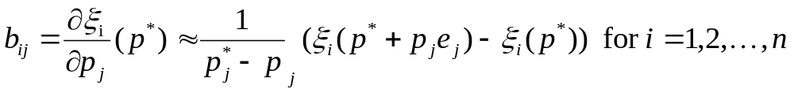
We are interested in obtaining information about the sign of ∂f_{i}/∂x_{j}(x∗,p∗)
e.g., if ∂f_{i}/∂x_{j} > 0, then x_{j} has a positive (catalytic) effect on the formation of x_{i}
Assumption: do not know f, but do know that certain parameters p_{j} do not effect certain variables x_{i}.
This gives matrix C⁰=(c⁰_{ij})∈{0,1}^{n×m} with c⁰_{ij}=0 ≡ ∂f_{i}/∂x_{j}=0
m experiments:
  change one parameter, say p_{k} (1≤k≤m)
  for perturbed p≈p∗, measure steady state vector x = ξ(p)
  estimate n “sensitivities”:
where e_{j} is the j^{th} canonical basis vector

Slide 17
  consider matrix B = (b_{ij})
  (in practice, perturbation experiment involves:
    letting the system relax to steady state
    measure expression profiles of variables x_{i} (e.g., using microarrys)
Let A be the Jacobian matrix ∂f/∂x
Let C be the negative of the Jacobian matrix ∂f/∂p
From f(ξ(p),p)=0, taking derivative with respect to p and using chain rules, we get C=AB.
This gives the linear algebraic formulation of the problem.

Slide 18
Thank you for your attention!

