Slide 1
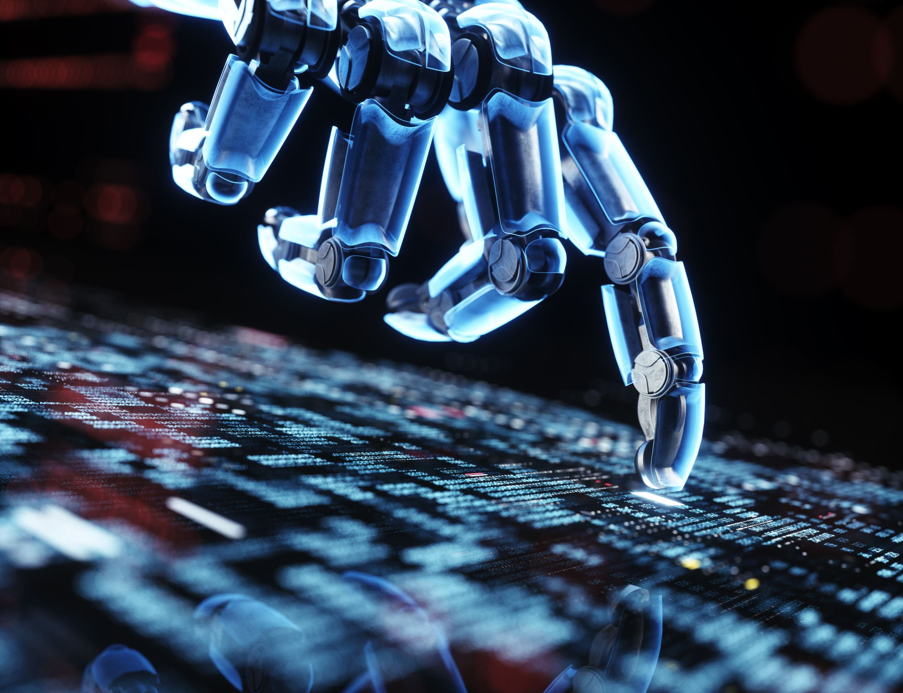
Introduction to Artificial Intelligence with Python
Lecture 0: Foundations of AI

Slide 2

Course Overview
Introduction to AI
Theory and Practical Implementation
Python for AI

Slide 3
What is Artificial Intelligence?
Machines performing intelligent tasks
Examples: Vision, Games, Speech, Translation

Slide 4
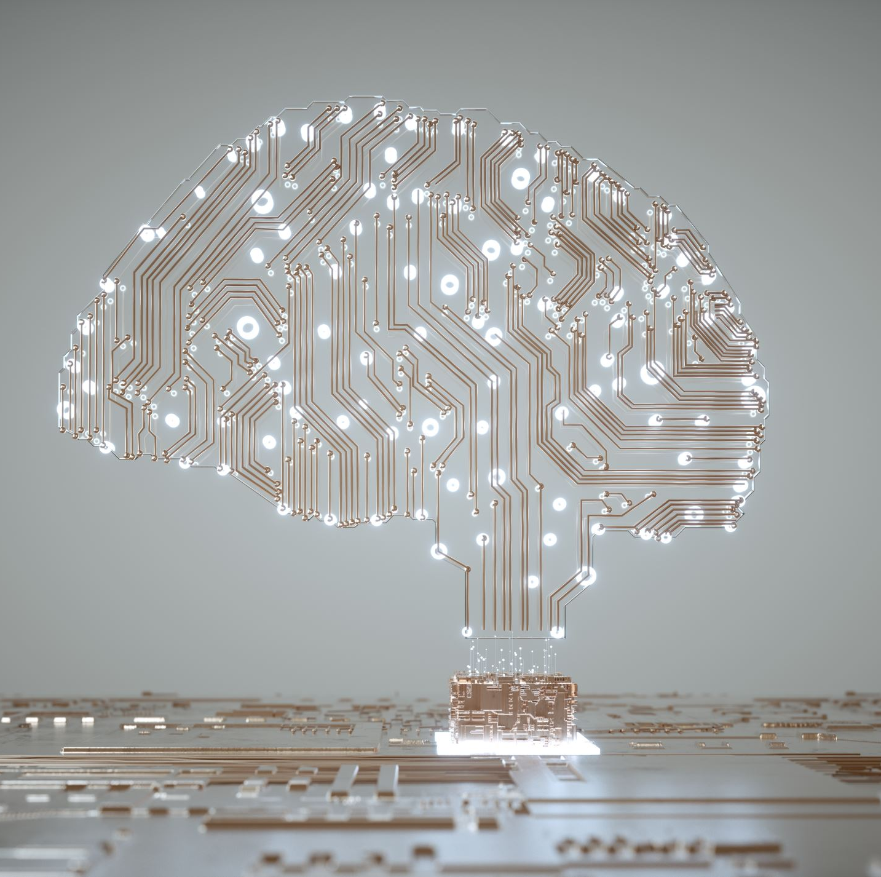
Major Topics in AI
Search
Knowledge Representation
Uncertainty
Optimization
Machine Learning
Neural Networks
NLP
Computer Vision

Slide 5
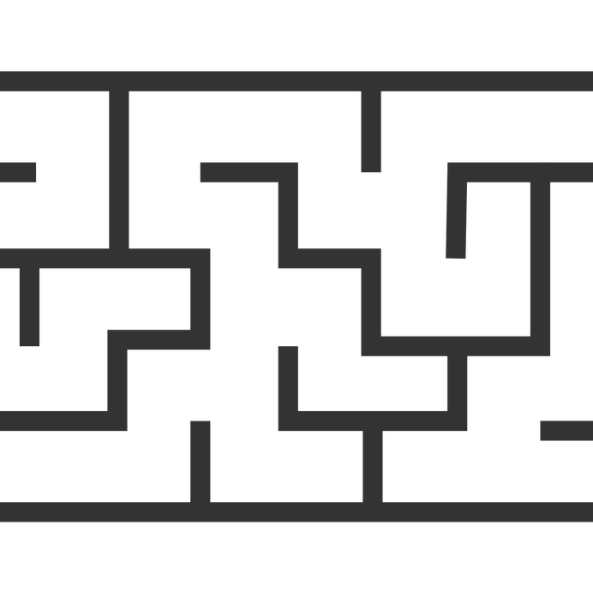
Search in AI
Finding actions from initial state to goal state

Slide 6
Knowledge Representation
Storing and organizing information
Drawing conclusions

Slide 7
Uncertainty
Handling incomplete information using probability

Slide 8
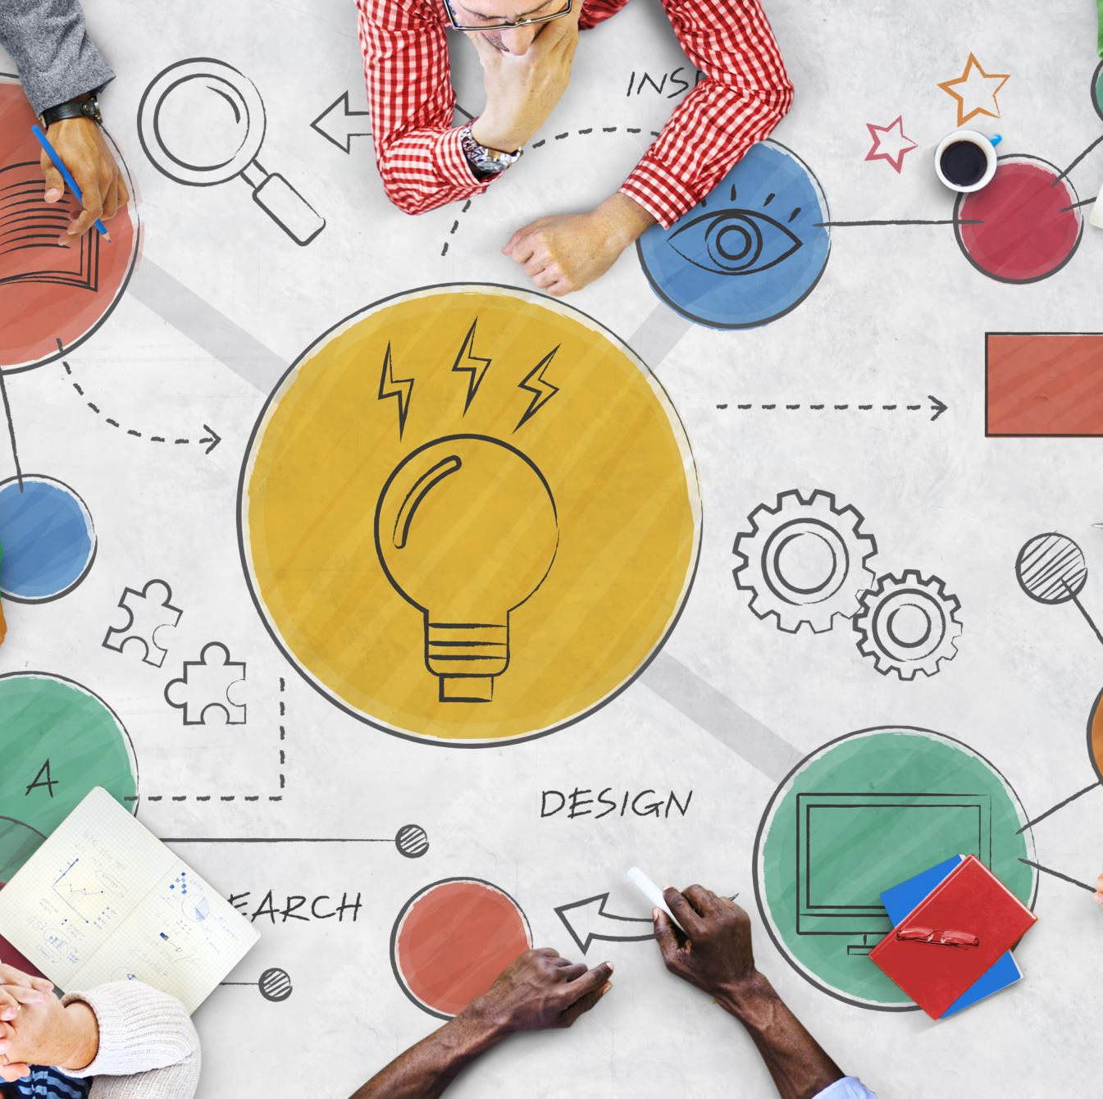
Optimization
Finding best solution among alternatives

Slide 9
Machine Learning
Learning from data
Improving with experience

Slide 10

Neural Networks
Brain-inspired learning models
Pattern recognition

Slide 11
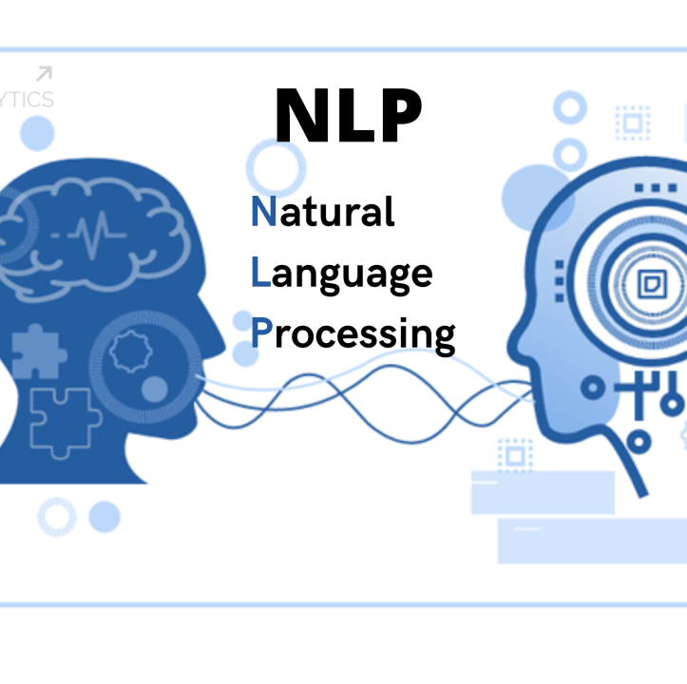
Natural Language Processing
Understanding human language
Chatbots, Translation

Slide 12
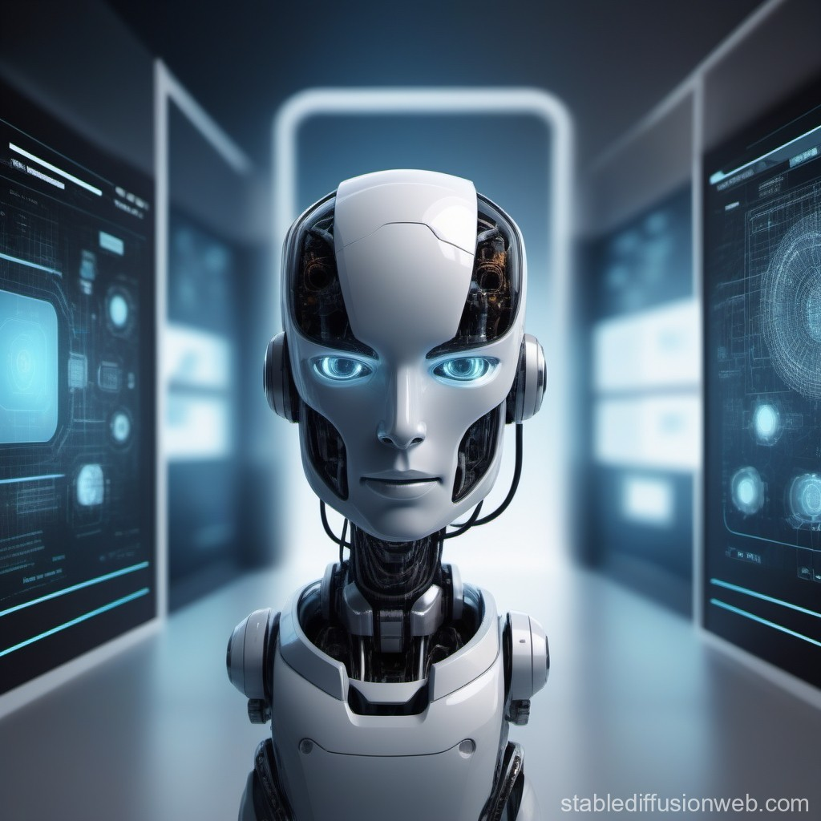
Computer Vision
Understanding images and videos

Slide 13

Summary
AI combines multiple techniques to build intelligent systems

Slide 14
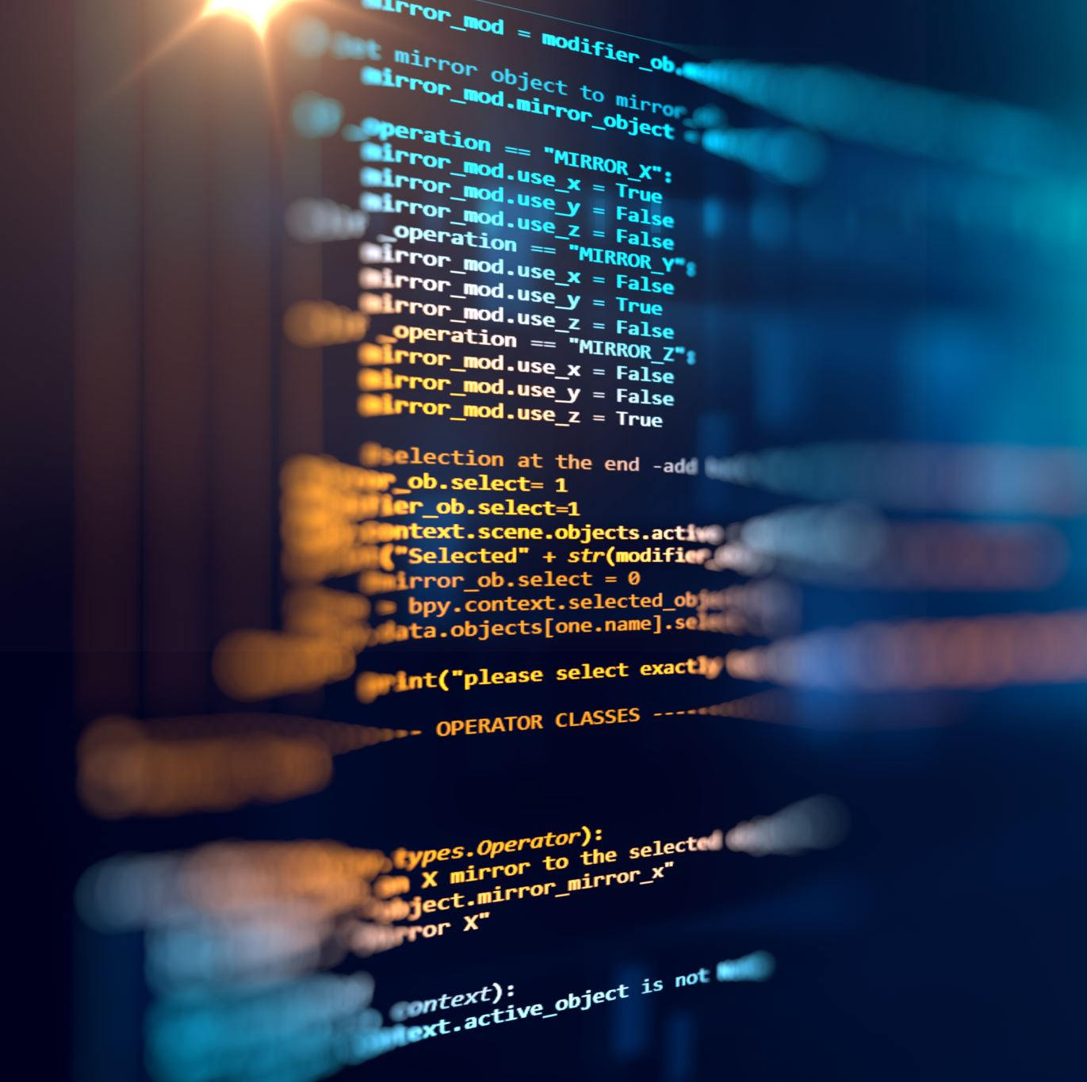
Next Lecture
Search Algorithms in AI

