Slide 1
ELASTICSEARCH-HADOOP
ARCHITECTURE:
At the core, elasticsearch-hadoop integrates two distributed systems: Hadoop, a distributed computing platform and Elasticsearch, a real-time search and analytics engine.

Slide 2
Use of ElasticSearch natively in hadoop
(By using ES-hadoop,thr is no need to use these software)
Apache-spark-input/output format
Apache pig-Storage
Apache hive- External table
Cascading – Tap/sink
Storm- spout/bolt
All Operations (read/write) are paralised(apache spark).

Slide 3
ES-HADOOP can easily READ/WRITE data from hadoop nd to ES transparently
Reading from Elasticsearch
Shards play a critical role when reading information from Elasticsearch. Since it acts as a source, elasticsearch-hadoop will create one Hadoop InputSplit per Elasticsearch shard.
In case of Apache Spark one Partition, that is given a query that works against index I. elasticsearch-hadoop will dynamically discover the number of shards backing I and then for each shard will create, in case of Hadoop an input split (which will determine the maximum number of Hadoop tasks to be executed) or in case of Spark a partition which will determine the RDD(resilient Distributed Datasets) maximum parallelism.

Slide 4
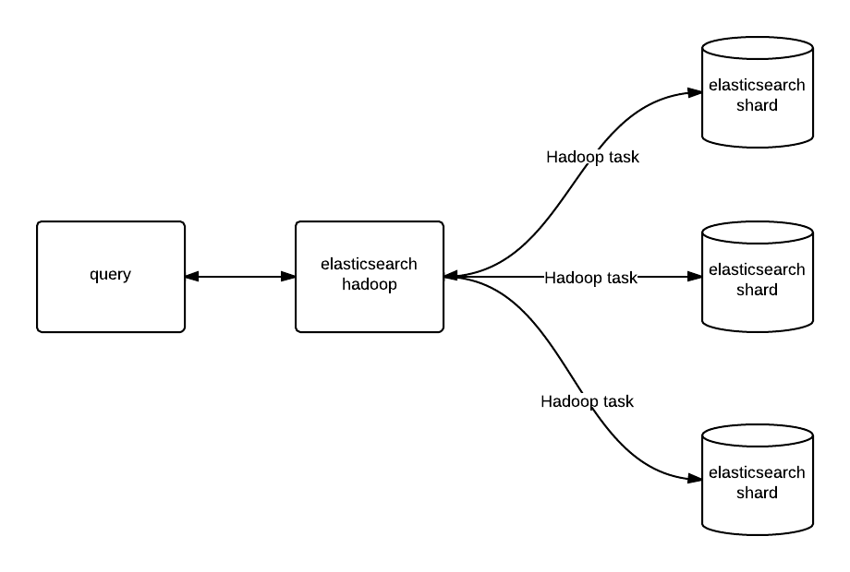

Slide 5
Writing to Elasticsearch
Writing to Elasticsearch is driven by the number of Hadoop input splits (or tasks) or Spark partitions available. elasticsearch-hadoop detects the number of (primary) shards where the write will occur and distributes the writes between these. The more splits/partitions available, the more mappers/reducers can write data in parallel to Elasticsearch.

Slide 6
