Slide 1
ElasticSearch
BY
NIKKI RASTOGI
ANKIT KANSAL
ABHINAV MISHRA

Slide 2
INTRODUCTION
Highly scalable open-source full-text search and analytics engine.
It is a NOSQL, distributed full text database
Allows us to store, search, and analyze big volumes of data quickly and in near real time.
It is based on the Lucene engine on top of which there is an HTTP REST interface which results in a distributed search engine that is incredibly easy to scale and returns results at lightning speed.

Slide 3
HISTORY
Shay Banon released the first version of Elasticsearch in February 2010.
FIRST VERSION started with 0.4 nd upto 2.2 version ,these versions didn,t support.
Thn frm 2.3 -5.5 version supports
Latest version is 6.0 beta 1

Slide 4
An Example of a scenario where ElasticSearch is useful
If someone runs an online web store where it allows it’s customers to search for products to be sold. In this case, one can use Elasticsearch to store one’s entire product catalog and inventory and provide search and autocomplete suggestions for them.

Slide 5
WHY DO WE NEED IT? [1]
Full txt search :
If we have a relational database and need to search tables in that, millions of records, results and complex procedures need to be followed and then if on top of it all, we add full txt search on relational database fields then speed is not optimal.
NRT is one of the imp property of elasticsearch. What this means is there is a slight latency/delay (normally one second) from the time you index a document until the time it becomes searchable.
Searching relevancy and score, where in a typical relational SQL database.

Slide 6
WHY DO WE NEED IT? [2]
Logging and analysis
Another edge case is that a lot people use Elasticsearch to store logs from various sources (to centralize them), so they can analyze them and make sense out of it. In this case, Kibana becomes handy and it connects to Elasticsearch cluster and create visualisations straight away.

Slide 7
Uses of ElasticSearch
We want Elasticsearch when we're doing a lot of text search, where traditional RDBMS databases are not performing really well . Elasticsearch is highly customizable, extendable through plugins. You can build robust search without much knowledge quite fast.
The documents that are stored in Elasticsearch are JSON documents that are schema-less. This means that you don’t have to define fields and their data types before adding data. Elasticsearch is open source, but is being developed by Elasticsearch. It is near real-time, meaning that from the point in time that one adds, modifies or deletes a document, the changes are propagated throughout the entire cluster within one or two seconds. For small clusters, the changes will practically be propagated faster.

Slide 8
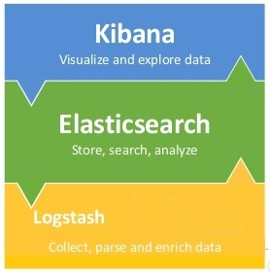
It consists of Elasticsearch, Logstash, and Kibana
ELK STACK

Slide 9
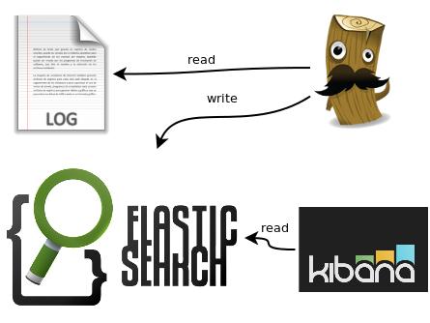

Slide 10
LOGSTASH
An open source, server-side data processing pipeline that ingests data from a multitude of sources simultaneously, transforms it, and then sends ELASTICSEARCH.
Written in RUBY.
Speaking of searching, logstash comes with a web interface for searching and drilling into all of our logs.

Slide 11
USES
Used to gather logging messages, convert them into json documents and store them in an ElasticSearch cluster.

Slide 12
ELASTICSEARCH

Slide 13
U.S.P. ‘s of ElasticSearch
We use Elasticsearch when we're doing a lot of text search, where traditional RDBMS databases are not performing really well .
highly customizable, extendable through plugins.
One can build robust search without much knowledge quite fast.
JSON documents are schema-less.
One doesn’t have to define fields and their data types before adding data.
Near real-time, meaning that from the point in time that one adds, modifies or deletes a document, the changes are propagated throughout the entire cluster within one or two seconds.

Slide 14
ELASTICSEARCH
TERMINOLOGY
NODES
Single server that is part of your cluster
Stores data. A node is identified by a name which by default is a random Universally Unique IDentifier (UUID) (assigned at startup).
You can define any node name you want .
This name is important for administration purposes where you want to identify which servers in your network correspond to which nodes in your Elasticsearch cluster.

Slide 15
CLUSTER
Collection of one or more nodes (servers) that together holds entire data.
A cluster is identified by a unique name which by default is "elasticsearch".
This name is important because a node can only be part of a cluster if the node is set up to join the cluster by its name.
Don’t reuse the same cluster names in different environments, otherwise you might end up with nodes joining the wrong cluster.

Slide 16
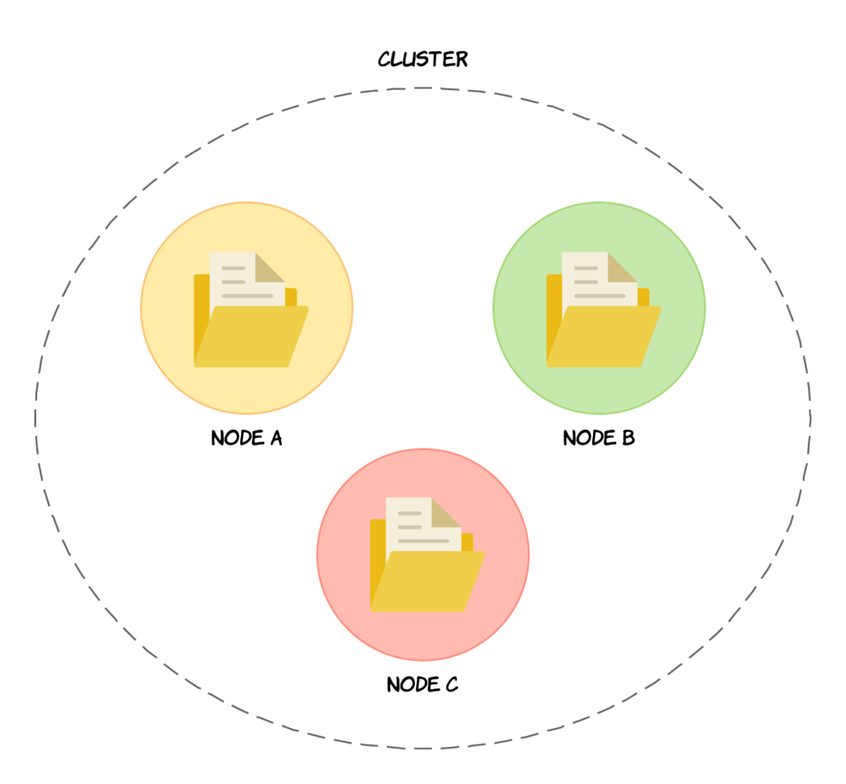

Slide 17
INDICES, TYPES AND DOCUMENTS
An index is a coll of docs that have somewhat related characteristics.
It is identified by a name (that must be all lowercase).
This name is used to refer to the index when performing indexing, search, update, and delete operations against he documents in it.
A type is a logical category/partition of the index based on certain criteria.
A document is a basic unit of information that can be indexed.
This document is expressed in JSON (JavaScript Object Notation). We can store as many docs in an index as we want but the doc needs to be actually assigned to a type inside an index.

Slide 18
SHARDS AND REPLICAS
A single index of a billion documents taking up 1TB of disk space may not fit on the disk of a single node or may be too slow to serve search requests from a single node alone.
Elasticsearch provides the ability to subdivide your index into multiple pieces called shards.
During creation of an index,one can simply define the number of shards that one wants. Each shard is in itself a fully-functional and independent "index" that can be hosted on any node in the cluster. Default no of shards=5.
Sharding is important for two primary reasons:
1. It allows you to horizontally scale your content volume. So if you have growing amounts of data, you will not face a bottleneck because you can always tweak the number of shards for a particular index.
2. It allows you to distribute and parallelize operations across shards thus increasing performance/throughput.

Slide 19
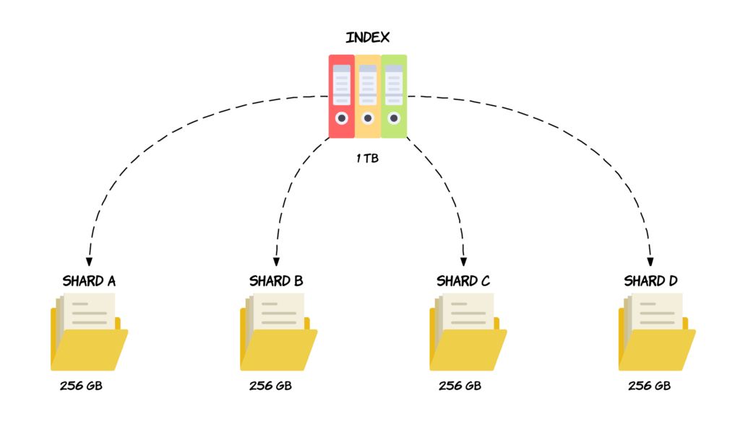
SHARDING

Slide 20
CONTROLLING NO OF SHARDS
A default no of 5 shards is sufficient in most cases.
But what if one does need to change the number of shards for an index? If the index has already been created, one unfortunately cannot change the number of shards.
We have to create a new index with the number of shards that we want and move our data over to the new index.
Determining which shard a given document should be stored in or has been stored is, is called routing. Routing is handled automatically by default, and most users won’t need to manually deal with it. ElasticSearch uses a formula for this..

Slide 21
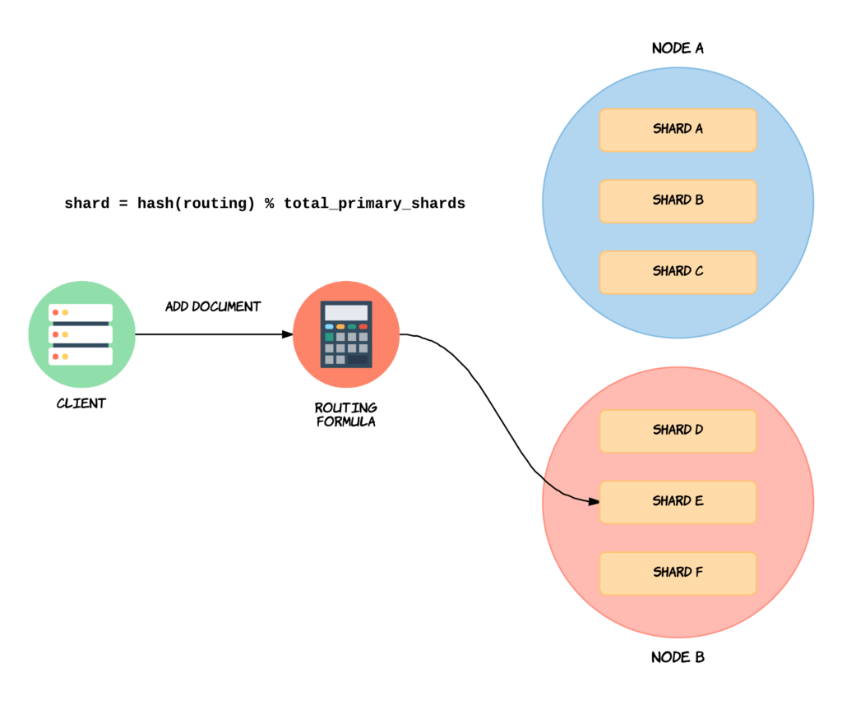

Slide 22
By default, the “routing” value will equal a given document’s ID.
This value is then passed through a hashing function, which generates a number that can be used for the division.
The remainder of dividing the generated number with the number of primary shards in the index, will give the shard number. This is how Elasticsearch determines the location of specific documents.
A custom routing val can also be set by the user.
If we change the number of shards, then the result of running the routing formula would change for documents.
an example of changing routing val and shard no

Slide 23
In a network/cloud environment where failures can be expected anytime, it is very useful and highly recommended to have a failover mechanism in case a shard/node somehow goes offline or disappears for whatever reason.
For this, Elasticsearch allows one to make one or more copies of your index’s shards into what are called replica shards, or replicas for short.
It provides high availability in case a shard/node fails. For this reason, it is important to note that a replica shard is never allocated on the same node as the original/primary shard that it was copied from.
By default, each index in Elasticsearch is allocated 5 primary shards and 1 replica which means that if you have at least two nodes in your cluster, your index will have 5 primary shards and another 5 replica shards (1 complete replica) for a total of 10 shards per index.

Slide 24
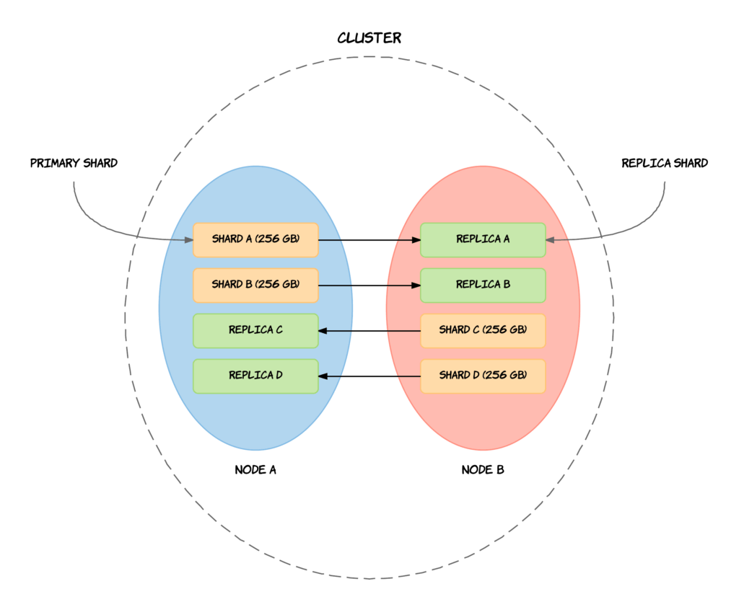
REPLICATION

Slide 25
SYNCING OF REPLICAS AND SHARDS
Elasticsearch uses a model named primary-backup for its data replication. This means that the primary shard in a replication group acts as the entry point for indexing operations.
Translated into normal English, this means that all operations that affect the index — such as adding, updating, or removing documents — are sent to the primary shard.
It is then responsible for validating the operations and. This involves checking if the request is structurally invalid, like trying to add a number to an object field etc.
When the operation has been accepted by it, the operation will be performed locally on itself.
When the operation completes, it will be forwarded to each of the replica shards in the replica group. If the shard has multiple replicas, the operation will be performed in parallel on each of the replicas.
When the operation has completed successfully on every replica and responded to the primary shard, it will respond to the client that the operation was successful.

Slide 26
KIBANA
Kibana is a window into the Elastic Stack.
It enables visual exploration and real-time analysis of data in Elasticsearch.
It’s an open source analytics and visualization platform designed to work with Elasticsearch.
One uses Kibana to search, view, and interact with data stored in Elasticsearch indices. One can easily perform advanced data analysis and visualize data in a variety of charts, tables, and maps.
Kibana makes it easy to understand large volumes of data. Its simple, browser-based interface enables you to quickly get the hang of ElasticSearch.

Slide 27
COMPONENTS OF KIBANA
A DASHBOARD A Kibana dashboard displays a collection of saved visualizations.
DEV TOOLS-- The Dev Tools page contains development tools that you can use to interact with your data in Kibana. It has a Console area. The Console plugin provides a UI to interact with the REST API of Elasticsearch. Console has two main areas: the editor, where you compose requests to Elasticsearch, and the response pane, which displays the responses to the request.
VISUALIZE--Visualize enables you to create visualizations of the data in your Elasticsearch indices. You can then build dashboards that display related visualizations. Kibana visualizations are based on Elasticsearch queries. By using a series of Elasticsearch aggregations to extract and process your data, you can create charts that show you the trends, spikes, and dips you need to know about.

Slide 28
X-PACK
X-Pack is an Elastic Stack extension that bundles security, alerting, monitoring, reporting, and graph capabilities into one easy-to-install package. While the X-Pack components are designed to work together seamlessly, one can easily enable or disable the features one wants to use.
Prior to Elasticsearch 5.0.0, one had to install separate Shield, Watcher, and Marvel plugins to get the features that are bundled together in X-Pack. With X-Pack, one no longer has to worry about whether or not one has the right version of each plugin, just install the X-Pack for the Elasticsearch version, and one is good to go!

Slide 29
CONCLUSION
Logstash provides an input stream to Elastic for storage and search, and Kibana accesses the data for visualizations such as dashboards. X-Pack provides security features to prevent unauthorized intrusion. Now let’s move onto the implementation section.

