Slide 1


Slide 2
AGENDA
Introduction to Blockchain
Need of Blockchain
Introduction to Bitcoin
Blockchain Security
Working of Blockchain
Ethereum
Ethereum vs Bitcoin
Smart Contracts
Hyperledger
Blockchain Applicatons
Advantages of Blockchain
Other uses

Slide 3
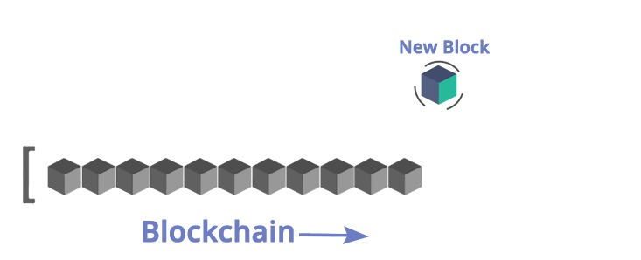
Introduction to Blockchain
Blockchain is a public distributed database which holds the encrypted data.It functions as a decentralized database and it is a spine for Bitcoin system.A distributed ledger is a database that allows transactions to have public “witnesses”.
An open blockchain network has no central authority.Since it is a shared and immutable ledger,the information in it is open for anyone and everyone to see.

Slide 4
Types of Blockchain
1.Public – Public blockchains have ledgers that are visible to everyone on the internet and anyone can verify and add a block of transactions to the blockchain.
2.Private – Private Blockchains allow specific users in the organisation to add and verify transaction blocks but everyone on the internet is generally allowed to view.
3.Consortium – These blockchains allow only a group of organisations to verify and add transactions but the ledger can open or restricted to selected groups.

Slide 5
Need of Blockchain
1.Lack of Security
2.Issues with current banking system
Double Spending
Centralized Power
Prone to hacks
Private Ledgers
3.Third party system

Slide 6

Introduction to Bitcoin
Bitcoin is the first decentralized and distributed digital currency developed by Satoshi Nakamoto. No single constitution or person controls it. Only 21 million bitcoins can ever be created. Every single bitcoin transaction is being stored in a massive distributed public ledger called the Blockchain.
Characteristics of Bitcoins:-
Decentralised
Anonymous
Transparent
Fast
Non-Repudiable
Safety and Control

Slide 7
Blockchain Security
When someone sends you cryptocoins over the Blockchain, they are actually sending them to a hashed version of what’s known as the “Public Key”. There is another key which is hidden from them, that is known as the “Private Key.” This Private Key is used to derive the Public Key. Both the Private Key and the Public Key are large integer numbers, usually represented using a separate Wallet Import Format (WIF) consisting of letters and numbers.

Slide 8
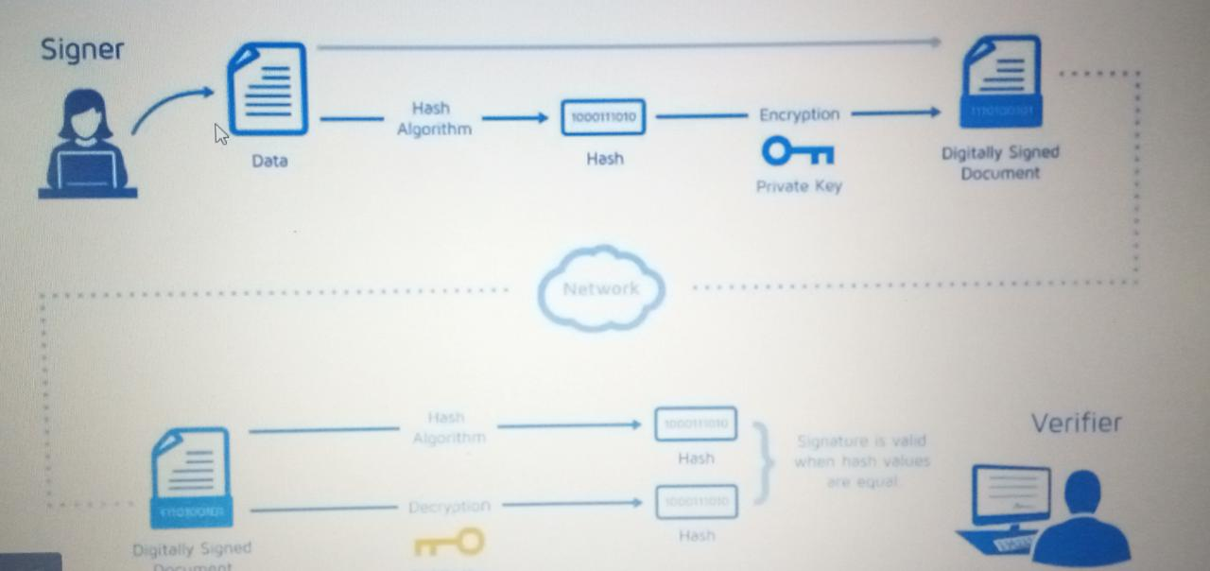

Slide 9
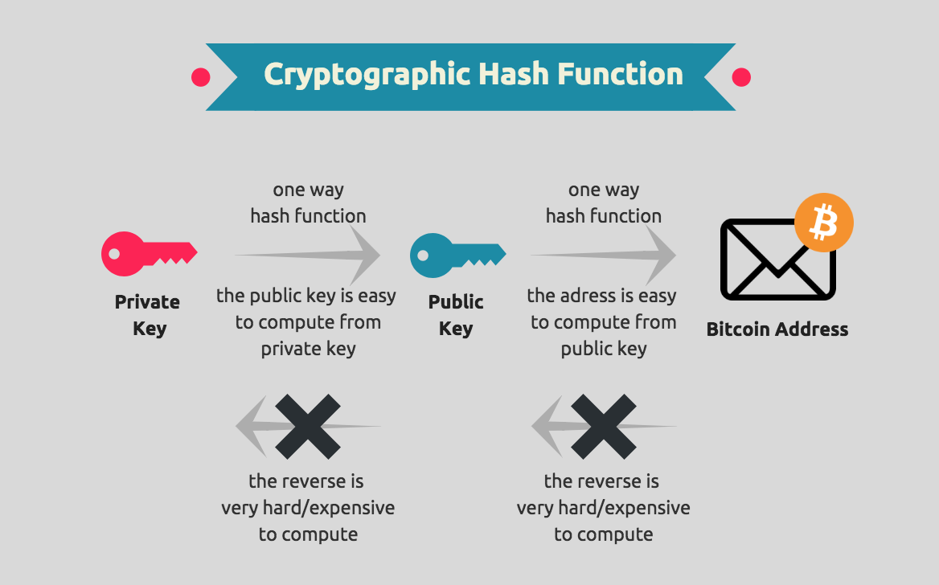
A hash is a function created using an algorithm that converts an input of letters and numbers(Private and Public key) into an encrypted output of fixed length.

Slide 10
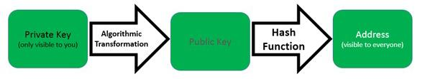
Sample Private Key in WIF:
The Private key is used to generate a signature for each blockchain transaction a user sends out.
The Private Key is used to mathematically derive the Public Key and vice versa with a hash function to produce the address that other people can see.

Slide 11
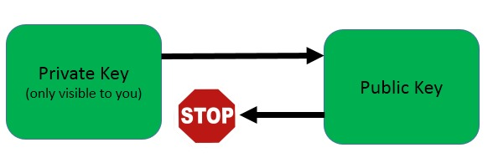
Cryptocurrencies uses a complicated mathematical algorithm which makes it very easy to generate Public Keys from Private Keys, but it is very difficult to “reverse” the algorithm to accomplish the opposite.
The process of reversing the process is even more complex — so much so that the world’s most powerful computer would need more than 40000000000000000000000000000000 years (that’s 31 zeroes!) to complete this calculation.

Slide 12
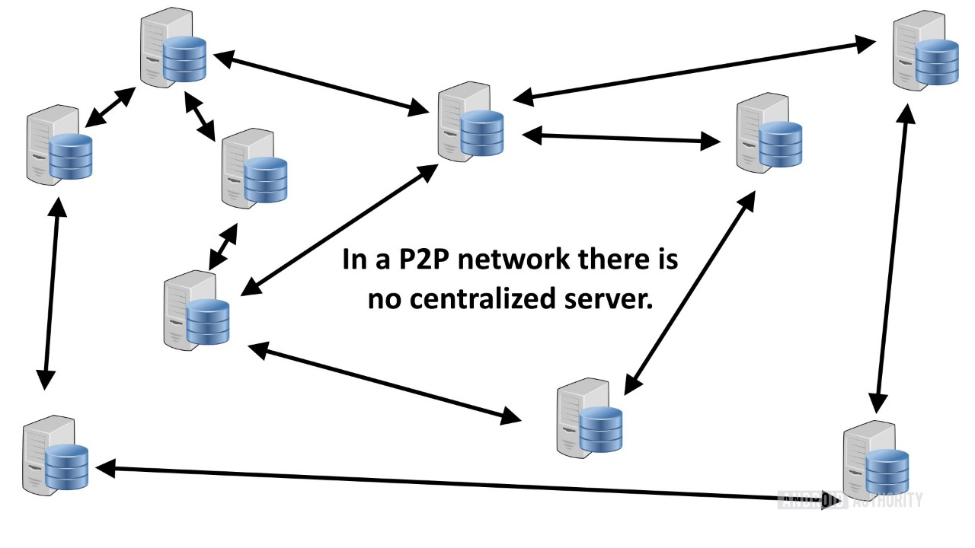
Peer to Peer(P2P) Network
In a P2P Network,whenever a transaction takes place,the details of the transaction are send to all the nodes and their ledger gets updated accordingly.

Slide 13
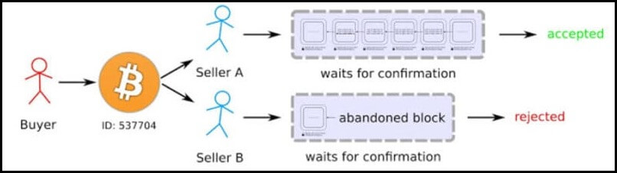
Double Spending

Slide 14
Terminologies
Nodes - The nodes are the computers that form part of the blockchain network. They store the updated copies of the transactions that are carried out.
Digital Mining – The process of validating whether a node has sufficient balance for the transaction or not.
Miners – The nodes that perform the process of digital mining are known as miners.For doing this,each miner receives some payment in the same currency. All the miners are nodes, but not all the nodes are miners.
Block – Block is a file which records some or all of the most recent blockchain transactions.

Slide 15
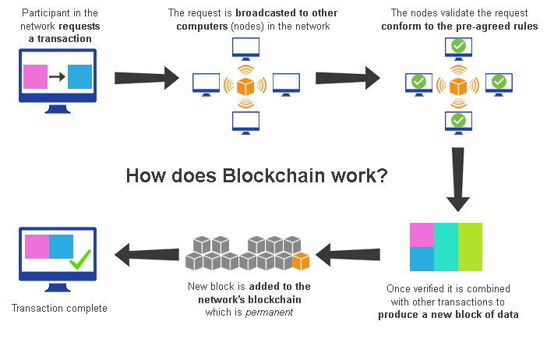

Slide 16
Working of Blockchain
Firstly, when the individual makes a call to transfer money following things will happen:
Request for the transaction represents online to the block itself.
Once that information is received by the block, it is again send to the nodes (networks).
Once this request is received by the nodes, it is then analyzed and approved by them.
After approval of the request,a new block is now officially added to the chain.
After this block is added, the money is transferred to the second individual.

Slide 17

Ethereum
Ethereum is a global, open-source platform for decentralized applications. On Ethereum, you can write code that controls digital value, runs exactly as programmed, and is accessible.
It extends the blockchain concepts from Bitcoin which validates, stores, and replicates transaction data on many computers around the world . Ethereum takes this one step further, and also runs computer code equivalently on many computers around the world.

Slide 18
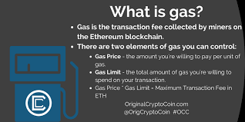

Slide 19
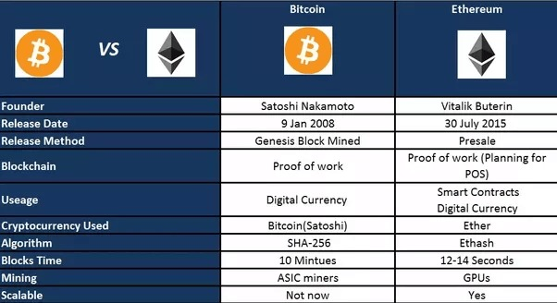
Ethereum vs Bitcoin

Slide 20
Smart Contracts
Smart contracts are immutable lines of code that are stored on a blockchain and automatically execute when predetermined terms and conditions are met. Smart contracts help you exchange money, property, shares, or anything of value in a transparent, conflict-free way while avoiding the services of a middleman.Smart contracts uses Solidity language which is similar to Java Script to write codes.

Slide 21
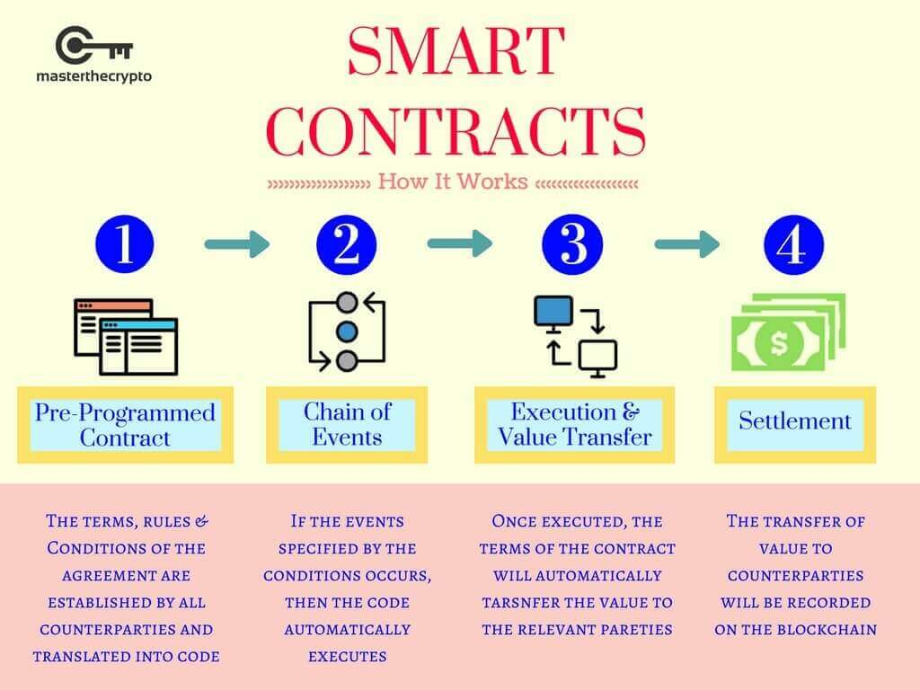

Slide 22

Hyperledger
“Hyperledger is an open source collaborative effort created to advance cross-industry blockchain technologies. It is a global collaboration, hosted by The Linux Foundation, including leaders in finance, banking, Internet of Things, supply chains, manufacturing, and Technology.”Hyperledger can be thought as of a softwarewhich everyone can use to create one’s own personalised blockchain services

Slide 23
Advantages of Blockchain
Blockchain transfers are the highest in terms of security.
Transparency.
Decentralization.
Zero percentage of fraud.
No government interference.
Instant transactions.
Improved financial efficiency(No involvement of third party).
Solves the problem of Double Spending.

Slide 24
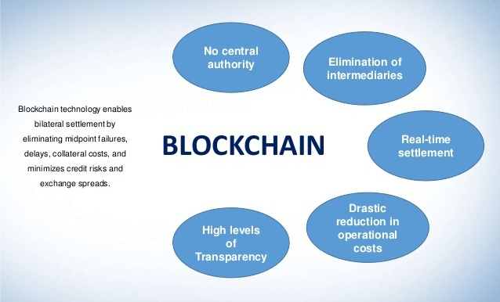

Slide 25
Blockchain Uses
Banking
Payments and Transfer
Voting
Online Music
Real Estate
Health care
Internet of Things
Law Enforcement

Slide 26
Blockchain Applications
Blockverify – It uses blockchain to end counterfeit attacks. Used in the verification of the counterfeit goods, stolen merchandise, fraudulent transactions etc.
Ripple – It provides a frictionless experience to send money globally. In current centralized system, transaction can takes days to complete(unreliable), are expensive and slow.
Ripple uses blockchain for transactions which makes it fast, easily accesible and reliable. The transaction cost is also very low.

Slide 27
Storj – It is an open source,decentralized file storage solution.It uses encryption,file sharding(dividing a large database into smaller parts for faster and easy management of data) and a blockchain based hash table to store files on a peer to peer network.It is fast,private and cheap.
Augur – It is a decentralized prediction market protocol owned and operated by the people that use it. It is used for weather forecasting, business forecasting , political forecasting etc.
Ethlance – It works on Ethereum and server has zero perccent service charge.It allows you create work profile without any restriction and fees.We just need to pay gas fees associated with these operations.

Slide 28


