Slide 1

Project 3 Howdy Neighbour!
By: Benson Coelho
Notes:
Introduction: Project 3!

Slide 2

Motivation
I bought a house!
Home and garden upkeep needs a fair bit of equipment – some used only a few times a year.
Own or hire?
Cost concerns
Storage space concerns
Get to know your neighbours!
Howdy Neighbour!
Notes:
I came up with the Idea for the app when I bought a house. And I quickly realized that the tools and equipment required for upkeep is an ever growing list. I also started to think about cost and storage space constraints. That made me think about this web application. It’s a way for neighbours to share tools and equipment that they own with others near them and rent from THEIR neighbors when they need it. It also doesn’t hurt to get to know your neighbours. I call it ‘Howdy Neighbour’.

Slide 3







Technologies used
MongoDB geoJSON
….and a number of packages
Notes:
Mongo – database
Express – maikng the connections
Front-end built with react and styled with react-bootstrap, mature package
Google maps APIs were useful to find exact address matches and store coordinates in the DB
Worked for the first time with MongoDB geoJSON schema. Great way to store location data and query it quickly. Reduces 3rd party api calls and cost.
Number of packages including moment for the time aspects, react-dates for calendar and other

Slide 4
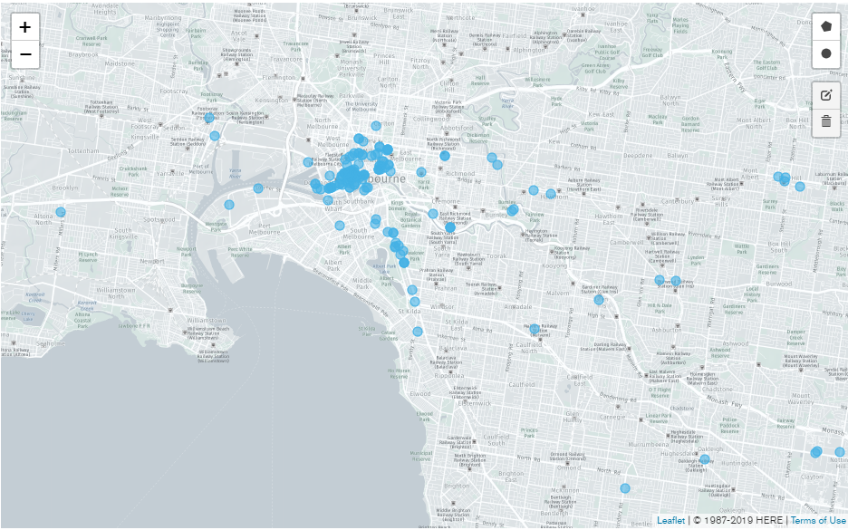
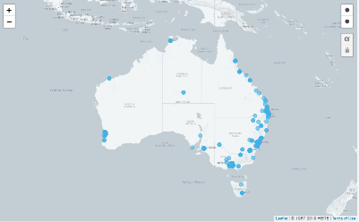
Database – Users & Assets
Approximately 3000 demo users and 15000 assets distributed near the capital cities…
Notes:
Used a publicly available address database
Built JSON seed, randomly assigning assets to each user
About 3000 users in the database for this demo with a total of about 15000 assets

Slide 5
Demonstration
Notes:
Home page
Find tools - book one - show item in booker, show in booked, show item calendar after booking
View page - edit one, remove one - line trimmer
Add new - add one - drill

Slide 6
Future Paths
Interactive map – see who is near you and what’s on offer
In app messaging
Earning and spending tracker
Rating system?

Slide 7
Questions?

Slide 8
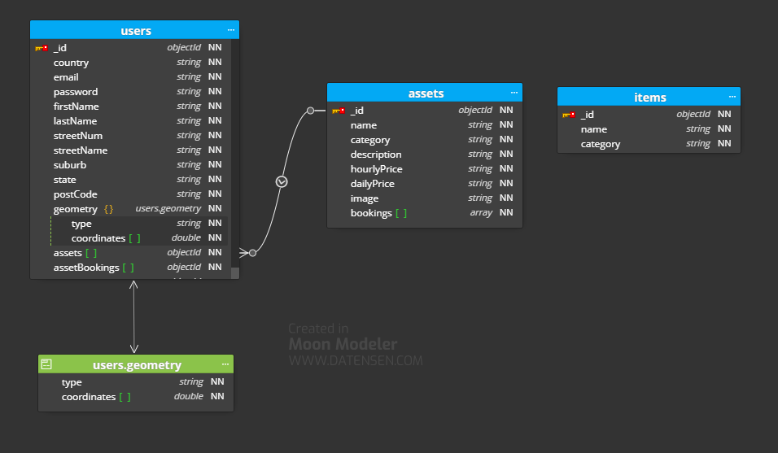
Database – Schema
Notes:
Users table contains all the location and signup data
The user geometry is the geoJSON schema that stores lat/long and the indexing methodology
It also contains the assets the user owns, and bookings that the user has made
Bookings of individual assets are stored at the asset level

