Slide 1
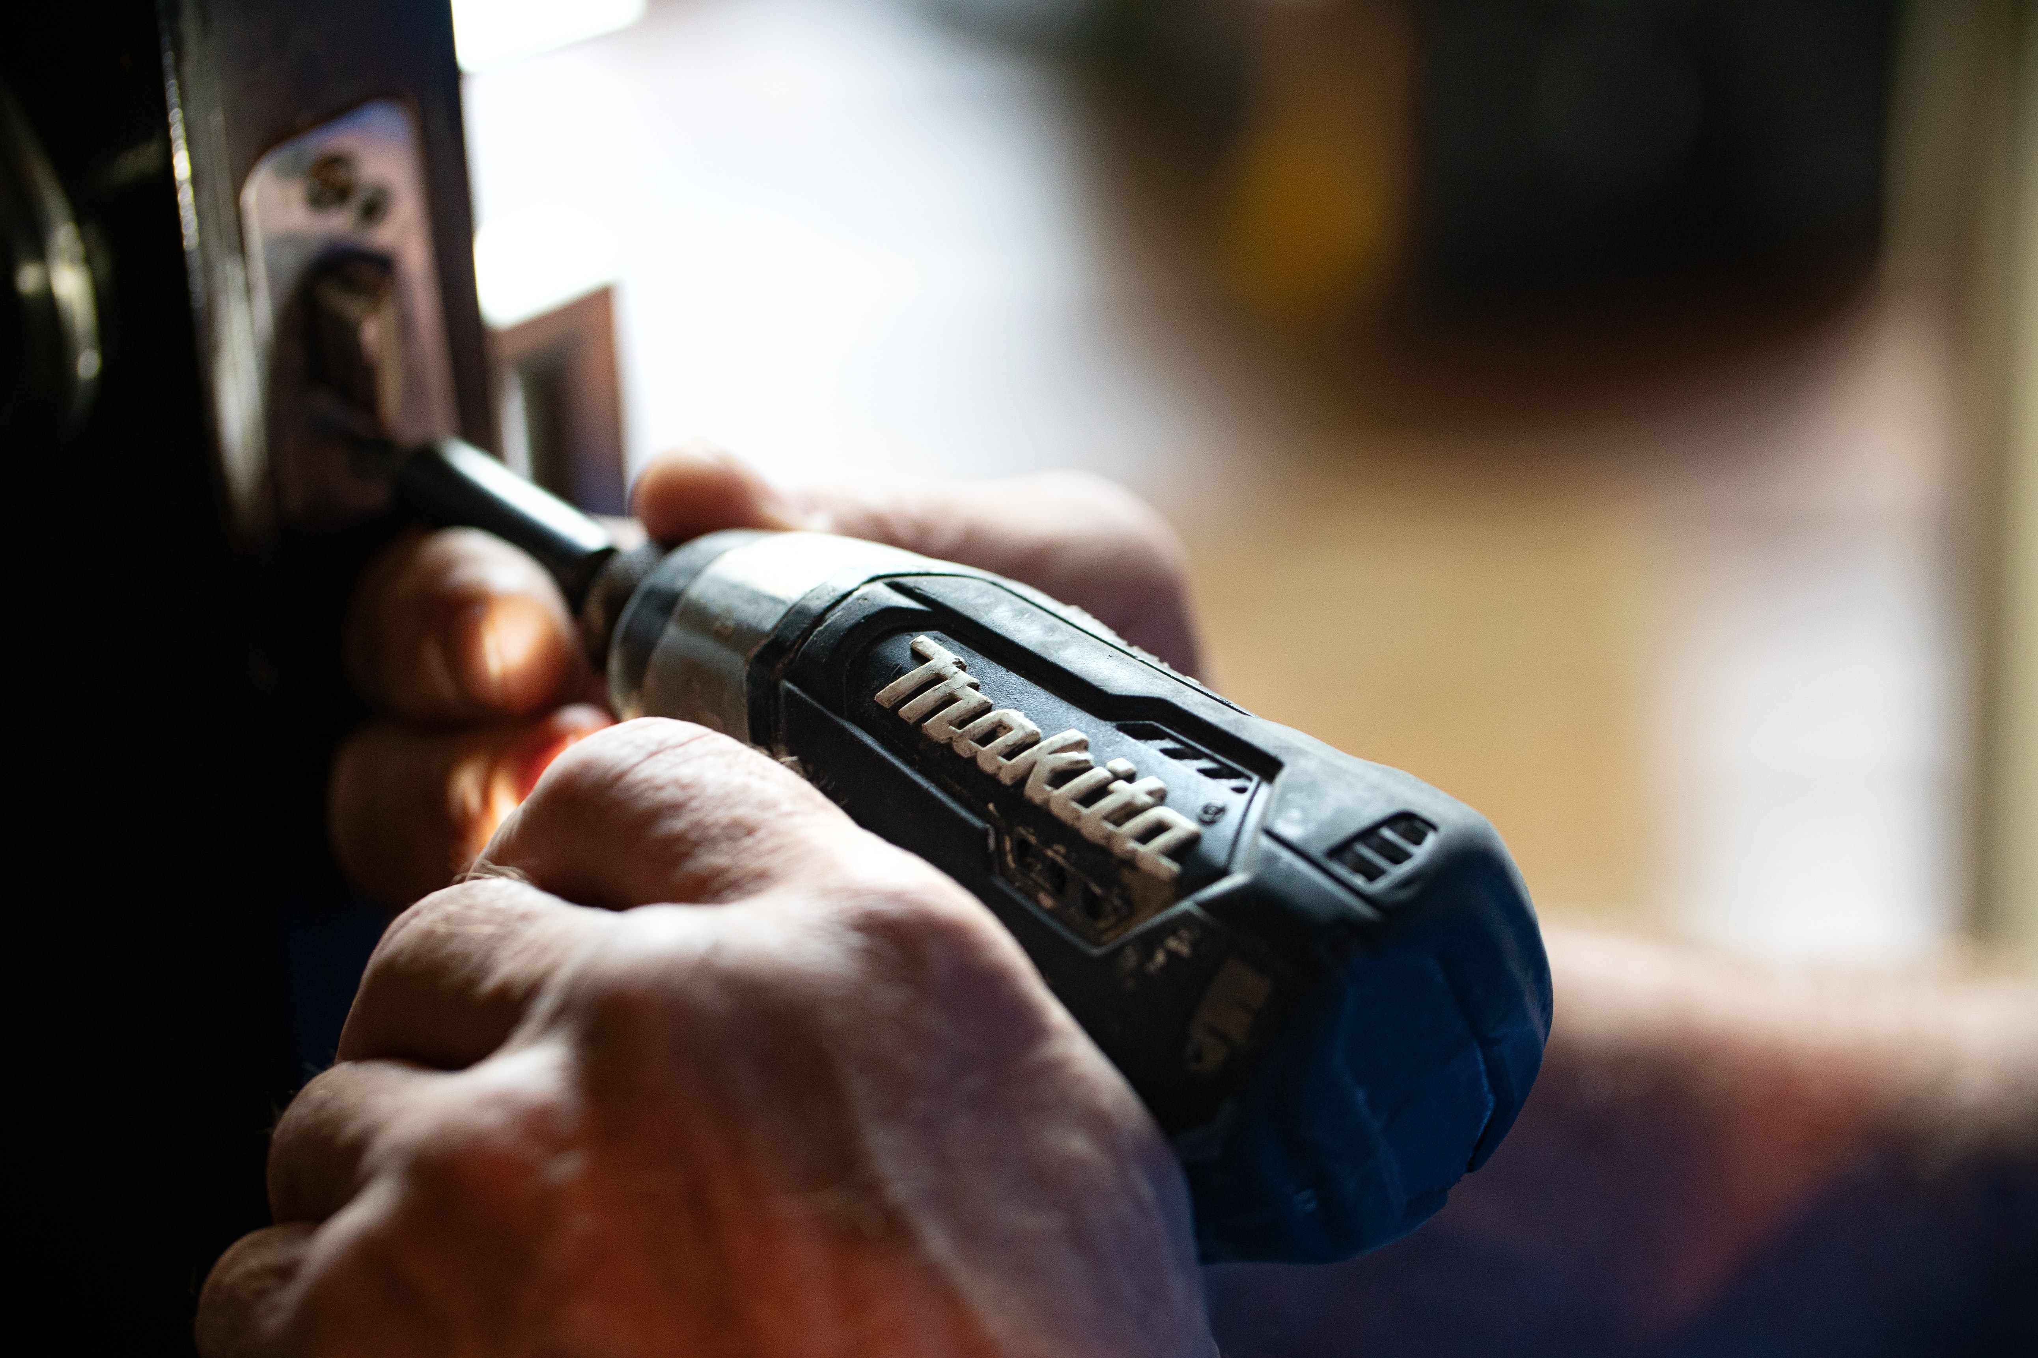
Project 3 Howdy Neighbour!
By: Benson Coelho

Slide 2
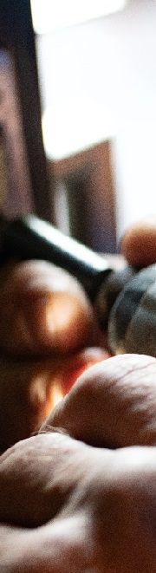
Overall Concept
Design a web-application with a market opportunity in keeping with current trends e.g. Sharing economy, in the vein of Uber, AirBNB, Car Next Door …
Create a project building on the skills gained during the bootcamp with emphasis on the MERN stack/MVC design paradigm.
Demonstrate application of both front end and back end technologies to create a product with market applicability

Slide 3
Motivation
I bought a house!
Home and garden upkeep needs a fair bit of equipment – some used only a few times a year.
Own or hire?
Cost concerns
Storage space concerns
Get to know your neighbours!

Slide 4
Design Process
MERN Stack
Mongo DB - Database
Express - Web server framework
React - Client-side JS framework
Node - Server-side JS runtime environment
MVC Design Paradigm
Modular and Organized codebase
Custom and third-party APIs
Google - Places and Geocoding APIs
Axios - Custom APIs

Slide 5






Technologies used
MongoDB geoJSON
….and a number of packages

Slide 6
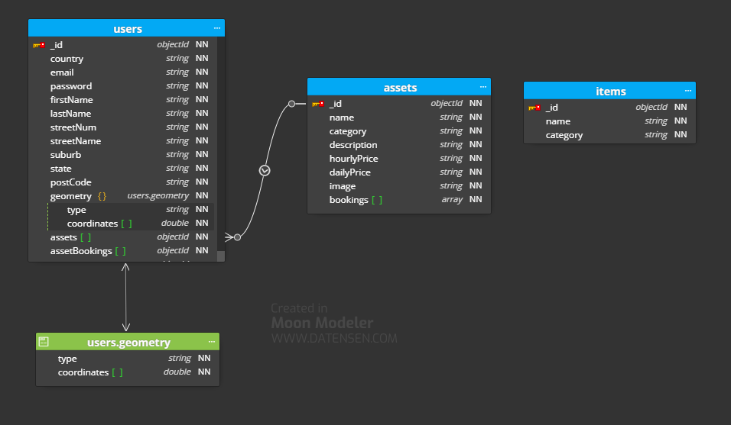
Database – Schema

Slide 7
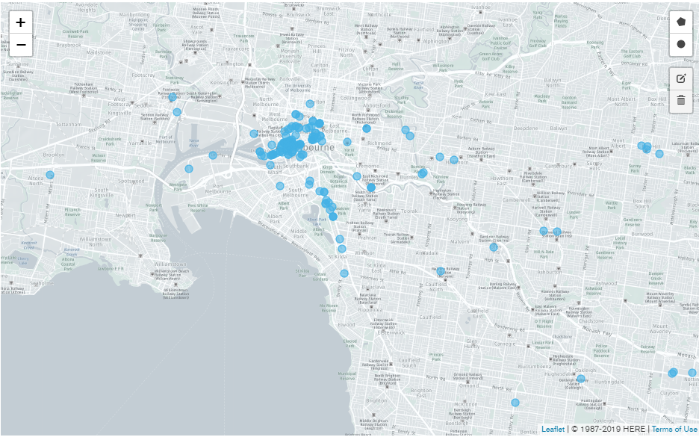
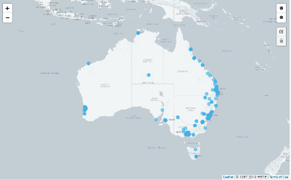
Database – Users & Assets
Approximately 3000 demo users and 15000 assets distributed near the capital cities…

Slide 8
Demonstration

Slide 9
Future Paths
Interactive map – see who is near you and what’s on offer
In app messaging
Earning and spending tracker
Rating system?

Slide 10
Questions?

